Slide 1

onTrack
A rail service reliability app
Bal, Luke, Tom, Matt and Andrei

Slide 2
About onTrack
Designed to help rail users make better decisions when planning their journeys.
Gives a visual indication of reliability on a particular service, based on historic records.
Allows users to:
search for and see future train times,
see an indication of the reliability of each service
purchase tickets
Reliability is assessed by taking the average number of minutes that particular journey has been late over the past 20 working days - also takes into account cancellations.
> 15 minutes
12 - 15 minutes
8 - 11 minutes
4 - 7 minutes
< 4 minutes

Slide 3
App Demonstration

Slide 4














Backend - Technologies

Slide 5
Backend - Problems
Darwin:
No standard - XML, JSON, SOAP, S3, FTP and other acronyms
Not all the data we would have liked was available to us
Got around this through third-party services:
realTimeTrains for historical data
national-rail-darwin node package for LDBWS
Not ideal, but works short-term.
Some difficulties with matching live information with historical information and async code
Testing difficult at times due to changing expectations and data

Slide 6
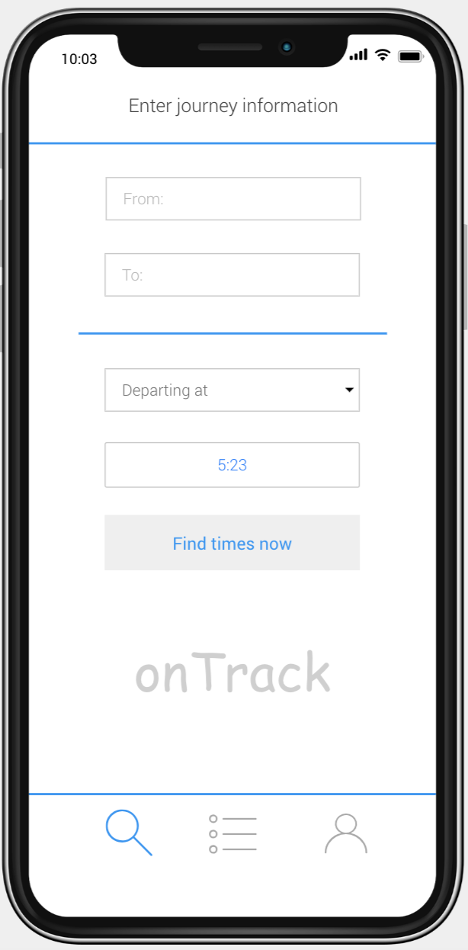
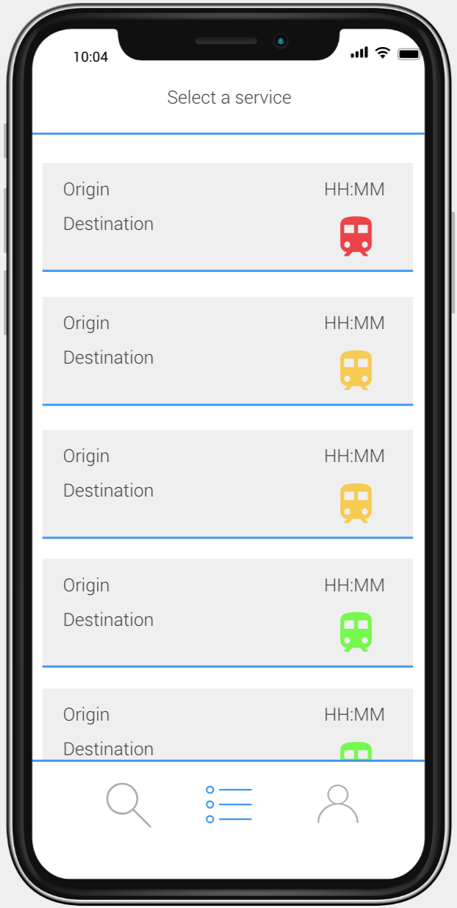
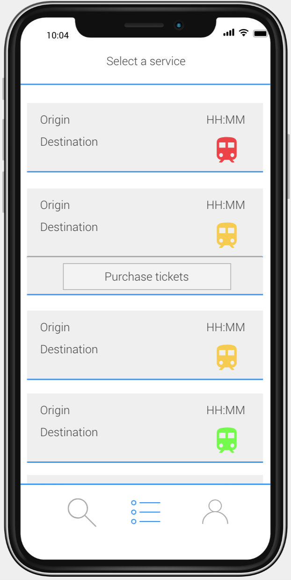
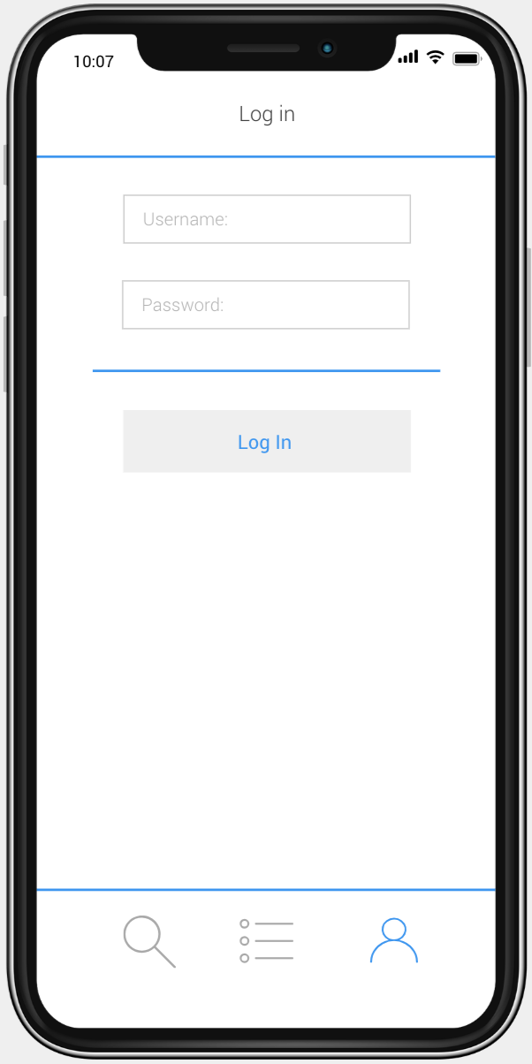

Front-end Plans

Slide 7




Front-end Technologies

Slide 8
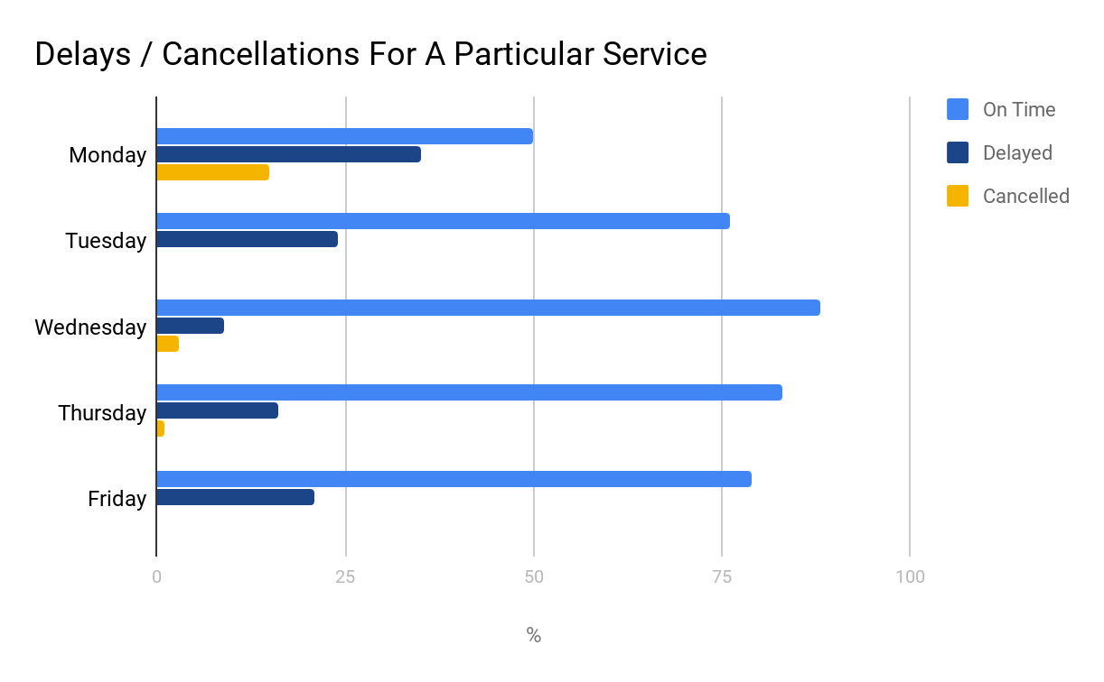
Advanced Features
Display how many carriages a live train has.
Display how busy a particular service is normally based on historical data.
A chart showing average lateness for each day of the week.
Reasons for historic cancellations.

Slide 9
Questions?

