Slide 1

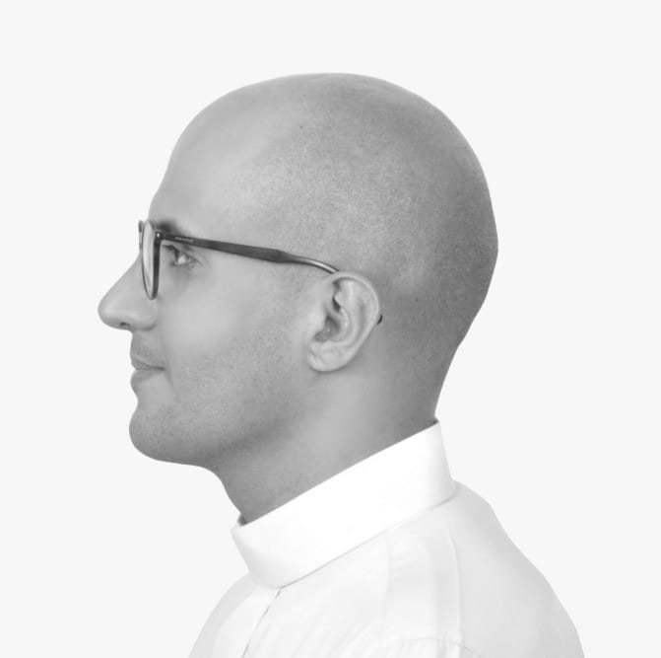
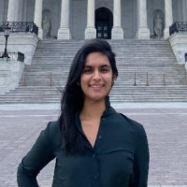
Senior Capstone Spring 2021 Project: Real Time Mask Control Identification Model for Government Control
By: Bandar AISwyan & Rempee Kalia

Slide 2
Project Definition

Slide 3
Define the Topic/Problem
Topic & Purpose: To give governments, police enforcement law and authority the tool to identify and potentially assist locating individuals who are not wearing face masks during the time of COVID.
Problem: is that there is no modern trained model that can identify people of the colour in an accurate manner.
Solution: Using Deep Learning, Python, and other libraries, we will use machine learning to identify a dataset of 6000 images (of people who are wearing face masks and people who are not) from different colors, genders & ages to make the model un biased.
Notes:
Motivation/Rational

Slide 4
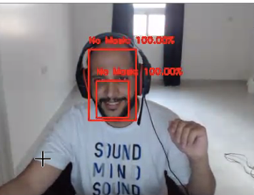

Slide 5
Scopes/Requirements
To enhance/add features in the development.
To develop new ways that the method can be effective in everyday/long term living life.
To see the effect on gender and age of people (Enhance the )bias) result to be accurate).
To compare different cultures with Covid-19 policies.

Slide 6
Capabilities/Functionalities
Train The Mask Recognizer: Feed it with 6000 pictures of people wearing mask or without masks and automatically train the model.
Voice Verification: To identify weather a mask is “on”, “Between” or “off” the face. This will produce the following audio.
Recognition of Mask: Live video recognition measured by the confidence level and support with vision.
Label Interface: The Red identifies “no mask”, the yellow identifies “mid-mask” wrong wear and the green identifies a “mask” on the face. AS shown below, the confidence level, in percentage, is als identified.

Slide 7
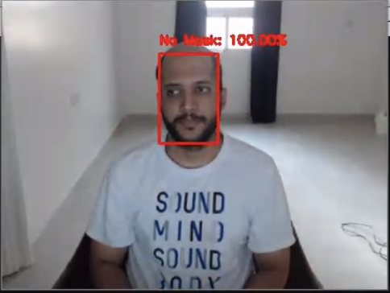
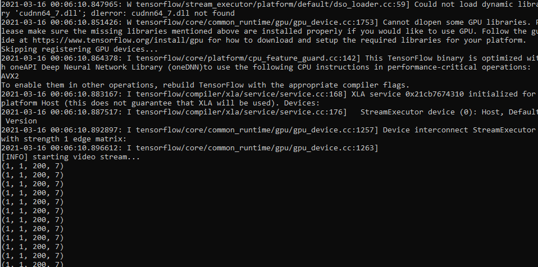
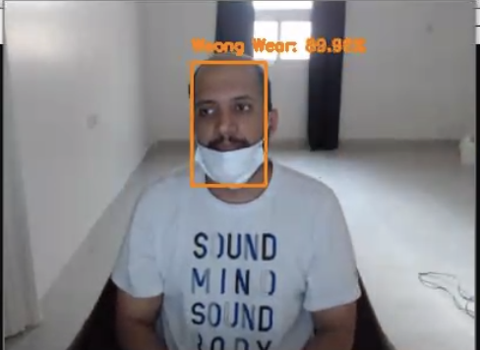
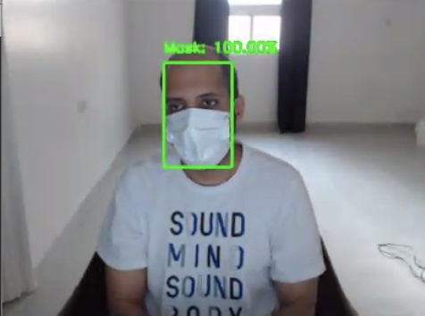
Sample Output
No Mask
Wrong Wear
Mask

Slide 8
Implementation

Slide 9
Languages & Tools Used
Languages:
Python: The code will be written in python
Tools:
Caffee Libraries: A deep learning framework that is made with expression, speed and modularity.
TensorFlow: Google detection model zoo that focus on light-weight models training reflection. Quality is measured with model speed (slow, medium and fast) and model performance (mAP — mean average precision).
OpenCV: multiprocessing Optimized performance webcam connection with stable FPS (Frame Per Second).
Keras: artificial neural networks, convolutional and recurrent neural networks.

Slide 10
Techniques
Deep Learning: will be using artificial algorithms for facial recognition.
Multiprocessing Processing: using threading to improve the real time video vision process and move the heavy workload to have multiple process object detection and load the process from/to the memory and the session of the application in a parallel manner,

Slide 11
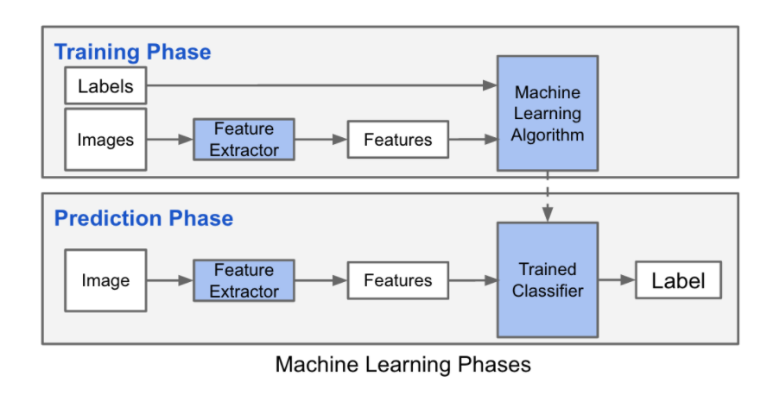
Design Material Diagrams:
Notes:
Add a sample screenshot of the application working.

Slide 12
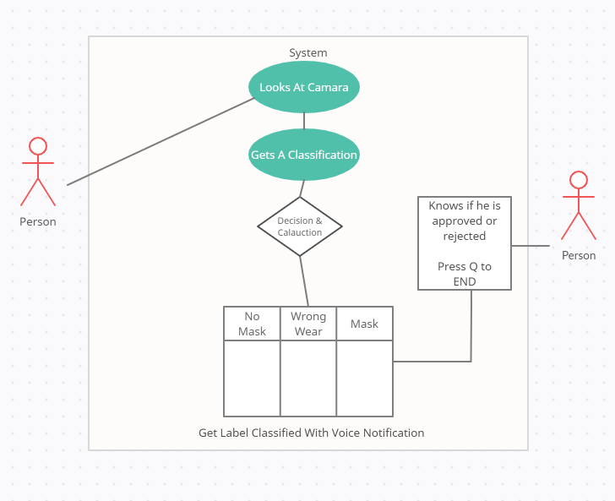
Design Material Diagrams:

Slide 13
Conclusion
A creation of a model that has been trained to identify masks by confidence level.
Will continue adding features for the remainder of our plan and the semester.
The team will continue to identify photographs that represent different areas of people wearing the mask as well as identifying how it affects different cultures.

