Slide 1


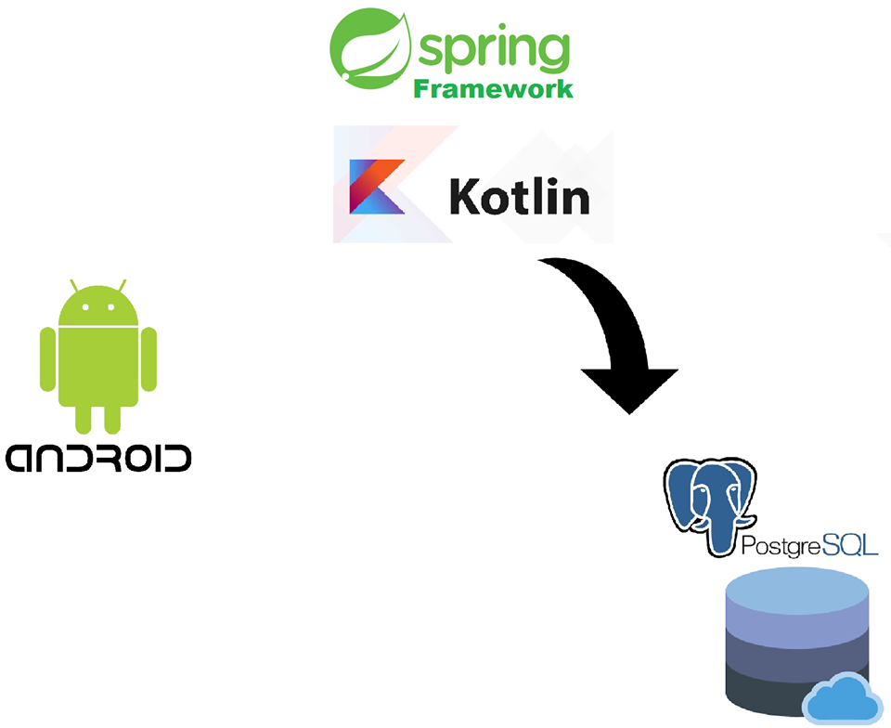
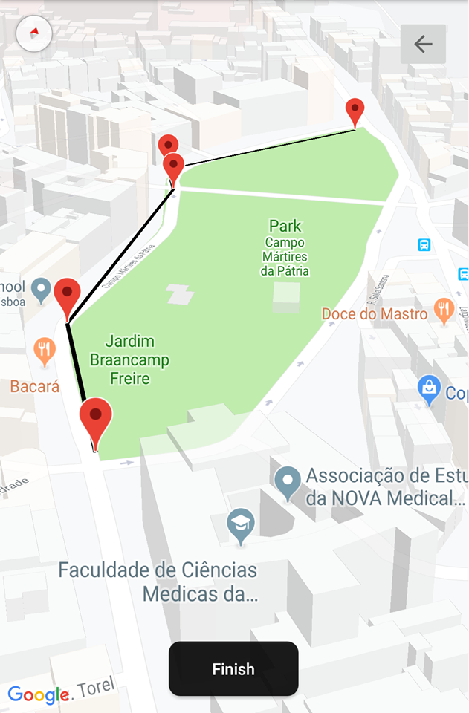
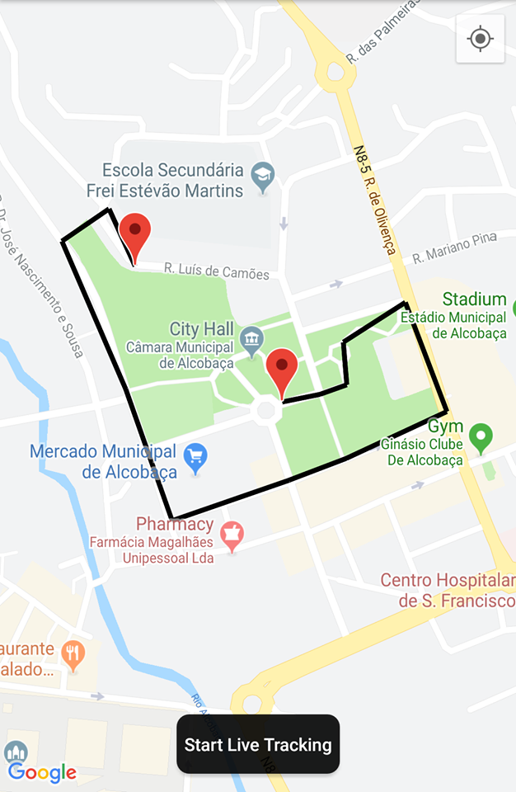
Project and Seminar 2018/2019
Supervisor: Perdro Félix
Students:
Baltasar Brito
Bernardo Costa
Degree in Informatics and Computer Engineering
SOCIAL ROUTING
An application to share and undergo city exploration

