Slide 1
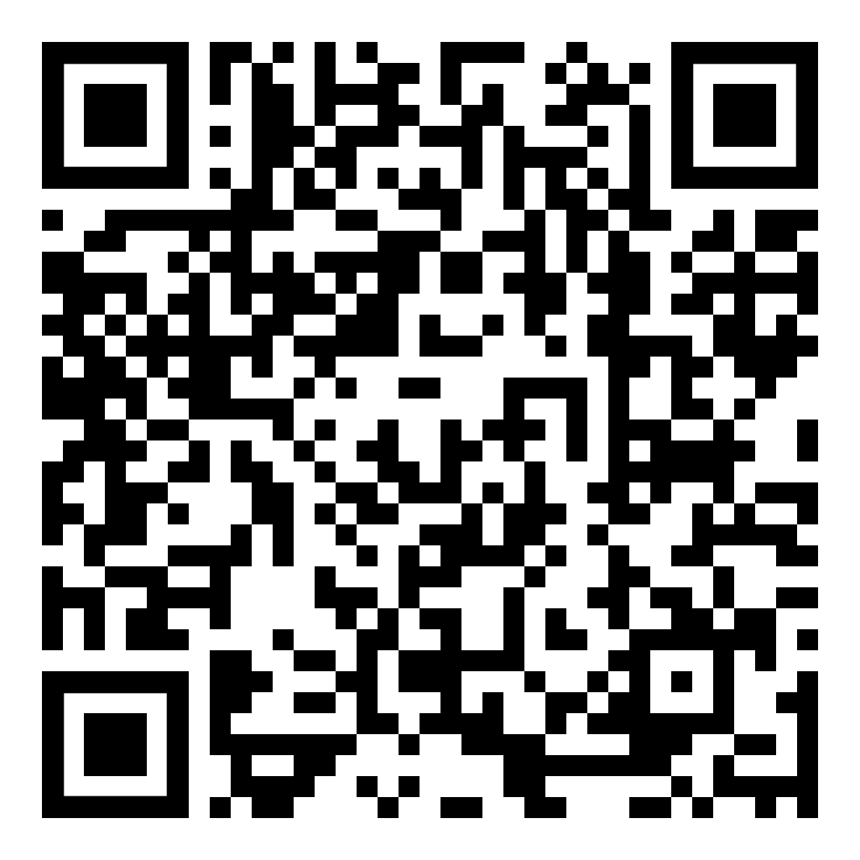

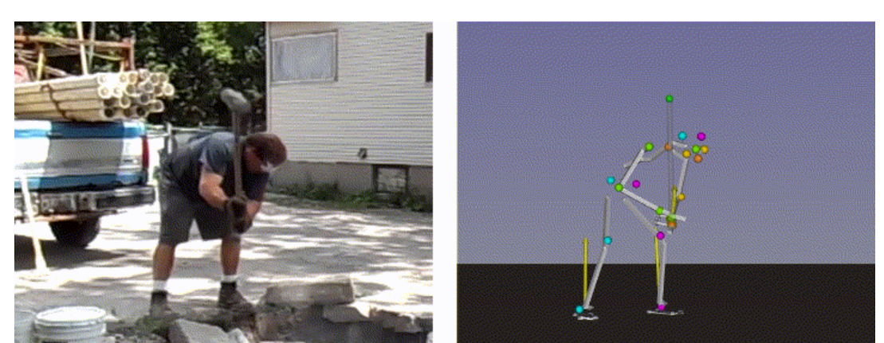
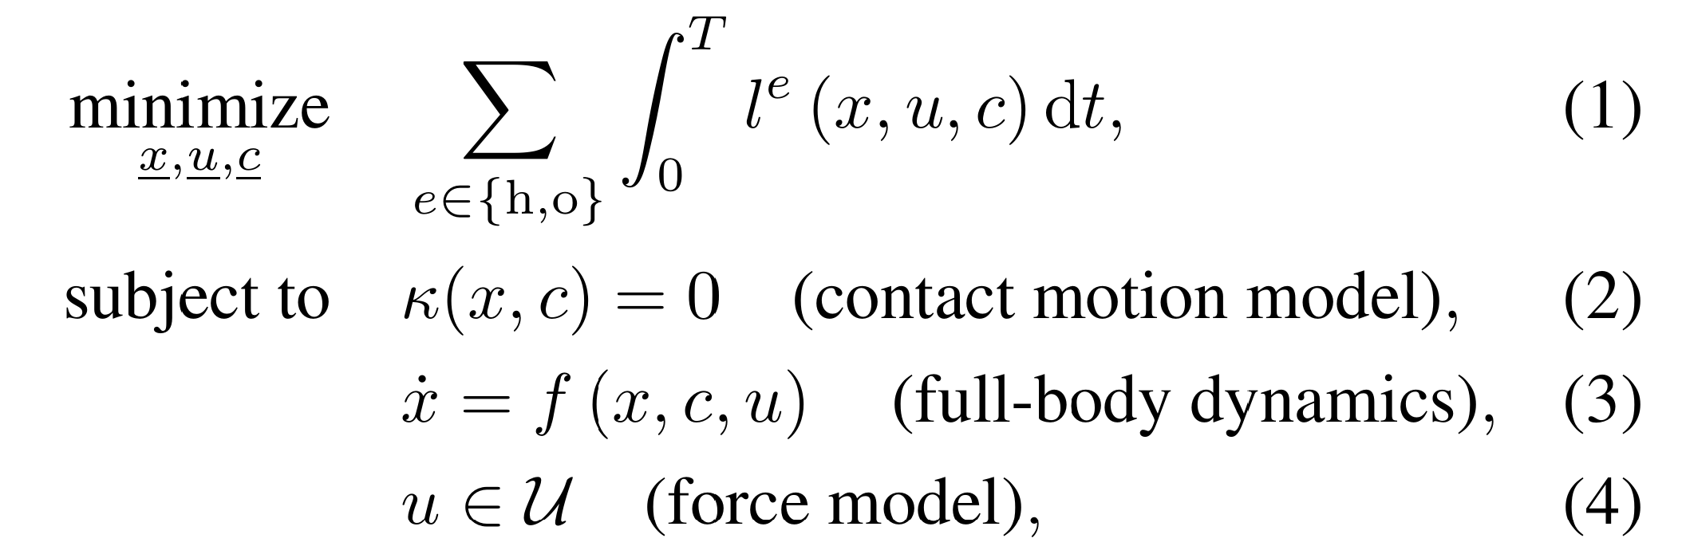
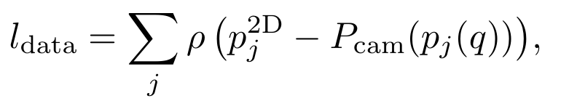
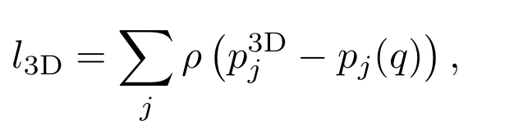
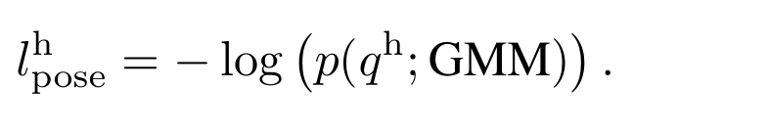
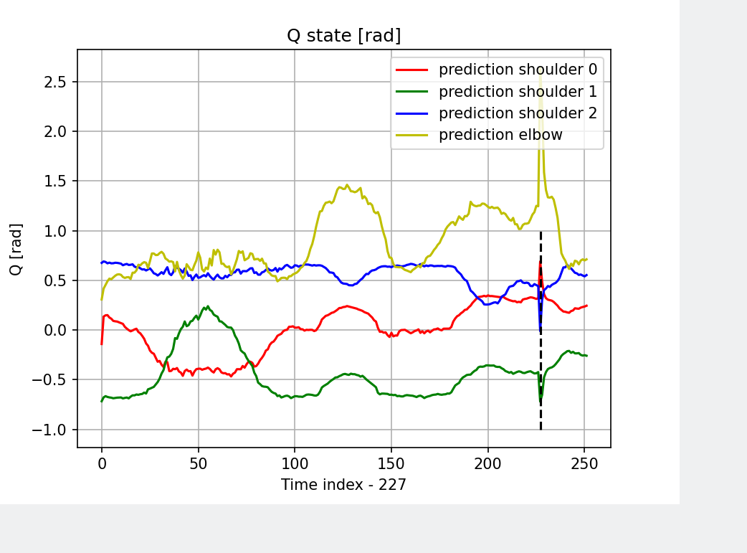
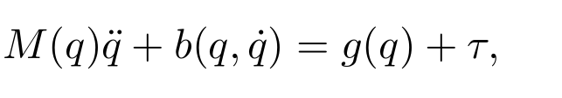
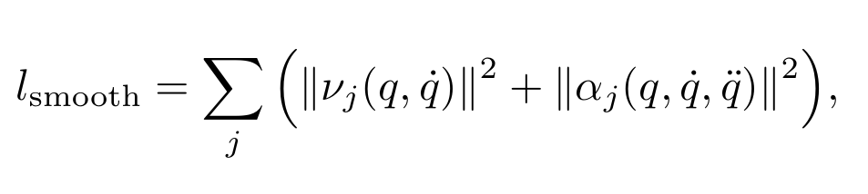

Estimating 3D Motion and Forces of Person-Object Interactions from Monocular Video
Reviewed by Matthieu Dinot, Balthazar Neveu
Goal: in order to do behavior cloning on robots
reconstruct 3D motion, body torques and contact forces
from non-stereo video in the wild
Simplification:
- arm model only, no tools, static calibrated camera
Pose estimation: Mediapipe RGB → (2d, 3d)
Optimization : Scipy.optim (no GMM, no contact, no 2D projection)
Vision: Pose estimation
3D POSE ESTIMATION
2D
2D POSE
ESTIMATION
2D
CONTACT
DETECTION
3D
OPTIMIZER
RAW VIDEO
OBJECT DETECTION
Optimizer
subject to dynamics constraint, contact forces
RELAXED dynamics constraint
With finite differences
+ contact ...

