Slide 1
Group Membership Block Chain (GMBC)
Question:
How can we represent and manage group membership in a way that is verifiable, tamper-proof, and practical in a decentralized topology?
A Group Membership Block Chain is…
a ledger of group membership updates over time
a publicly verifiable record of membership and policy enforcement
tamper-proof based on public key authentication
supports zero-conflict centralized topologies
supports conflict-resolution in decentralized topologies

Slide 2










mygroup@example.com
Invite Bob to
a new group.
Remove Alice
and myself.
Chuck
Alice
Invite Chuck
and Diane.
Evan
Remove Bob,
invite Evan.
Diane
Bob
Genesis Block
Update Block
Update Block
Update Block
Created at 2015-07-26T15:46:01Z
Add Alice as a member
Add Bob as a member
URI is mygroup@example.com
Created at 2015-07-26T15:48:36Z
Add Chuck as a member
Add Diane as a member
Created at 2015-07-27T08:16:51Z
Remove Bob as a member
Add Evan as a member
Updated at 2015-07-31T012:41:11Z
Remove Alice as a member
Remove Evan as a member
Created and signed by Alice
Created and signed by Bob
Created and signed by Diane
Created and signed by Evan

Slide 3
✗
mygroup@example.com
++
++
+-
--
incorrect or missing hash of previous block
✗
mygroup@example.com
++
++
+-
--
invalid signature on block
✗
mygroup@example.com
++
++
-
+
updated by non-member
✗
mygroup@example.com
++
++
-
+
updated by non-member
✗
mygroup@example.com
++
++
+-
+
updater and signature don't match
✔
mygroup@example.com
++
++
+-
--
VALID BLOCK CHAIN

Slide 4

+-
-
+
✔
0x1AF73
first conflicting block has smaller hash
mygroup@example.com
++
++
conflicting
histories
0x1AF73 < 0x311BF
+-
0x311BF
-
✗
+
first conflicting block has larger hash

Slide 5
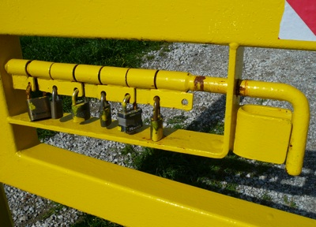
Group Key (GK)
A GK is a standard JOSE JSON representation that wraps a content key with the public keys of each other GMBC group member. GK objects can be shared openly without compromising confidentiality.

Slide 6




Group
??
Communication
Resource
??
mygroup@example.com
++
+

