Slide 1
DRONE making
Fopple technologies
BY
MITS – MADANAPALLE STUDENTS

Slide 2
CONTENTS:
INTRODUCTION
EVOLUTION
CLASSIFICATION OF DRONE
COMPONENTS
DRONE DESIGN
LIMITATIONS
CONCLUSION

Slide 3
INTRODUCTION
A DRONE(Dynamic Remotely Operated Navigation Equipment) is an aircraft that flies without a crew on board
In simply, a Drone is a flying robot that can be remotely controlled or fly autonomously using software-controlled flight plans in its embedded systems, that work in conjunction with onboard sensors and a global positioning system (GPS).
The term drone usually refers to any unpiloted aircraft. Sometimes referred to as unmanned aerial vehicles (UAVs), these crafts can carry out an impressive range of tasks, ranging from military operations to package delivery.
A UAV(unmanned aerial vehicle) is capable of controlled, sustained level flight and is powered by jet

Slide 4
EVOLUTION
In 1915, NIKOLA TESLA wrote about UNMANNED AERIAL VEHICLE(UAV).
The first attempt at a self-propelled drone as an aerial target was completed in 1916.
The rise of modern drone technology can be traced back to World War II and the Cold War. These two events paved the way for the rapid development and adaptation of drones for survillience at boarders
Today, these flying machines are excessively used across multiple sectors, including Military, Agriculture, photography, image segmentation and intelligence, construction, livestock mapping, terrain mapping, and many more. Also, we are witnessing the rise of AI drones, which is pushing drone technology into a new era.

Slide 5
CLASSIFICATION OF DRONE
There are mainly Two types of DRONEs:
MULTIROTOR
MONOCOPTER
DUALCOPTER
TRICOPTER
QUADCOPTER
HERACOPTER
OCTACOPTER
FIXED WING

Slide 6
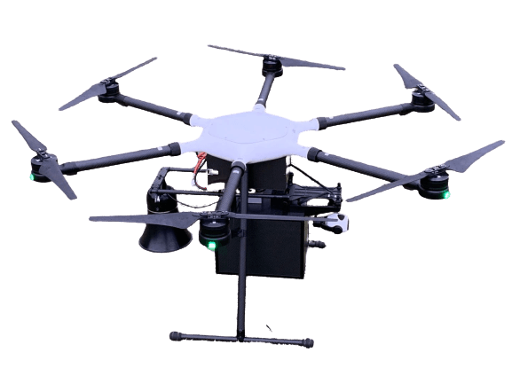
MULTIROTOR
Vertical takeoff and landing
Short distance and less pay load

Slide 7
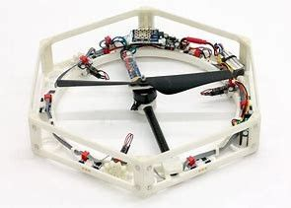
TYPES OF MULTIROTOR
MONOCOPTER

Slide 8
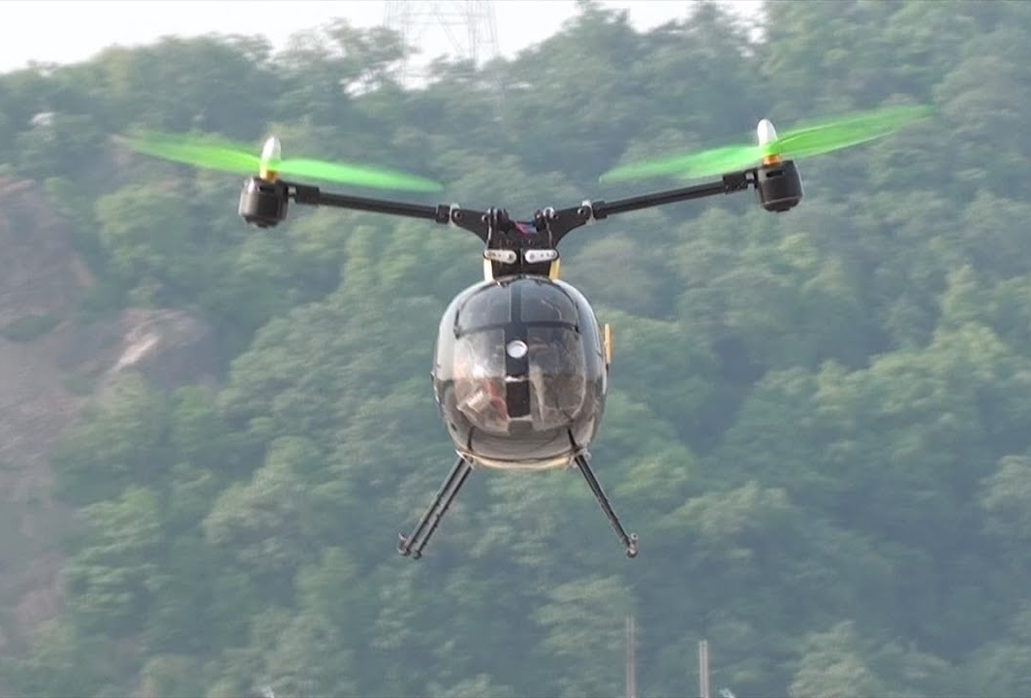
TYPES OF MULTIROTOR
DUALCOPTER

Slide 9
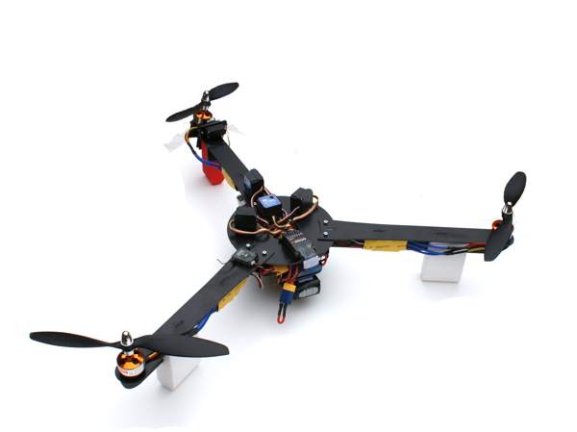
TYPES OF MULTIROTOR
TRICOPTER

Slide 10
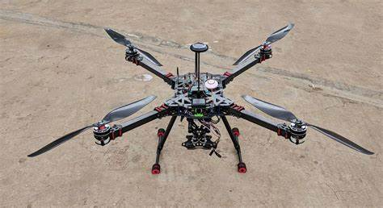
TYPES OF MULTIROTOR
QUADCOPTER

Slide 11
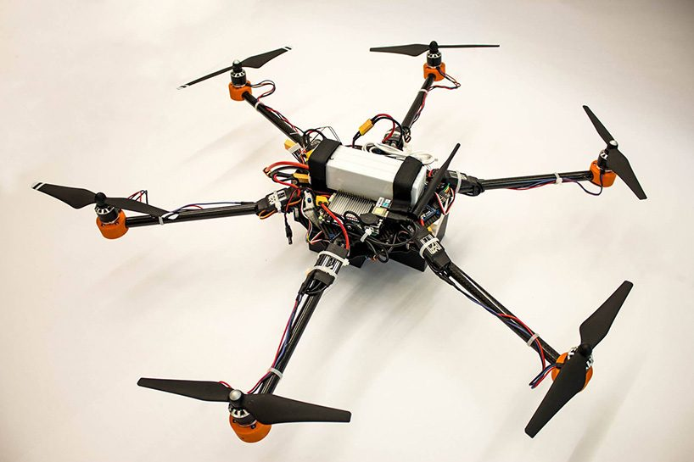
TYPES OF MULTIROTOR
HEXACOPTER

Slide 12
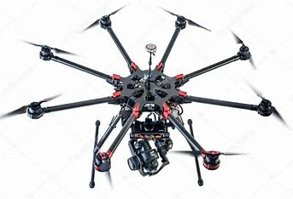
TYPES OF MULTIROTOR
OCTACOPTER

Slide 13
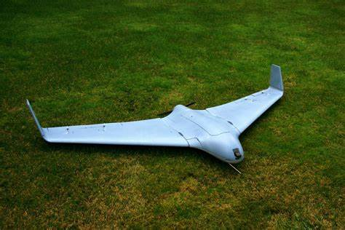
FIXED-WING
Horizontal takeoff and landing
longer distance and more pay load
Router is placed Infront or backside of the body

Slide 14
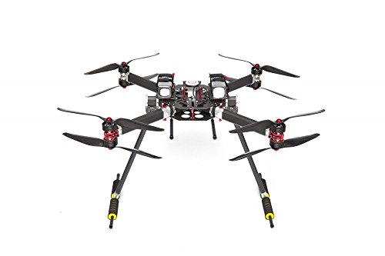
Other hybrid drones
X8

Slide 15
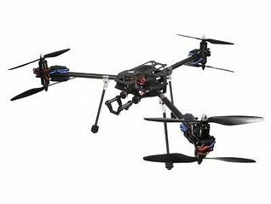
Other hybrid drones
Y6

Slide 16
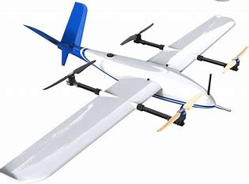
Other hybrid drones
VTOL(Vertical TakeOff and Landing)

Slide 17
DRONE CALCULATIONS
DRONE | BODY | LOAD | AUW
OK | 70% | 30% | 100%
GOOD | 50% | 50% | 100%
BEST | 40% | 60% | 100%
EFFICIENCY = AUW X WEIGHT / THRUST GREATER THAN AUW

Slide 18
FLYING CONTROLS
TU
TU – Throttle Up
TD – Throttle Down
YL – Yaw Left
YL – Yaw Right
PF – Pitch Forward
PB – Pitch Backward
RL – Roll Left
RL – Roll Right
PF
YL
YR
RL
RR
TD
PB

Slide 19
Flying channels
For DRONE flying controls, it need minimum 5 channels:
Channel no. | Channel Name | Channel Controls
1 | ROLL
2 | PITCH
3 | THROTTLE
4 | YAW
5 | FLIGHTMODE | GPS/AUTOMATIC/MANUAL
There is another key called Application key which is used to perform the main Work

Slide 20
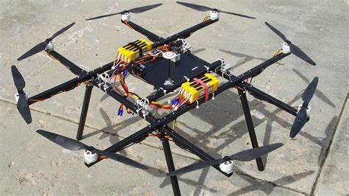
MODEL:
X
X
X
X
X
X
X
X

Slide 21
DRONE COMPONENTS:
MOTORS
PROPELLERS
TX & RX
BATTERY
FLIGHT CONTROLLER
ESC
FRAME
PMU
PDB

Slide 22
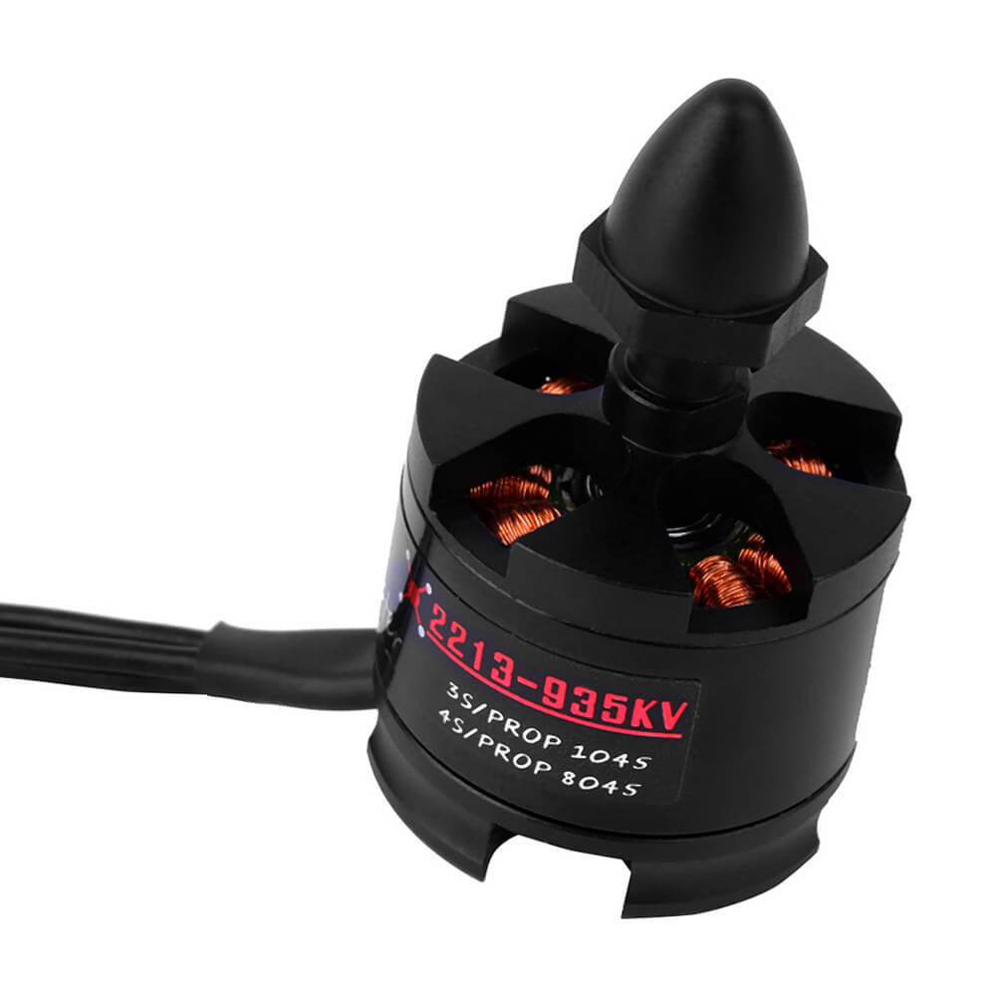
MOTORS
SPECIFICATION | VALUE
KV | 935
WEIGHT | 55grams
DIAMETER | 27.9mm
LENGTH | 39.7mm
3S(Li-Po) | 1045(prop)
MAXIMUM THRUST | 850grams
ESC RECOMMENDED | 18Amps

Slide 23
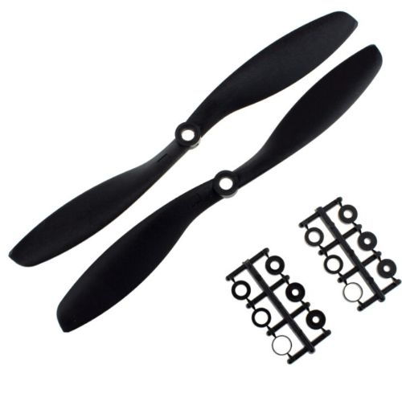
propellers
SPECIFICATION | VALUE
DIAMETER | 10 Inch(25.4 cm)
SLOPE | 4.5 Inch(11.43 cm)
BORE | 3 – 7.8mm(approximately)
RECOMMENDED MOTOR | 800KV – 2200KV

Slide 24
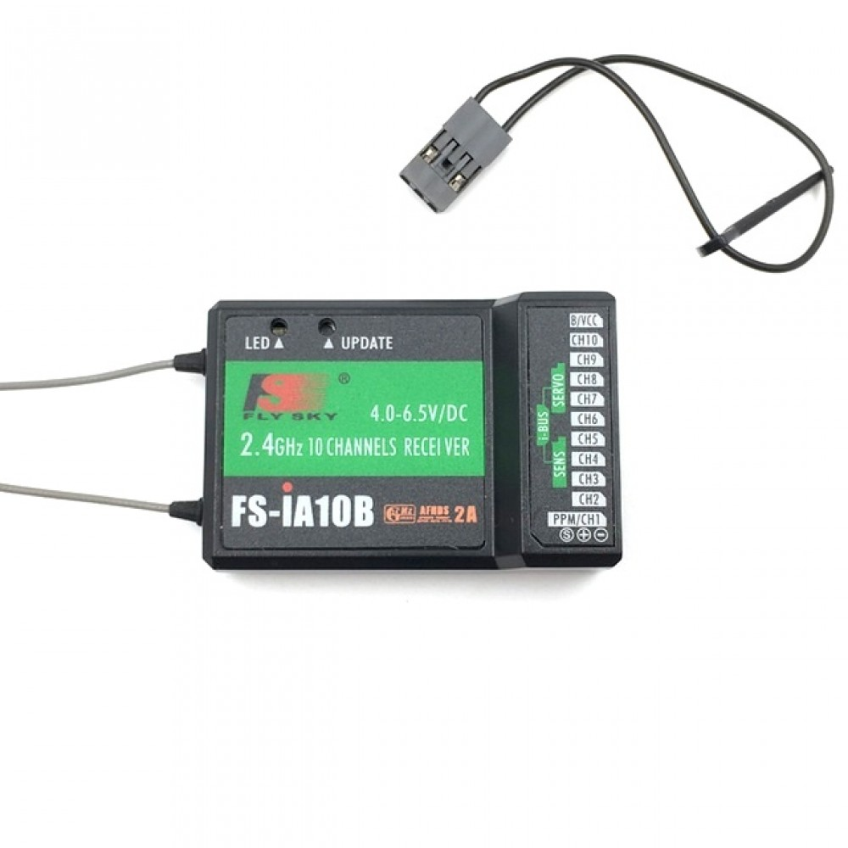
TX & RX
SPECIFICATION | VALUE
WIRELESS PROTOCOL | AFHDS 2A
REMOTE CONTROL DISTANCE | 500 to 1500m(in the air)
POWER | 4.0 – 6.5 V
DATA INTERFACE | PWM/PPM
HUMIDITY RANGE | 20-95%

Slide 25
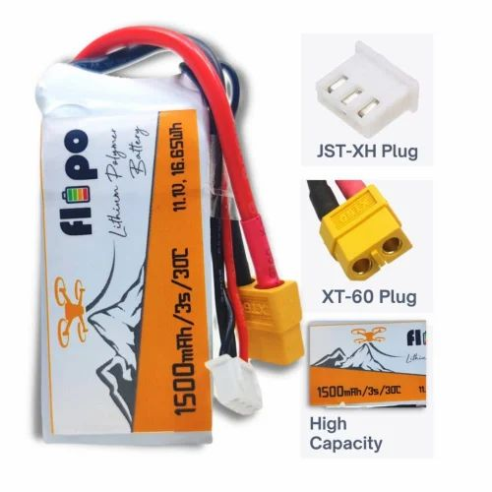
BATTERY
For this project, we use 3S battery and its specifications are:
BATTERY | Min. VOLTAGE(V) | Max. VOLTAGE(V)
1S | 3.7 | 4.2
3S | 11.1 | 12.6
6S | 22.2 | 25.2
12S | 44.4 | 50.4
SPECIFICATION | VALUE
MODEL NO. | Flipo 3300/3S 40C
VOLTAGE | 11.1V
Max. CHARGE CURRENT | 13.2 A(4C)
CAPACITY | 3300(mAh)

Slide 26
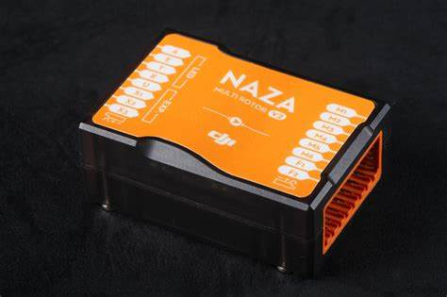
FLIGHT CONTROLLER
NAZA-M V2 Multirotor Autopilot Controller set With GPS acts as the brains of the aircraft, managing pilot input and interpreting data from the various sensors, helping maintain a stable flying condition.

Slide 27
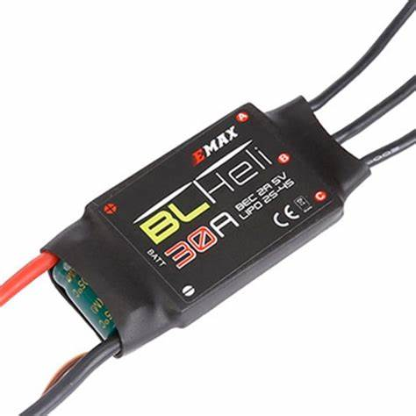
Esc (Electronic Speed controller)
SPECIFICATION | VALUE
Burst Current | 40 Amps
Constant Current | 30 Amps
BEC | 5V/2Amp
Suitable Lipo Batteries | 2 - 4S
Weight | 28 gms

Slide 28
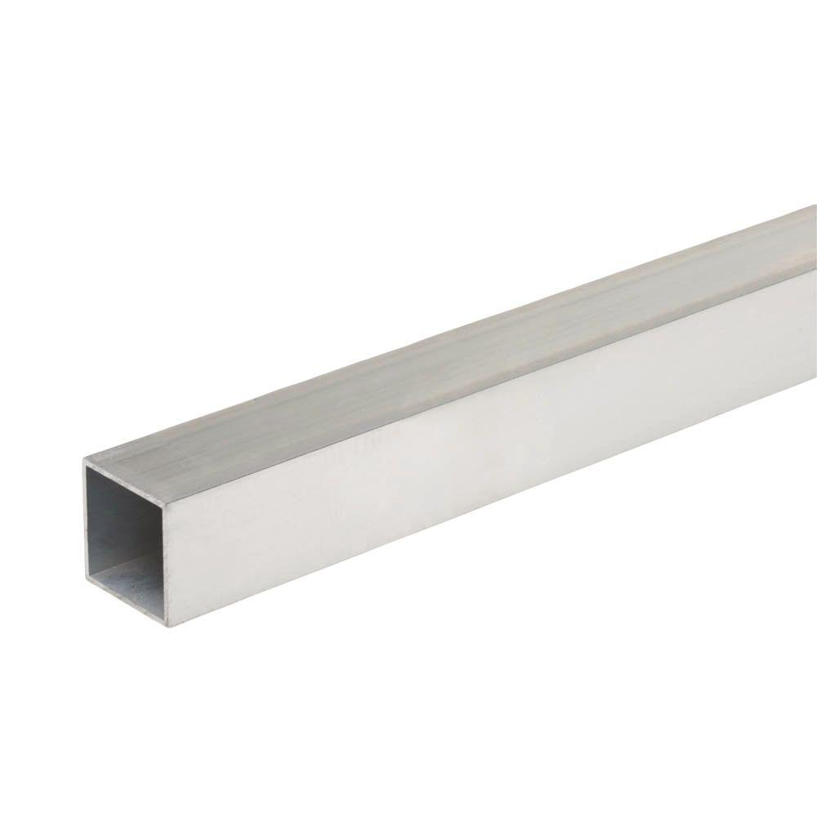
frame
For this project, we are using Aluminium ¾” squared pipe.
X
X
X
X
X
X
X
X
‘X’ - indicates the position of Motors

Slide 29
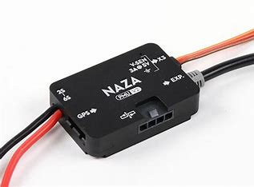
PMU(POWER MANAGEMENT UNIT)
The DJI NAZA M PMU V2 is a compact power management unit (PMU) that features enhanced BEC functionality and extendable CAN BUS ports. It can be used as an independent PMU for the DJI Zenmuse H3-2D brushless gimbal when used with your DJI Phantom quadcopter

Slide 30
PDB(POWER DISTRIBUTION BOARD)
For this project, we are using octacopter PDB board
Its job is to split an incoming electrical power feed into multiple secondary or subsidiary circuits.

Slide 31
DRONE DESIGN
STEPS FOR MAKING DRONE:
MAKING FRAME
SOLDERING ECS’s, POWER CABLE, PMU to PDB
FIXING THE MOTORS TO ARMS
FIXING FC, RECIEVER AND CONNECT THE ESC,s TO EACH MOTOR
THROTTLE CALIBRATION
ARMING AND FLIGHT MODE
BASIC TAKE-OFF WITHOUT PAY LOAD
TAKE-OFF WITH PAYLOAD
FIELD TRAIL

