Slide 1
Crop Recommendation System: Based on climate factors using Random Forest

Slide 2
Our Team : VH170
NAME | REG.NO
Y.V.Harinadh Reddy | 99210042016
J.Vamshi Krishna | 99210042140
T.Gangadhar | 9921004720
KATAMGARI BALARAJU | 99210041674

Slide 3

Problem Statement
Existing models lack accuracy and personalization, leading to suboptimal yields and resource mismanagement. By employing Random Forest, our model aims to overcome the limitations of existing systems, providing farmers with more reliable and context-aware crop recommendations.

Slide 4
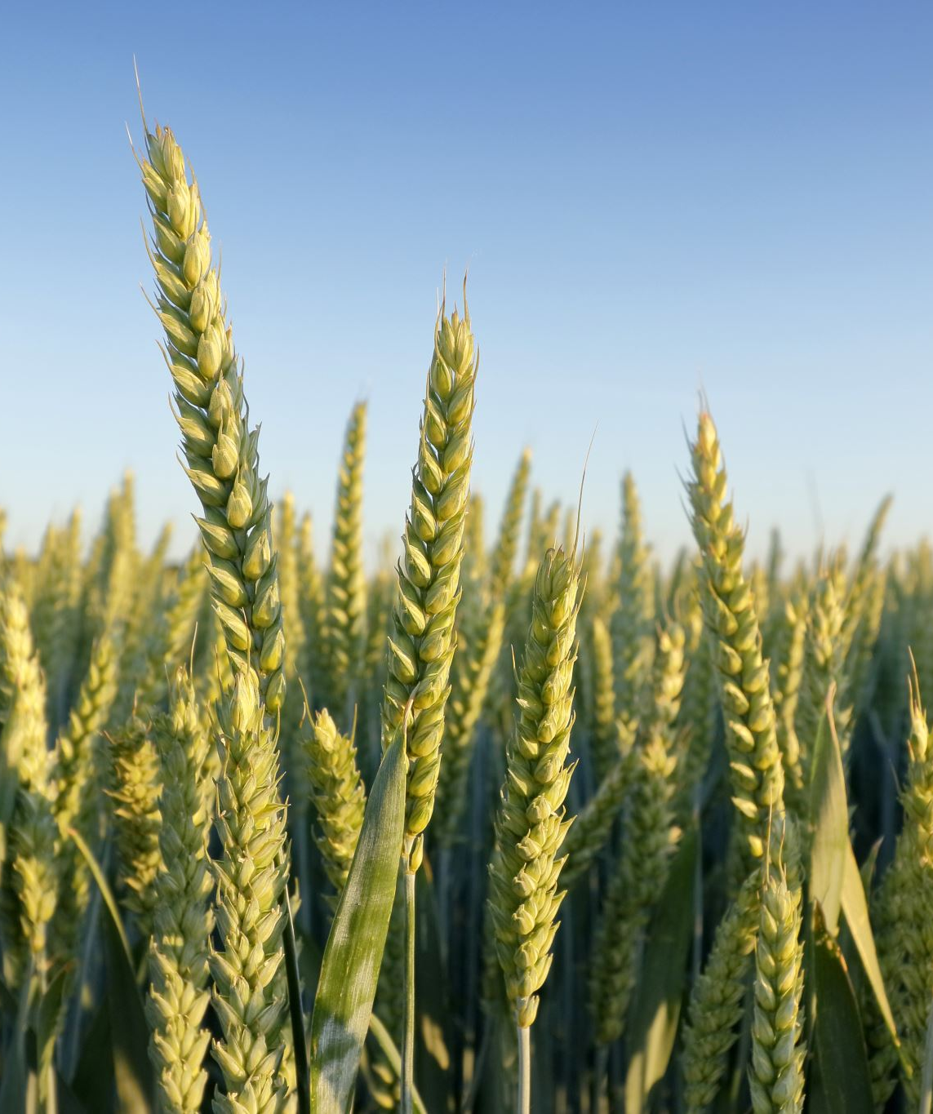
Objective
The crop recommendation system using random forest algorithm aims to optimize agricultural practices by suggesting suitable crops based on places, soil types and nutrients ,ph value and climate factors.

Slide 5
About Project
The project centers on building a crop recommendation system utilizing Random Forest and Gradient Boosting algorithms.
The system processes data encompassing soil nutrients and climate attributes, including N, P, K, rainfall, humidity, temperature, and soil pH.
Through extensive feature engineering and normalization, the data is structured for analysis. The Random Forest ensemble and Gradient Boosting models are trained on the normalized dataset, with hyperparameter tuning for optimal performance.
The goal is to deliver an effective system that provides accurate crop recommendations, accounting for the intricate relationships between soil quality, climate conditions, and crop outcomes, supporting sustainable and informed agricultural decisions.

Slide 6
Approach
Gather relevant data from reliable sources, including details on soil types, climatic conditions, and historical crop yield data.
1
Perform comprehensive feature engineering to structure the raw data into a meaningful data frame suitable for machine learning analysis.
2
Choose Random Forest and Gradient Boosting algorithms for their ability to handle complex relationships within the dataset.
3
Feed the normalized data into algorithms for training, utilizing Random Forest to create an ensemble of decision trees and Gradient Boosting for sequential accuracy improvement.
4
Conduct experimentation and fine-tune hyperparameters to optimize the performance of Random Forest and Gradient Boosting models.
5

Slide 7

Software Requirements
Jupyter Notebook
Visual Studio
Python

Slide 8
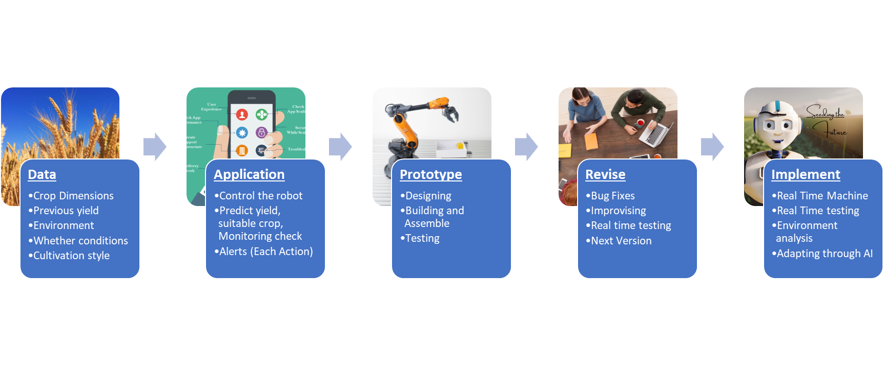
Flow Chart

Slide 9
List Of Modules
Data Collection
Algorithm
User Interface
Training
Testing and Validation
Monitoring and Maintenance

Slide 10
Data Source and Output
Input
. Data of the ph values and nutrient values of soil and climate attributes like Rainfall,temperature,humidity will feed as the input for the model
Output
Implement an efficient system capable of predicting the crops based on the types of soils, places and climate patterns using random forest algorithm with good accuracy.

Slide 11
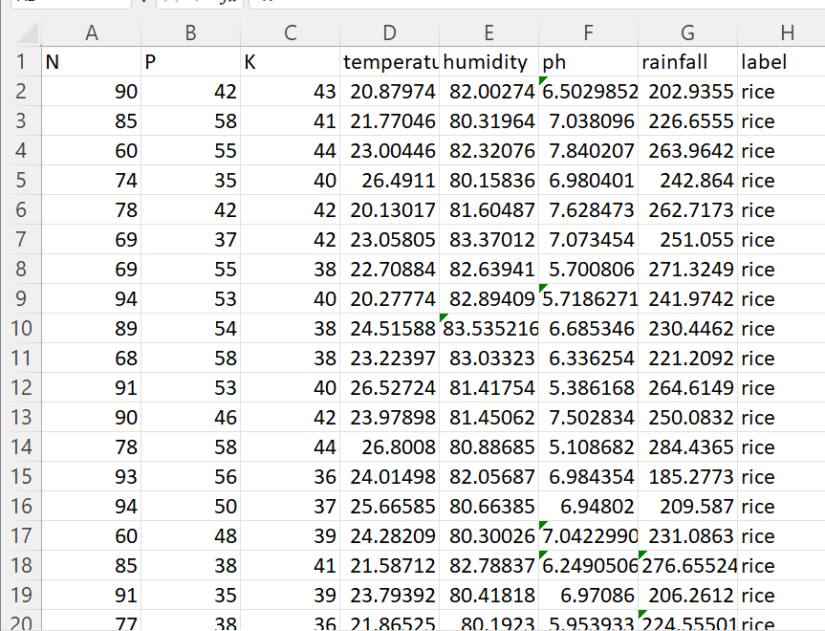
Input Data Set

Slide 12
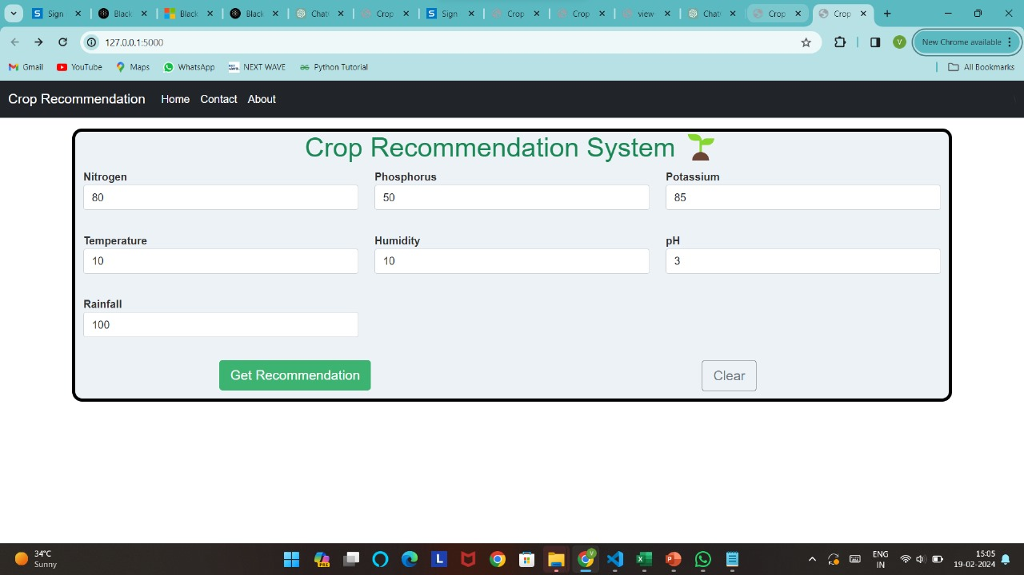
INPUT(WEB PAGE)

Slide 13
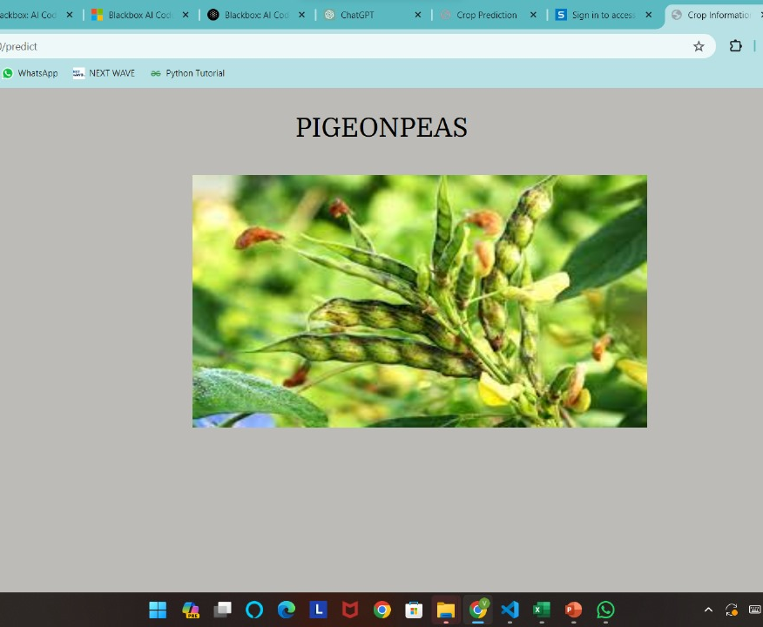
Output(Crop Prediction)

Slide 14

Future Work
The future development of the crop recommendation system entails the inclusion of factors such as pest prevalence, crop rotation, and socio-economic considerations. Integration of satellite imagery, exploration of advanced machine learning techniques, and collaboration with agricultural experts can further refine the model's accuracy. Expanding the geographical scope and tailoring the system to diverse agro-climatic zones will enhance its applicability.

Slide 15

Conclusion
In summary, the crop recommendation system, using Random Forest and Gradient Boosting, offers farmers valuable insights on soil and climate factors. Successful implementation of feature engineering ensures robust training, with future improvements focusing on integrating additional factors and enhancing accessibility through collaboration with experts. Continuous refinement, guided by user feedback, positions the system as a vital tool for sustainable and efficient farming.

Slide 16
Work Timeline
Month\Week | Week1 | Week2 | Week3 | Week4
December | _ | _ | Selection of the Project Title | Project title confirmation through Brain storm
January | Data set Preparation | Front end website design | Algorithm for model | Coding for process output
February | Integrating the Code and Input | Testing the functioning of the model / Error correction | Submission | _

Slide 17
THANK YOU

