Slide 1

The Discount Trap
Uncovering Hidden Profit Leaks in Retail Data
DATA ANALYTICS CASE STUDY

Slide 2

The Problem: Revenue Up, Profit Stagnant
Revenue grew 18–27% YoY — yet profit margin held flat at 11–12%. Leadership had strong suspicions but no clear diagnosis.
Underperforming Regions
Loss-Making Products
Which markets were eroding margins despite strong top-line growth?
Were specific SKUs or categories dragging down overall profitability?
Excessive Discounting
Was aggressive promotion driving volume — or simply destroying margin?

Slide 3
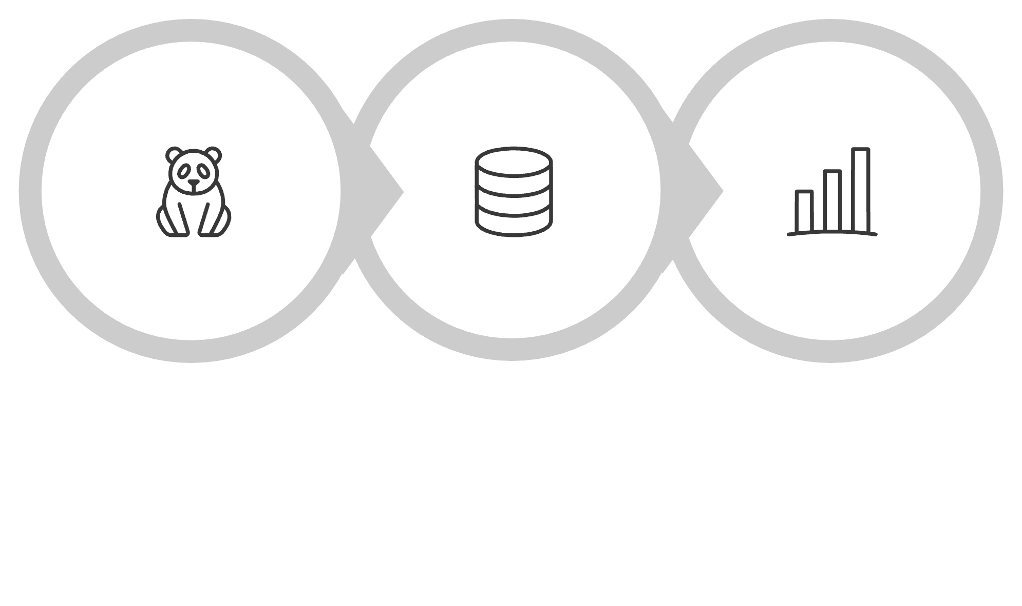
Analytical Approach
A structured three-phase methodology addressed 7 business questions through ~50 SQL queries, transforming raw transactional data into executive-ready insights.
Data Prep
Root-Cause
Dashboard
Each phase built on the last — from raw data to root causes to boardroom-ready visualizations.

Slide 4
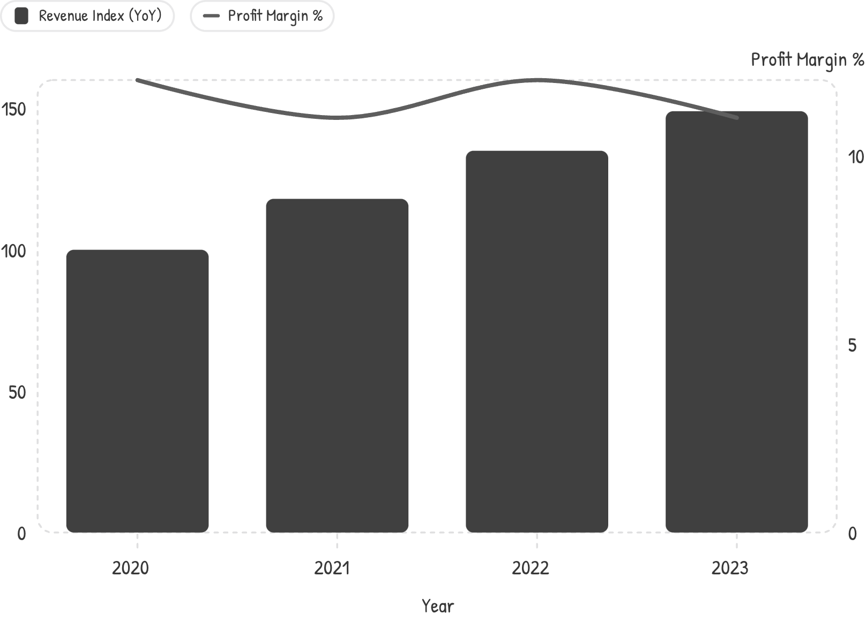

Finding 1: Revenue Growth ≠ Profit Growth
The Core Disconnect
Revenue climbed steadily year-over-year, yet profit margin oscillated between 11% and 12% — never improving despite significant growth.
High-revenue regions were not synonymous with high-profit regions. Scale was masking structural margin erosion beneath the surface.
Top-line growth without margin discipline is a warning signal — not a success story.

Slide 5
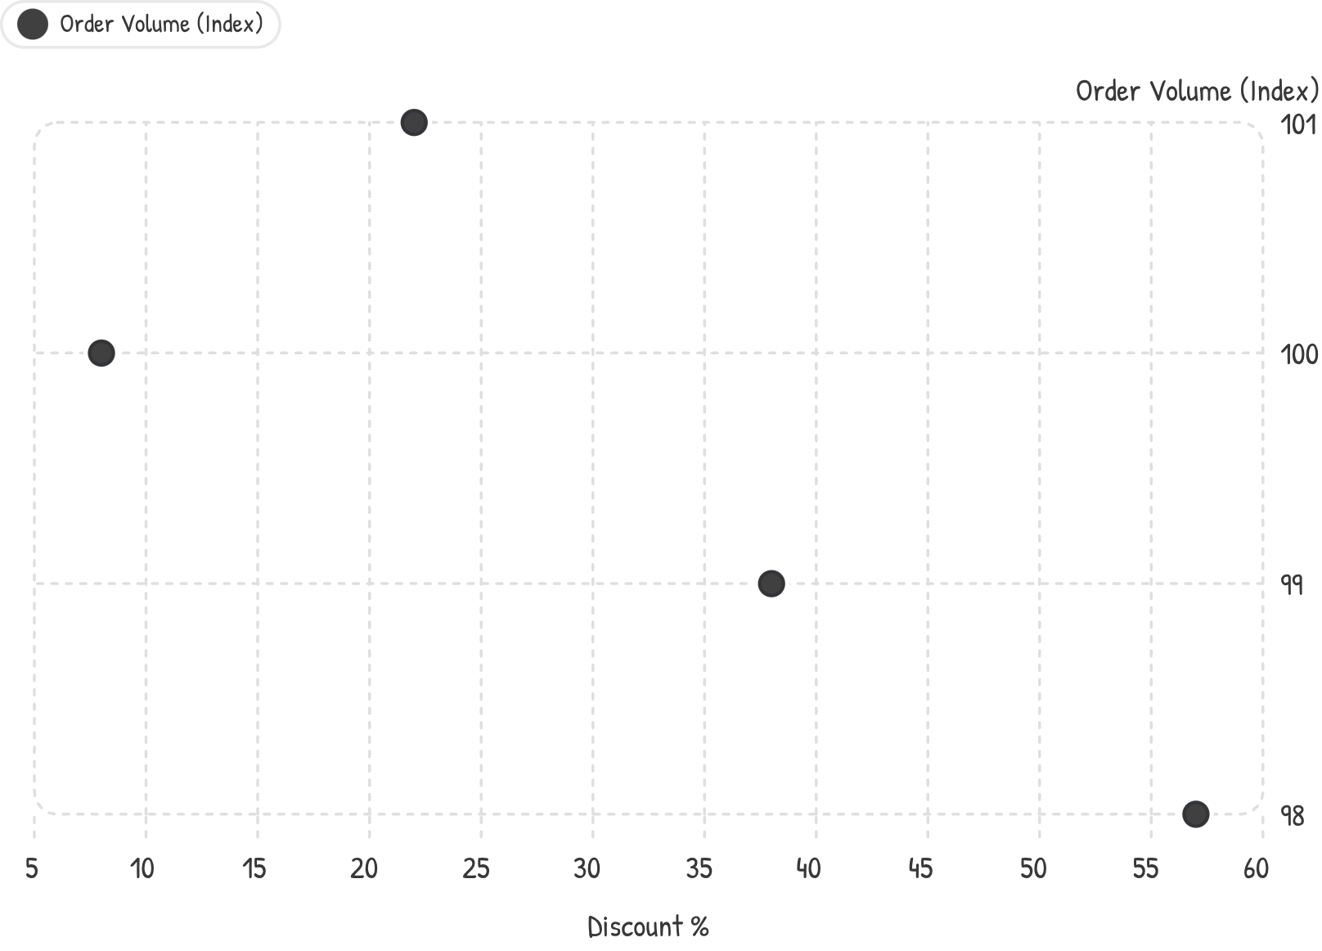
Finding 2: Southeast Asia — The Discount Trap
2% Profit Margin — and No Volume Reward
Discounts reached up to 57% in Southeast Asia, yet order volume remained completely flat as discounts increased. There was zero demand elasticity — customers weren't buying more; the business was simply giving away margin.
Profit margin: 2% (lowest of all regions)
Max discount depth: 57%
Order volume response: None

Slide 6
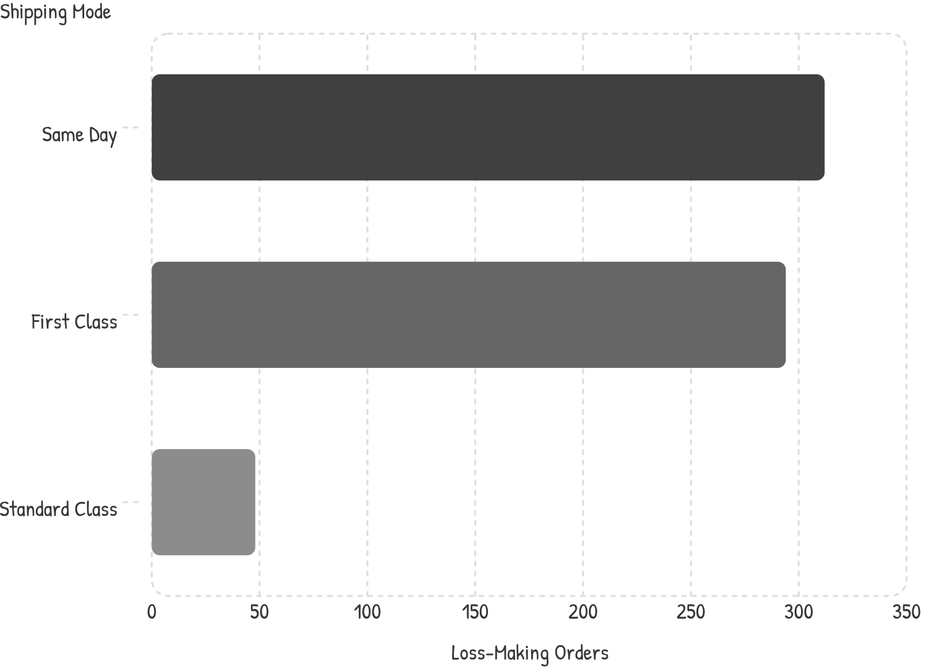
Finding 3: EMEA — Shipping Mode Is the Silent Killer
606 Orders Turned Loss-Making
EMEA's 5.45% margin wasn't driven by discounting — it was driven by shipping mode selection. Same Day and First Class shipping converted 606 orders into net losses, while Standard Class remained profitable.
Same Day: 312 loss-making orders
First Class: 294 loss-making orders
Standard Class: only 48 losses
Shipping cost policy — not pricing — is the primary margin lever in EMEA.

Slide 7
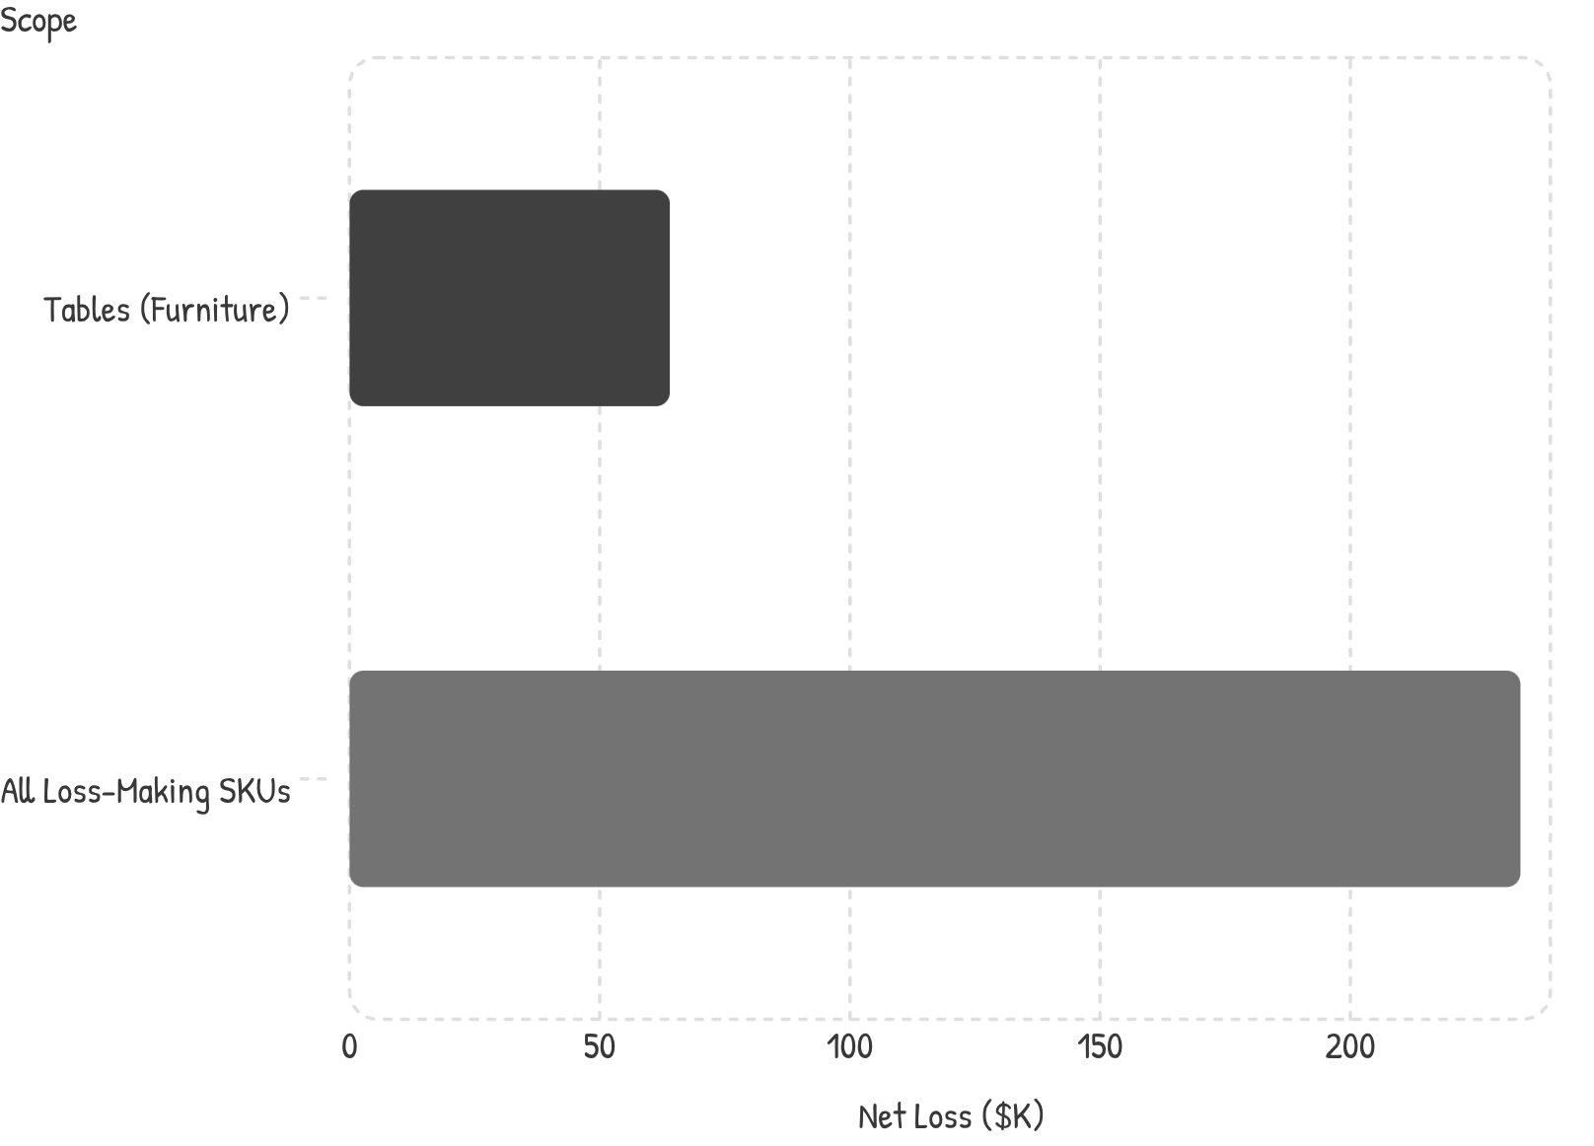
Finding 4: Products Bleeding Red
One Sub-Category. $64K in Losses.
The Tables sub-category within Furniture alone generated a $64K net loss. Company-wide, 181 products (18% of all SKUs) were losing money — collectively eroding $234K from annual profitability.
Tables sub-category loss: $64K
Loss-making SKUs: 181 products (18%)
Total product-level loss: $234K

Slide 8





Recommendations: Four High-Impact Levers
Cap Discounts at 20%
Eliminate deep-discount promotions in Southeast Asia with no volume return.
Mandate Standard Class in EMEA
Default to Standard Class shipping; require approval for premium modes.
Emergency SKU Review: Tables
Audit all 181 loss-making SKUs — reprice, delist, or renegotiate supplier terms.
Replicate the Canada Model
Canada's 26.6% margin is the blueprint — codify and scale its playbook globally.

Slide 9
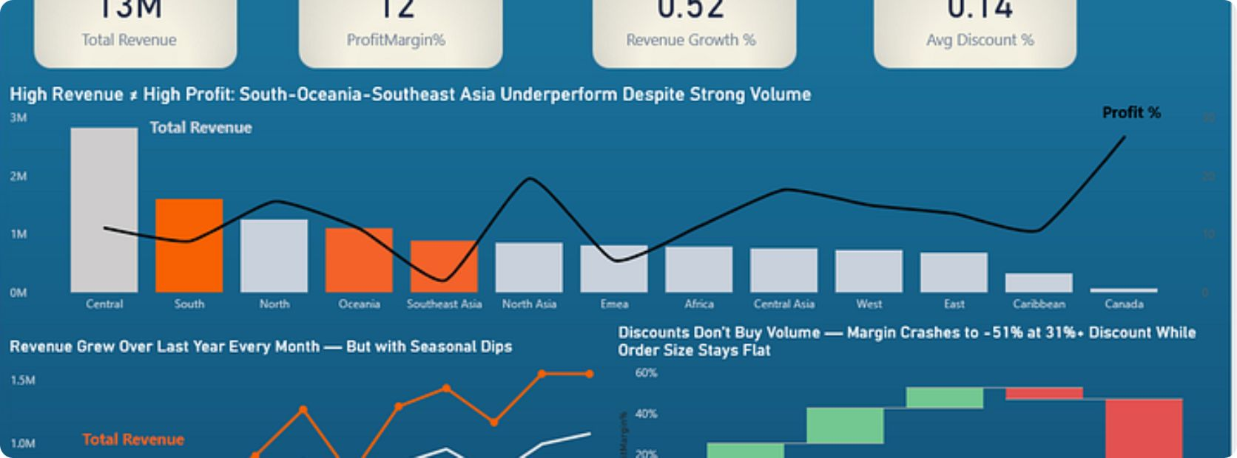
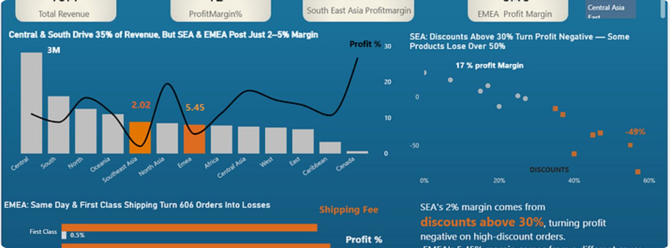
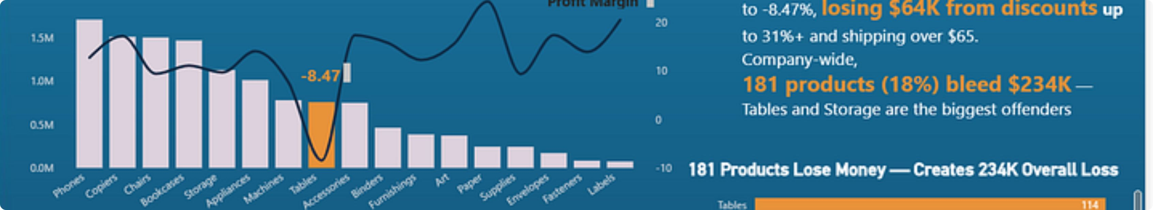
Dashboard Preview: From Data to Decision
Three Power BI pages translate findings into an interactive executive narrative — enabling self-serve exploration from enterprise overview to regional and product-level drill-downs.

Slide 10

Key Takeaway
Growth without margin discipline erodes profitability. The right data-driven policy changes can recover $150K+ annually — without sacrificing a single dollar of revenue.
Diagnose
Prescribe
Revenue growth masked structural margin leaks across regions, shipping, and products.
Targeted policy changes — discount caps, shipping mandates, SKU reviews — address root causes.
Recover
$150K+ in annual profit recovery is achievable without reducing top-line revenue.

