Slide 1
CREATE A CHATBOT IN PYTHON
Phase 3: Development Part 1
.

Slide 2
Topic: Start building the chatbot by preparing the environment and implementing basic user interactions. Install required libraries, like transformers for GPT-3 integration and flask for web app development
Create a Chatbot in Python
Introduction:
A chatbot is a computer program designed to simulate human conversation. It can interact with users through text or speech and respond to their queries or requests.
Chatbots are used for a wide range of applications, from customer support and virtual assistants to entertainment and information retrieval.
Creating a chatbot is a challenging but rewarding endeavor that combines various technologies and skills, from programming and NLP to machine learning.

Slide 3
Necessary steps to follow:
we'll start building a chatbot by preparing the environment, loading and preprocessing a dataset, and implementing basic user interactions. We'll also install the required libraries, such as "transformers" for GPT-3 integration and "Flask" for web app development. Please note that the "transformers" library is useful for using pre-trained language models, and you can integrate GPT-3 or other models based on your preferences.
Environment Setup.
We can create a virtual environment to manage project dependencies and versions. Open your terminal and run:
# Create a virtual environment (optional but recommended)
python -m venv chatbot-env
# Activate the virtual environment
# On Windows:
chatbot-env\Scripts\activate
# On macOS and Linux:
source chatbot-env/bin/activate.
2. Install Required Libraries.
flask is a lightweight web framework that we'll use for creating a simple web-based chatbot interface.

Slide 4
3. Basic User Interaction.
Create a Python script (e.g., chatbot.py) to handle basic user interactions. You can use a simple rule-based system to provide responses based on user input, or you can integrate a pre-trained model (e.g., GPT-3) to generate responses.
4. Web App Development.
If you want to create a web-based chatbot interface, you can use Flask. Create a Flask app in a separate Python file (e.g., app.py).
5.Data Preprocessing.
Tokenize the text data, remove stop words, and perform any necessary data cleaning. This step is crucial for natural language processing
6. Implement the Chatbot:
* Write the code to implement the chatbot using your chosen approach (rule-based, retrieval-based, generative).
*For machine learning-based chatbots, design and train the models.

Slide 5
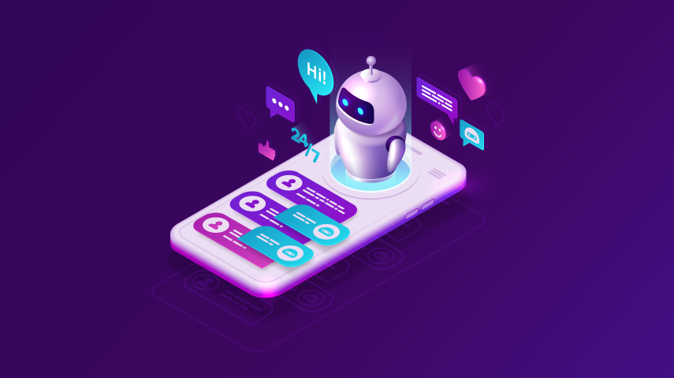
7.Design Conversation Flow:
*Define the conversation flow and the types of questions or inputs the chatbot should handle.
*Create a decision tree or dialogue management system to guide the conversation.
8.Test and Evaluate.
* Test your chatbot with a variety of user inputs and evaluate its responses.
*Use metrics like accuracy, F1-score

Slide 6
Program:
import random
responses = {
"hello": "Hello! How can I help you?",
"how are you": "I'm just a computer program, but thanks for asking!",
"bye": "Goodbye! Have a great day!",
def chatbot_response(user_input):
user_input = user_input.lower()
for keyword, response in responses.items():
if keyword in user_input:
return response
# If no match is found,
return "I'm sorry, I don't understand. Please ask another question."
print("Chatbot: Hello! Type 'bye' to exit.")
while True:
user_input = input("You: ")
if user_input.lower() == 'bye':
print("Chatbot: Goodbye!")
break
response = chatbot_response(user_input)
print("Chatbot:", response)

Slide 7
step by step
(for Start building the chatbot by preparing the environment and implementing basic user interactions)
Step 1: Define the Purpose and Goals
*What specific tasks or interactions should the chatbot handle?
*What problem or challenge will the chatbot solve for users?
*How will the chatbot improve user experiences or streamline operations?
Step 2: Choose a Platform or Framework
*Technical Expertise
*Integration
*Scalability
*AI and NLP Capabilities
Step 3: Design the Conversation Flow
*Identify the different intents or purposes behind user interactions.
* Define entities or specific information the chatbot needs to collect from users. Entities can include names, dates, product names, and more.
* Create dialog trees that outline .

Slide 8
Step 4: Develop and Test the Chatbot
* Programming.
*Training.
*Testing.
Step 5: Deploy and Monitor the Chatbot
*Website Integration: Include the chatbot on your website so that visitors may utilize it while they are there.
* Messaging Apps: To reach a wider audience, integrate the chatbot with well-known messaging services like Facebook Messenger or WhatsApp.
*Mobile Apps: Integrate the chatbot to offer in-app assistance in your mobile application.
*Voice Assistants: When designing a chatbot for voice interactions, deploying it on platforms and devices that can actively support voice is essential.

Slide 9
Conclusion:
*)A chatbot is one of the simple ways to transport data from a computer without having to think for proper keywords to look up in a search or browse several web pages to collect information; users can easily type their query in natural language and retrieve information.
*)In this project, we have introduced a chatbot that is able to interact with users. This chatbot can answer queries in the textual user input. For this purpose, AIML with program-o has been used. The chatbot can answer only those questions which he has the answer in its AIML dataset.
*)with this foundation step completed,our dataset is now primed for subsequent stages of building for creating a chatbot in python.

