Slide 1
CREATE A CHATBOT IN PYTHON

Slide 2
Phase 5: Project Documentation & Submission
Topic: In this part you will document your project and prepare it for submission.

Slide 3
Chatbot in Python
Introduction:
*Start by defining the objectives and scope of your chatbot.
*Determine what tasks it should perform, the type of conversations it will handle, and the target audience it will interact with.
*Create a set of predefined rules and responses that the chatbot follows. This approach is suitable for simple and structured conversations.
*If you're taking a machine learning approach, you'll need training data. This could be a dataset of conversations or labeled examples to train your chatbot.
*Thoroughly test your chatbot to identify and fix issues. Collect user feedback and continuously improve your chatbot's responses and capabilities.

Slide 4
*Consider using libraries like NLTK, spaCy, TensorFlow, or specialized chatbot frameworks like Rasa.
*If you opt for a machine learning approach, you'll need training data. This can be a dataset of conversations or labeled examples to train your chatbot.
*Creating a chatbot can be a rewarding project, and it can be as simple or as sophisticated as you wish, depending on your goals and the technologies you choose to implement. As you gain experience, you can explore more advanced techniques in natural language processing and machine learning to enhance your chatbot's capabilities.
Dataset Link: https://www.kaggle.com/datasets/grafstor/simple-dialogs-for-chatbot

Slide 5
Here’s the list of tools and software used in the process:
1. NLTK (Natural Language Toolkit):
NLTK is a widely-used Python library for natural language processing and text analysis. It provides tools for tokenization, stemming, and other NLP tasks that can be essential for chatbot development.
2. spaCy:
spaCy is a popular NLP library that excels in text processing and linguistic analysis. It's known for its speed and accuracy in tasks like entity recognition and part-of-speech tagging.
3. Rasa:
Rasa is an open-source framework for building conversational AI. It provides tools for natural language understanding, dialogue management, and chatbot development.

Slide 6
4. TensorFlow and Keras:
If you're creating a machine learning-based chatbot, TensorFlow and its high-level API Keras can be used for building and training neural networks for natural language processing tasks.
5.ChatterBot:
ChatterBot is a simple and straightforward Python library for creating chatbots. It's based on machine learning and can be a good choice for beginners.
6.Web Frameworks (Flask, Django, etc.):
When creating web-based chatbots, you'll need a web framework like Flask or Django to handle HTTP requests and responses for the chatbot's interface.

Slide 7
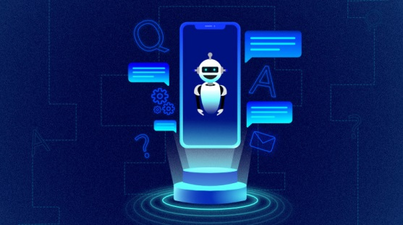
7.Microsoft Bot Framework:
If you're looking to create chatbots for Microsoft platforms, the Microsoft Bot Framework provides a set of tools and services for bot development.
8.Slack API:
To create chatbots that integrate with Slack, you can use the Slack API, which provides extensive documentation and tools for building Slack bots.

Slide 8
1.Problem Definition and Design Thinking
*Choose a suitable framework or library for building the chatbot in Python
*Design the conversational flow and logic of the chatbot
*Implement the chatbot functionality using Python code
*Test and debug the chatbot for errors and bugs
*Deploy the chatbot to a platform or service of choice

Slide 9
Approach to Solving the Problem for create a chatbot in python:
* Define the goal and scope of the chatbot
* Choose a suitable framework or library for natural language processing (NLP) and dialogue management
*Design the chatbot's personality, voice and tone
*Create a data set of sample conversations and intents
*Train and test the chatbot's NLP and dialogue models

Slide 10
DESIGN THINKING:
Answering common questions:
The chatbot can provide quick and accurate answers to frequently asked questions, such as the hours of operation, contact information, or product details. The chatbot can also handle simple queries that do not require complex reasoning or calculations, such as the weather, the time, or the date.
Providing guidance:
The chatbot can assist users with specific tasks or goals, such as booking a reservation, placing an order, or filling out a form. The chatbot can also offer suggestions, tips, or feedback to help users complete their tasks or improve their experience.
Directing users to appropriate resources:
The chatbot can recognize when a user needs more information or assistance than the chatbot can provide, and direct them to the relevant web pages, documents, or human agents. The chatbot can also follow up with users to ensure their satisfaction and resolve any issues.

Slide 11
2.Innovation
● Explore innovative techniques such as ensemble methods.
● Deep learning architectures to improve the prediction system's accuracy and robustness.
● consider exploring advanced techniques like using pre-trained language models
● To enhance the quality of responses (e.g., GPT3).
<Data collection
<Data preprocessing
< Choose Ensemble Methods
<Design Deep Learning Architectures

Slide 12
Approach to Solving the Problem:
● Define the goal and scope of the chatbot.
● Gather relevant data for your prediction.
system. - Preprocess the data, including cleaning, tokenization, and any necessary formatting.
● Integrate pre-trained language models like GPT- 3 into your system.
● Deploy your prediction system, ensuring it's accessible to users through the desired platform or application.
● Train and test the chatbot's NLP and dialogue models.
● Continuously monitor the performance and robustness of your system in real-world scenarios.

Slide 13
Design Thinking:
Empathize: Begin by understanding the needs and pain points of your target users. Who will be using the chatbot, and what problems should it solve for them?
Conduct user interviews, surveys, or research to gain insights into user expectations.
Answering common questions: The chatbot can provide quick and accurate answers to frequently asked questions, such as the hours of operation, contact information, or product details. The chatbot can also handle simple queries that do not require complex reasoning or calculations, such as the weather, the time, or the date.
Providing guidance: The chatbot can assist users with specific tasks or goals, such as booking a reservation, placing an order, or filling out a form. The chatbot can also offer suggestions, tips, or feedback to help users complete their tasks or improve their experience.
Directing users to appropriate resources: The chatbot can recognize when a user needs more information or assistance than the chatbot can provide, and direct them to the relevant web pages, documents, or human agents. The chatbot can also follow up with users to ensure their satisfaction and resolve any issues.

Slide 14
Integration:
One of the key steps in developing a chatbot is to decide how it will be integrated with the website or app. This decision depends on several factors, such as the purpose of the chatbot, the target audience, the user interface design, and the technical feasibility. Some of the common ways to integrate a chatbot are: *Incorporating advanced techniques like pre-trained language models such as GPT-3 can significantly enhance the quality of responses in your prediction system or chatbot. These models bring a wealth of natural language understanding and generation capabilities, making them valuable assets for improving user interactions.
*By combining ensemble methods, deep learning architectures, and pre-trained language models in a thoughtful and iterative design process, you can create a prediction system or chatbot that not only offers accurate predictions but also delivers high-quality responses, ultimately providing a superior user experience.
*Remember to continuously gather user feedback and adapt your system to changing needs, ensuring that it remains relevant and effective over time. The synergy of innovative techniques and a user-centric design approach can lead to a powerful and robust solution

Slide 15
3.Building the chatbot by preparing the environment and implementing basic user interactions.
Environment Setup.
We can create a virtual environment to manage project dependencies and versions. Open your terminal and run:
# Create a virtual environment (optional but recommended)
python -m venv chatbot-env
# Activate the virtual environment
# On Windows:
chatbot-env\Scripts\activate
# On macOS and Linux:
source chatbot-env/bin/activate.
Install Required Libraries.
flask is a lightweight web framework that we'll use for creating a simple web-based chatbot interface.
Basic User Interaction.
Create a Python script (e.g., chatbot.py) to handle basic user interactions. You can use a simple rule-based system to provide responses based on user input, or you can integrate a pre-trained model (e.g., GPT-3) to generate responses

Slide 16
Web App Development.
If you want to create a web-based chatbot interface, you can use Flask. Create a Flask app in a separate Python file (e.g., app.py).
Data Preprocessing.
Tokenize the text data, remove stop words, and perform any necessary data cleaning. This step is crucial for natural language processing
Implement the Chatbot:
* Write the code to implement the chatbot using your chosen approach (rule-based, retrieval-based, generative).
*For machine learning-based chatbots, design and train the models.
Design Conversation Flow:
*Define the conversation flow and the types of questions or inputs the chatbot should handle.
*Create a decision tree or dialogue management system to guide the conversation.
Test and Evaluate.
* Test your chatbot with a variety of user inputs and evaluate its responses.

Slide 17
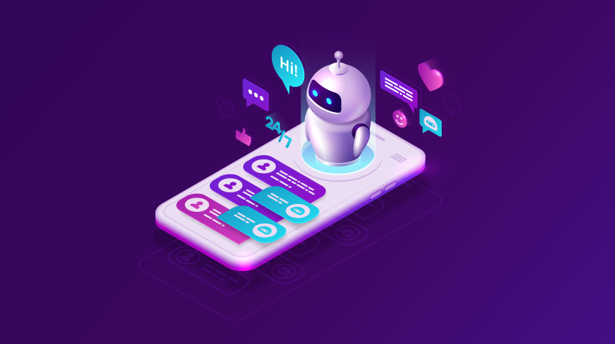
A chatbot is a computer program designed to simulate human conversation. It can interact with users through text or speech and respond to their queries or requests.

Slide 18
Program:
import random
responses = {
"hello": "Hello! How can I help you?",
"how are you": "I'm just a computer program, but thanks for asking!",
"bye": "Goodbye! Have a great day!",
def chatbot_response(user_input):
user_input = user_input.lower()
for keyword, response in responses.items():
if keyword in user_input:
return response
# If no match is found,
return "I'm sorry, I don't understand. Please ask another question."
print("Chatbot: Hello! Type 'bye' to exit.")
while True:
user_input = input("You: ")
if user_input.lower() == 'bye':
print("Chatbot: Goodbye!")
break
response = chatbot_response(user_input)
print("Chatbot:", response)

Slide 19
step by step
(for Start building the chatbot by preparing the environment and implementing basic user interactions)
Step 1: Define the Purpose and Goals
*What specific tasks or interactions should the chatbot handle?
*What problem or challenge will the chatbot solve for users?
*How will the chatbot improve user experiences or streamline operations?
Step 2: Choose a Platform or Framework
*Technical Expertise
*Integration
*Scalability
*AI and NLP Capabilities
Step 3: Design the Conversation Flow
*Identify the different intents or purposes behind user interactions.
* Define entities or specific information the chatbot needs to collect from users. Entities can include names, dates, product names, and more.
* Create dialog trees that outline

Slide 20
4.Start building the chatbot by preparing the environment and implementing basic user interactions. Install required libraries, like transformers for GPT-3 integration and flask for web app development.
Necessary steps to follow:
Step 1: Create a Chatbot Using Python ChatterBot In this step, you’ll set up a virtual environment and install the necessary dependencies. You’ll also create a working command-line chatbot that can reply to you—but it won’t have very interesting replies for you yet.Running these commands in your terminal application installs ChatterBot and its dependencies into a new Python virtual environment.
Step 2: Begin Training Your Chatbot In the previous step, you built a chatbot that you could interact with from your command line. The chatbot started from a clean slate and wasn’t very interesting to talk to.
Step 3: Export a WhatsApp Chat
At the end of this step, you’ll have downloaded a TXT file that contains the chat history of a WhatsApp conversation

Slide 21
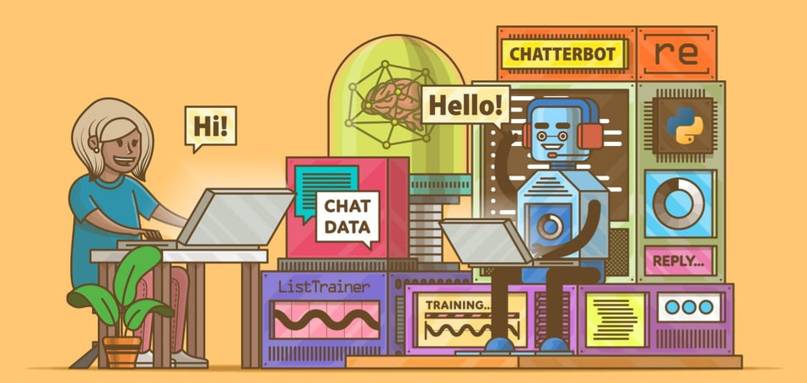
Step 4: Clean Your Chat Export
In this step, you’ll clean the WhatsApp chat export data so that you can use it as input to train your chatbot on an industry-specific topic. In this example, the topic will be … houseplants!
Step 5: Train Your Chatbot on Custom Data and Start Chatting
In this step, you’ll train your chatbot with the WhatsApp conversation data that you cleaned in the previous step. You’ll end up with a chatbot that you’ve trained on industry-specific conversational data, and you’ll be able to chat with the bot

Slide 22
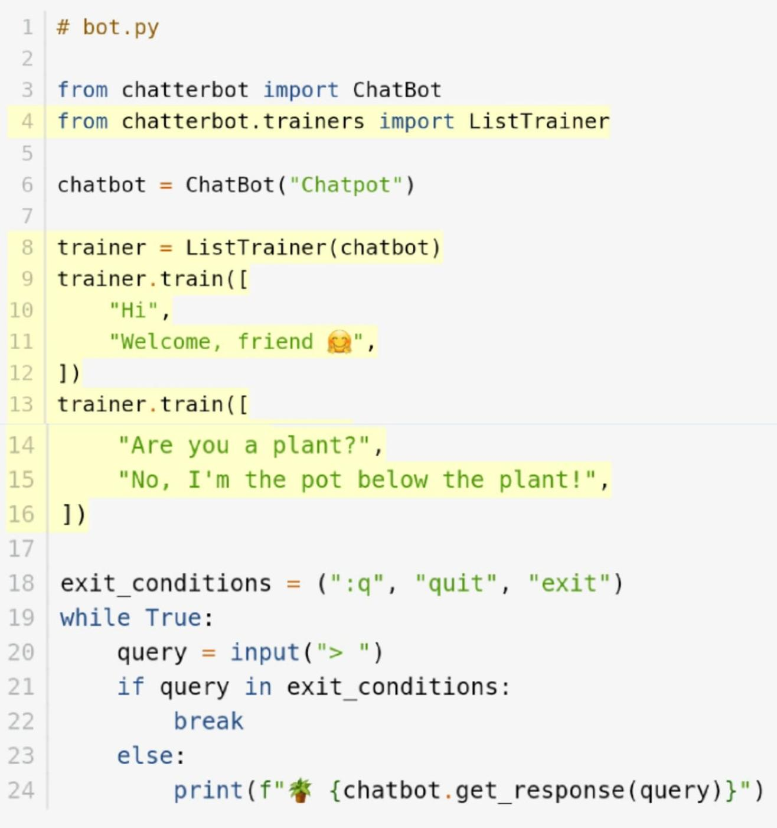
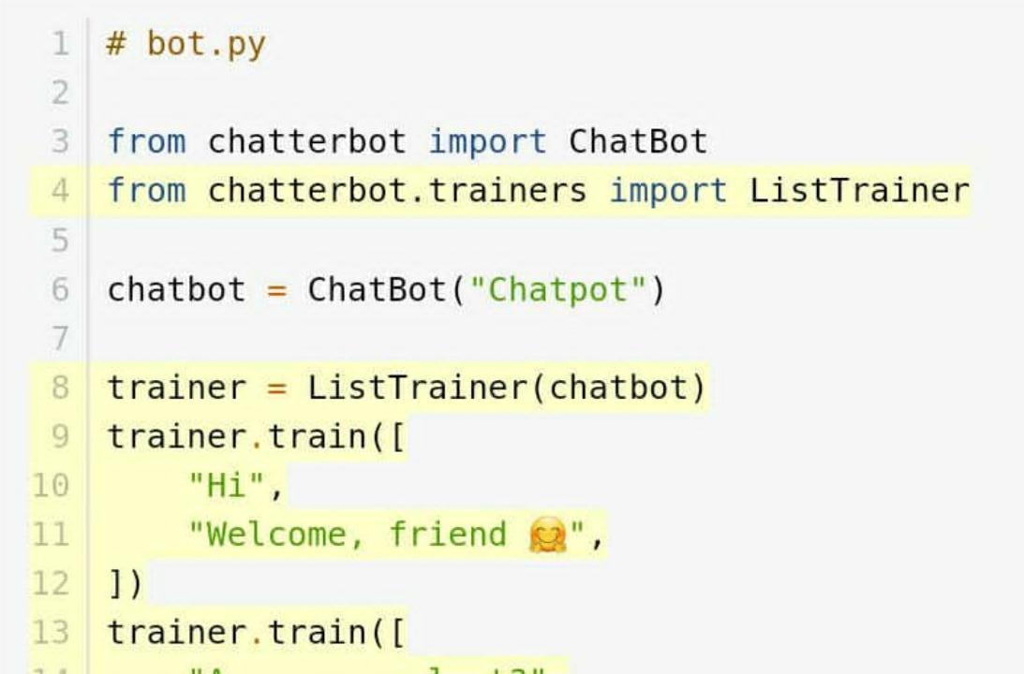
Program:

Slide 23
step by step
(for Start building the chatbot by preparing the environment and implementing basic user interactions)
Step 1:Define the Purpose:
Determine the purpose and functionality of your chatbot. What will it do? Who is the target audience.
Step 2:Choose a Framework or Library: You can use libraries like NLTK, spaCy, or Transformers for natural language processing. For building the chatbot itself, you can use frameworks like Rasa, ChatterBot, or even create a custom solution
.
Step 3:Data Collection and Preprocessing: Gather and preprocess training data, which includes text conversations or relevant datasets. Tokenize and clean the text data.

Slide 24
Conclusion:
In conclusion, developing a chatbot in Python offers a versatile and powerful approach to create interactive and automated conversational agents. Python's rich ecosystem of libraries and frameworks, like NLTK, spaCy, and TensorFlow, provide the tools needed for natural language processing and machine learning, making it a suitable choice for chatbot development. However, success in building an effective chatbot also depends on understanding the target audience, crafting meaningful dialogues, and continuous improvement through user feedback. Python's flexibility and community support make it a robust choice for creating chatbots that can be integrated into various applications and platforms.chatbot plays a crucial role in future for Artificial Intelligence.

