Slide 1
balugurisruthi61
Bluestock Fintech MJ28 · Capstone Project I
Individual Submission
Mutual Fund Analytics Platform
Data Engineering · EDA · Performance & Risk Analytics · Power BI Dashboard
40
10
46,000
32,778
4.4 Yrs
Fund Schemes
Fund Houses
NAV Records
Transactions
Data Span
GitHub: github.com/balugurisruthi61-bot/data-project · Due: 10 June 2026

Slide 2
Problem & Objective
02
THE PROBLEM
MY OBJECTIVE
1. Mutual fund data (NAV, AUM, SIP flows, holdings) is spread across 10 disconnected raw sources with no unified view 2. Investors cannot easily compare risk-adjusted performance (Sharpe, Sortino, Alpha, Beta) across 40 schemes & 10 fund houses 3. No automated way to validate AMFI codes between fund master and NAV history before analysis 4. Investor transaction behaviour (state, age, transaction type) is not visualized for decision-making
✅ Build a Python ETL pipeline (live_nav_fetch.py + data_ingestion.py) to fetch & validate fund NAV data from AMFI ✅ Perform EDA across AUM, SIP inflows, folio growth, category inflows & portfolio sector allocation ✅ Compute CAGR, Sharpe, Sortino, Alpha, Beta, Max Drawdown, VaR/CVaR for all 40 schemes ✅ Build a Power BI dashboard for investor transaction analytics (state, age group, transaction type, year)

Slide 3
Data Sources & Datasets
Data Sources & Datasets
03
03
# | Dataset | Size | Description
01 | fund_master.csv | 40 schemes | 10 AMCs, categories, expense ratios, fund managers
02 | nav_history.csv | 46,000 rows | Daily NAV, Jan 2022 – May 2026 (4.4 yrs)
03 | aum_by_fund_house.csv | 91 rows | Quarterly AUM by AMC, 2022–2025
04 | monthly_sip_inflows.csv | 48 months | SIP inflows, active accounts, SIP AUM
05 | category_inflows.csv | 145 rows | Category-wise net inflows by month
06 | industry_folio_count.csv | 21 rows | Total & equity folio growth
07 | scheme_performance.csv | 40 schemes | Returns, Sharpe, AUM, ratings, risk grade
08 | investor_transactions.csv | 32,778 rows | Transaction-level: state, age, type, amount
09 | portfolio_holdings.csv | 323 rows | Stock-level holdings across 34 funds
10 | benchmark_indices.csv | 8,051 rows | NIFTY50/100/Midcap/Smallcap, CRISIL indices
📁 Repo: github.com/balugurisruthi61-bot/data-project | Total: ~87,000+ data points across 10 CSVs

Slide 4
Data Ingestion, ETL & Validation
04
FETCH
LIVE NAV
LOAD
MASTER &
HISTORY
CROSS-
VALIDATE
AMFI CODES
COMPUTE
DAILY
RETURNS
EDA &
ANALYTICS
NOTEBOOKS
📄 live_nav_fetch.py
📄 data_ingestion.py — Validation
import requests, pandas as pd schemes = { "SBI_Bluechip": 119551, "ICICI_Bluechip": 120503, ...} for name, code in schemes.items(): url = f"api.mfapi.in/mf/{code}" pd.DataFrame(
data[
"data"]).to_csv( f"data/raw/{name}_nav.csv")
fund_codes = set(fund_master[ "amfi_code"]) nav_codes = set(nav_history[ "amfi_code"]) missing = fund_codes - nav_codes print("Missing:", len(missing)) # ✅ OUTPUT: # Missing AMFI Codes Count: 0 # All 40 codes matched perfectly # between fund_master & nav_history

Slide 5
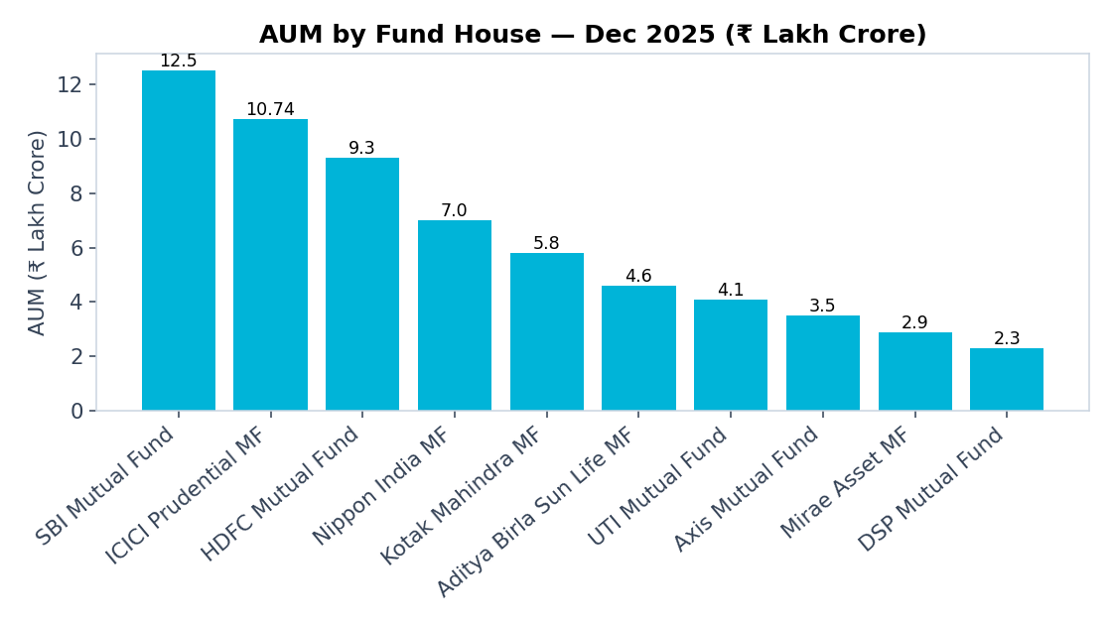
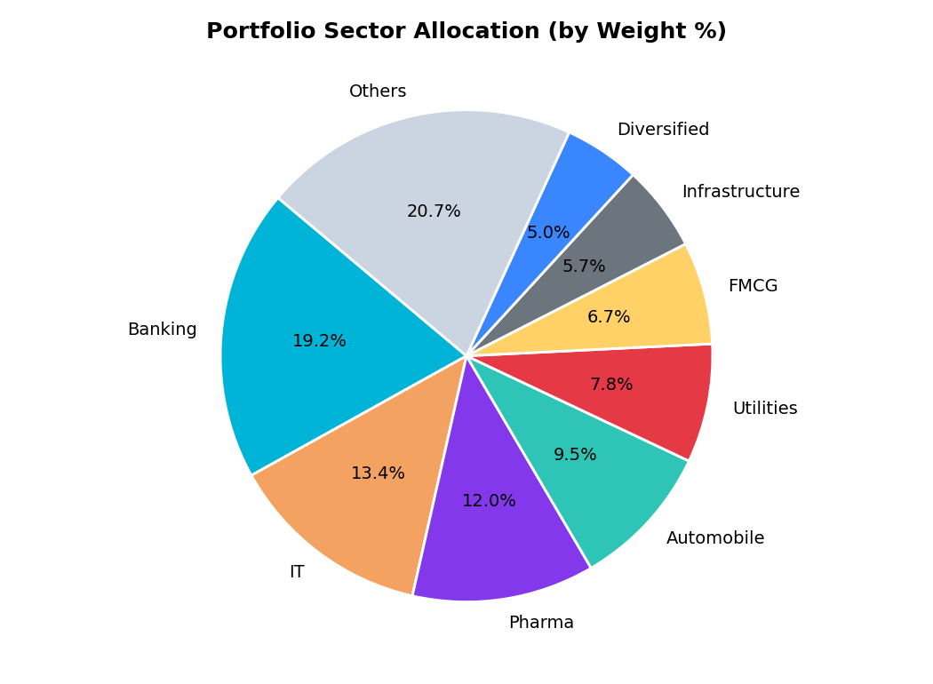
EDA — AUM & Portfolio Allocation
05
Insight: SBI MF leads AUM (₹12.5 LCr, 186 schemes); Banking (19.2%) & IT (13.4%) dominate portfolio sector allocation across 34 analyzed funds.

Slide 6
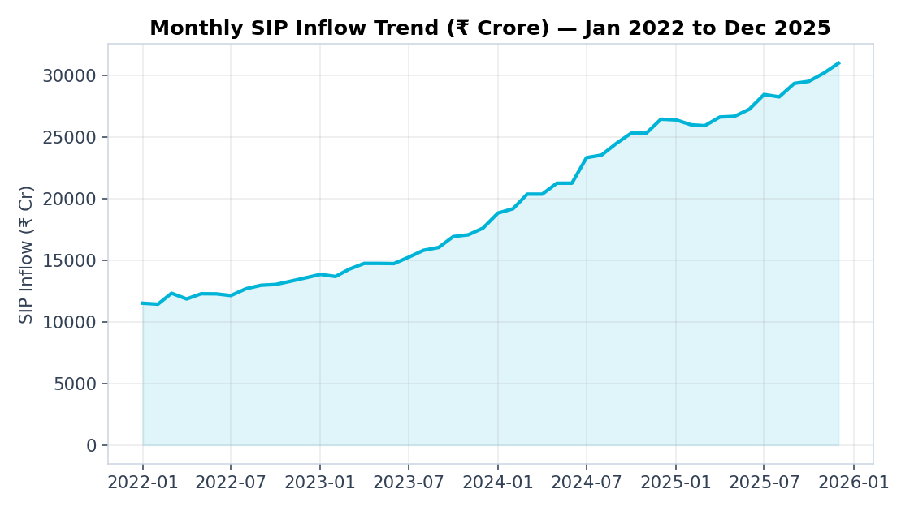
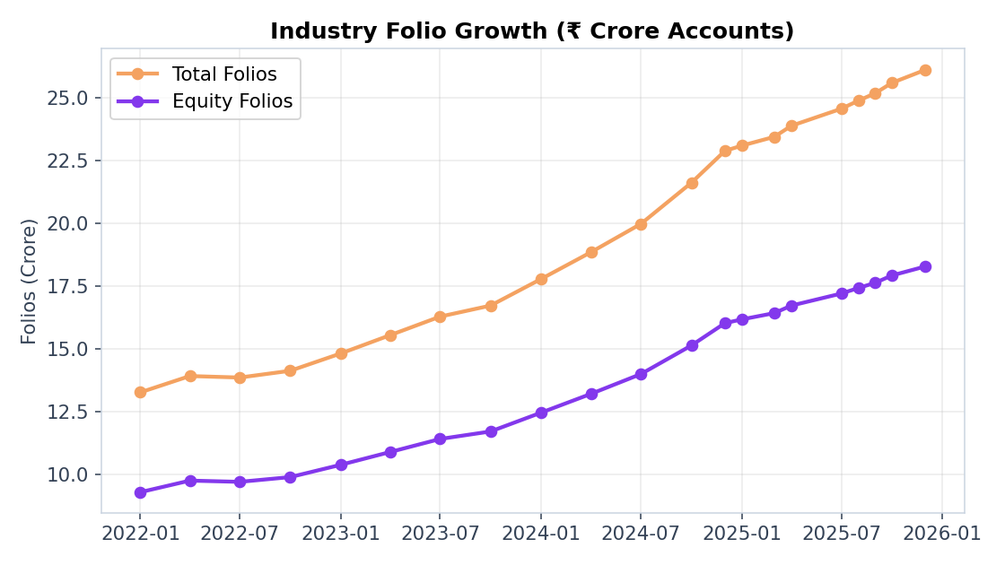
EDA — Industry Growth Trends
06
+169% SIP Inflow growth
₹11,517 Cr → ₹31,002 Cr
+90% Active SIP accounts
4.91 Cr → 9.35 Cr
+97% Total folios
13.26 Cr → 26.12 Cr

Slide 7
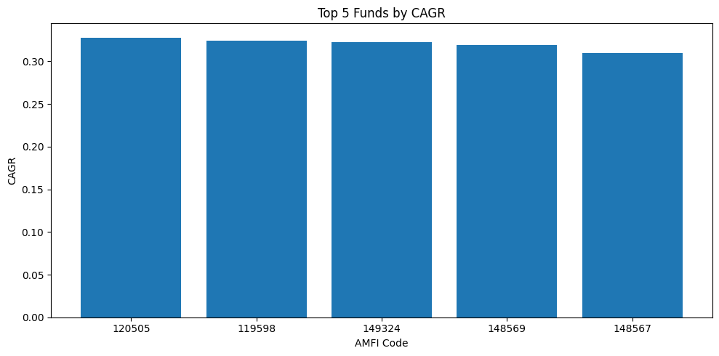
Fund Performance — Top 5 by CAGR
Fund Performance — Top 5 by CAGR
07
07
Computed from 02_nav_history.csv (Performance_Analytics.ipynb) — CAGR = (End NAV / Start NAV)^(1/years) − 1, over 4.4-yr span
Scheme Name | Fund House | Category | CAGR | Sharpe | Sortino | Max DD
ICICI Pru Midcap Fund - Regular - Growth | ICICI Prudential MF | Mid Cap | 32.8% | 1.18 | 2.03 | -18.2%
SBI Small Cap Fund - Regular Plan - Growth | SBI Mutual Fund | Small Cap | 32.4% | 0.95 | 1.68 | -28.7%
DSP Small Cap Fund - Regular - Growth | DSP Mutual Fund | Small Cap | 32.3% | 0.95 | 1.62 | -31.2%
Mirae Asset Tax Saver Fund - Regular - Growth | Mirae Asset MF | ELSS | 31.9% | 1.23 | 2.15 | -16.4%
Mirae Asset Large Cap Fund - Regular - Growth | Mirae Asset MF | Large Cap | 31.0% | 1.45 | 2.39 | -11.3%

Slide 8
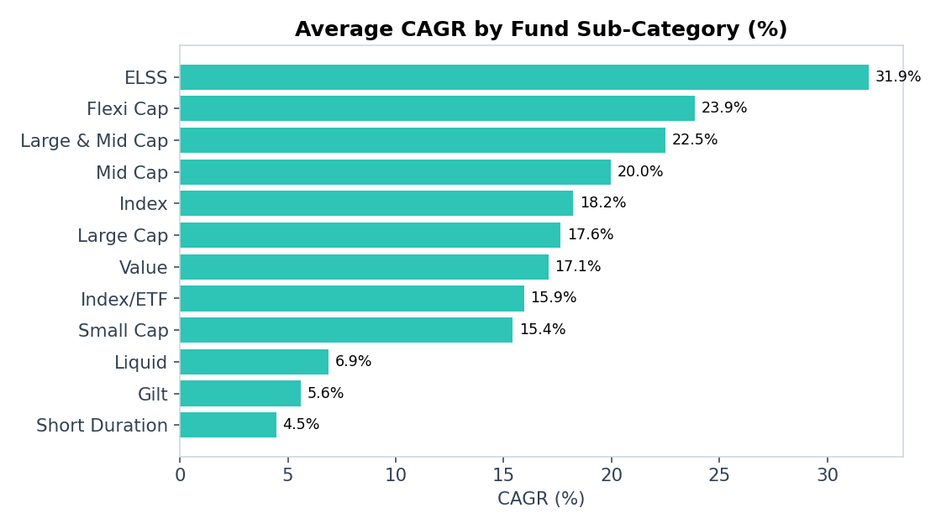
Category-wise Performance Benchmark
08
🏆 ELSS Leads
ELSS funds show the highest average CAGR (31.9%) — tax-saving funds with equity-heavy allocation paid off.
📊 Flexi & Large-Mid Cap Strong
Flexi Cap (23.9%) and Large & Mid Cap (22.5%) categories balanced growth with diversification.
🛡️ Liquid = Lowest Risk
Liquid funds show lowest CAGR (6.9%) but near-zero volatility — ideal for parking short-term funds.
⚠️ Small Cap — High Variance
Small Cap shows wide CAGR range (1.5% to 32.4%) — fund selection matters far more here than category choice.

Slide 9
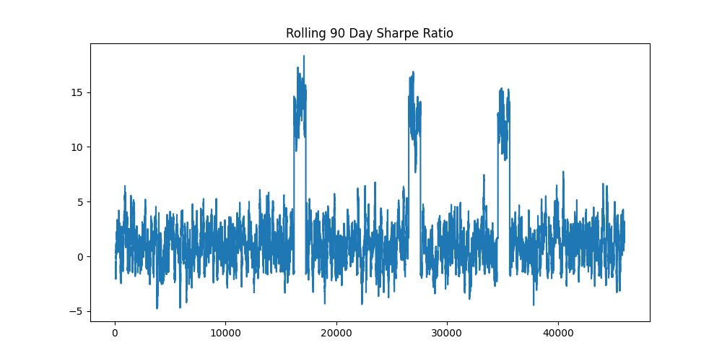
Risk Metrics — VaR, CVaR & Rolling Sharpe
09
Historical VaR (5%)
-1.63%
Daily loss exceeded only 5% of the time
CVaR (Expected Shortfall)
-2.98%
Avg loss on the worst 5% of days
Best Sharpe (Top 5 CAGR funds)
1.45
Mirae Asset Large Cap Fund
From Advanced_Analytics.ipynb — 90-day rolling Sharpe ratio, computed on daily NAV returns (annualized ×√252)
Rolling Sharpe Range
-5 to +18
90-day window across full dataset

Slide 10
Advanced Analytics — Recommendations & Risk
10
🎯 Top 'Low-Risk' Fund Recommendations
📊 Portfolio Concentration (HHI)
Filtered: risk_grade == 'Low', ranked by Sharpe Ratio (07_scheme_performance.csv)
HHI = Σ(weight²) for each fund's holdings
Result: All 34 funds analyzed → HHI < 0.25 → "Diversified Portfolio" for every fund
Top concentration holdings (single-stock weight):
• Infosys Ltd (IT) — 38.2% in one fund
• Sun Pharma — 35.1% in one fund
• Bharti Airtel — 30.4% in one fund
Insight: Despite individual large single-stock bets, overall portfolio HHI stays diversified across the 9-sector spread.
Scheme Name | Risk Grade | Sharpe
ICICI Pru Liquid Fund (Regular) | Low | 7.68
Kotak Liquid Fund (Regular) | Low | 6.18
ABSL Liquid Fund (Regular) | Low | 5.14
📌 Code logic:
recommended = df[df['risk_grade'] == 'low']
top_funds = recommended.sort_values(
by='sharpe_ratio', ascending=False).head(3)

Slide 11
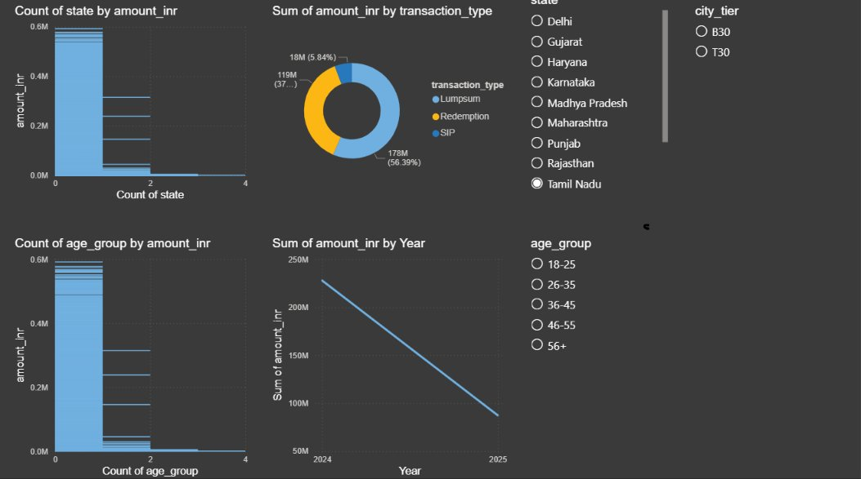
Power BI Dashboard — Transaction Analytics
11
📍 State Filter = Tamil Nadu → Total ₹315.2M across 2,806 transactions | Lumpsum ₹177.7M (56.4%) · Redemption ₹119.1M (37.8%) · SIP ₹18.4M (5.8%) | 2024→2025: ₹227.9M → ₹87.3M

Slide 12
Key Findings & Recommendations
13
✅ 100% Data Quality
📈 SIP Culture is Growing Fast
AMFI code cross-validation between fund_master.csv and nav_history.csv returned zero missing codes — all 40 schemes fully traceable across NAV history.
SIP inflows grew 169% (₹11,517 Cr → ₹31,002 Cr) and total investor folios nearly doubled (+97%) from 2022 to 2025 — strong retail participation trend.
🏆 ELSS & Mid/Small Cap Lead Returns
🛡️ Liquid Funds for Safety, Equity for Growth
ELSS (31.9% avg CAGR) and select Mid/Small Cap funds (up to 32.8% CAGR) topped performance — but with deeper max drawdowns (-16% to -31%).
Liquid funds (ICICI Pru, Kotak, ABSL) offer Sharpe >5 with near-zero volatility — ideal as the 'Low risk_grade' recommendation set for conservative investors.

Slide 13
MJ28
Thank You
Bluestock Fintech MJ28 · Capstone Project I · Mutual Fund Analytics
Submitted by: balugurisruthi61 | Individual Submission
✅ Final_Report.pdf (15–20 pages)
✅ Bluestock_MF_Presentation.pptx (14 slides)
✅ GitHub: github.com/balugurisruthi61-bot/data-project

