Slide 1
EDA ON STOCK PORTFOLIO DATA SET
GROUP MEMEBERS:-
K Balarajaiah,S20200010085
E Jaswanth Krishna,S20200020257

Slide 2
Problem Statement: The goal of this project is to do exploratory data analysis on a stock portfolio performance dataset. We performed Linear Regression on the dataset and test all the assumptions of linear regression.

Slide 3
About Dataset:-
The dataset has 12 attributes of totally 315 rows
6 inputs(weights) => ' Large B/P ', ' Large ROE ', ' Large S/P ',' Large Return Rate in the last quarter ', ' Large Market Value ',' Small systematic Risk’
6 outputs =>'Annual Return', 'Excess Return’, 'Systematic Risk', 'Total Risk', 'Abs. Win Rate','Rel. Win Rate'

Slide 4
Methodology
Data Pre-processing
Null Values
Influential points
EDA
Heatmap
Data Exploration
Feature Engineering
PCA
Bartlett’s Sphericity test
Scree Plot
Feature Reduction
Test of Assumptions
Multicollinearity
Autocorrelation
Normality
Model:-
OLS
Homoscedasticity

Slide 5
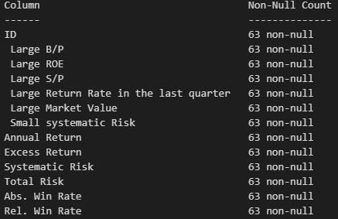
Data Pre-processing:- A) Null Values:-
There are no null values in dataset.

Slide 6
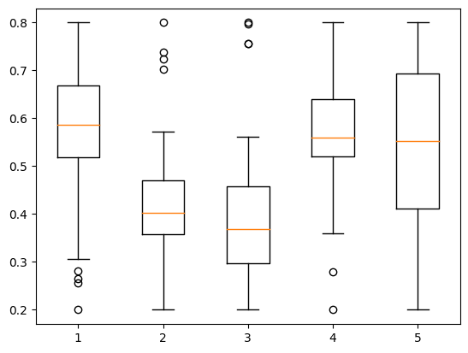
Data Pre-processing:- B) Influential points:- Outliers in Inputs(Weights):-

Slide 7
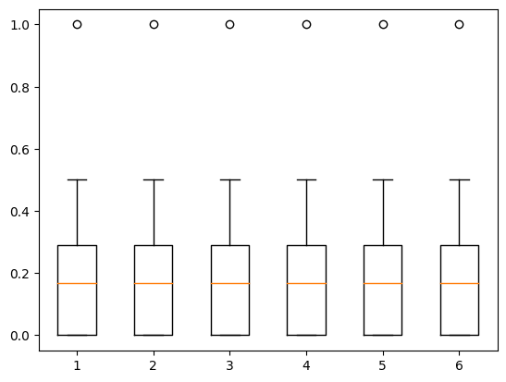
Data Pre-processing:- B) Influential points:- Outliers in Outputs:-

Slide 8
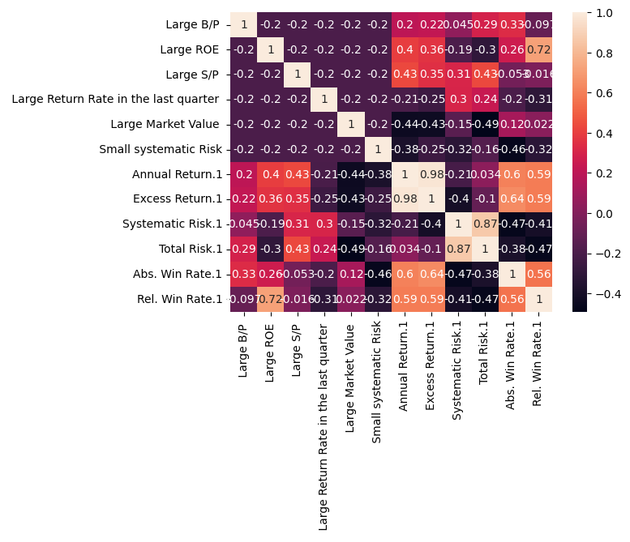
Exploratory Data Analysis:- A) Heat Map:- Here we see the correlation between all attributes in the dataset.

Slide 9
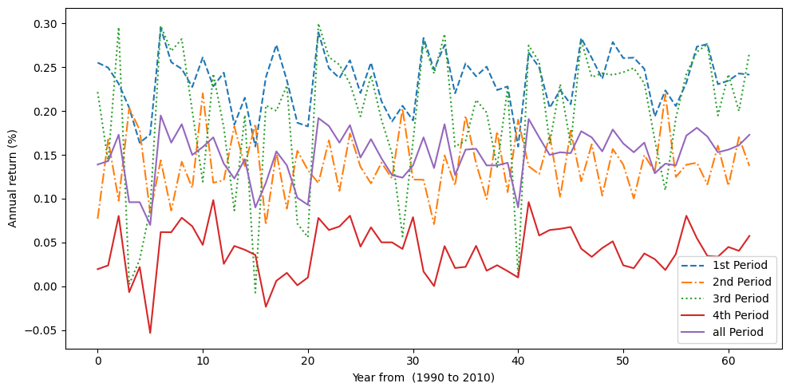
Exploratory Data Analysis:- B) Data Exploration:-
Annual returns(non-normalised data) of stocks in all periods trend.

Slide 10
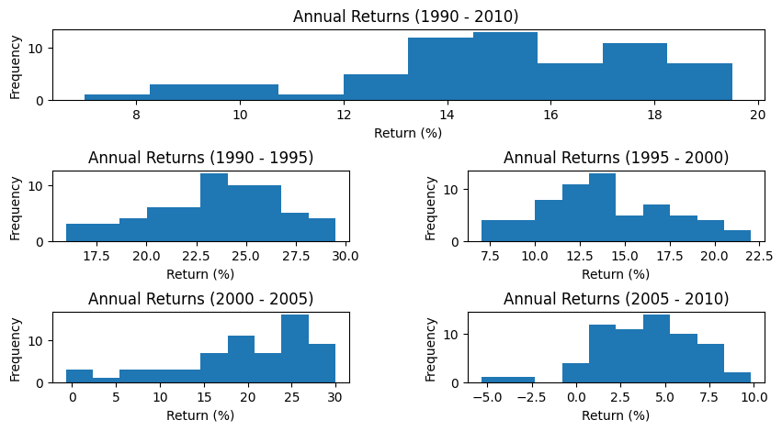
Exploratory Data Analysis:- B) Data Exploration:-
Annual returns corresponds to their frequency trend we see here all are normal

Slide 11
Exploratory Data Analysis:- C) Feature Engineering :-
We have defined three types of labels small , medium and large caps based on their market value by binning data as bins (0.0,.33,0.6,1) on overall time period.
Large Market value | CAP
0.00 – 0.33 | Small Cap
0.33 – 0.6 | Medium Cap
0.6-0.1 | Large cap

Slide 12
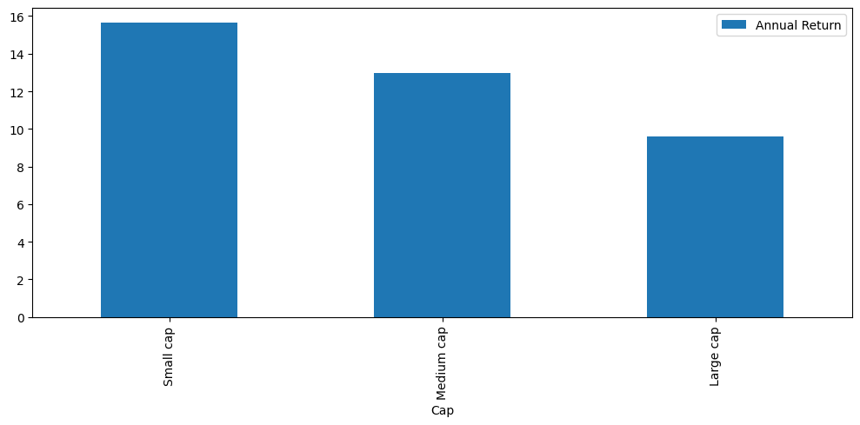
Exploratory Data Analysis:- C) Feature Engineering :-
Comparison of average Annual return with respect to Market value

Slide 13
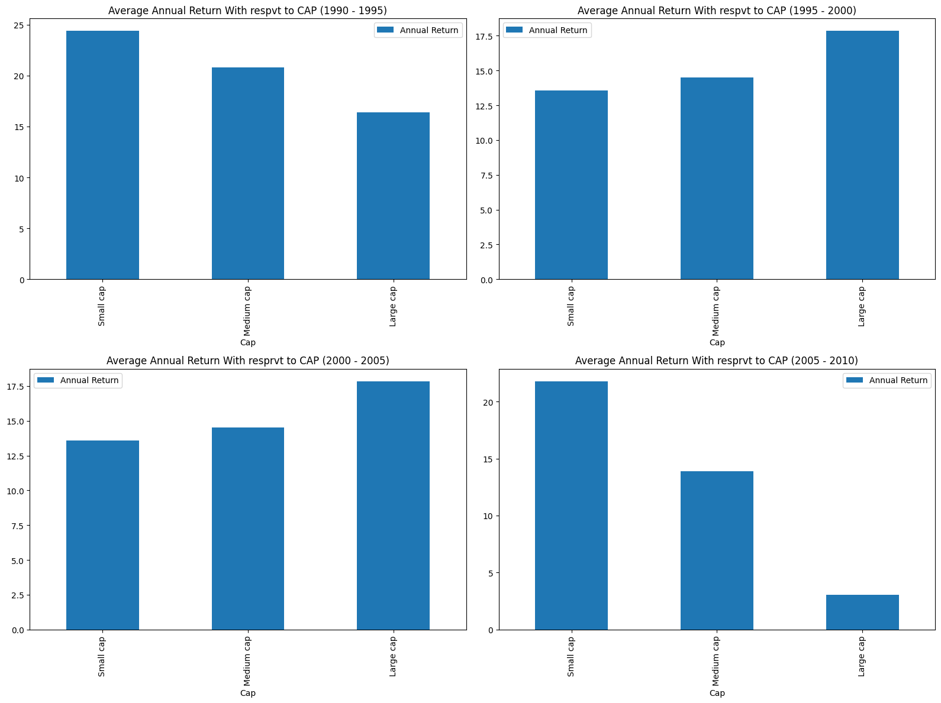
Exploratory Data Analysis:- C) Feature Engineering :-
Here we can see the trend of market values of small ,medium and large industries over these four periods like how it is varying.

Slide 14
Exploratory Data Analysis:- C) Feature Engineering :-
Here we binned annual returns of companies as 'Very Low’, 'Low’ , 'Medium’ , 'High’ , 'Very High’ over all periods. We can see no. of stocks w.r.t to stocks
Annual Return | Return
-10 - 5 | Very low
5 – 10 | Low
10 - 15 | Medium
15 – 20 | High
20 – 35 | Very High

Slide 15
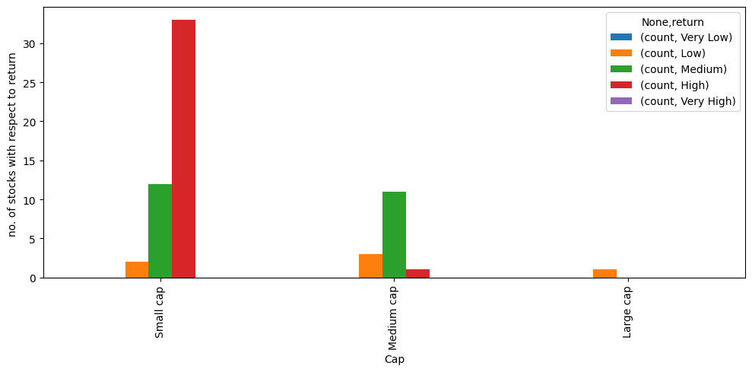
Exploratory Data Analysis:- C) Feature Engineering :-

Slide 16
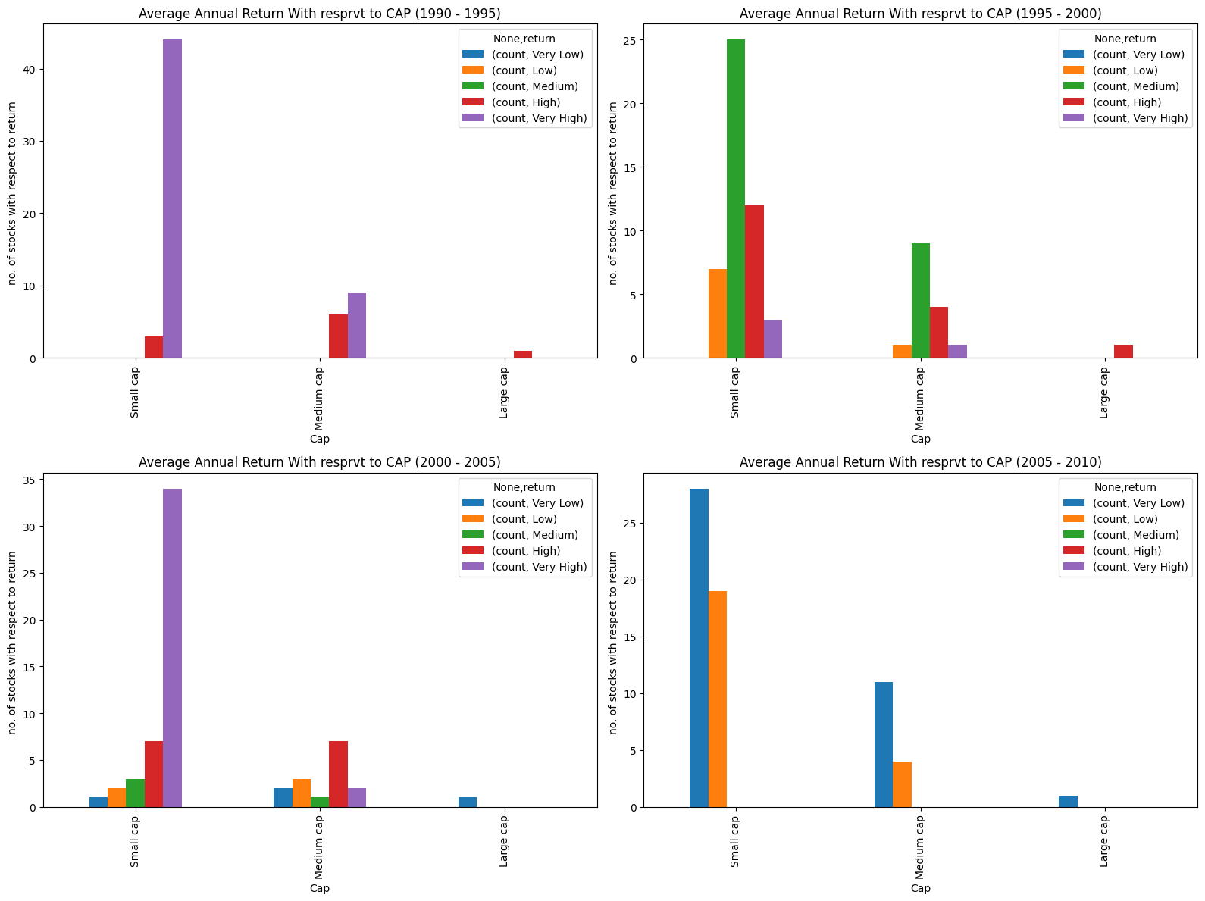
Exploratory Data Analysis:- C) Feature Engineering :-
Comparitively, the trend for all four periods.

Slide 17
Exploratory Data Analysis:- C) Feature Engineering :-
Binning of Total risk% into 5 bins namely “Very low , low , medium , High , Very High “ as represented in the table:
Total Risk | Risk Bin
0 – 8% | Very Low
8 – 11% | Low
11 – 13% | Medium
13-17% | High
17 – 22% | Very High

Slide 18
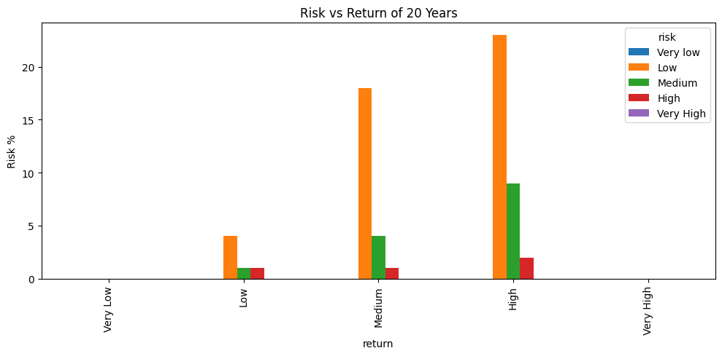
Exploratory Data Analysis:- C) Feature Engineering :-

Slide 19
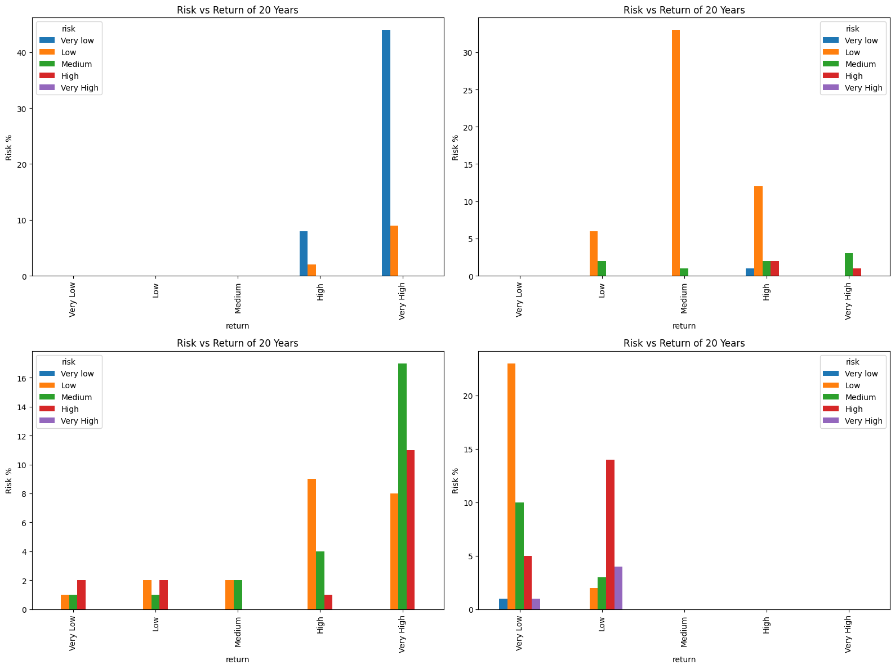
Exploratory Data Analysis:- C) Feature Engineering :-
Trend of total risk of small ,medium and large industries over these four periods like how it is varying.

Slide 20
Exploratory Data Analysis:- C) Feature Engineering :-
Binning of Stocks by analyzing the annual return with Benchmark into “Positive , negative , zero”
Excess return | Sign
>0% | Positive
= 0 | Zero
< 0% | Negative

Slide 21
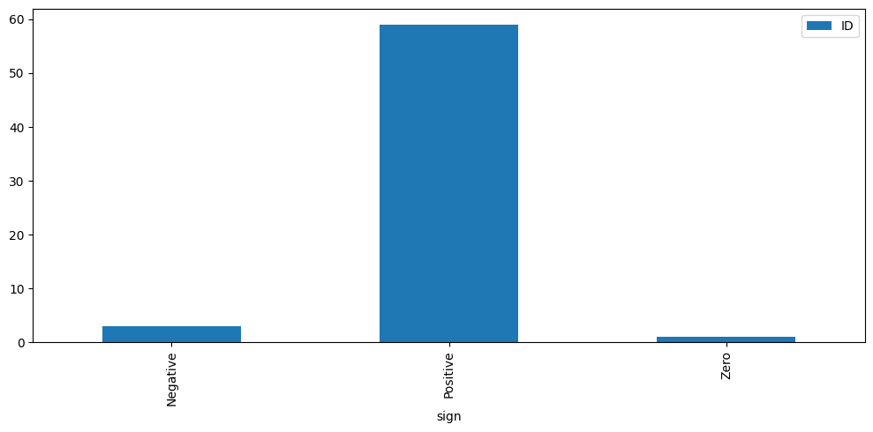
Exploratory Data Analysis:- C) Feature Engineering :-
Over all analysis of stocks analysis over 20 years .
57 stocks have generated more return than Benchmark

Slide 22
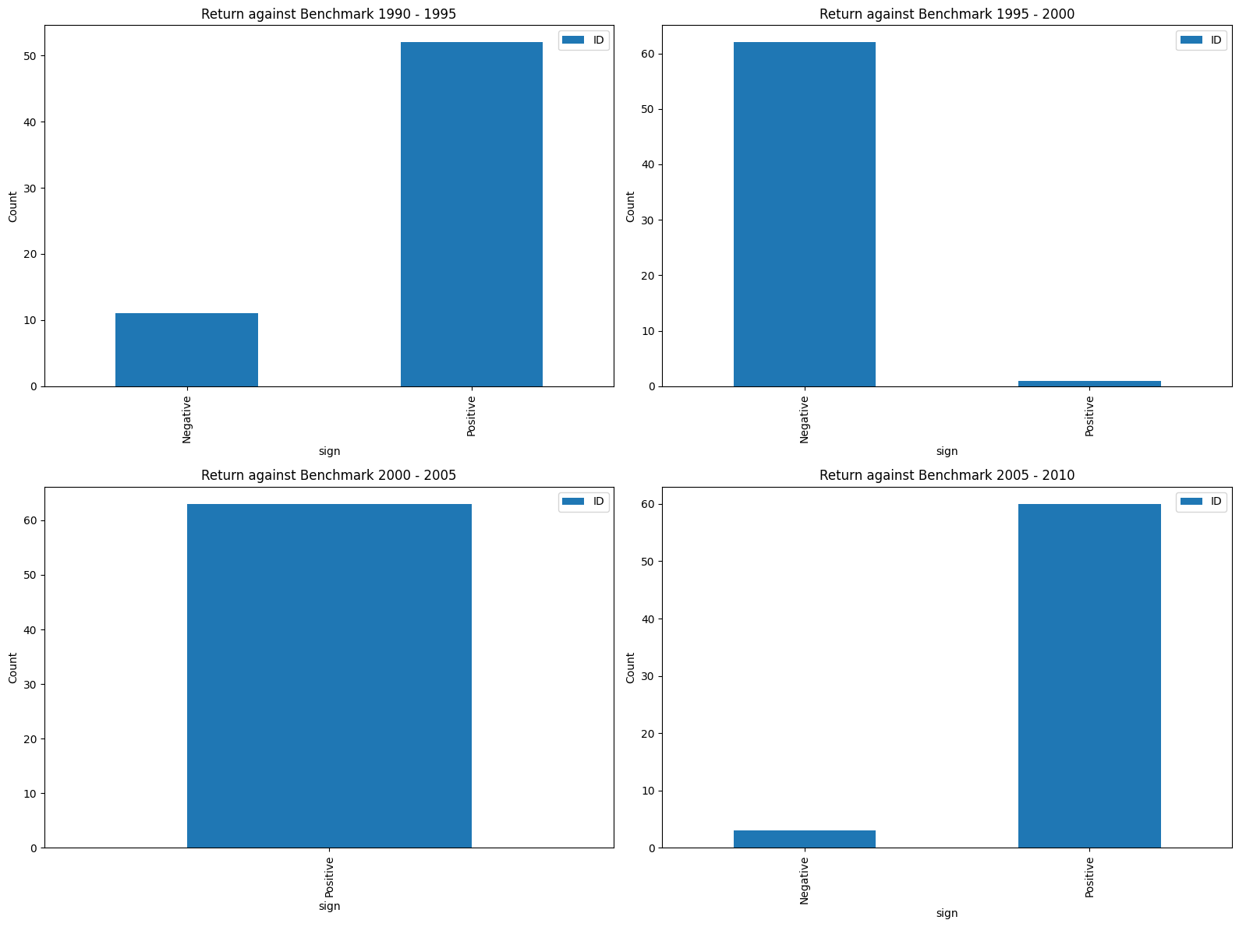
Exploratory Data Analysis:- C) Feature Engineering :-
Analysing stocks beating the benchmark over 20 years with 4 time frames

Slide 23
Principal Component Analysis (PCA)
For dimentionality reduction

Slide 24
PCA:- A)Bartlett's sphericity test:
correlations between variables
H0 : R = I
H1 : R != I
If p < 0.5 : reject H0 (PCA is required)
If p > 0.5: accept H0 (PCA is not required)
Results:
Chi-square value: 749.0536602587168
P-value: 6.429146777304694e-150
PCA is required for the weights as P value is too small.

Slide 25
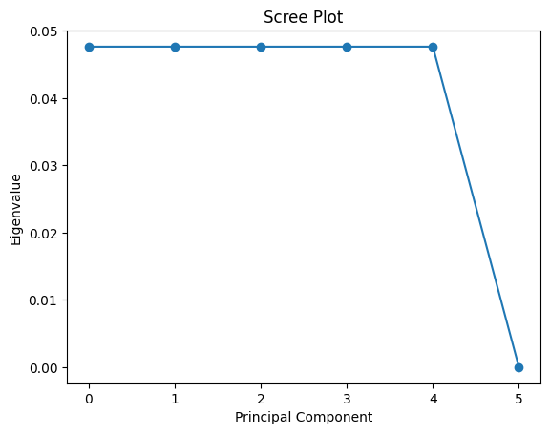
PCA:- B) Scree plot(Elbow method):

Slide 26
Test of Assumptions:- A) Multi-collinearaity:-
VIF (Variance Inflation Factor) is a measure of the degree of multicollinearity in a regression analysis.
VIF of PCA with 5 columns are as follows:
a. VIF of PCA1: 1.00
b. VIF of PCA2: 1.00
c. VIF of PCA3: 1.00
d. VIF of PCA4: 1.00
e. VIF of PCA5: 1.00

Slide 27
Test of Assumptions:- B) Autocorrelation:-
DW Test:-
If DW is two: there is no correlation
If DW > two: there is no correlation
If DW < two: there is no correlation
DW statistic for each column of PCA’s: [1.92880016 1.8952121 1.47743874 2.15861333 2.50857133]
Columns having DW with 1.477 ,2.50 are dropped as they are highly correlated.

Slide 28
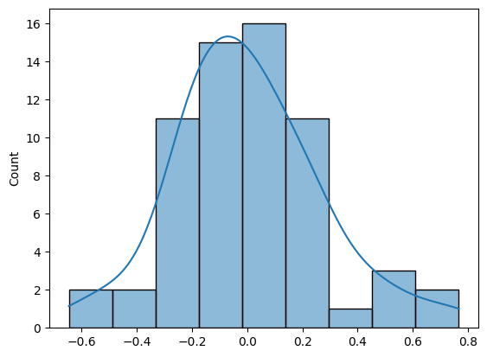
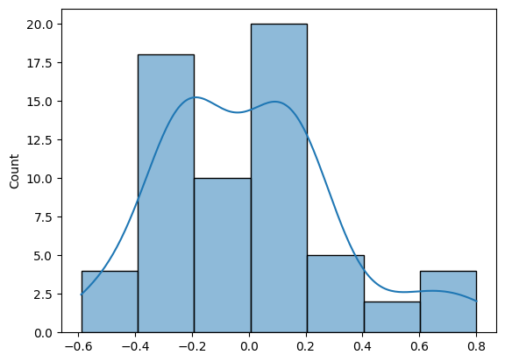
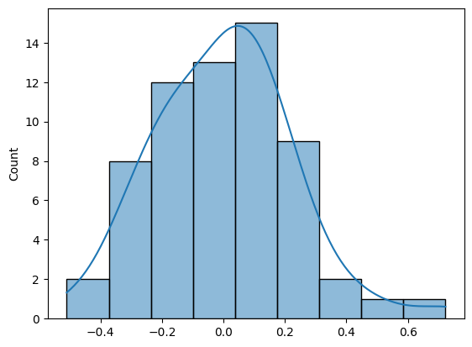
Test of Assumptions:- C)Normality:-
Checking normality and transforming data which is not following normal distribution.

Slide 29
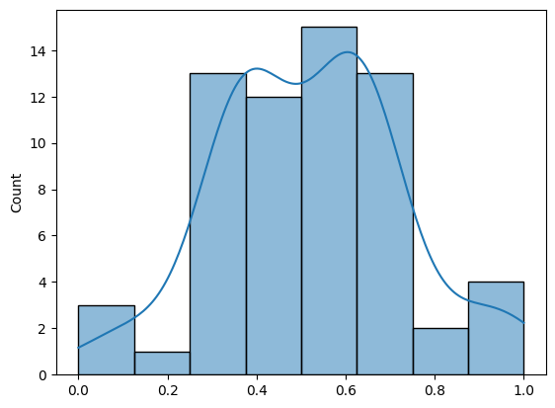
Test of Assumptions:- C)Normality:-
Transforming data

Slide 30
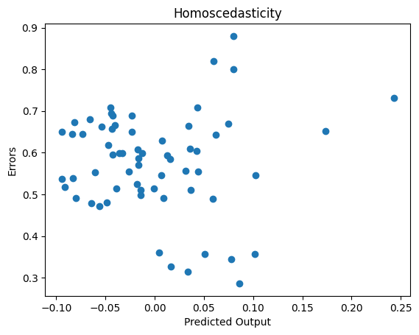
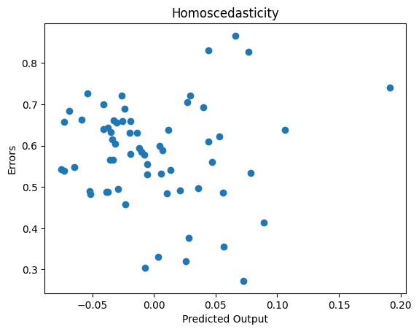
Test of Assumptions:- D) Homoscedasticity:-
Equal variance in the errors or residuals of a statistical model across all levels of the predictor variables.

Slide 31
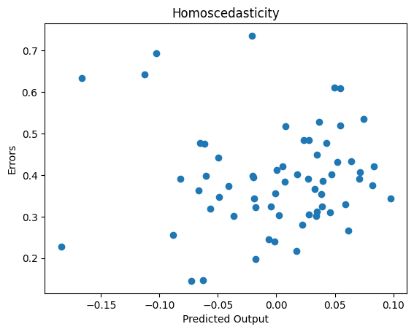
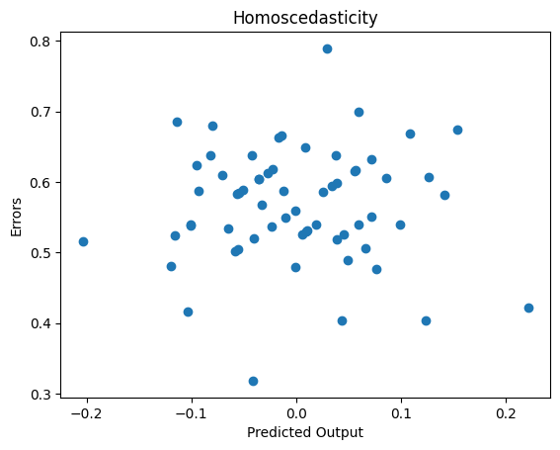
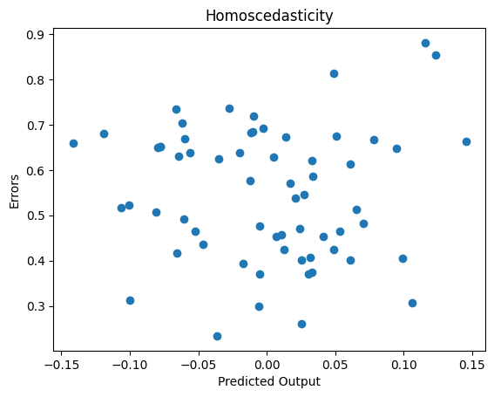
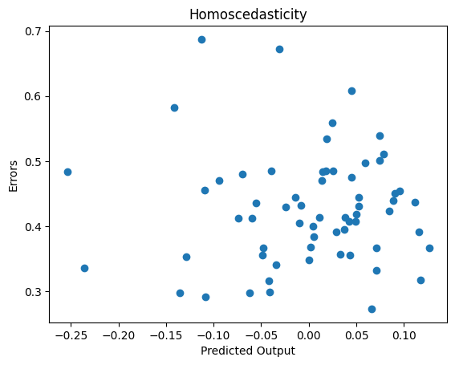
Test of Assumptions:- D) Homoscedasticity:-

Slide 32
Ordinary Least square method (OLS)
Equation of the regression model :
Output = W1 * PCA1 + W2* PCA2 + W3 * PCA3 +Constant
We have build 6 models for prediction of each output variable and check their R square values
Tabulated the R square values of each model

