Slide 1
Prefect-Log
An IOS App – v0.1 (in development)

Slide 2
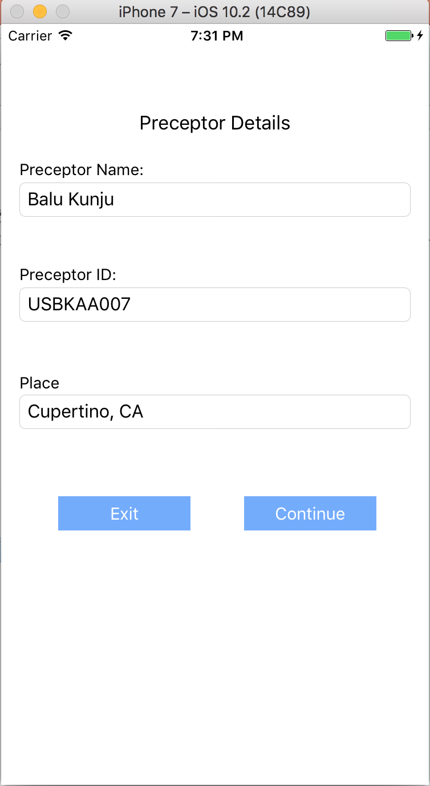
First Screen
Preceptor enters his/her Name/ID/Place details …

Slide 3
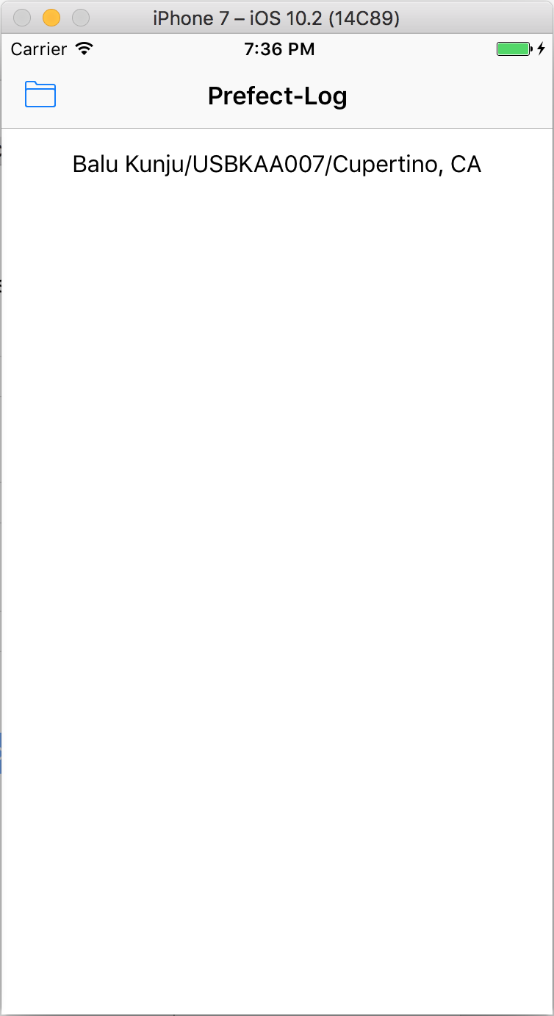
Main Screen
Sittings history screen (Yet to be implemented)

Slide 4
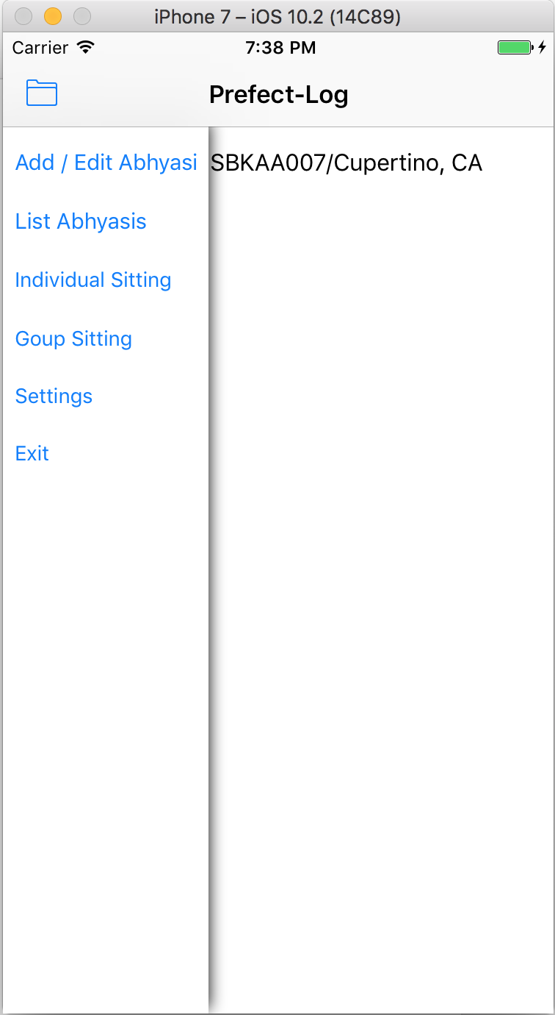
Settings Slide-Out Menu
Clicking on the folder icon will open up the slide-out menu

Slide 5
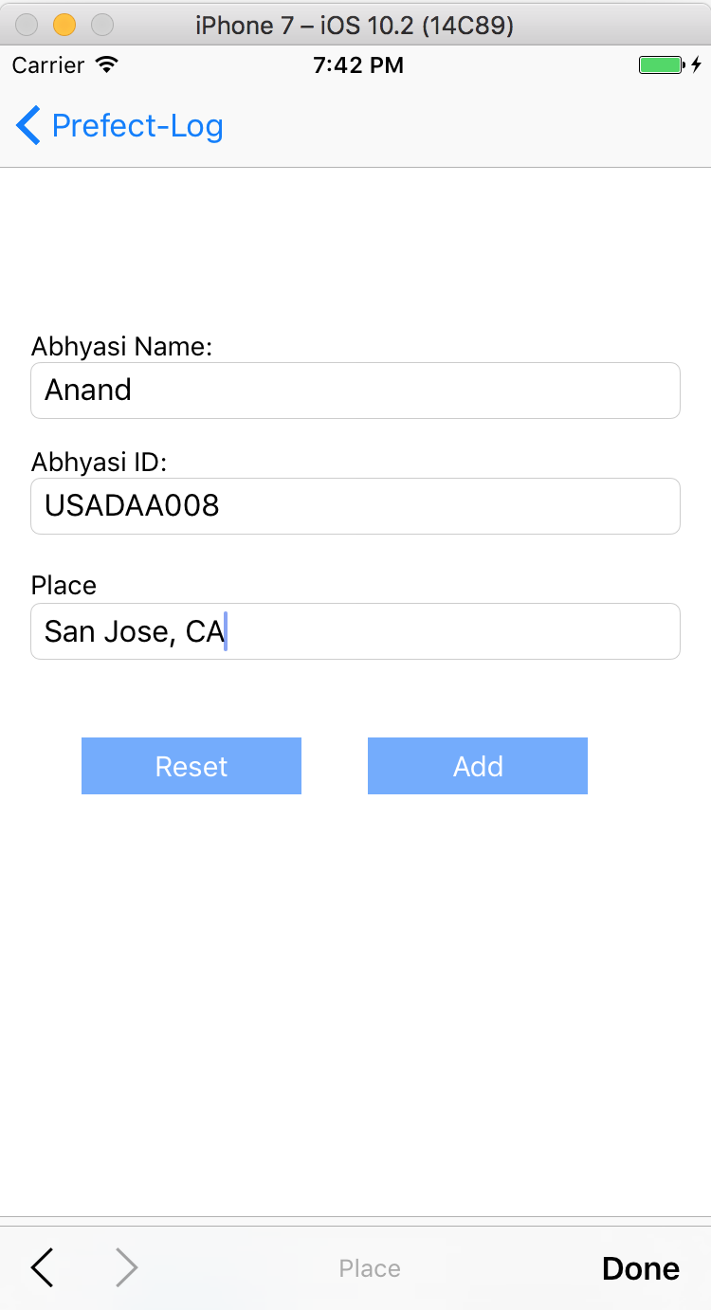
Add / Edit Abhyasi Menu
Select Add / Edit Menu Item to add or edit the abhyasi details

Slide 6
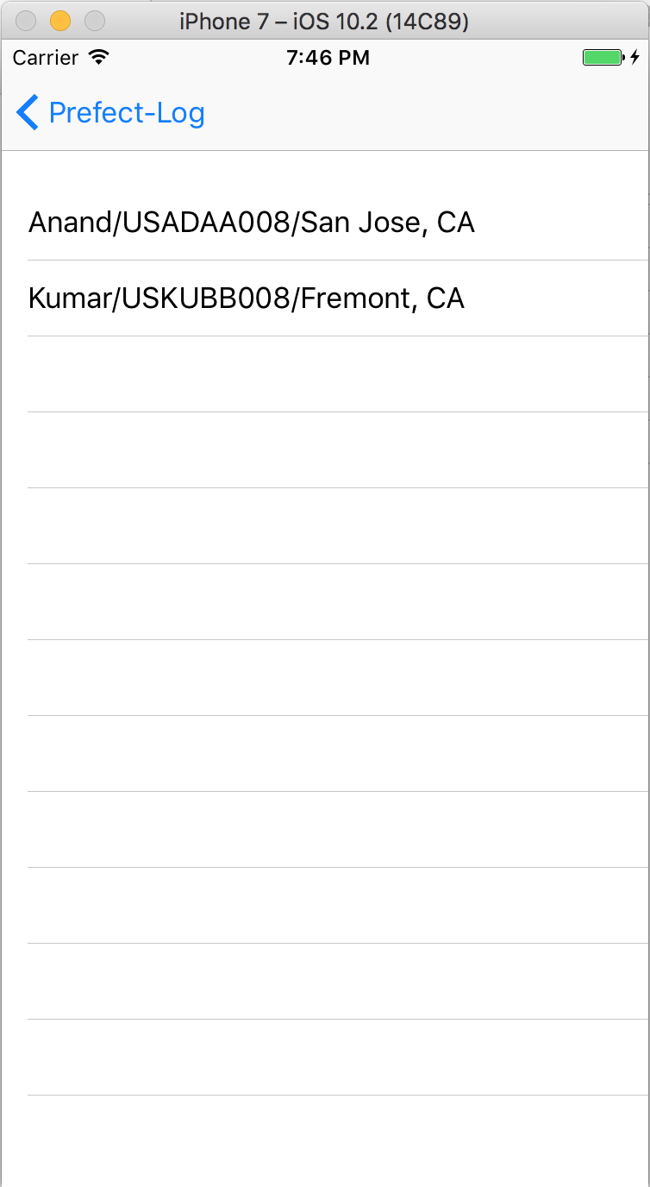
List Abhyasi Screen
Select List Abhyasi Menu Item to list all the abhyasis

Slide 7
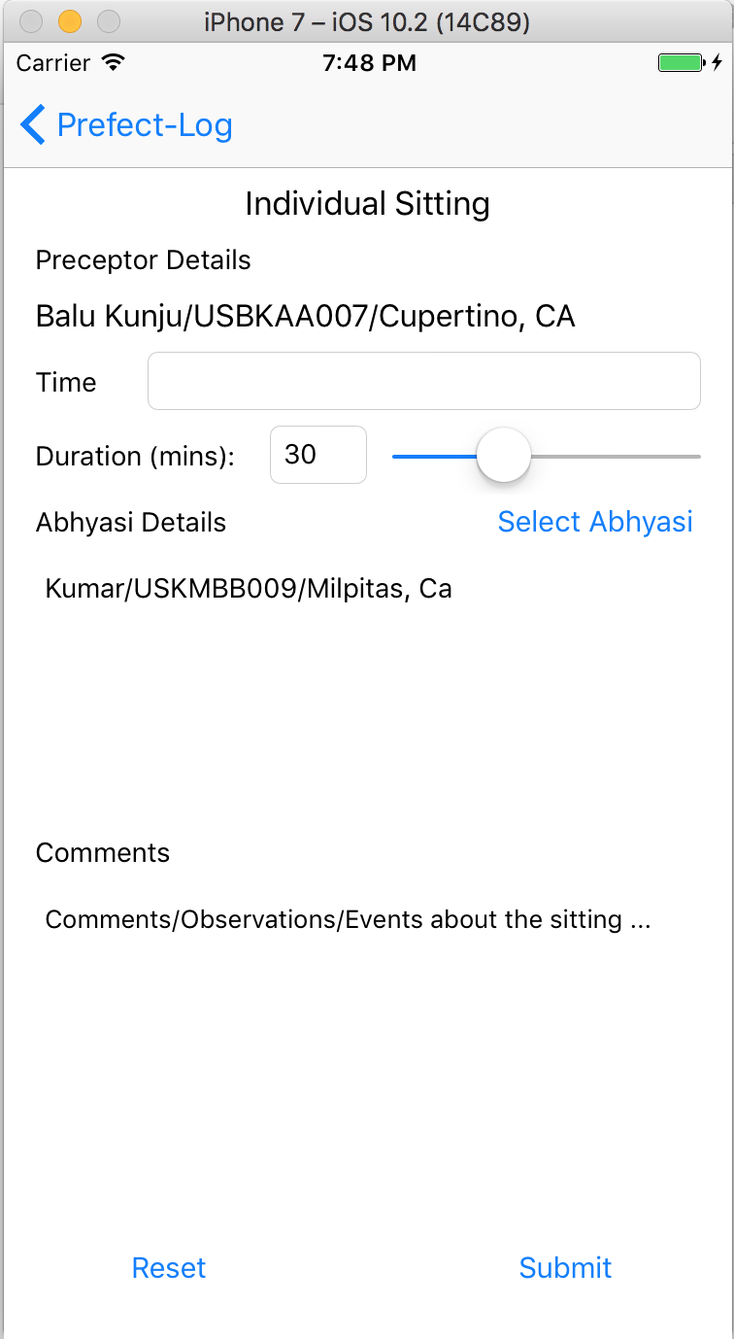
Log Individual Sitting
Enter details about the individual sitting

Slide 8
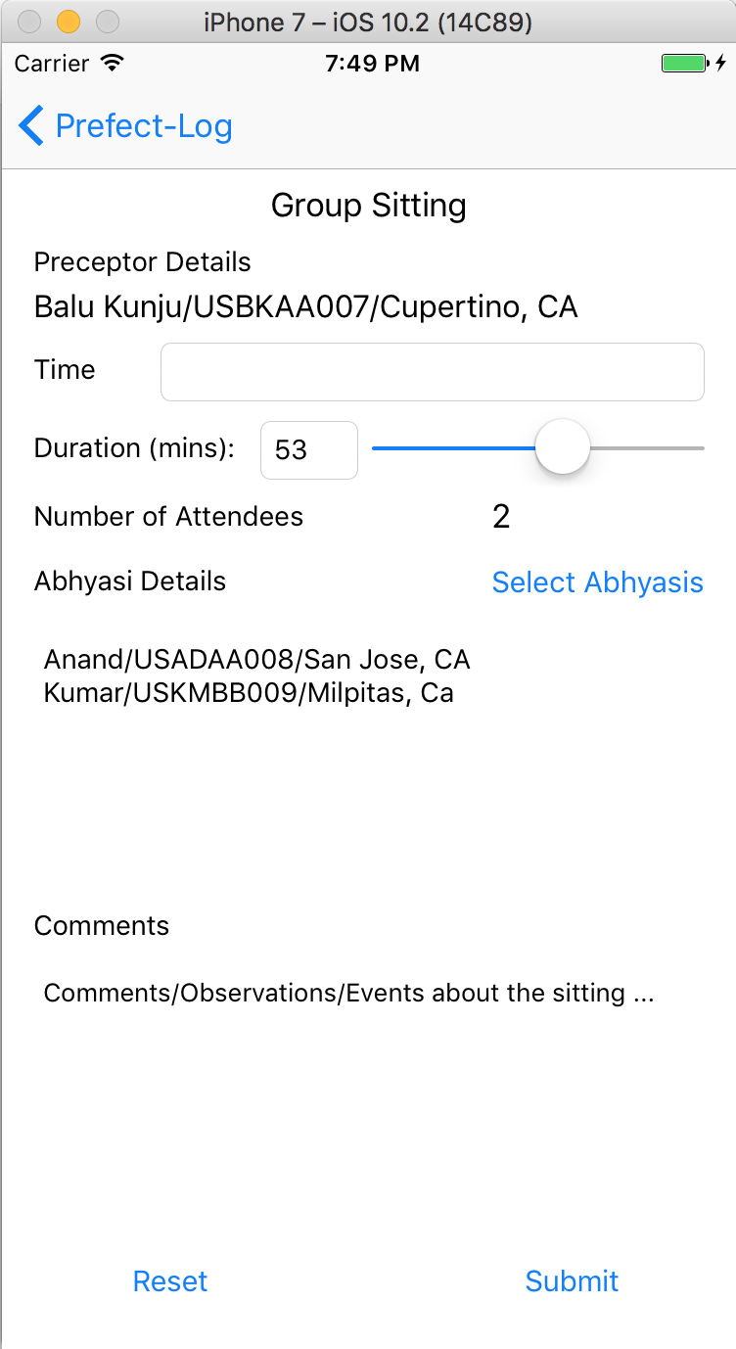
Log Group Sitting
Enter details about the group sitting

Slide 9
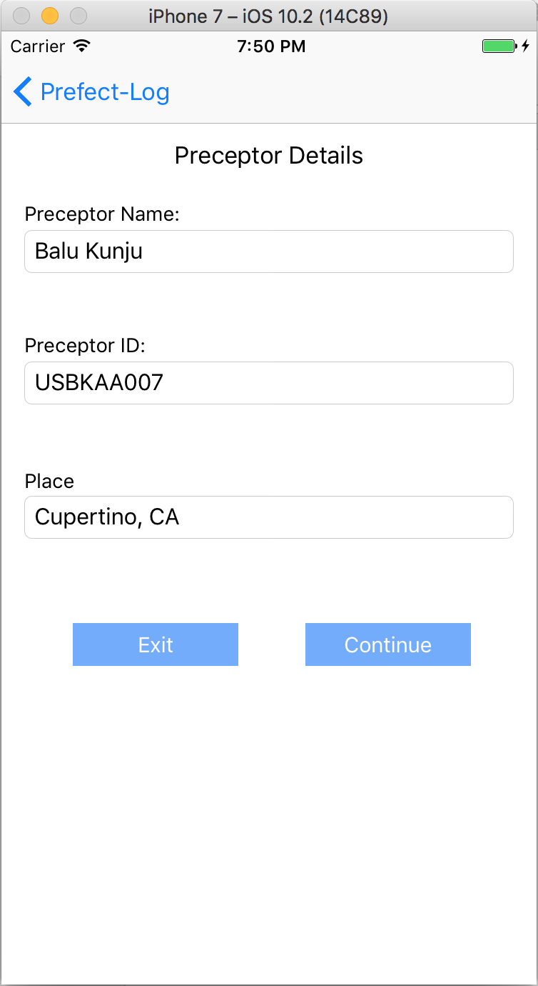
Settings Screen

