Slide 2
Content
What is RAG?
Limitations of Traditional Language Models
How RAG Addresses These Limitations ?
Exaplanation of Flow Chart
Different Scenarios

Slide 3
Introduction
Power of traditional language models
+
External information sources
First retrieve relevant information, and then use a generative model to create a response.
Knowledge beyond Pre-trained data.

Slide 4
Limitations of Traditional Language Models
Lack of Up-to-Date Information
Factual Errors
Limited Contextual Understanding
Contextual Understanding Examples:
Bank - Context of finance (or) river
Mouse - Context of computer (or) biology
Spring - Context of season (or) mechanics.

Slide 5
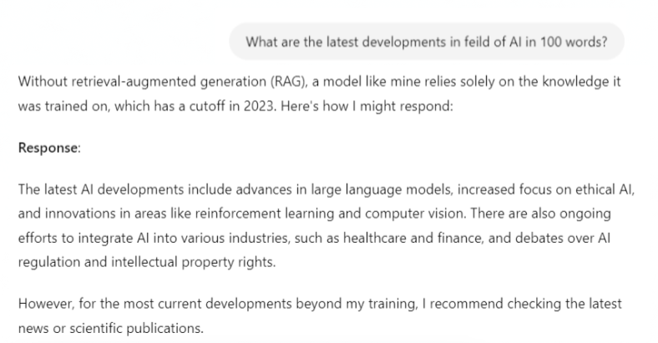
Output of a model without RAG

Slide 6
How RAG Addresses These Limitations ?
Up-to-date information
Improved Accuracy
Enhanced Contextual Understanding
Source verification

Slide 7
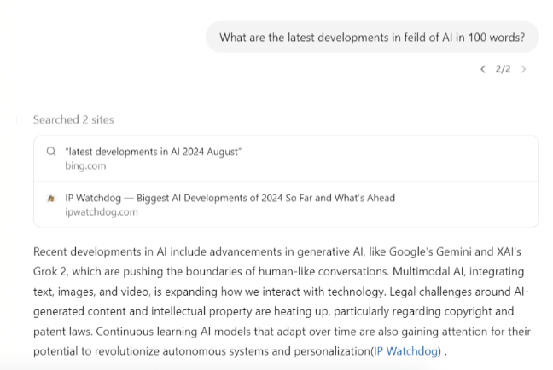
Output of a model with RAG

Slide 8
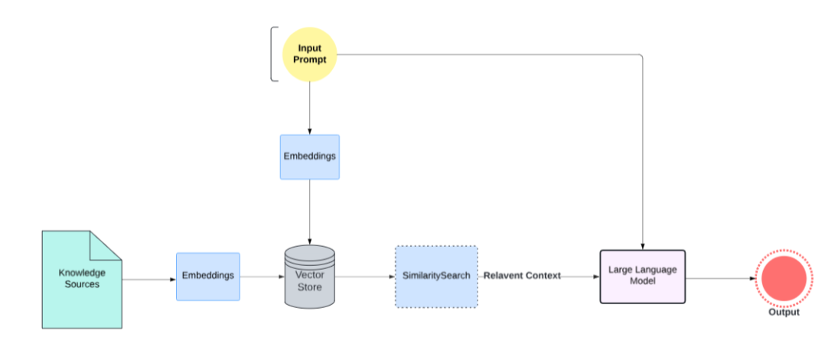
Flowchart

Slide 9
Input Processing
The process begins when an input query or prompt is provided to the system.
Example:
Input: The user asks, "What are the benefits of using solar energy?"

Slide 10
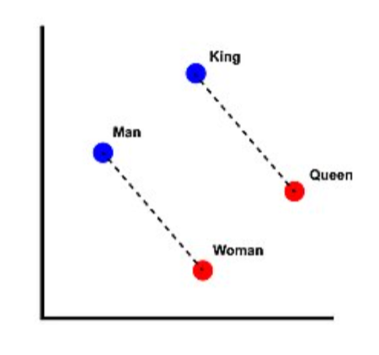
Embeddings
Embeddings are dense, fixed-size vector representations of data.
They capture the semantic meaning of the input in a high-dimensional space.
Less Distance, More Similarity.
Types of Embeddings:
Word2Vec/Glove
Transformer-based - BERT, RoBERTa,SBERT

Slide 11
Embeddings for Knowledge Sources
Knowledge sources and Input Query are embedded with the same model.
To make this efficient, large documents are often split into smaller chunks
Types of Chunking:
Fixed-Length Chunks: Ex - 512 tokens.
Semantic Chunks: Natural boundaries like paragraphs or sections

Slide 12
Vector Store
Indexes all embeddings
Allows for efficient retrieval using similarity measures like Cosine similarity, Euclidean distance, etc.
Examples:
FAISS (Facebook AI Similarity Search)
Annoy (Approximate Nearest Neighbors Oh Yeah)
Elasticsearch with Dense Vectors
Pinecone

Slide 13
Retrieval Phase
Encoding the Query: encoded into a vector representation (often a Transformer-based model).
Searching a Corpus: The encoded query is then used to search a large corpus of documents, databases, or text sources
Selecting Relevant Passages: The system retrieves the top-N most relevant passages or documents.
Example:
The system encodes this query and searches a large database of documents about energy, climate, and sustainability.
It retrieves passages from articles or studies that discuss the benefits of solar energy, such as cost savings, environmental impact, and energy independence.

Slide 14
Generative Model
It refers to the large language model (LLM) that generates coherent and contextually relevant text based content.
Examples:
GPT Series (e.g., GPT-3, GPT-4)
T5 (Text-to-Text Transfer Transformer)
BART (Bidirectional and Auto-Regressive Transformers)

Slide 15
Generation Phase
Contextual Input Construction: The retrieved passages are combined with the original input query to create a new, enriched input for the generative model.
How it Works:
The model first generates a draft response based on the input.
The relevant context is integrated to refine and enhance the response.

Slide 16
Generation Phase
Generating a Response: The generative model can now produce text that is grounded in the retrieved information, making the output more accurate and contextually relevant.
Example:
The generative model uses this information to produce a detailed response, such as: "Solar energy offers several benefits, including reduced electricity bills, lower carbon emissions, and energy independence. By harnessing sunlight, households and businesses can save on energy costs and contribute to a more sustainable environment."

Slide 17

Hypothetical Scenario
RAG and a Travel Agent:
Imagine you're planning a trip to Europe. You have a specific set of preferences: you want to visit historical sites, enjoy local cuisine, and stay in budget-friendly accommodations.
Traditional Approach:
Limited Knowledge
RAG-Enhanced Travel Agent:
Access to Vast Information
Personalized Recommendations
Real-Time Updates

