Slide 1
AWS
Amazon Web Services

Slide 2
History

Slide 3
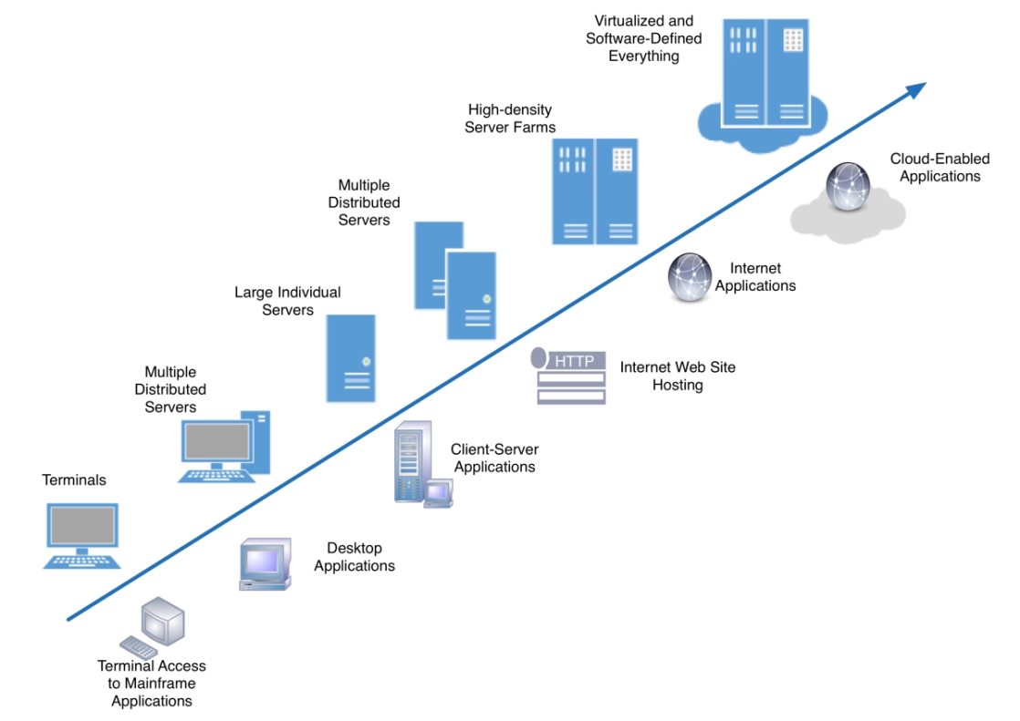

Slide 4

Client-Server Computing Concepts

Slide 5
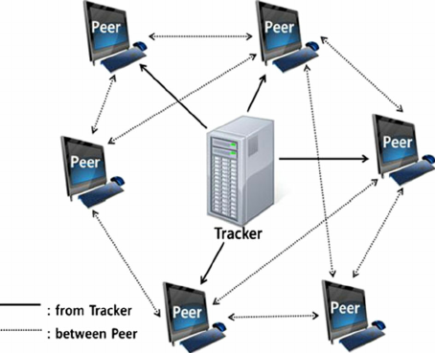
Peer to Peer Computing (P2P)

Slide 6
P2P vs Client Server
Basic | There is a specific server and specific clients connected to the server. | Clients and server are not distinguished; each node act as client and server.
Service | The client request for service and server respond with the service. | Each node can request for services and can also provide the services.
Focus | Sharing the information. | Connectivity.
Data | The data is stored in a centralized server. | Each peer has its own data.
Server | When several clients request for the services simultaneously, a server can get bottlenecked. | As the services are provided by several servers distributed in the peer-to-peer system, a server in not bottlenecked.
Expense | The client-server are expensive to implement. | Peer-to-peer are less expensive to implement.
Stability | Client-Server is more stable and scalable. | Peer-to Peer suffers if the number of peers increases in the system.

Slide 7
What is Cloud Computing?
Cloud Computing is a general term used to describe a new class of network based computing that takes place over the Internet,
basically a step on from Utility Computing
a collection/group of integrated and networked hardware, software and Internet infrastructure (called a platform).
Using the Internet for communication and transport provides hardware, software and networking services to clients
These platforms hide the complexity and details of the underlying infrastructure from users and applications by providing very simple graphical interface or API (Applications Programming Interface).

Slide 8
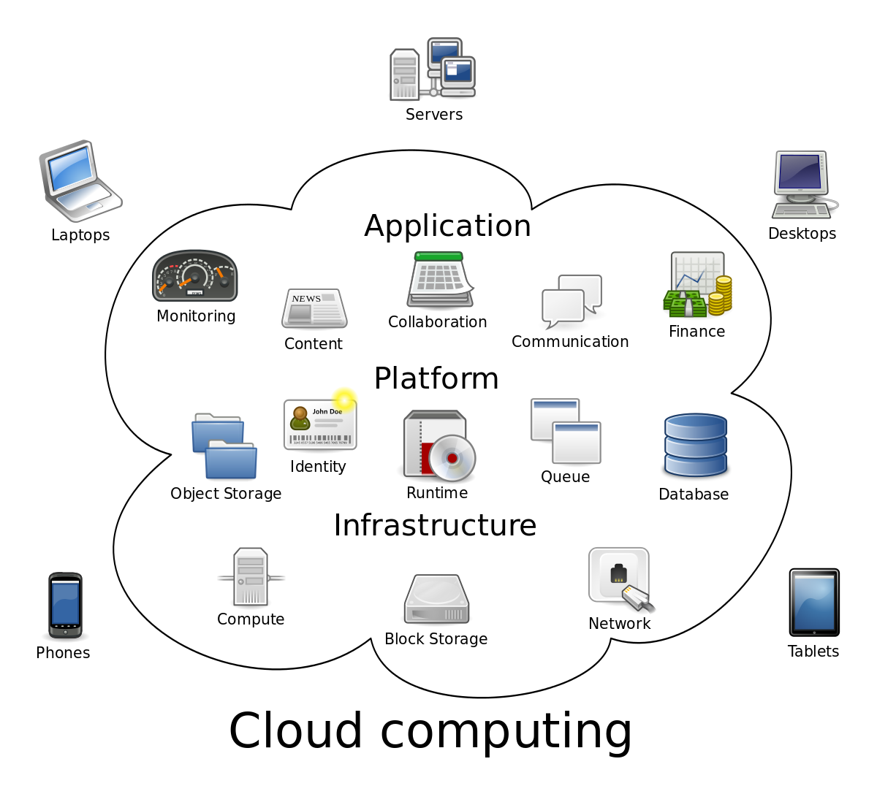
What is Cloud Computing?
Shared pool of configurable computing resources
On-demand network access
Provisioned by the Service Provider

Slide 9
What is Cloud Computing?
In addition, the platform provides on demand services, that are always on, anywhere, anytime and any place.
Pay for use and as needed, elastic
scale up and down in capacity and functionalities
The hardware and software services are available to
general public, enterprises, corporations and businesses markets

Slide 10
Cloud Summary
Cloud computing is an umbrella term used to refer to Internet based development and services
A number of characteristics define cloud data, applications services and infrastructure:
Remotely hosted: Services or data are hosted on remote infrastructure.
Ubiquitous: Services or data are available from anywhere.
Commodified: The result is a utility computing model similar to traditional that of traditional utilities, like gas and electricity - you pay for what you would want!

Slide 11
Cloud Computing Characteristics
Common Characteristics:
Massive Scale
Resilient Computing
Homogeneity
Geographic Distribution
Virtualization
Service Orientation
Low Cost Software
Advanced Security
Essential Characteristics:
On Demand Self-Service
Broad Network Access
Rapid Elasticity
Resource Pooling
Measured Service
Adopted from: Effectively and Securely Using the Cloud Computing Paradigm by peter Mell, Tim Grance
11

Slide 12
Cloud Computing Deployment Models

Slide 13
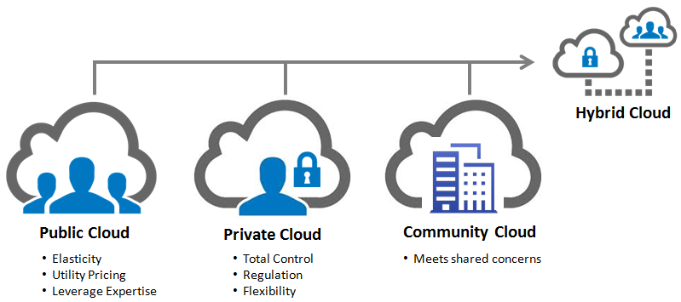

Slide 14
Cloud Delivery/Service Models

Slide 15
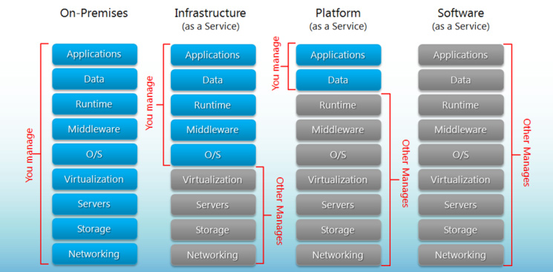

Slide 16
Challenges with Distributed Computing
Heterogeneity
Openness
Security
Confidentiality
Integration
Availability
Scalability
Fault handling
Concurrency
Transparency

Slide 17
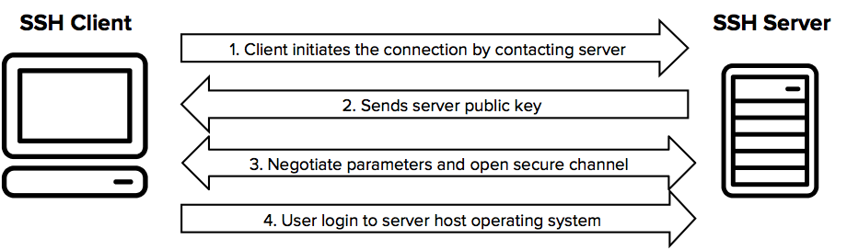
How SSH Works

Slide 18
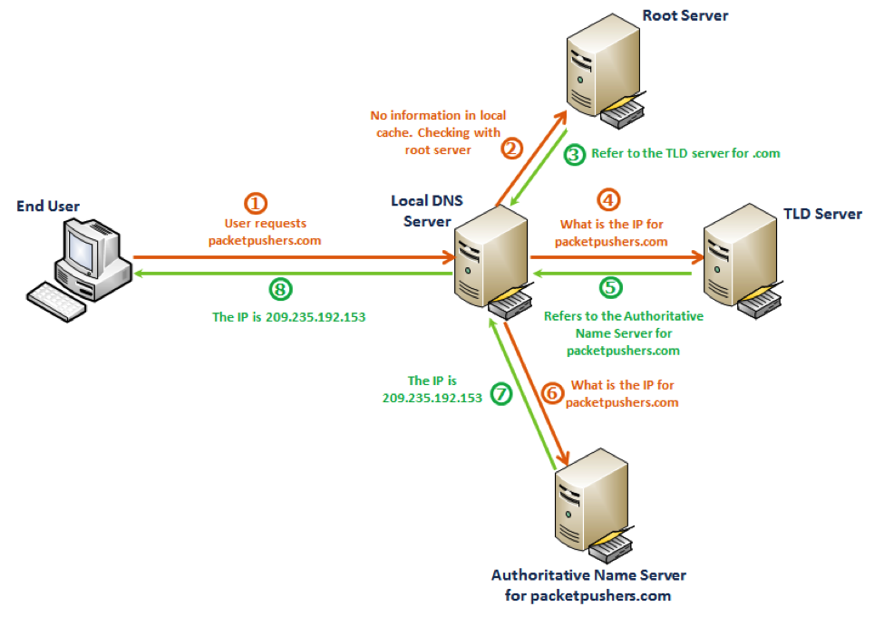
How DNS Works

Slide 19
VPC

Slide 20
VPC
Amazon VPC is your own private network inside Amazon’s cloud infrastructure. It is an alternative to maintaining your own data centre and is cheaper since it creates resources on demand. It is also more secure since Amazon takes care of the infrastructure security for you.

Slide 21
VPC Features
AWS VPC is flexible to connectivity as it can get connected to the Internet, data centre based on AWS resources that one can expose publically and those which one has to keep private.
It privately connects to the Software as service solutions which Is supported by AWS Private link.
Ability to privately connect the VPCs within your own organizations and internal services across different accounts.
Privately connect to Virtual Private Network without using an Internet gateway.
Peer VPCs together to share resources across multiple virtual networks owned by the owner or other AWS accounts.
Using network access control list inbound and outbound access to and from individual subnets is controlled.
It provides a feature of security such that the data stored in Amazon S3 can only be accessed from within your Amazon VPC.
Using VPC peering you can connect your AWS VPC with other VPCs and access resources in the other VPCs.

Slide 22
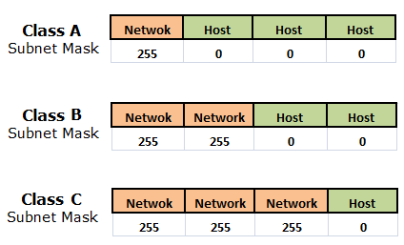
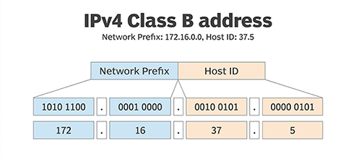
Subnet
Subnet is a part of your VPC that can contain resources that share a common subnet mask and that contain instances and resources that can normally only be accessed within that subnet except if you use an internet gateway to make them public.

Slide 23
Internet Gateway
An Internet Gateway allows you to make a subnet public by providing a route to the internet. All instances within the subnet can access the internet only through this gateway. Also, resources from the internet can access the instances in your subnet using this gateway.
NAT Gateway
You can allow instances from your private subnet to connect to the internet using a NAT gateway. The instances in the private subnet do not have an IP address, so the NAT gateway translates the private IP to a public IP before routing the traffic out to the internet. NAT stands for Network Address Translation and it does just that – translates private IPs to public IP.

Slide 24
CIDR block
CIDR or Classless Inter-Domain Routing is used to allocate IP address within a network. We will use CIDR blocks to mark a range of IP addresses for each subnet within a VPC. The VPC itself would have a CIDR block that lists all the IP addresses available with it.
What is a Route table
A route table contains rules for routing traffic within a subnet and from the subnet to outside world. Amongst other things, we use routing tables to add internet gateways and NAT gateways to the subnet.

