Slide 1
Git / GitLab

Slide 2
Summery
Introduction
VCS: Version Control System
Git vs SVN
Historical Git
Setting in square Git
routines Git
Advanced features Git
GitLab: It is what ?
GitLab features
Management of the branches
Sweater request
Internal outcome / Review System
Git Tips
Demo

Slide 3
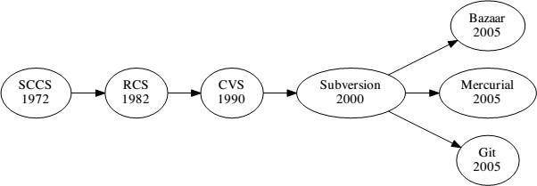
INTRODUCTION

Slide 4
INTRODUCTION
Two type of management of version:
Centralized Revision Control System (CVCS )
Distributed Version Control System (DVCS)

Slide 5














GIT vs SVN
Git vs SVN
commit
update
repo SVN
Dev1
Dev2
commit
Push
repo cenottratlised GIT
clone
repo GIT
Dev1
Dev2

Slide 6
GIT vs SVN
Centralized Revision Control System (CVCS )
CVS, SVN ...
Architecture customer server
A alone repository
A server central contains all the data
A lot of queries enter the customer and the server (enough slow)
Addiction of server ( check out)

Slide 7
GIT VS SVN
- Distributed Version Control System (DVCS)
Git, mercurial
All the data are sure our machine
The operations are very rapid
Log in Internet only for the sweater and push

Slide 8
Historical GIT
Git History:
created in April 2005 by Linus Torvalds
Goal : manage the workflow integration of the patches of core Linux
Replace BitKeeper
In May 2013 36 % of professional uses Git

Slide 9







Git configuration
Config
git config --global user.name "test"
git config --global user.email "xyxyx@ysz.com"
initialisation
# mkdir saas
# cd saas
# git init
Clone the deposit
# git clone " url filing "
#We can specied a name of deposit
git clone url myrepository

Slide 10
Git configuration (Gitignore)
gitignore :
data sensitive or useless
Create / Edit the .gitignore at the root of project
Examples of files at ignore:
# / saas /
/ saas / data
/ saas / log
/ saas / roles
/ saas / temp
lib.so : the file lib.so will be unknown
* .class : all the files in .class will ignored
conf / : all the files folder conf will ignored
conf / ** / *. yml : all the files . ymlof all the subfolders of conf / will ignored

Slide 11
Git workflow
Status of file
checkout
Working directory
Staging area
Repository
Untracked modified
Statged
Committed

Slide 12



Git workflow
staging area
#affiche the status of the working directory and staging area
git status
# adds a file at the staging area
git add
#: unstage new file
git rm --cached
git checkout -: took of a file the staging area

Slide 13






Git workflow
commit:
Each commit is unique: hashed (Revision dan SVN)
git commit -m "my comment of commit "
# generates a commit with the amendments contained in #The staging area
git commit -a -m "comment of commit "
# added all the files modified (not additions / #suppressions) at the staging areaet commite)
Revert
Pushed to Revert # commit
git revert <Commit_hash>

Slide 14
Git workflow
Status file abstract
untracked
git commit
git add
git status
statged

Slide 15

routines Git
Git push
git push origin master #branche Master
git push origin nouvelleBranche new # plugged

Slide 16
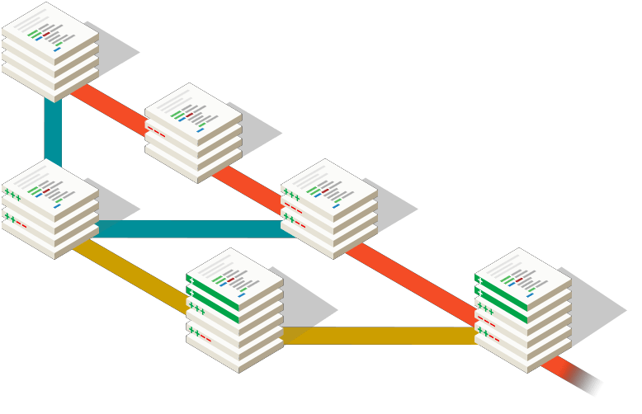
Management of the branches

Slide 17



Management of the branches
Management of the branches
git push origin master #branche Master
git push origin nouvelleBranche new # plugged
setting at day of branch
# I developed and commits on my plugged local
# But the origin of my branch (the master for example) has also evolved !
git checkout Master
git pull
git checkout nouvelleBranche
git rebase master nouvelleBranche

Slide 18



Management of the branches
Management of the branches
git checkout Master
# I dev on the master (as I shall have a crééer plugged)
...
git commit -am "I committed on the master "
# I see myself
git branch newFeature
# Now I have to put the master "clean" # If I still want to keep files
git reset --soft HEAD ~ 1
# If I do not want to keep files
git reset --hard HEAD ~ 1

Slide 19
Management of the branches
lister the branches:
git branch
recover branches remote:
git fetch
lister the branches remote:
git branch -at

Slide 20
Management of the branches
Management of the Conflicts
git checkout --theirs <File>
git checkout --bear <File>
git add *
git commit

Slide 21
Management of the tags
lister the branches:
git tag V0.1
lister Branches remote:
git tag

Slide 22
Migrate svn to git
Migration SVN to Git:
git svn clone http: // svn / repo / here / trunk demo

Slide 23








Migrate svn to git
Remove branch / tag local
git tag -d 1.0
git branch -d nouvelleBranche
Remove branch / tag distant
git push origin : 1.0
git push origin :plugged
Other orders
git checkout Master
git tag -a 1.0 -m "Stable release 1.0 ' git push origin 1.0
git rm
git rm -cached git fetch

Slide 24
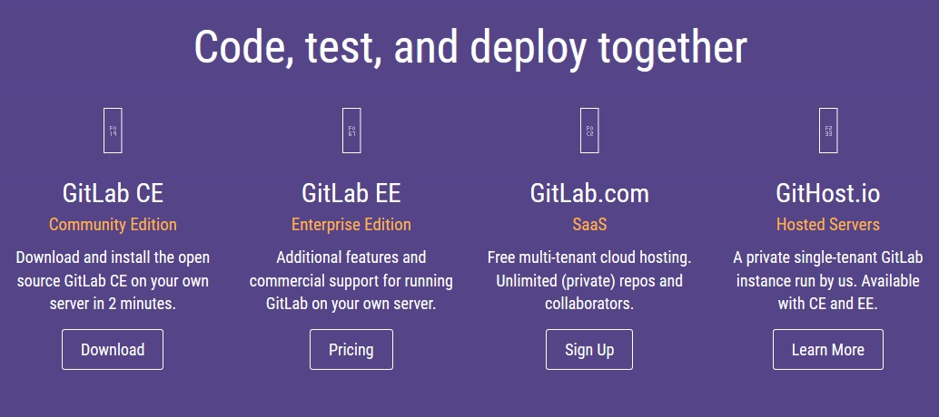
GitLab

Slide 25
Git Lab

Slide 26
GitLab
Interface web for git
clone of GitHub
Management of the rest: public, private, internal
Code review
outcome tracking
25,000 users we at single server

Slide 27
GitLab workflow
Git lab workflow:
Clone the repository
Edit, commit and push
Create Merge Request
Reviewer comments
Merge branch

Slide 28
Git Lab
View commit

Slide 29
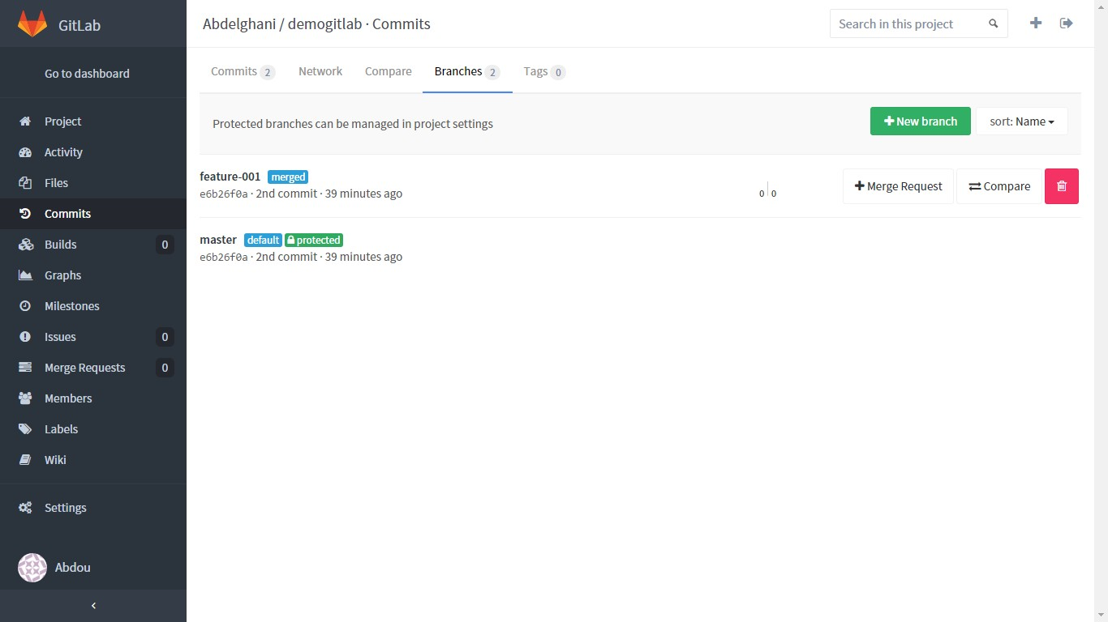
Git Lab
adding plugged

Slide 30
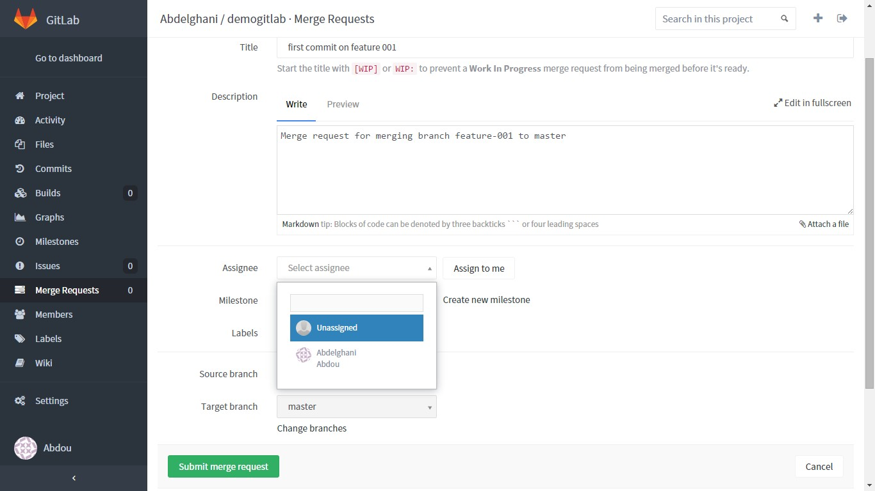
Git Lab
Pull Request

Slide 31
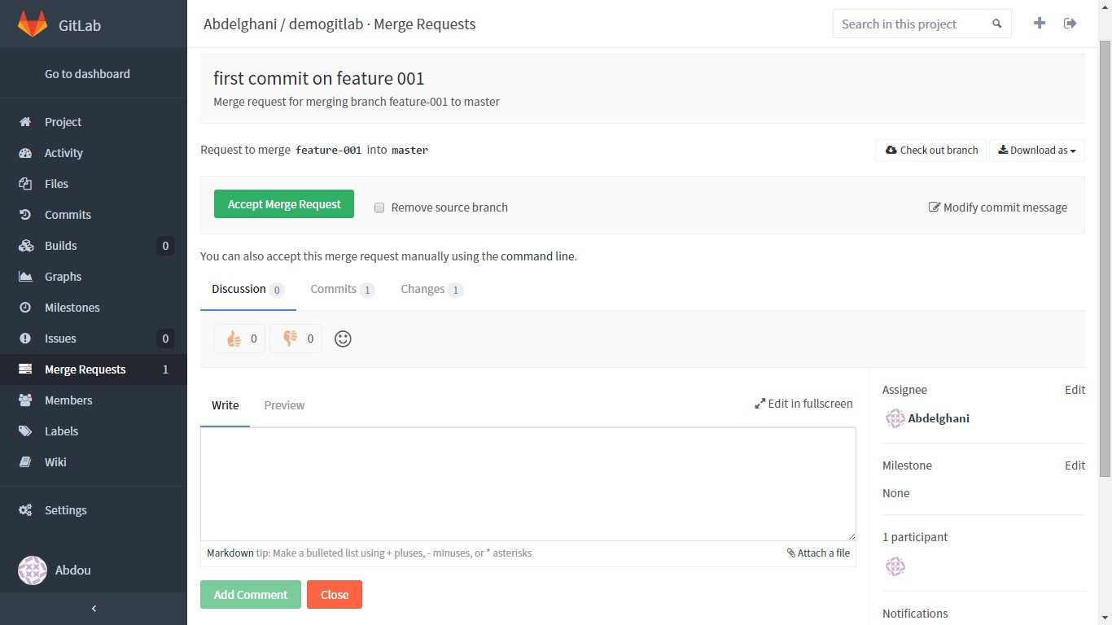
Git Lab

Slide 32
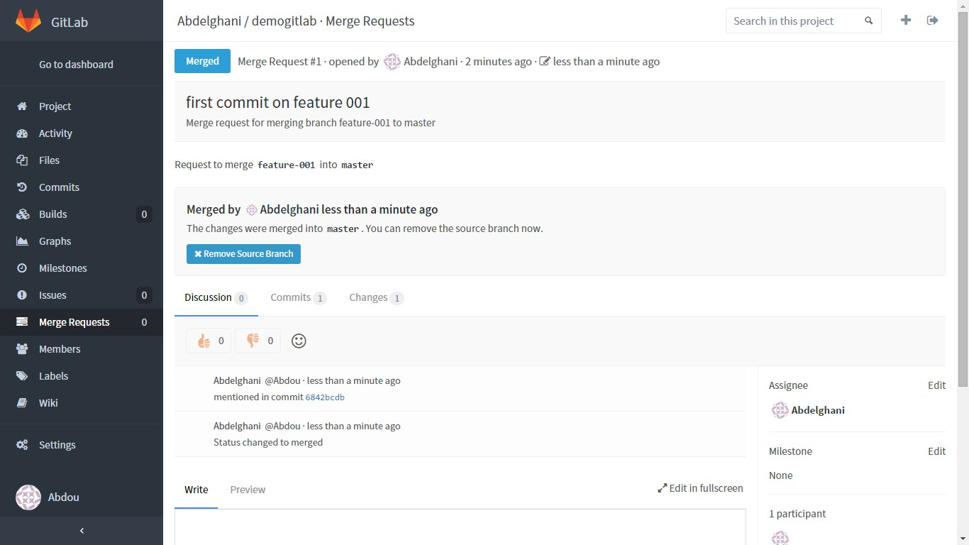
Git Lab

Slide 33
Git Tips
How to know impushed commit
How to postponement at single commit
Best practices

Slide 34






Git Tips
Before push commits:
# I did commit C1, C2
git pull -rebase
#Then we can publish:
git push
Correct the commits
# I did commit C1 git commit -am "C1" # To change commit git Amend

Slide 35



Git Tips
Before push commits:
Revert all # exchange
git --hard reset HEAD ^ # reset 1 commits
git --hard reset HEAD ~ 5 (reset 5 commits)
# Commits not published
git log origin / master..HEAD

Slide 36



Git Tips
Before push commits:
#I am the master and I commits on the plugged B1 The commit time being #hash hash_commit
#(by example). # I do a
git checkout master"# To return to the trunk (the master branch). I run #Puis :
git cherry-pick hash_commit

Slide 37






Git Tips
Git log :
# Indicates the author of each line of a file
git blame <File>
# Visualier the commit
git log
git log commit id_commit1..id_commit2 # id1 den and id2
#Visualier content commit
git show
git diff # id_commit diff between working copy and commit git diff id_commit1 id_commit2 # diff between two commits
Git grep
Search for text in # a file
git grep <text> [<Ref>]

Slide 38






Git Tips
# Create a patch (last n commits)
git-size patch [-not]
# Apply patch
git apply <Patch>
git checkout brancheRecette
# I dev few corrections minor ...
...
# Obviously absolute emergency! Correction to do and push on the serverof recipe.
git stash
# I do my patch urgent
...
git commit -am "urgent Fix!" git push
git stash apply
# I continue corrections minor.
...

Slide 39
Thank you

