Slide 1
Maven

Slide 2
Introduction
Maven is a project management and comprehension tool that provides developers a complete build lifecycle framework. Development team can automate the project's build infrastructure in almost no time as Maven uses a standard directory layout and a default build lifecycle.
Maven provides developers ways to manage the following −
Builds
Documentation
Reporting
Dependencies
SCMs
Releases
Distribution
Mailing list

Slide 3
Features of Maven
Simple project setup that follows best practices.
Consistent usage across all projects.
Dependency management including automatic updating.
A large and growing repository of libraries.
Extensible, with the ability to easily write plugins in Java or scripting languages.
Instant access to new features with little or no extra configuration.
Automatic parent versioning − No need to specify the parent in the sub module for maintenance.
Better Error and Integrity Reporting − Maven improved error reporting, and it provides you with a link to the Maven wiki page where you will get full description of the error.

Slide 4
Java
Check version
Java -version
Set JAVA Environment
export JAVA_HOME=/usr/local/java-version
export PATH=$PATH:$JAVA_HOME/bin/
Maven
Set Maven Environment Variables
export M2_HOME=/usr/local/apache-maven/apache-maven-x.y.z
export M2=$M2_HOME/bin
Set Maven bin path
export PATH=$M2:$PATH

Slide 5
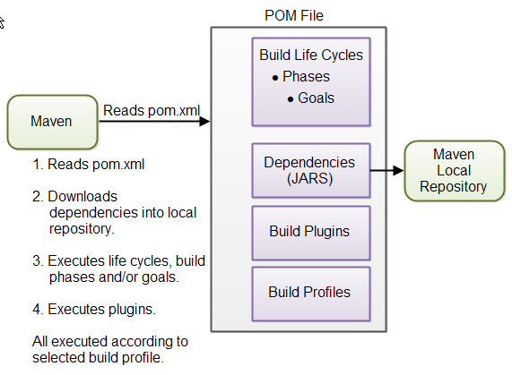
Maven Overview - Core Concepts

Slide 6
Maven
Verify Maven Installation
mvn –version
Create Project
mvn archetype:generate -DgroupId=com.mycompany.app -DartifactId=my-app -DarchetypeArtifactId=maven-archetype-quickstart -DarchetypeVersion=1.4 -DinteractiveMode=false
Then Move the folder you create, in that you can see the pom.xml file with structured folder.

Slide 7
Maven Commands
To Build package
mvn package
It does following thinks while execute:
validate
generate-sources
process-sources
generate-resources
process-resources
Compile
Then run the package using
java -cp target/my-app-1.0-SNAPSHOT.jar com.mycompany.app.App
To Clean
mvn clean dependency:copy-dependencies package

Slide 8
Maven Phases
validate: validate the project is correct and all necessary information is available
compile: compile the source code of the project
test: test the compiled source code using a suitable unit testing framework. These tests should not require the code be packaged or deployed
package: take the compiled code and package it in its distributable format, such as a JAR.
integration-test: process and deploy the package if necessary into an environment where integration tests can be run
verify: run any checks to verify the package is valid and meets quality criteria
install: install the package into the local repository, for use as a dependency in other projects locally
deploy: done in an integration or release environment, copies the final package to the remote repository for sharing with other developers and projects.

Slide 9
Dependencies

Slide 10
Project Dependencies
<dependencies>
<dependency>
<groupId>org.jsoup</groupId>
<artifactId>jsoup</artifactId>
<version>1.7.1</version>
</dependency>
<dependency>
<groupId>junit</groupId>
<artifactId>junit</artifactId>
<version>4.8.1</version>
<scope>test</scope>
</dependency>
</dependencies>

Slide 11
External Dependencies
<dependency>
<groupId>mydependency</groupId>
<artifactId>mydependency</artifactId>
<scope>system</scope>
<version>1.0</version>
<systemPath>${basedir}\war\WEBINF\lib\mydependency.jar</systemPath>
</dependency>

Slide 12
Snapshot Dependencies
Under development JAR with version
<version>1.0-SNAPSHOT</version>
<dependency>
<groupId>com.jenkov</groupId>
<artifactId>java-web-crawler</artifactId>
<version>1.0-SNAPSHOT</version>
</dependency>

Slide 13
Exclude Dependency
<dependency>
<groupId>example.jaxrs</groupId>
<artifactId>JAX-RS-TOOLKIT</artifactId>
<version>1.0</version>
<scope>compile</scope>
<exclusions>
<exclusion>
<groupId>com.fasterxml.jackson.core</groupId>
<artifactId>jackson-core</artifactId>
</exclusion>
</exclusions>
</dependency>

Slide 14
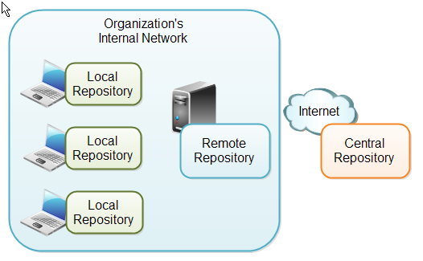
Maven Repositories

Slide 15
Local Repository
A local repository is a directory on the developer's computer
<settings>
<localRepository>
d:\data\java\maven\repository
</localRepository>
</settings>

Slide 16
Remote Repository
<repositories>
<repository>
<id>jenkov.code</id>
<url>http://maven.jenkov.com/maven2/lib</url>
</repository>
</repositories>

Slide 17
Build Life Cycles
Maven has 3 built-in build life cycles. These are:
default
clean
Site
The default life cycle handles everything related to compiling and packaging your project. The clean life cycle handles everything related to removing temporary files from the output directory, including generated source files, compiled classes, previous JAR files etc. The site life cycle handles everything related to generating documentation for your project. In fact, site can generate a complete website with documentation for your project.

