Slide 1


Jenkins Continuous Build System

Slide 2
Executive summary
 Continuous integration systems are a vital part of any Agile team because they help enforce the ideals of Agile development
 Jenkins, a continuous build tool, enables teams to focus on their work by automating the build, artifact management, and deployment processes
 Jenkins’ core functionality and flexibility allow it to fit in a variety of environments and can help streamline the development process for all stakeholders involved

Slide 3
Agenda
 Continuous Integration (CI)
 What is it?
 What are the benefits?
 Continuous Build Systems
 Jenkins
 What is it?
 Where does it fit in?
 Why should I use it?
 What can it do?
 How does it work?
 Where is it used?
 How can I get started?
 Putting it all together
 Conclusion
 References

Slide 4
CI - Defined
 “Continuous Integration is a software development practice where members of a team integrate their work frequently, usually each person integrates at least daily - leading to multiple integrations per day. Each integration is verified by an automated build (including test) to detect integration errors as quickly as possible” – Martin Fowler

Slide 5
CI – What does it really mean?
 At a regular frequency (ideally at every commit), the system is:
 Integrated
 All changes up until that point are combined into the project
 Built
 The code is compiled into an executable or package
 Tested
 Automated test suites are run
 Archived
 Versioned and stored so it can be distributed as is, if desired
 Deployed
 Loaded onto a system where the developers can interact with it

Slide 6

CI - Workflow
Regular Interval
Continuous Build System
Artifact Repository
Code Repository
Executable/ Package
Testing Results
Source & Tests
Test Reports
Deployment
Developers

Slide 7
CI – Benefits
 Immediate bug detection
 No integration step in the lifecycle
 A deployable system at any given point
 Record of evolution of the project

Slide 8
CI – The tools
 Code Repositories
 SVN, Mercurial, Git
 Continuous Build Systems
 Jenkins, Bamboo, Cruise Control
 Test Frameworks
 JUnit,Cucumber, CppUnit
 Artifact Repositories
 Nexus, Artifactory, Archiva

Slide 9

Jenkins
 Branched from Hudson
 Java based Continuous Build System
 Runs in servlet container
 Glassfish,Tomcat
 Supported by over 400 plugins
 SCM,Testing, Notifications, Reporting, Artifact Saving,Triggers, External Integration
 Under development since 2005
 http://jenkins-ci.org/

Slide 10
Jenkins - History
 2005 - Hudson was first release by Kohsuke Kawaguchi of Sun Microsystems
 2010 – Oracle bought Sun Microsystems
 Due to a naming dispute, Hudson was renamed to Jenkins
 Oracle continued development of Hudson (as a branch of the original)

Slide 11
Jenkins – Fitting in
Code Repository
Regular Interval
Artifact Repository
Executable/ Package
Testing Results
Source & Tests
Test Reports
Deployment
Developers

Slide 12
Why Jenkins? Flexibility!
 Jenkins is a highly configurable system by itself
 The additional community developed plugins provide even more flexibility
 By combining Jenkins with Ant, Gradle, or other Build Automation tools, the possibilities are limitless

Slide 13
Why Jenkins? Free/OSS
 Jenkins is released under the MIT License
 There is a large support community and thorough documentation
 It’s easy to write plugins
 Think something is wrong with it? You can fix it!

Slide 14
What can Jenkins do?
 Generate test reports
 Integrate with many different Version Control Systems
 Push to various artifact repositories
 Deploys directly to production or test environments
 Notify stakeholders of build status
 …and much more

Slide 15
How Jenkins works - Setup
 When setting up a project in Jenkins, out of the box you have the following general options:
 Associating with a version control server
 Triggering builds
 Polling, Periodic, Building based on other projects
 Execution of shell scripts, bash scripts, Ant targets, and Maven targets
 Artifact archival
 Publish JUnit test results and Javadocs
 Email notifications
 As stated earlier, plugins expand the functionality even further

Slide 16
How Jenkins works - Building
 Once a project is successfully created in Jenkins, all future builds are automatic
 Building
 Jenkins executes the build in an executer
 By default, Jenkins gives one executer per core on the build server
 Jenkins also has the concept of slave build servers
 Useful for building on different architectures
 Distribution of load

Slide 17
How Jenkins works - Reporting
 Jenkins comes with basic reporting features
 Keeping track of build status
 Last success and failure
 “Weather” – Build trend
 These can be greatly enhanced with the use of pre-build plugins
 Unit test coverage
 Test result trending
 Findbugs, Checkstyle, PMD

Slide 18
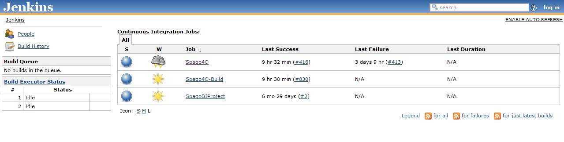
Jenkins by example – Main Page
 The main page provides a summary of the projects
 Quick view of
 What’s building (“No builds in the queue”)
 Build Executor Status (both “Idle”)
 Status of the projects

Slide 19
Jenkins by example – Project Status
 Project status pages provide more details about a given project
 The status of the last several builds
 Charting (depending on plugins)
 Dependencies

Slide 20
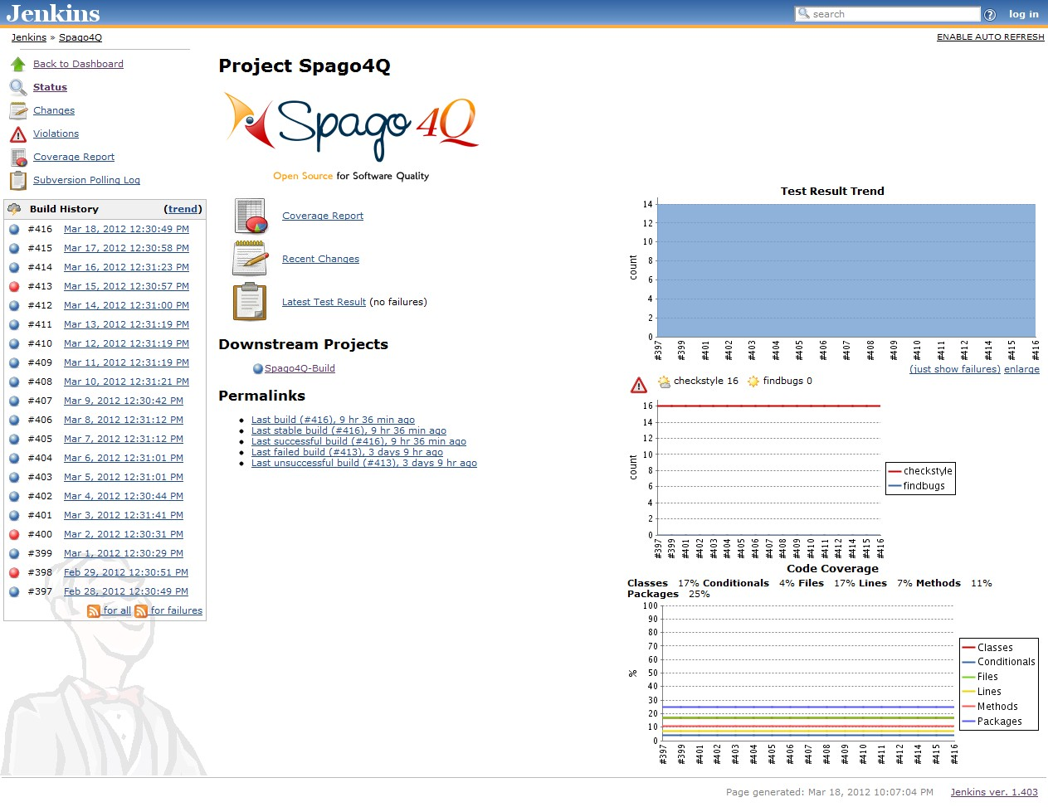
Jenkins by example – Project Status

Slide 21
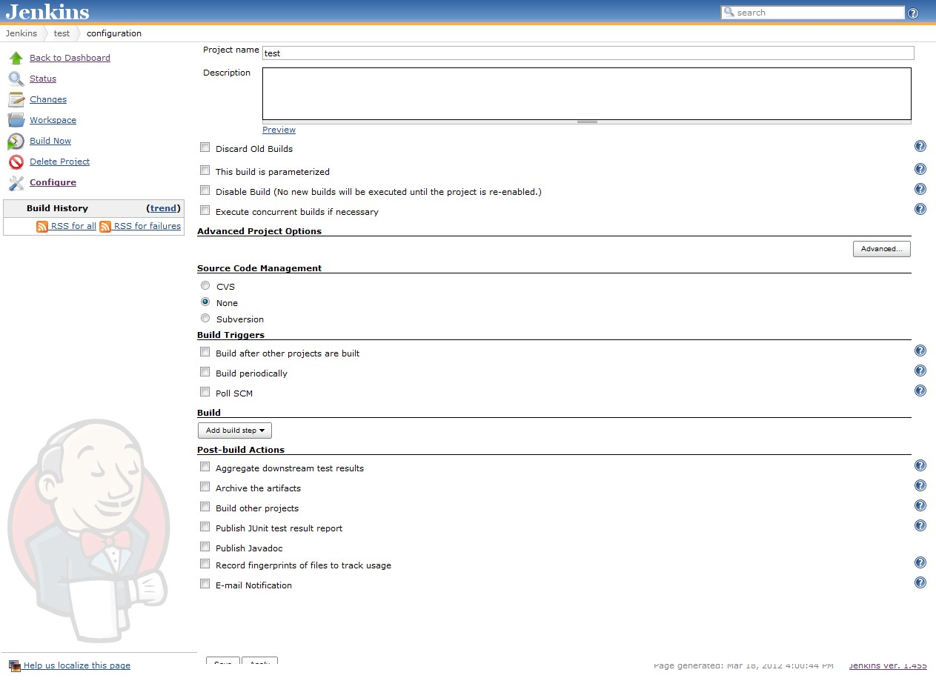
Jenkins by example – New Project

Slide 22
Enhancing Jenkins
 Jenkins plugin system can enable a wide range of features including (but certainly not limited to)
 SCM
 Mercurial, Git, Subversion
 Testing
 Selenium,Windmill,TestLink
 Notifications
 IRC,Twitter, Jabber
 Reporting
 Doxygen, PMD, Findbugs
 Artifact Saving
 Artifactory, Amazon S3, SCP
 Triggers
 Jabber, Directory Watchers
 External Integration
 GitHub, Bugzilla, JIRA
 And most importantly – The CI Game
 A points based game where developers compete against each other to develop the most stable, well- tested code

Slide 23
Running Jenkins yourself
 Jenkins is packaged as a WAR, so you can drop it into whichever servlet container you prefer to use
 Jenkins comes pre-packaged with a servlet if you just want a light- weight implementation
 Native/Supported packages exist for
 Windows
 Ubuntu/Debian
 Redhat/Fedora/CentOS
 Mac OSX
 openSUSE
 FreeBSD
 OpenBSD
 Solaris/OpenIndiana
 Gentoo

Slide 24
Running Jenkins yourself – Updates
 Jenkins has two release lines
 Standard releases
 Weekly bug fixes and features
 Long-Term Support releases
 Updates about every 3 months
 Uses a “Stable but older” version from the standard release line
 Changes are limited to backported, well-tested modifications

Slide 25
Letting someone else run Jenkins
 There are also cloud-based solutions that can provide a Jenkins instance
 Cloudbees - http://www.cloudbees.com/
 ShiningPanda - https://www.shiningpanda.com/

Slide 26
Tying it into Agile
 For an Agile team, Jenkins provides everything needed for a robust continuous build system
 Jenkins supports Agile principles by constantly providing access to working copies of software
 Jenkins’ extensibility allows the system to adapt to many different pre-existing environments

Slide 27
Putting it all together
 While an integral part of a CI system, Jenkins is by no means the only component
 In order for a CI system to function, a common repository for the codebase needs to exist
 A database of artifacts needs to exist, so deliveries can be made at past iterations
 The last step in a CI process is the deployment of the components built
 …and none of this matters if the developers don’t use the system; procedures need to ensure the system is used as intended

Slide 28
Conclusion
 Continuous integration is a necessity on complex projects due to the benefits it provides regarding early detection of problems
 A good continuous build system should be flexible enough to fit into pre-existing development environments and provide all the features a team expects from such a system
 Jenkins, a continuous build system, can be an integral part of any continuous integration system due to it’s core feature set and extensibility through a plugin system

Slide 29
References
 Continuous Integration – Martin Fowler
 http://www.martinfowler.com/articles/continuousIntegration.html
 Hudson
 http://hudson-ci.org/
 Hudson Continuous Integration Server
 http://www.code-magazine.com/articleprint.aspx?quickid=0906071&printmode=true
 The Hudson Book
 http://www.eclipse.org/hudson/the-hudson-book/book-hudson.pdf
 Jenkins
 https://wiki.jenkins-ci.org
 Monkey Image
 http://corrines-corner2006.blogspot.com/2011/09/freebie-monday_26.html
 What is Continuous Integration
 http://confluence.public.thoughtworks.org/display/CCNET/What+is+Continuous
+Integration

