Slide 1
Module 1 Building blocks of angular

Slide 2
Outline
what is angular?
angular1 vs angular2 vs angular 4
First angular application using angular cli
Running angular application
Anatomy of scaffolded project
Installing augury and inspecting angular app with augury
Debugging first angular app
Building blocks of angular

Slide 3
Single Page Application
Wiki says:
A single-page application (SPA) is a web application or web site that fits on a single web page with the goal of providing a user experience similar to that of a desktop application. In an SPA, either all necessary code – HTML, JavaScript, and CSS – is retrieved with a single page load, or the appropriate resources are dynamically loaded and added to the page as necessary, usually in response to user actions. The page does not reload at any point in the process, nor does control transfer to another page, although the location hash or the HTML5 History API can be used to provide the perception and navigability of separate logical pages in the application. Interaction with the single page application often involves dynamic communication with the web server behind the scenes.

Slide 4
What is angular
Javascript framework for client side SPA applications
Applications will be developed using HTML CSS and JS
A full rewrite of the Angular 1.x framework, introducing a brand new application architecture completely built from scratch in TypeScript

Slide 5
Angular features
Data binding
HTML as template
Modules
Out of the box useful services
Simple API
Develop Across All Platforms
Speed & Performance
Incredible Tooling

Slide 6
Angular1 vs angular 2
angular1
angular2
Controller based
Javascript as only language
5 ways to create services
Complicated directive api
Not a great in performance
Not built with mobile support in mind
Component based
Typescript, ES5, ES6, dart
1 Simplified service definition
Simplified directive api
Improved performance
mobile oriented

Slide 7
Angular2 vs angular4
Faster & Smaller
View Engine
Animation Package
Improved *ngIf and *ngFor
Angular Universal
TypeScript 2.1 & 2.2 compatibility
Source Maps for Templates
ngIf with Else
Apps Testing Simplified
Etc..

Slide 8
Language of choice
Angular has support for following languages
ES5
ES6
Typescript
dart

Slide 9
setup
npm install @angular/cli -g
https://cli.angular.io/

Slide 10
Augury
Google Chrome Developer Tool extension for debugging and profiling Angular 2 applications
Augury helps Angular 2.0 developers visualize the application through component trees, and visual debugging tools.
Developers get immediate insight into their application structure, change detection and performance characteristics

Slide 11
First angular app
2
1
cd hello-angular
3
ng serve --open
ng new hello-angular

Slide 12
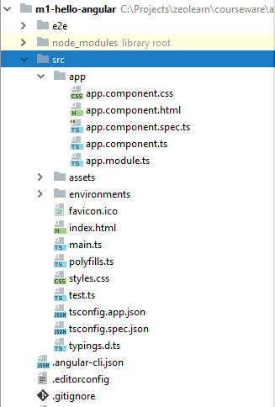
Anatomy of project
@angular/cli scaffolds the production project structure with all configurations in place like below
Dev and production builds
Code liniting
Unit testing
E2e testing
You will spend all your time inside src/app folder coding your application

Slide 13
ng serve ??
ng serve does many things under the hood.
Builds and serves your app, rebuilding on file changes.
ng serve uses .angular-cli.json file to read the configuration
It all starts with “main” property value from .angular-cli.json

Slide 14
main.ts – the starting point of execution
import { enableProdMode } from '@angular/core'; import { platformBrowserDynamic } from '@angular/platform-browser-dynamic'; import { AppModule } from './app/app.module'; import { environment } from './environments/environment'; if (environment.production) { enableProdMode(); } platformBrowserDynamic().bootstrapModule(AppModule);

Slide 15
Bootstrapping Module
Process of starting the angular application
Angular application may contain many modules, hence you need to explicitly convey the starting module of your application

Slide 16
App Module or Root Module
import { BrowserModule } from '@angular/platform-browser'; import { NgModule } from '@angular/core'; import { AppComponent } from './app.component'; @NgModule({ declarations: [ AppComponent ], imports: [ BrowserModule ], providers: [], bootstrap: [AppComponent] }) export class AppModule { }

Slide 17
Bootstrapping component
Angular module may contain many components in a module
You need to explicitly specify which component should be started first

Slide 18
App / Bootstrapping Component
import { Component } from '@angular/core'; @Component({ selector: 'app-root', templateUrl: './app.component.html', styleUrls: ['./app.component.css'] }) export class AppComponent { title = 'app'; }

Slide 19
Execution flow
main.ts
Bootstraps app module
AppModule.ts
Bootstraps app component
AppComponent.ts
Display UI with state
index.html
<app-root></app-root>
http://abc.com
server responds with index.html

Slide 20
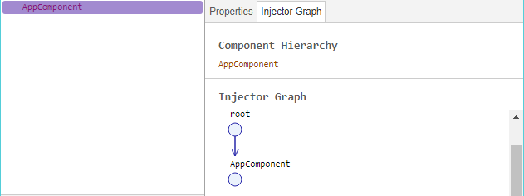
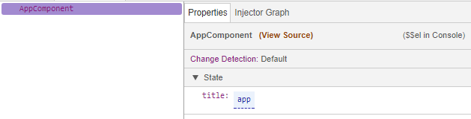
Inspecting app with Augury

Slide 21
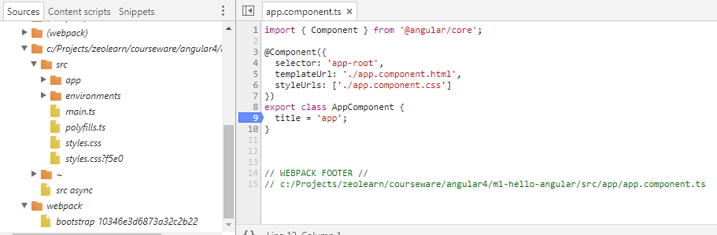
Debugging Angular App

Slide 22
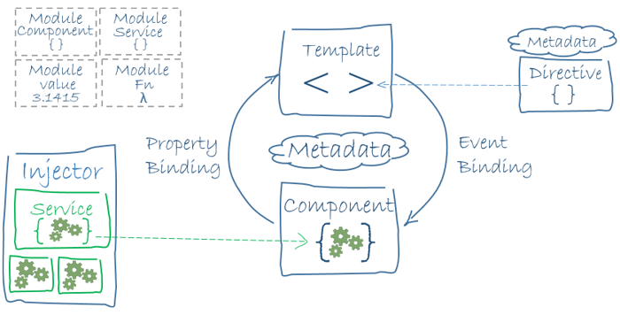
Building blocks

Slide 23
What you develop in angular
Modules
Component
Template
Metadata
Directive
Pipes
Services
DI

