Slide 1
Module 2 Components

Slide 2
Outline
Understand component architecture
Creating components manually and using CLI
Understanding component selector
Working with component templates and stylesheets
Understanding and implementing component composition

Slide 3
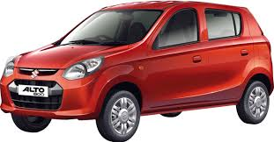
A car is single piece

Slide 4
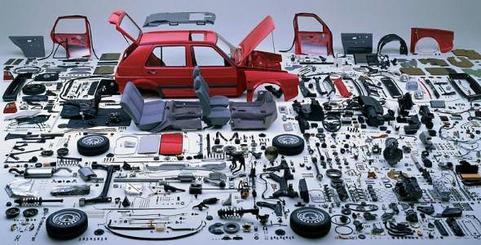
A car is several pieces

Slide 5
Component based architecture
A component is a software object, meant to interact with other components, encapsulating certain functionality or a set of functionalities.
Look at large monolithic applications as set of reusable types composed to build a larger thing

Slide 6
Angular component
Component is responsible to present UI
Has Template
Has class
State - Data
Behavior - Logic
Has Metadata
Use decorator @
Make Angular aware of intentions

Slide 7
QuestionnaireComponent
import {Component} from '@angular/core'; @Component({ selector: 'app-questionnaire', template: `<h1>{{title}}</h1>`, styles: ['h1 { color:cyan}'] }) export class QuestionnaireComponent { title = 'Customer Satisfaction'; }

Slide 8
Component Class
Provides state and behavior of the UI

Slide 9
Template & Styles
Provides UI & css
2 types for template
Internal - template
External – templateUrl
2 types for styles
Internal - styles
External – styleUrls

Slide 10
Metadata
Supplied with typescript decorator
Marks the class to be treated as one of the angular artifact, in this case component
selector – tag name to be used in the html markup of other components

Slide 11
Component Registration
Component must be registered with module before it can be used
In the module under put the component type as one on the value for declarations array property

Slide 12
Creating components with cli
ng generate component <component_name>
ng g c <component_name>
ng g c <component_name> -it -is --no-spec --flat

Slide 13

Composing components

Slide 14
Non-inherited styles
Angular solves the namespacing issues with CSS
Angular simulates the shadow-dom by default
You can control the shadow-dom simulation with encapsulation property of metadata

Slide 15
ViewEncapsulation
/** * Emulate `Native` scoping of styles by adding an attribute containing surrogate id to the Host * Element and pre-processing the style rules provided via * {@link Component#styles} or {@link Component#styleUrls}, and adding the new Host Element * attribute to all selectors. * * This is the default option. */ Emulated = 0, /** * Use the native encapsulation mechanism of the renderer. * * For the DOM this means using [Shadow DOM](https://w3c.github.io/webcomponents/spec/shadow/) and * creating a ShadowRoot for Component's Host Element. */ Native = 1, /** * Don't provide any template or style encapsulation. */ None = 2,

Slide 16
Know your self
@Component decorator is optional to create a component, true or false?
Component can be created without template true or false?
Which property of module should be amended before component can be used?
Styles from parent component will be cascaded to all child components by default, true or false
ng g com , command is used to scaffold angular component
Which ng command is used to create new angular app?

