Slide 1
Module 0 Typescript / ES6

Slide 2
Outline
What is typescript
Why typescript
What it ES6
Setting up tools need to work with typescript
Variable scoping
Datatypes
Type inference and annotation
Functions in typescript
Interfaces and classes
Modules
Experimental decorators

Slide 3
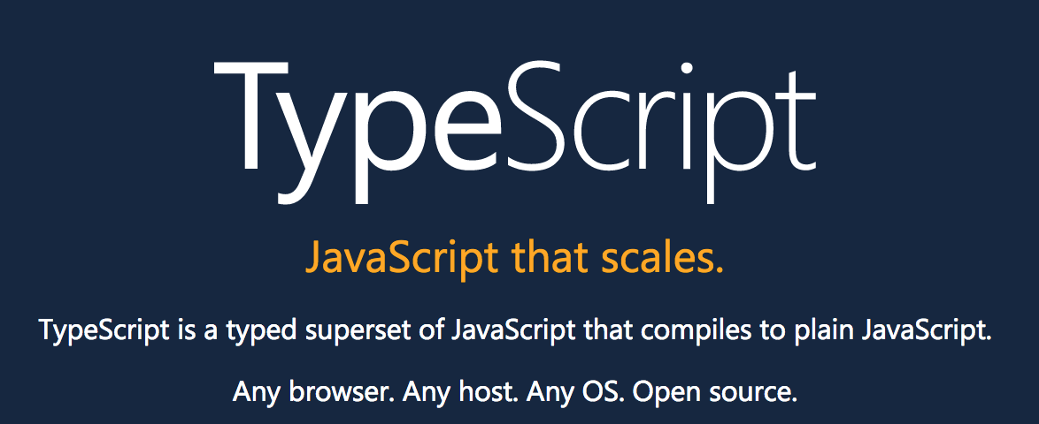
Typescript – Official website says

Slide 4
Why typescript
Superset of JS
Provides type safety
Transpiles to JS
Cross platform
Open Source

Slide 5
What is ES6
ES6 or ES2015 is recent version
A significant update to the language

Slide 6
Setup
npm install -g typescript

Slide 7
tsc and tsserver
tsc – compiler that Transpiles TS to JS
tsserver - standalone server, a node executable that encapsulates the TypeScript compiler and language services, and exposes them through a JSON protocol. tsserver is well suited for editors and IDE support.

Slide 8
Types
Boolean
Number
String
Array
Enum
Any
Void
Null and Undefined
Union

Slide 9
Functions
Fundamental building block of any applications in JavaScript
Provides mandatory, optional and default parameters
Function types
Arrow functions
Function overloading

Slide 10
Interfaces
Defines a contract both structural and behavioral
Support for mandatory and optional properties
Compilation: Interfaces are a compile-time language feature of TypeScript, and the compiler does not generate any JavaScript code from interfaces that you include in your TypeScript projects. Interfaces are only used by the compiler for type checking during the compilation step

Slide 11
Classes
Blueprint / template for creating objects
Encapsulation
Containerize State and behavior

Slide 12
Abstract Class
Abstract classes are base classes from which other classes may be derived.
They may not be instantiated directly.
Unlike an interface, an abstract class may contain implementation details for its members.
The abstract keyword is used to define abstract classes as well as abstract methods within an abstract class.

Slide 13
Decorators
Decorators in TypeScript provide a way of programmatically tapping into the process of defining a class
Allow us to inject code into the actual definition of a class
Use the form @expression, where expression must evaluate to a function that will be called at runtime with information about the decorated declaration
Applied when a class is being defined, and not when it is being instantiated
Similar to attributes in C#, or annotations in Java.
Can be applied to class, property, method and parameter

Slide 14
Modules
Modules are stored in files. There is exactly one module per file and one file per module.
Each module is a piece of code that is executed once it is loaded.
In that code, there may be declarations (variable declarations, function declarations, etc.).
By default, these declarations stay local to the module.
You can mark some of them as exports, then other modules can import them.
A module can import things from other modules. It refers to those modules via module specifiers
Relative paths ('../model/user')
Absolute paths ('/lib/js/helpers')
Names ('util')
Modules are singletons

Slide 15
Modules – Example 1
//------ lib.js ------ export const sqrt = Math.sqrt; export function square(x) { return x * x; } export function diag(x, y) { return sqrt(square(x) + square(y)); } //------ main.js ------ [ cherry pick import] import { square, diag } from 'lib'; console.log(square(11)); // 121 console.log(diag(4, 3)); // 5
//------ main.js ------ [ complete module import] import * as lib from 'lib'; console.log(lib.square(11)); // 121 console.log(lib.diag(4, 3)); // 5

Slide 16
Modules – Example 2
//------ MyClass.js ------ export default class { ··· } // no semicolon! //------ main2.js ------ import MyClass from 'MyClass'; const inst = new MyClass();
//------ myFunc.js ------ export default function () { ··· } // no semicolon! //------ main1.js ------ import myFunc from 'myFunc'; myFunc();

Slide 17
Know your self
All JS is valid in TS, true or false?
JS VMs understand typescript, true or false?
caetdroor – descramble this
Every is exported out of module by default, true or false?
[“TS”,2.4,true] which type is legal to hold such array
What is duck typing?
Interfaces are a run-time language feature of TypeScript, true or false

