Slide 1
Module 2
Working with modules
Notes:
Keep to agenda
Know your students
Check retention periodically
Employ visual aids
Use various teaching techniques
Use real-life scenarios
Use positive reinforcement

Slide 2
Outline
Understanding modules
Usage of require, exports and module.exports
Types of modules
Knowing npm (node package manager)
Overview of package.json file
Publishing modules to npm

Slide 3
Modules
Javascript style of organizing code
A few different module systems available for JavaScript, but they all work in a similar way
Code in single file is a module
Expose functionality to outside world with exports or module.exports object
Import the modules using require

Slide 4
require
Node.js follows the CommonJS module system
require - builtin function
All require do is;
reads a javascript file
executes the file
return the exports object

Slide 5
module.exports or exports
module.exports is initialized to an empty object
exports is just a reference to module.exports
Whatever is contained in the module.exports variable at the end of your script is the exported value of your module
Whatever is contained in the module.exports variable is imported when used via require

Slide 6
Types of Modules
Builtin
const os= require(os);
Local or user define
const logger= require('./logger);
Third party
const request= require('request');

Slide 7
npm
Package management tool for node js applications

Slide 8
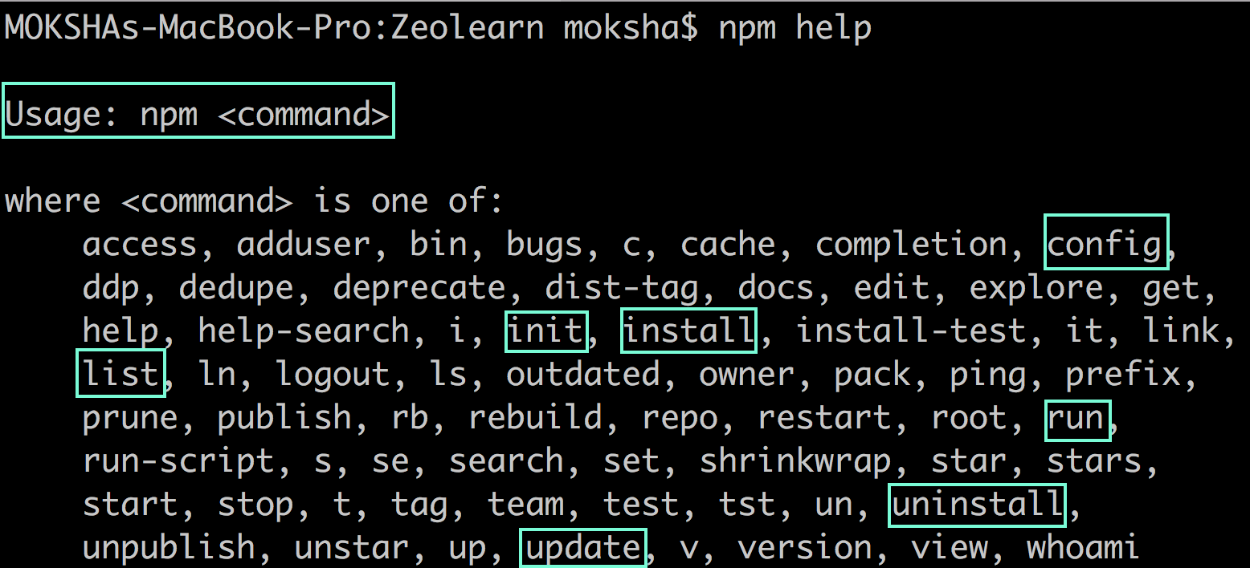
npm help

Slide 9
package.json
Configuration file for npm
Records metadata about current project, its dependencies etc.

Slide 10
semver
MAJOR.MINOR.PATCH

Slide 11
Version ranges
Tilde Ranges ~1.2.3 ~1.2 ~1
Allows patch-level changes if a minor version is specified on the comparator. Allows minor-level changes if not
~1.2.3 := >=1.2.3 <1.(2+1).0 := >=1.2.3 <1.3.0
~1.2 := >=1.2.0 <1.(2+1).0 := >=1.2.0 <1.3.0 (Same as 1.2.x)
~1 := >=1.0.0 <(1+1).0.0 := >=1.0.0 <2.0.0 (Same as 1.x)

Slide 12
Version ranges
Caret Ranges ^1.2.3 ^0.2.5 ^0.0.4
Allows changes that do not modify the left-most non-zero digit in the [major, minor, patch] tuple
^1.2.3 := >=1.2.3 <2.0.0
^0.2.3 := >=0.2.3 <0.3.0
^0.0.3 := >=0.0.3 <0.0.4

Slide 13
Summary
Techniques for modularizing JavaScript code
Using require() to import
Using exports or module.exports to export
Types of modules
Overview and usage of npm
Understanding versioning and semver

Slide 14
Check your knowledge
Which function is used to import modules?
Name 3 different module types?
How do you export a code from a module?
Code in how many files is a module?
What does npm stands for?
What does leftmost digit stands for in semver?
What is npm configuration file named as?

