Slide 1
Module 3
Events & Streams
Notes:
Keep to agenda
Know your students
Check retention periodically
Employ visual aids
Use various teaching techniques
Use real-life scenarios
Use positive reinforcement

Slide 2
Outline
Node’s EventEmitter class
Async programming with Events
Callbacks vs Events
Understanding streams
Types of streams
Piping between streams

Slide 3
Events - Official Site Says
Much of the Node.js core API is built around an idiomatic asynchronous event-driven architecture in which certain kinds of objects (called "emitters") periodically emit named events that cause Function objects ("listeners") to be called.
All objects that emit events are instances of the EventEmitter class

Slide 4
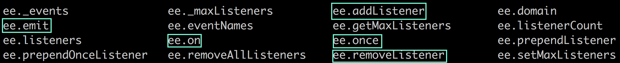
EventEmitter - Core Object for events

Slide 5
EventEmitter
The publisher uses event.emit(type,[args])
The subscriber uses event.on(type, handler)

Slide 6
Events vs callbacks
The publisher uses event.emit(type,[args])
The subscriber uses event.on(type, handler)

Slide 7
Stream - Official Site Says
A stream is an abstract interface for working with streaming data in Node.js
Simply put continuous flow of data from source to destination , like unix pipes
Stream is an EventEmitter with some specials methods

Slide 8
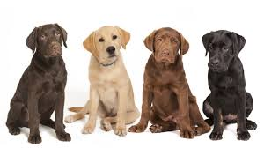
Types of Stream
Readable
Writable
Duplex
Transform

Slide 9
Readable Stream
Inherits from require(‘stream’).Stream
Property: readable (bool)
Events: ‘data’, ‘end’, ‘close’, ‘error’
Methods: pause(), resume(), end(), destroy()

Slide 10
Writable Stream
Inherits from EventEmitter
Property: writable (boolean)
Events: ‘drain’, ‘error’, ‘close’, ‘pause’, ‘resume’
Methods: write(), end(), destroy()
Notes:
Trainer notes:
‘drain’ event:
The drain event is for when a writable stream's internal buffer has been emptied.
This can only happen when the size of the internal buffer once exceeded its highWaterMark property, which is the maximum bytes of data that can be stored inside a writable stream's internal buffer until it stops reading from the data source.
The cause of something like this can be due to setups that involve reading a data source from one stream faster than it can be written to another resource. For example, take two streams:
var fs = require('fs'); var read = fs.createReadStream('./read'); var write = fs.createWriteStream('./write');
Now imagine that the file read is on a SSD and can read at 500MB/s and write is on a HDD that can only write at 150MB/s. The write stream will not be able to keep up, and will start storing data in the internal buffer. Once the buffer has reached the highWaterMark, which is by default 16KB, the writes will start returning false, and the stream will internally queue a drain. Once the internal buffer's length is 0, then the drain event is fired.

Slide 11
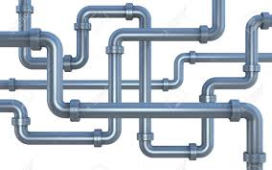
piping
An Input stream can be piped to output stream
Pipes can be chained
Handles back pressure automatically
src => pipe => dest
readableStream.pipe(writableStream);

Slide 12
Summary
Understanding Events
EventEmitter class
Understanding Streams
Reading and writing streams
Using pipe()

Slide 13
Check your knowledge
How many types of streams?
Stream is a __________ with special methods
Src -> ________ -> dest
On vs Once
How do you unregister from an event?
Function to raise an event?
All objects that emit events are instances of the ________ class

