Slide 1
Module 6
Express JS

Slide 2
Outline
Understanding express js framework
Scaffolding project with express-generator
Understanding routing and middleware

Slide 3
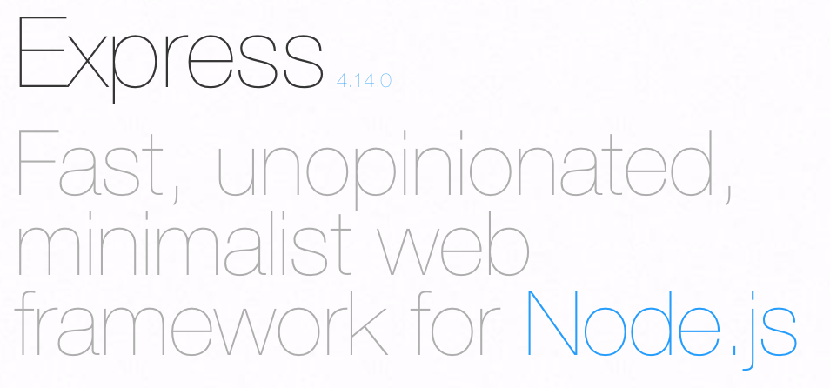
Express - Official site says

Slide 4
Express - What can be developed
Web Applications
API

Slide 5
Express - Setup
npm install express --save

Slide 6
HelloWorld Express
var express = require('express') var app = express() app.get('/', function (req, res) { res.send('Hello World!') }) app.listen(3000, function () { console.log('Example app listening on port 3000!') })

Slide 7
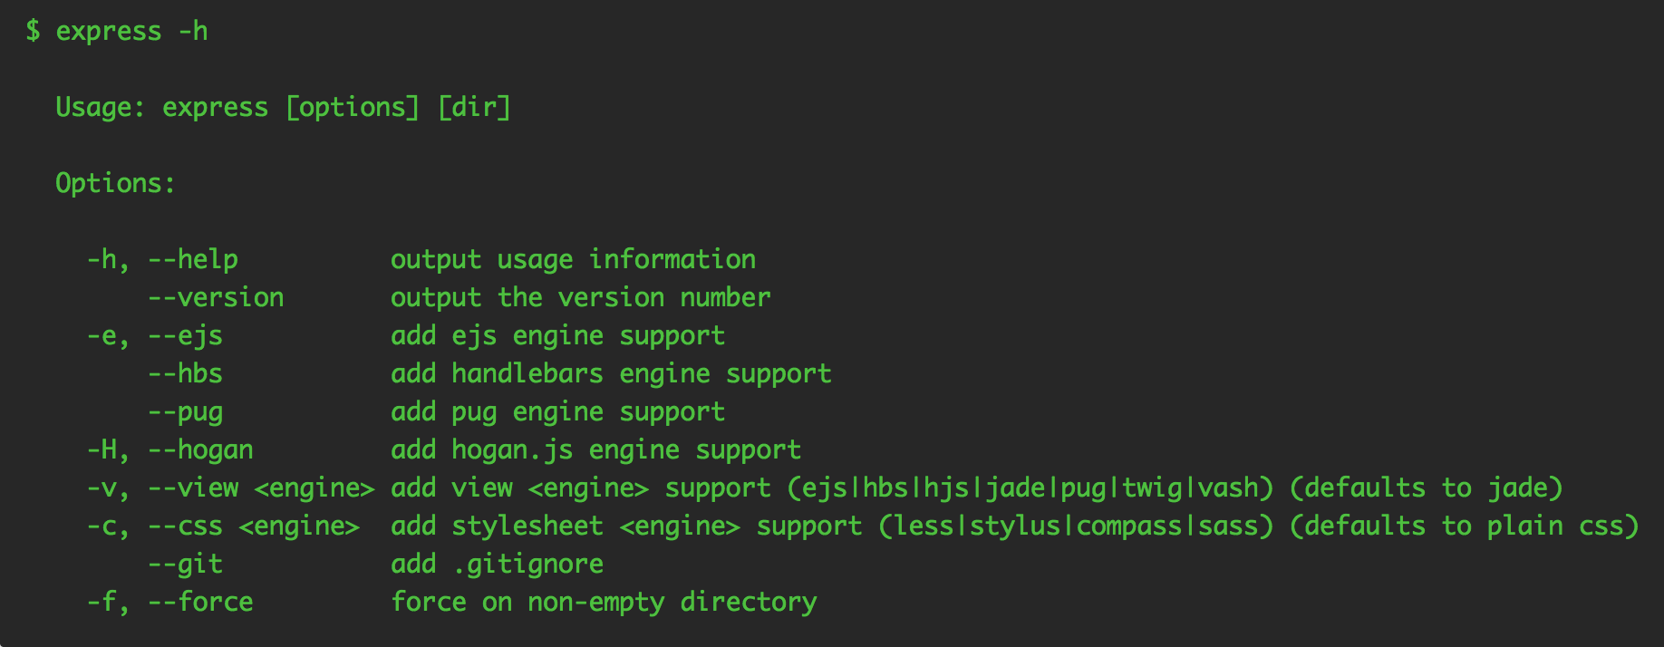
Express Generator - Setup & Usage

Slide 8
Express Generator - Create new app
express --view=jade myapp

Slide 9
Express Generator - Introspect Project
Review the folder structure

Slide 10
Express Generator - Run the app
npm start

Slide 11

Routing
Routing refers to the definition of application end points (URIs) and how they respond to client requests.
Simply put unique address for a resource on a server

Slide 12
Routing - How to use
app.METHOD(PATH, HANDLER)
app is an instance of express.
METHOD is an HTTP request method, in lowercase.
PATH is a path on the server.
HANDLER is the function executed when the route is matched.

Slide 13
Routing - Example routes
app.get(‘/products’, HANDLER)
app.post(‘/products’, HANDLER)
app.put(‘/products/:id’, HANDLER)
app.delete(‘/products/:id’, HANDLER)
app.all(‘/products/status’, HANDLER)

Slide 14
Middleware
Functions that have access to the request object (req), the response object (res), and the next function in the application’s request-response cycle.
The next function is a function in the Express router which, when invoked, executes the middleware succeeding the current middleware.

Slide 15
What Middleware can do
Execute any code.
Make changes to the request and the response objects.
End the request-response cycle.
Call the next middleware in the stack.

Slide 16
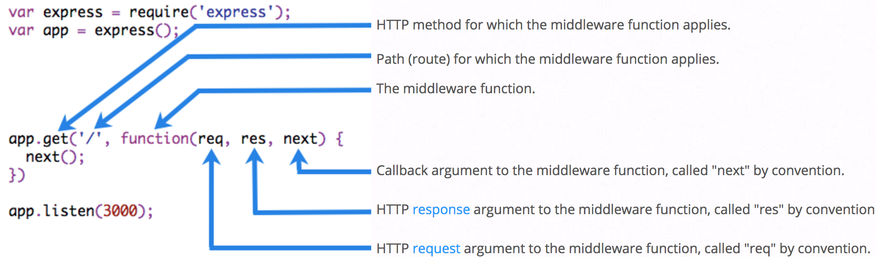
Anatomy of Middleware

Slide 17
Request Object
Represents the HTTP request and has properties for the request query string, parameters, body, HTTP headers, and so on
Some most used properties
req.baseUrl | req.cookies | req.query
req.hostname | req.method | req.params
req.path

Slide 18
Response Object
Represents the HTTP response and has properties for cookies, sending responses, headers etc.,
Some most used methods
res.attachment | res.cookie | res.download
res.end | res.json | res.redirect
res.render | res.send | res.sendFile
res.sendStatus | res.set | res.status

Slide 19
Check your knowledge - 1
Name 2 types of applications that can be developed with express js?
Middleware functions do not have access to req and res, true or false?
app.GET is used to serve http get requests, true or false?
Which concept refers to “definition of application end points”
Name methods to end request-response cycle

Slide 20
Check your knowledge - 2
Which request property is used to read query params?
Is it possible to find the current request http method?
Which method is used to send json response to client?
How to set header on response?
How to set cookie on response?
res.end vs res.send?

