Slide 1
Module 9 Templating Engines

Slide 2
Outline
Understand significance of templating engines
Understand building blocks of jade
Template inheritance

Slide 3
What is JavaScript Template
A method of separating HTML structure from the content contained within
Good choice to keep UI and Model separate
One of the key player in MVC architecture
Some of the examples are Jade, Handlebars, EJS, moustache etc.,
Code which compiles template view and model is called as templating engine

Slide 4
Templating Engines
Jade
EJS
Handlebars
Mustache
And many more…

Slide 5
Setup
npm install jade --save

Slide 6
Jade
A template language and engine for JavaScript apps
Express JS have built-in support for Jade templating engine
To use, configure it in you app using
app.set('view engine', 'jade');

Slide 7
Jade Building Blocks
Jade has python like syntax, indentation plays vital role in deriving the parent child relationship
Building blocks
Simple tags
Attributes
Blocks of text
Loops
Interpolation
JavaScript
Blocks

Slide 8
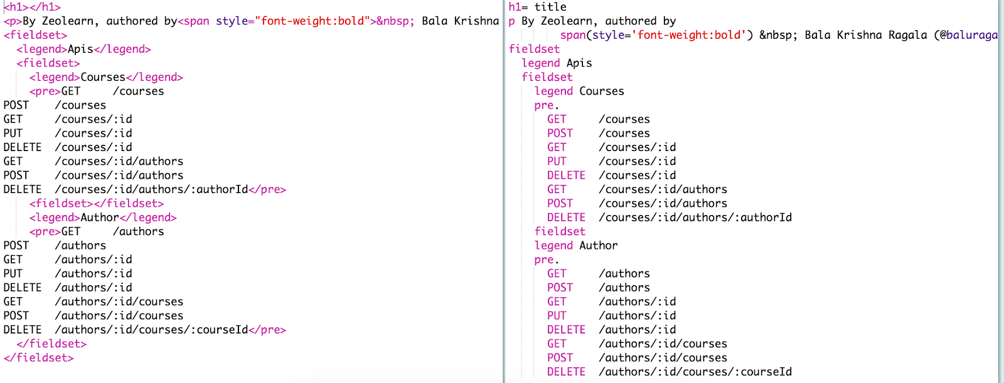
HTML To JADE, JADE To HTML

Slide 9
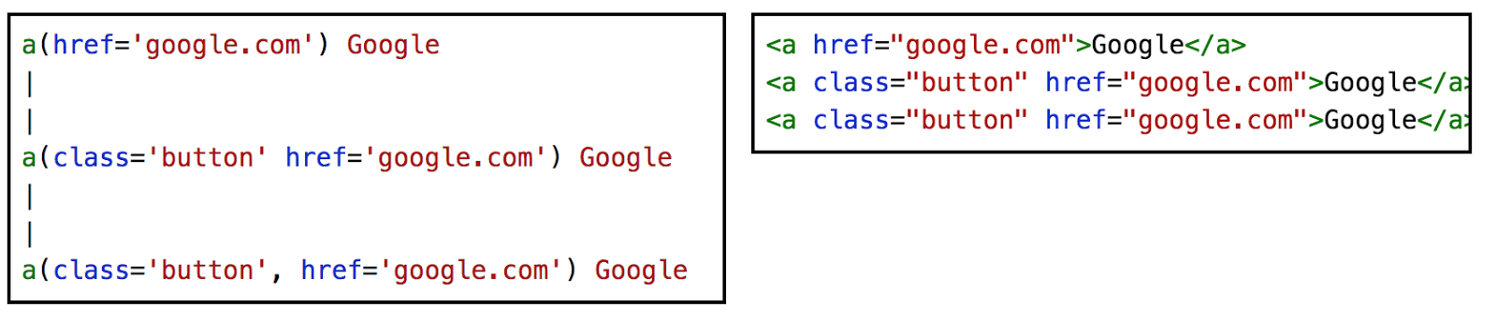
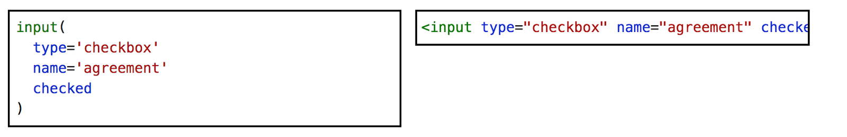
Attributes

Slide 10
Literals - ID / Class

Slide 11
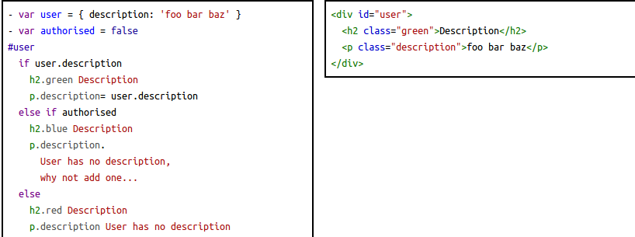
Conditionals

Slide 12
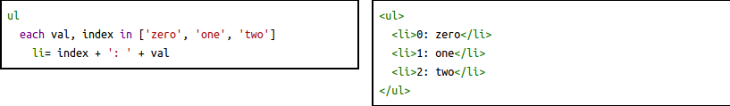
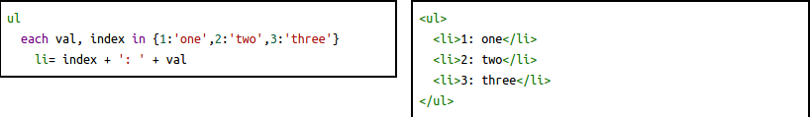
Loops - each

Slide 13
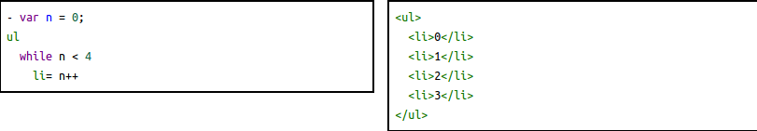
Loops - while

Slide 14
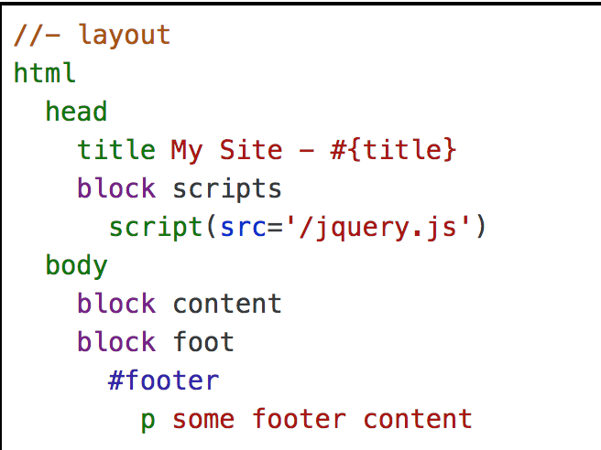
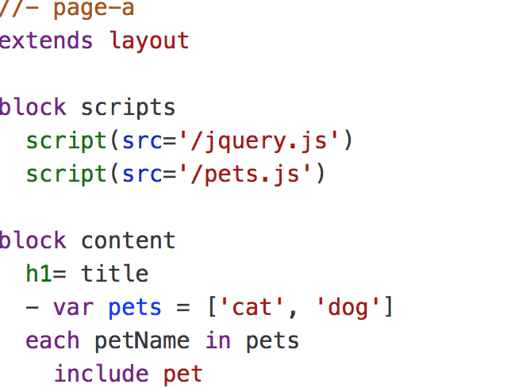

Template Inheritance

Slide 15
Check your knowledge
Which operator is used form interpolation?
Does jade support do while loop, true or false?
Templating engines are used to improve productivity and maintainability true or false?
Which response method is used to generate response from template?
Which express method is used to configure view engine?

