Slide 1
BRAVE BRICK
SUSHMENDRA KUMAR SINGH 140040080.
ARUN KUMAR KADAGANCHI 140040101.
M. BALU RAJENDRA PRASAD 140040091.
DHARAN KONDAVEETI 140040110

Slide 2
Problem Statement
Our aim is to develop an entertaining game which can help kill any free time an engineering student might have.
We also aim to demonstrate the fact that popular apps on the play store can be made with relative ease. Our project used the android app “Amazing Brick” as a reference.

Slide 3
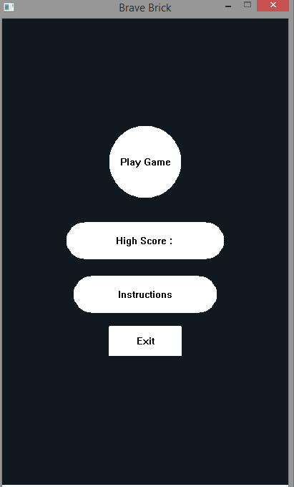
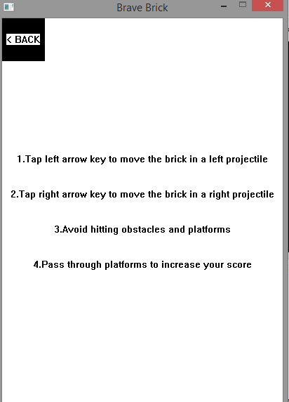
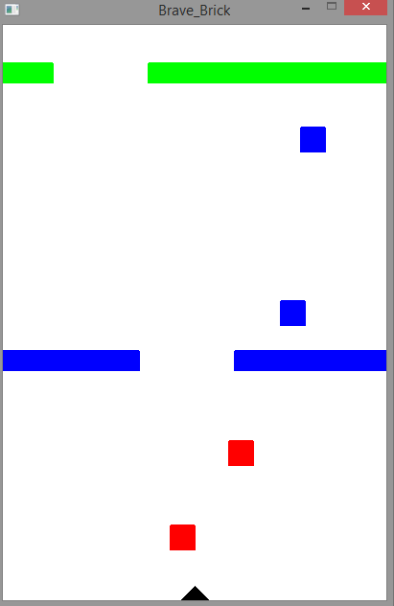
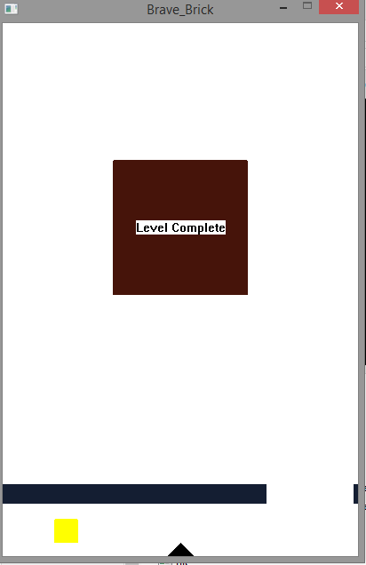
Some Screenshots of our game.

Slide 4
Challenges We Have Faced So Far:
The greatest challenge we have faced so far is the integration of the movement of the brick with the movement of the obstacles.
We will solve this problem using the function ‘keyPressEvent( )’.

Slide 5
Future Work
We can add new features, like power-ups, to enhance the game-playing experience.
An example of a power-up would be making the brick indestructible.

