Slide 1
Html

Slide 2
History of html
Tim berner’s-lee, a physicist at the CERN reserch institute in switzerland invented HTML in 1991.
The first version consisted of 18 HTML tag.
Now are currently about 140 HTML tags.

Slide 3
Version of HTML
1991:- burner’s lee invented html.
1993:- HTML 1.0 is released.
1995:- HTML 2.0 is released.
1997:- HTML 3.0 is released.
1999:- HTML 4.0 is released.
2014:- HTML 5.0 is released.

Slide 4
Introduction of html
HTML stands for ‘hyper text markup language’.
Backbone of web development.
used to design static web pages.
It is not a programming language, it’s a markup language.
Not case sensitive.
Extension:- .html or .htm
Executed in any web browser.

Slide 5
Basic structure of html
<docktype html>
<html>
<head>
<title>This is first web page. </title>
</head>
<body>
<h1> this is first web page. </h1>
<p> first paragraph of my web page. </p>
</body>
</html>

Slide 6
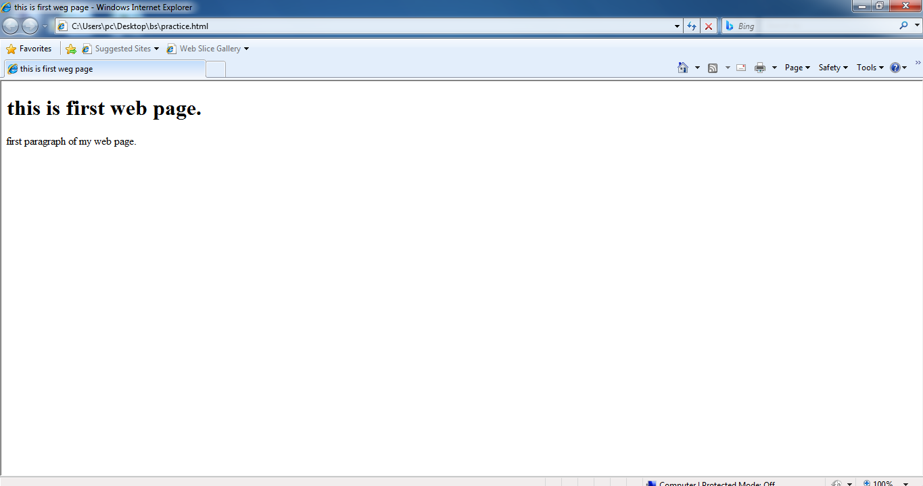

Slide 7
Html elements…
For the default display and styling purpose in HTML, all the elements are divided into two categories :-
(i) block elements,
(ii) inline elements.

Slide 8
Block elements
These elements always starts in new line and occupy full width.
Following are the block level elements:- <address>, <article>, <aside>, <blockquote>, <canvas>, <dd>, <dl>, <div>, <dt>, <fieldset>, <figcaption>, <figure>, <footer>, <form>, <h1>-<h6>, <header>, <hr>, <li>, <main>, <nav>, <noscript>, <ol>, <ul>, <output>, <p>, <pre>, <section>, <table>, <tfoot>, <video>

Slide 9
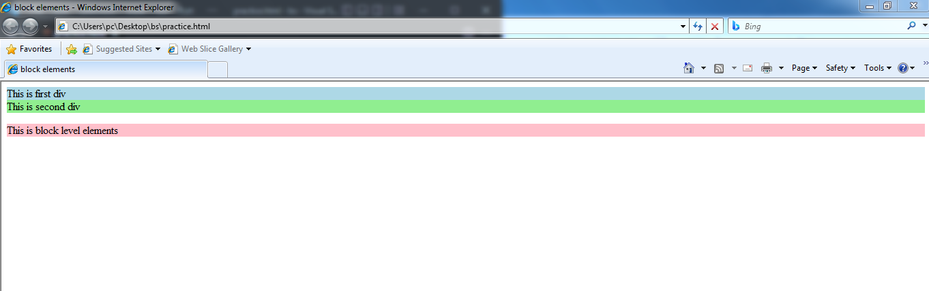
<!DOCTYPE html>
<head>
<title>block elements</title>
</head>
<body>
<div style="background-color: lightblue;">This is first div</div>
<div style="background-color: lightgreen;">This is second div</div>
<p style="background-color: Pink;"> This is block level elements</p>
</body>
</html>

Slide 10
Inline elements
Starts in the same line.
Their width is equal to their content.
Mostly inline elements doesn’t support width and height. exe.:- <b>, <i>, <strong>, <em>
Following are the inline elements:- <a>, <abbr>, <acronym>, <b>, <bdo>, <big>, <br>, <button>, <cite>, <code>, <dfn>, <em>, <i>, <img>, <input>, <kbd>, <lable>, <map>, <object>, <q>, <samp>, <script>, <select>, <small>, <span>, <strong>, <sub>, <sup>, <textarea>, <time>, <tt>, <var>

Slide 11
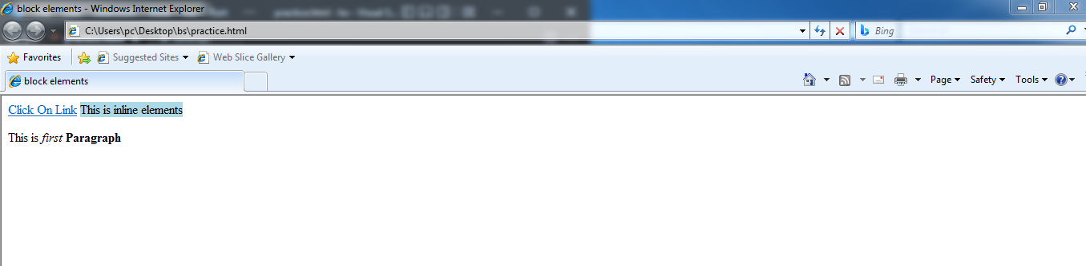
<!DOCTYPE html>
<head>
<title>block elements</title>
</head>
<body>
<a href="https://www.google.com">Click On Link</a>
<span style="background-color: lightblue;"> This is inline elements</span>
<p> This is <i>first</i> <b>Paragraph</b></p>
</body>
</html>

