Slide 1

Subject Name: Advanced Algorithms
Unit No:1
Unit Name: Fundamental of Algorithms
Faculty Name : Ms Vanita Mane.

Slide 2
Module No 1: Fundamental of Algorithms
Lecture No: 1
Introduction to Analysis of Algorithms

Slide 3

Algorithm
Finite No. of steps or set of instructions required to solve a given problem
The typical meaning of "algorithm" is a formally defined procedure for performing some calculation.
An algorithm provides a blueprint to write a program to solve a particular problem.
It is considered to be an effective procedure for solving a problem in finite number of steps. That is, a well-defined algorithm always provides an answer and is guaranteed to terminate
Lecture No: 1 Introduction to Analysis of Algorithms

Slide 4

Introduction to analysis of Algorithms
Analysis of Algorithms
To analyze an algorithm means determining the amount of resources (such as time and storage) needed to execute it
•Efficiency of an algorithm can be measured in terms of:
  Execution time (time complexity)
    Time complexity: A measure of the amount of time required to execute an algorithm
  The amount of memory required (space complexity)
    Calculated by considering data and their size
Lecture No: 1 Introduction to Analysis of Algorithms

Slide 5
Performance Analysis of Algorithm
The efficiency of an algorithm can be decided by measuring the performance of an algorithm.
Performance can be measured by computing the time and storage requirement
Lecture No: 1 Introduction to Analysis of Algorithms

Slide 6
Space Complexity S(P)=C+S_{P}(I)
Fixed Space Requirements (C)
Independent of the characteristics of the inputs and outputs
  instruction space
  space for simple variables, fixed-size structured variable, constants
Variable Space Requirements (S_{P}(I))
depend on the instance characteristic I
  number, size, values of inputs and outputs associated with I
  recursive stack space, formal parameters, local variables, return address
Lecture No: 1 Introduction to Analysis of Algorithms

Slide 7
Example
Algorithm ADD(x,n)
{
//Problem Description: The algorithm performs addition of all the elements in an array. Array is of floating type
//Input: An array x and n is total number of element in array
// output: return sum which is of data type float.
Sum=0.0
for i=1 to n do
Sum=Sum + x[i]
return Sum
}
S(p)≥(n+3)
Lecture No: 1 Introduction to Analysis of Algorithms

Slide 8
Time Complexity T(P)=C+TP(I)
Compile time (C)
independent of instance characteristics
run (execution) time T_{P}
Definition
A program step is a syntactically or semantically meaningful program segment whose execution time is independent of the instance characteristics.
Example
  abc = a + b + b * c + (a + b - c) / (a + b) + 4.0
  abc = a + b + c
T_{P}(n)=c_{a}ADD(n)+c_{s}SUB(n)+c_{l}LDA(n)+c_{st}STA(n)
Lecture No: 1 Introduction to Analysis of Algorithms

Slide 9
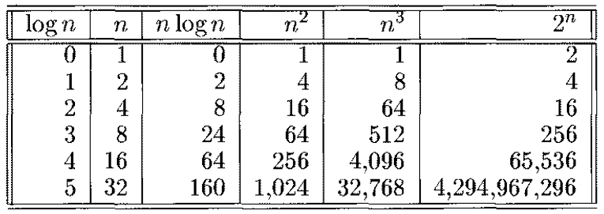
Order of growth
Measuring the performance of an algorithm in relation with input size n is called order of growth.
Lecture No: 1 Introduction to Analysis of Algorithms

Slide 10
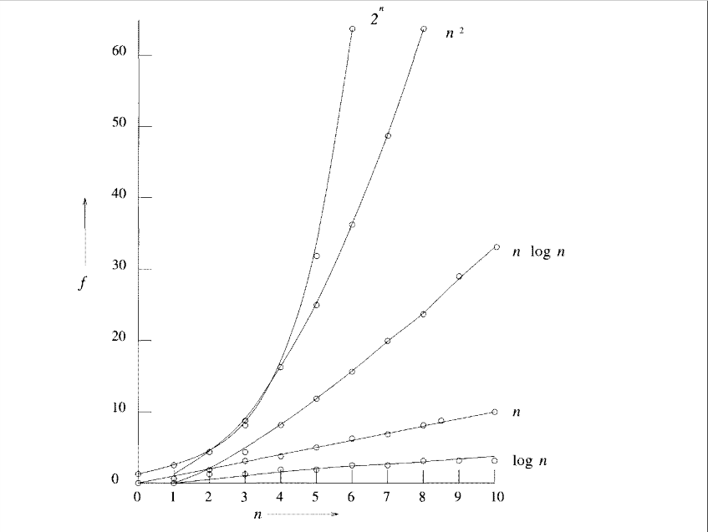
Order of growth
Lecture No: 1 Introduction to Analysis of Algorithms

Slide 11
Best case, Worst case and Average case Analyses
The worst case
  running time T(n) of an algorithm is the function defined by the maximum number of steps taken on any instance of size n.
The best case
  running time T(n) of an algorithm is the function defined by the minimum number of steps taken on any instance of size n.
The average-case
  running time T(n) of an algorithm is the function defined by an average number of steps taken on any instance of size n.
Which of these is the best to use?
18
Lecture No: 1 Introduction to Analysis of Algorithms

Slide 12
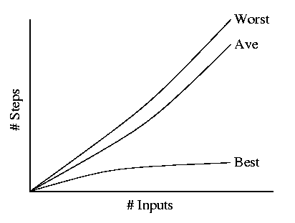
Best, Worst, and Average Case
Lecture No: 1 Introduction to Analysis of Algorithms

Slide 13
Example
Consider the following algorithm
Algorithm Seq_search ( x[0,1,….n-1] ,key)
{
//problem description: This algorithm is for searching the key element from an //array x[0,1,….n-1] sequentially
//Input: an array X[0…n-1] and search key
//output:return the index of x where key value is present.
  for i-0 to n-1 do
  if(x[i]==key) then
  return i
}
Lecture No: 1 Introduction to Analysis of Algorithms

Slide 14
Example
Best case : if key element is present at first location in the list x[0,1,….n-1] the algorithm run for a very short time and there by we will get the best case time complexity.
Cbest =1
Worst case : if key is present at nth location
  Cworst =n
Average case :Let the algorithm is for sequential search and P be a probability of getting successful search n is the total number of elements in the list.
  The first match of the element will occur at ith location. Hence probability of occurring first match is P\n for every ith element.
  The probability of getting unsuccessful search is(1-P)
Lecture No: 1 Introduction to Analysis of Algorithms

Slide 15
Example
Now we can find average case
Cavg(n)=Probability of successful search + Probability of unsuccessful search
Cavg=[1.P/n+2. P/n+3. P/n……+i. P/n]+n(1-P)
=P/n [1+2+3……i+….n]+n(1-P)
=P(n+1)/2 + n(1-P)
If P=0 means no successful search
Cavg=n --> worst case
If P=1 we get a successful search
Cavg=(n+1)/2
Lecture No: 1 Introduction to Analysis of Algorithms

Slide 16
Asymptotic Notation( Growth of function)
The efficiency can be measured by computing time complexity of each algorithm
Asymptotic notation is a shorthand way to represent the time complexity.
It is also defines in terms of function
Various notation such as Ω,Θ, and Ο used as asymptotic notation.
Lecture No: 1 Introduction to Analysis of Algorithms

Slide 17
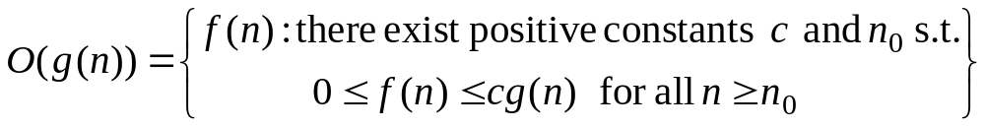
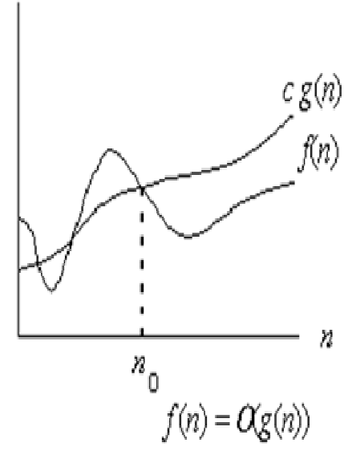
Big-oh(O) Notation
For a given function g(n), we denote by O(g(n)) the set of functions
We use O-notation to give an asymptotic upper bound of a function, to within a constant factor.
f(n)=O(g(n)) means that there existes some constant c s.t. f(n) is always ≤ cg(n)for large enough n.
It represent the upper
bound of algorithm
running time.
Lecture No: 1 Introduction to Analysis of Algorithms

Slide 18
Example
1.Consider function f(n)=2n+2 and g(n)=n² then we have to find some constant c so that f(n)≤c*g(n).
Solution: As f(n)=2n+2 and g(n)= n² then find c.
If n=1
f(n)=2n+2=4 g(n)= n² = 1 i.e f(n)>g(n)
If n=2
f(n)=2n+2=6 g(n)= n² = 4 i.e f(n)>g(n)
If n=3
f(n)=2n+2=8 g(n)= n² = 9 i.e f(n)<g(n)
Hence we can conclude that for n≥3
We obtained
f(n)≤c*g(n)
2. Consider function f(n)=100n+6and g(n)=101n then we have to find some constant c so that f(n)≤c*g(n).
Lecture No: 1 Introduction to Analysis of Algorithms

Slide 19
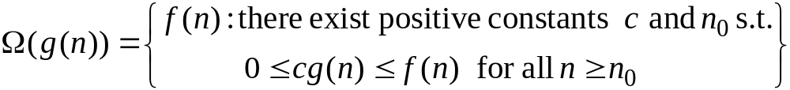
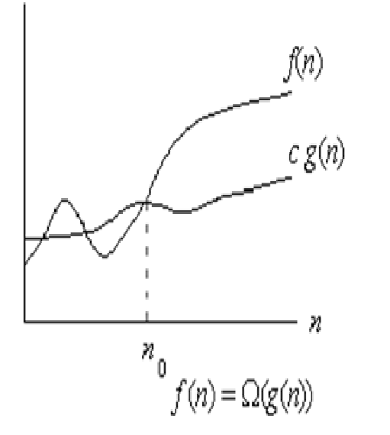
Omega Notation (Ω)
For a given function g(n), we denote by Ω(g(n)) the set of functions
We use Ω-notation to give an asymptotic lower bound on a function, to within a constant factor.
f(n)= Ω (g(n))means that there exists some constant c s.t. f(n) is always ≥cg(n) for large enough n.
It represent the lower bound of
algorithm running time
Lecture No: 1 Introduction to Analysis of Algorithms

Slide 20
Example
1.Consider function f(n)=3n+2 and g(n)=3n then we have to find some constant c so that f(n)≥c*g(n).
Solution: As f(n)=3n+2 and g(n)= 3n then find c.
If n=1
f(n)=3n+2=5 g(n)= 3n = 3 i.e f(n)>g(n)
Hence we can conclude that for n≥1
We obtained
f(n)≥c*g(n)
2. Consider function f(n)=100n+6and g(n)=100n then we have to find some constant c so that f(n)≥c*g(n).
Lecture No: 1 Introduction to Analysis of Algorithms

Slide 21
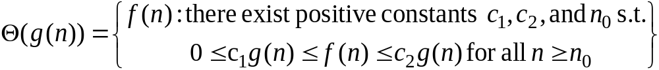
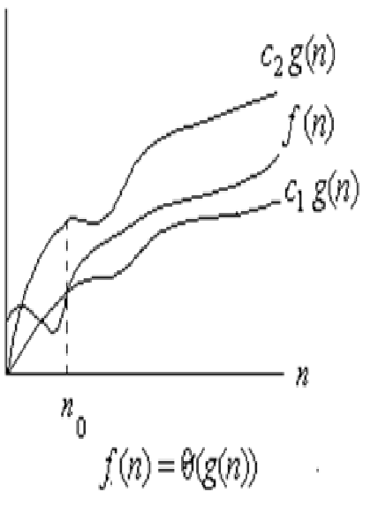
Theta Notation (Θ)
For a given function g(n), we denote by Θ(g(n)) the set of functions
A function f(n) belongs to the set Θ(g(n)) if there exist positive constants c₁ and c₂ such that it can be “sand- wiched” between c₁ g(n) and c₂g(n) or sufficienly large n.
F(n)= Θ(g(n)) means that there exists some constant c₁ and c₂ s.t c₁ g(n)≤ f(n)≤ c₂ g(n) for large enough n.
It represent running time between
upper bound and lower bound of
algorithm.
Lecture No: 1 Introduction to Analysis of Algorithms

Slide 22
Example
State whether the following function are correct or incorrect and justify your answer.
      3n+2=O(n)
      100n+6=O(n)
      10n²+4n+2=O(n²)
Interpret the following equation
  2n²+Θ(n)= Θ (n²)
Lecture No: 1 Introduction to Analysis of Algorithms

Slide 23
Logarithmic Loops
Multiply 2^{iterations}<1000
Divide 1000/2^{iterations} >=1
Example
Case1:
  1. i=1
  2. loop(i<=1000)
  application code
  i=i+1
  3. end loop
  f(n)=O(n)
  Case2:
  1. i=1
  2. loop(i<=1000)
  application code
  i=i+2
  3. end loop
  f(n)=O(n/2)
  Case3:
  1. i=1
  2. loop(i<=1000)
  application code
  i=i*2
  3. end loop
  f(n)=O(log₂n)
  Case4:
  1. i=1
  2. loop(i<=1000)
  application code
  i=i/2
  3. end loop
  f(n)=O(log₂n)
Lecture No: 1 Introduction to Analysis of Algorithms

Slide 24
Recurrence relation
A recurrence relation is an equation that defines a sequence based on a rule that gives the next term as a function of the previous term(s). It is also defined as a function by means of an expression that includes one or more smaller instances of itself.
Example for the recursive definition is factorial function , Fibonacci series.
Lecture No: 1 Introduction to Analysis of Algorithms

Slide 25

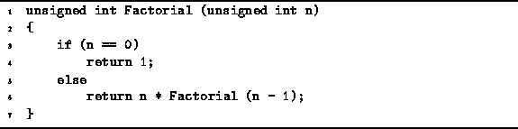
Example of Recursive Program
Recursive program to compute n!
Lecture No: 1 Introduction to Analysis of Algorithms

Slide 26
Recurrence Relations to Remember
T(n) = T(n/2) + O(1)
T(n) = T(n-1) + O(1)
T(n) = 2 T(n/2) + O(1)
T(n) = T(n-1) + O(n)
T(n) = 2 T(n/2) + O(n)
Recurrence | Algorithm | Big-Oh Solution
T(n) = T(n/2) + O(1) | Binary Search | O(log n)
T(n) = T(n-1) + O(1) | Sequential Search | O(n)
T(n) = 2 T(n/2) + O(1) | tree traversal | O(n)
T(n) = T(n-1) + O(n) | Selection Sort (other n² sorts) | O(n²)
T(n) = 2 T(n/2) + O(n) | Mergesort (average case Quicksort) | O(n log n)
Lecture No: 1 Introduction to Analysis of Algorithms

Slide 27
Module No 1: Basic Concepts and Finite Automata
Lecture No:2
Complexity of recursive algorithms

Slide 28
Recurrence relation
A recurrence relation is an equation that defines a sequence based on a rule that gives the next term as a function of the previous term(s). It is also defined as a function by means of an expression that includes one or more smaller instances of itself.
Example for the recursive definition is factorial function , Fibonacci series.
Lecture 2: Complexity-complexity of recursive algorithms

Slide 29
Example of Recursive Program
Recursive program to compute n!
Lecture 2: Complexity-complexity of recursive algorithms

Slide 30
Finding Complexity of recursive algorithms
There are 3 methods by which we can find complexity of recursive algorithms.
They are
  1) Repeated Substitution i.e Substitution Method.
  2) Recursion-Tree Method
  3) Master Method
Lecture 2: Complexity-complexity of recursive algorithms

Slide 31
Example
Consider a recurrence relation
T(n)=T(n-1)+n
With initial condition T(0)=0
Let,
T(n)=T(n-1)+n ------- equation 1
T(n-1)=T(n-2)+n-1 -------putting this in equation 1 we get
T(n)=T(n-2)+(n-1)+n ------- equation 2
T(n-2)=T(n-3)+n-2 -------putting this in equation 2 we get
T(n)=T(n-3)+(n-2)+(n-1)+n ------- equation 3
T(n-k)=T(n-k)+n-k -------putting this in equation k we get
T(n)=T(n-k)+……….(n-2)+(n-1)+n ------- equation k
If K=n then
T(n)=T(0)+1+2……….+n
T(n)=0+1+2……….+n
T(n)=n(n+1)/2=O(n²)
Lecture 8: Recursive algorithms, The substitution method

Slide 32
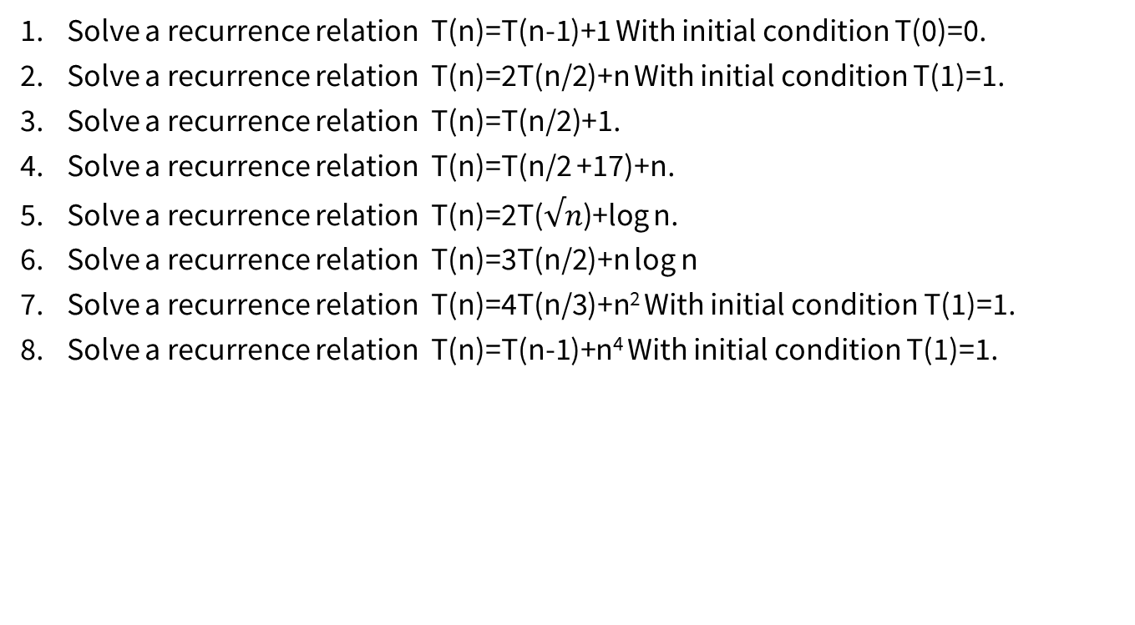
Example
Lecture 2: Performance analysis , space and time complexity

Slide 33
Lecture No: 3
Finding complexity by tree method

Slide 34
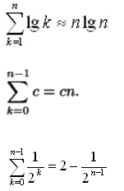



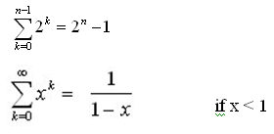
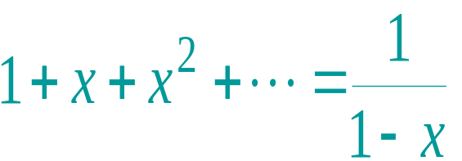
Solving Recurrence Relations
In evaluating the summation one or more of the following summation formulae may be used:
Special Cases of Geometric Series and Arithmetic series:
for |x| < 1
Lecture No 3: Finding complexity by tree method

Slide 35
The recursion-tree method
The recurrence relation can also be solved using tree method.
In this method a recursion tree is built in which each node represents the cost of single subproblem in the form of recursive function invocation.
Then we sum up the cost at each level to determine the overall cost.
Thus recursion tree helps up to make a good guess of time complexity.
Lecture No 3: Finding complexity by tree method

Slide 36
The recursion-tree method
Convert the recurrence into a tree:
  Each node represents the cost incurred at various levels of recursion
  Sum up the costs of all levels
Steps
  Cost of each level
  Find the depth of tree
  Find the number of leaves
Lecture No 3: Finding complexity by tree method

Slide 37
Example of recursion tree
Solve T(n) = T(n/4) + T(n/2) + n²:
Lecture No 3: Finding complexity by tree method

Slide 38
Example of recursion tree
Solve T(n) = T(n/4) + T(n/2) + n²:
T(n)
Lecture No 3: Finding complexity by tree method

Slide 39
Example of recursion tree
Solve T(n) = T(n/4) + T(n/2) + n²:
n²
T(n/4)
T(n/2)
65
Lecture No 3: Finding complexity by tree method

Slide 40
Example of recursion tree
Solve T(n) = T(n/4) + T(n/2) + n²:
n²
(n/4)²
(n/2)²
T(n/16)
T(n/8)
T(n/8)
T(n/4)
Lecture No 3: Finding complexity by tree method

Slide 41
Example of recursion tree
Solve T(n) = T(n/4) + T(n/2) + n²:
n²
(n/4)²
(n/2)²
(n/16)²
(n/8)²
(n/8)²
(n/4)²
…
Θ(1)
Lecture No 3: Finding complexity by tree method

Slide 42

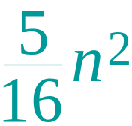
Example of recursion tree
Solve T(n) = T(n/4) + T(n/2) + n²:
n²
(n/4)²
(n/2)²
(n/16)²
(n/8)²
(n/8)²
(n/4)²
…
Θ(1)
Lecture No 3: Finding complexity by tree method

Slide 43
Example of recursion tree
Solve T(n) = T(n/4) + T(n/2) + n²:
n²
(n/4)²
(n/2)²
(n/16)²
(n/8)²
(n/8)²
(n/4)²
…
Θ(1)
Lecture No 3: Finding complexity by tree method

Slide 44
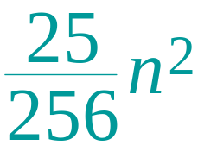
Example of recursion tree
Solve T(n) = T(n/4) + T(n/2) + n²:
n²
(n/4)²
(n/2)²
(n/16)²
(n/8)²
(n/8)²
(n/4)²
…
…
Θ(1)
Lecture No 3: Finding complexity by tree method

Slide 45
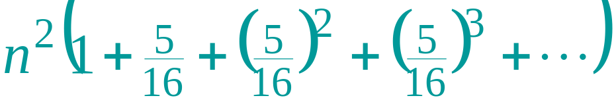
Example of recursion tree
Solve T(n) = T(n/4) + T(n/2) + n²:
n²
(n/4)²
(n/2)²
(n/16)²
(n/8)²
(n/8)²
(n/4)²
…
…
Θ(1)
Total =
geometric series
= Θ(n²)
Lecture No 3: Finding complexity by tree method

Slide 46
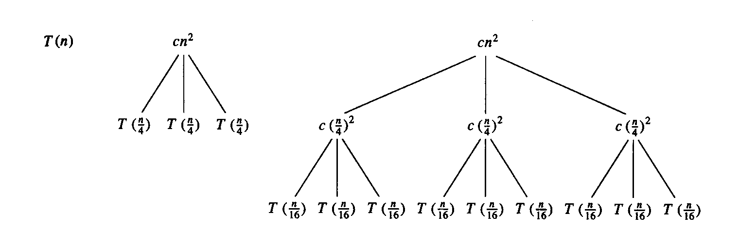
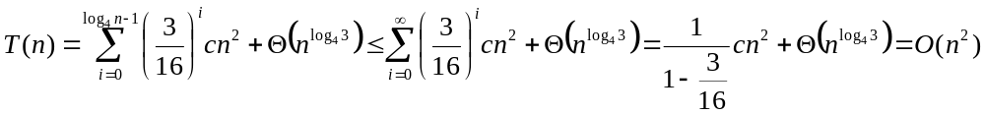
Example 2
E.g.: T(n) = 3T(n/4) + cn²
Subproblem size at level i is: n/4^{i}
Subproblem size hits 1 when 1 = n/4^{i} ⇒ i = log₄n
Cost of a node at level i = c(n/4^{i})²
Number of nodes at level i = 3^{i} ⇒ last level has 3^{log}₄^{n} = n^{log}₄³ nodes
Total cost:
⇒ T(n) = O(n²)

Slide 47
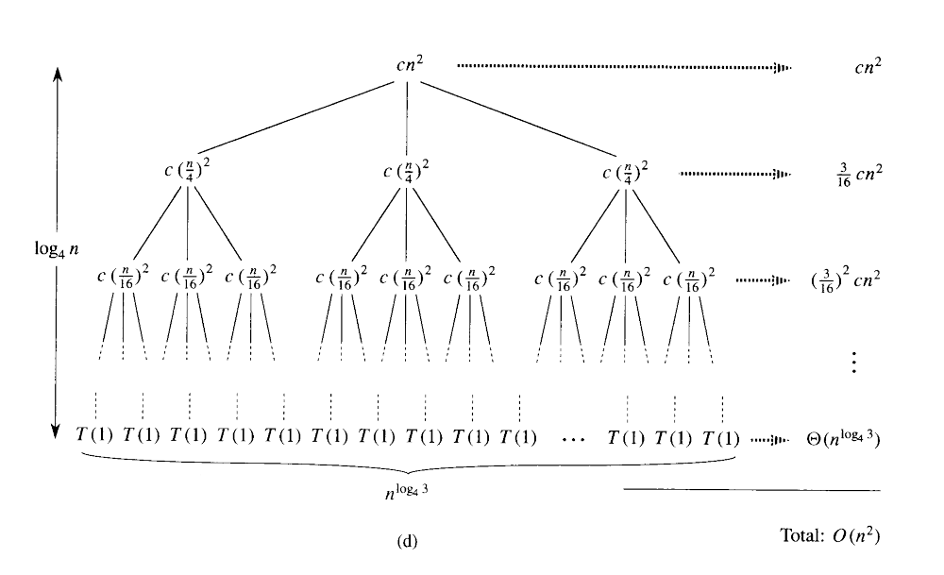
Recursion-tree method (Cont !!!)

Slide 48
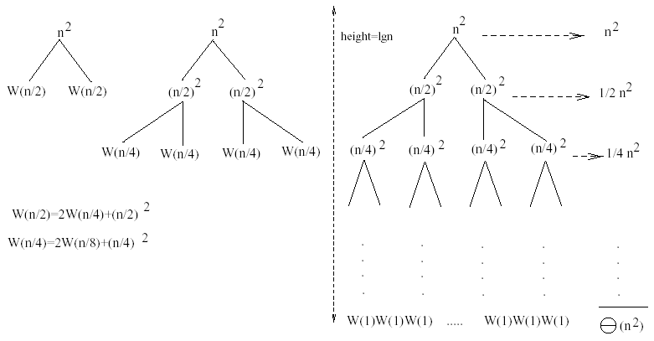
Example 1
W(n) = 2W(n/2) + n²
Subproblem size at level i is: n/2^{i}
Subproblem size hits 1 when 1 = n/2^{i} ⇒ i = lgn
Cost of the problem at level i = (n/2^{i})² No. of nodes at level i = 2^{i}
Total cost:
⇒ W(n) = O(n²)
Lecture No 3: Finding complexity by tree method

Slide 49
Solve
T(n)=2T(n/2)+O(n)
T(n)=2T(n/2)+4n T(1)=4
T(n)=T(n/3)+ T(2n/3)+ O(n)
Lecture No 3: Finding complexity by tree method

Slide 50
Lecture No: 4 Master Theorem

Slide 51
Master Theorem
The Master Theorem applies to recurrences of the following form:
T (n) = aT (n/b) + f(n)
where a ≥ 1 and b > 1 are constants and f(n) is an asymptotically positive function. There are 3 cases:
If f(n) = O(n^logba−€ )for some constant € >0,
  then T (n) = Θ(n logba ).
If f(n) = Θ(n^logba) with1 k ≥ 0,
then T (n) = Θ(n^logba log n).
If f(n) = Ω(n^logba +€ ) with € > 0, and f(n) satisfies the regularity condition,
then T (n) = Θ(f(n)).
Regularity condition: af(n/b) ≤ cf(n) for some constant c < 1 and all sufficiently large n
Lecture No 4: Master Theorem

Slide 52
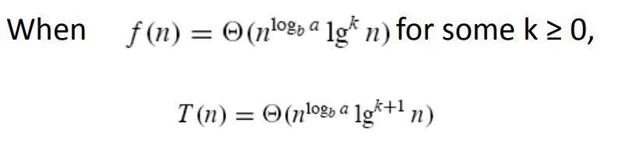
Generalized Case 2
Lecture No 4: Master Theorem

Slide 53
Using The Master Method
T(n) = 9T(n/3) + n
  a=9, b=3, f(n) = n
  n^{logb a} = n^{log3 9} = Θ(n²)
  Since f(n) = O(n^{log3 9 - ε}), where ε=1, case 1 applies:
  Thus the solution is T(n) = Θ(n²)
Lecture No 4: Master Theorem

Slide 54
Examples
T (n) = 3T (n/2) + n^2
T (n) = 4T (n/2) + n^2
T (n) = T (n/2) + 2^n
T (n) = 16T (n/4) + n
T (n) = 2T (n/2) + n log n
T (n) = 2T (n/4) + n 0.58
T (n) = 4T (n/2) + cn
T (n) = 3T (n/3) + n/2
T(n) = 4T(n/2) + n^2 + n
T(n) = T(n/2 + 5) + n^2
Lecture No 4: Master Theorem

Slide 55
Thank You

