Slide 1

Subject Name: Advanced Algorithms
Unit No:4
Unit Name: Maximum Flow
Faculty Name : Ms Vanita Mane.

Slide 2
Module No 4: : Maximum Flow
Lecture No: 29
Introduction to Flow networks

Slide 3
Concept of Flow Network
We can model road map as a directed graph in order to find the shortest path from one point to another and in the similar way, we can also interpret directed graph as a flow network.
Flow networks can be used to model many problems, including liquids flowing through pipes, parts through assembly lines, current through electrical networks and information through communication networks.
Each directed edge in a flow network is considered as a channel for the material.
Each channel has a stated capacity, given as a maximum rate at which the material can flow through it, for example, 200 gallons of liquid per hour through a pipe or 20 amperes of electric current through a wire.
Vertices are channel junctions and material flows through the vertices without collecting in source and sink.
In other words, the rate at which material enters a vertex must equal the rate at which it leaves the vertex.
4
Lecture 25 : Introduction to Flow Network

Slide 4
Definition of Flow Network
Let G = (V, E) be a flow network with a capacity function c.
Let s be the source of the network, and let t be the sink.
A flow in G is a real valued function f : V X V → R that satisfies the following two properties :
Capacity constraint : For all u, v Є V, we require 0 ≤ f( u, v) ≤ c( u, v)
Flow conservation : For all u Є V – { s, t }, we require
∑ f ( u, v) = ∑ f ( v, u )
v Є V v Є V
When ( u, v) ∉ E, there can be no flow from u to v and f( u, v ) = 0.
Lecture 29 : Definition of Flow Network

Slide 5
Definition of Flow Network
Flow network is a directed graph G=(V,E) such that each edge has a non-negative capacity c(u,v)≥0.
Two distinguished vertices exist in G namely :
  Source (denoted by s) : In-degree of this vertex is 0.
  Sink (denoted by t) : Out-degree of this vertex is 0.
Flow in a network is an integer-valued function f defined on the edges of G satisfying 0 ≤ f(u,v) ≤ c(u,v), for every Edge(u,v) in E.
Augmented Path is a path from source s to sink t in a residual graph.
Residual Graph is graph after sending the flow through the network with edges having remaining capacities (residual capacity).
Lecture 29 : Definition of Flow Network

Slide 6
Module No 4: Maximum Flow
Lecture No:30
Example on Flow networks

Slide 7
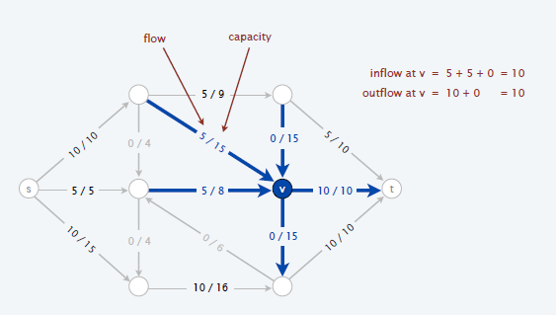
Definition of Flow Network ( cont….)
The capacity constraint simply says that the flow from one vertex to another must be non negative and must not exceed the given capacity.
The flow conservation property says that the total flow into a vertex other than the source or sink must equal the total flow out of that vertex – informally. “ Flow in equals flow out. “
Lecture 30: Example on Flow networks

Slide 8
Maximum Flow
In maximum flow problem we wish to compute the greatest rate at which we can ship material
from the source to the sink without violating any capacity constraints.
In other words, we are given a flow network G with source s and sink t, and we wish to find a flow
of maximum flow.
For solving maximum flow problems Ford Fulkerson method is used.
Lecture 30: Example on Flow networks

Slide 9
Lecture No: 31
Ford Fulkerson Method

Slide 10
Ford Fulkerson Algorithm
FORD-FULKERSON(G,s,t)
  • for each edge (u,v)  E[G]
    • do f[u,v] 0
    • f[v,u] 0
  • while there exists a path p from s to t in the residual network Gf
    • do cf(p) min{cf(u,v): (u,v) is in p}
      • for each edge (u,v) in p
        • do f[u,v] f[u,v]+cf(p)
Lecture No 31 Ford Fulkerson Method

Slide 11
Ford Fulkerson Algorithm
After every step in the algorithm the following is maintained:
• Capacity Constraints : ∀ 𝑢, 𝑣 𝜖 𝐸 𝑓 𝑢, 𝑣 ≤ 𝑐(𝑢, 𝑣)
➢ The flow along an edge can not exceed its capacity.
• Skew Symmetry : ∀ 𝑢, 𝑣 𝜖 𝐸 𝑓 𝑢, 𝑣 = −𝑓(𝑣, 𝑢)
➢ The net flow from u to v must be the opposite of the net flow from v to u
• Flow Conservation :
➢ Unless u is s or t. The net flow to a node is zero, except for the source, which
"produces" flow, and the sink, which "consumes" flow.
Lecture No 31 Ford Fulkerson Method

Slide 12
Ford Fulkerson Algorithm
When the algorithm terminates?
All paths from s to t are blocked by either a
• Full forward edge
• Empty backward edge
Lecture No 31 Ford Fulkerson Method

Slide 13
Lecture No: 32
Example on Ford Fulkerson

Slide 14
Example
Lecture No 32: Example on Ford Fulkerson

Slide 15
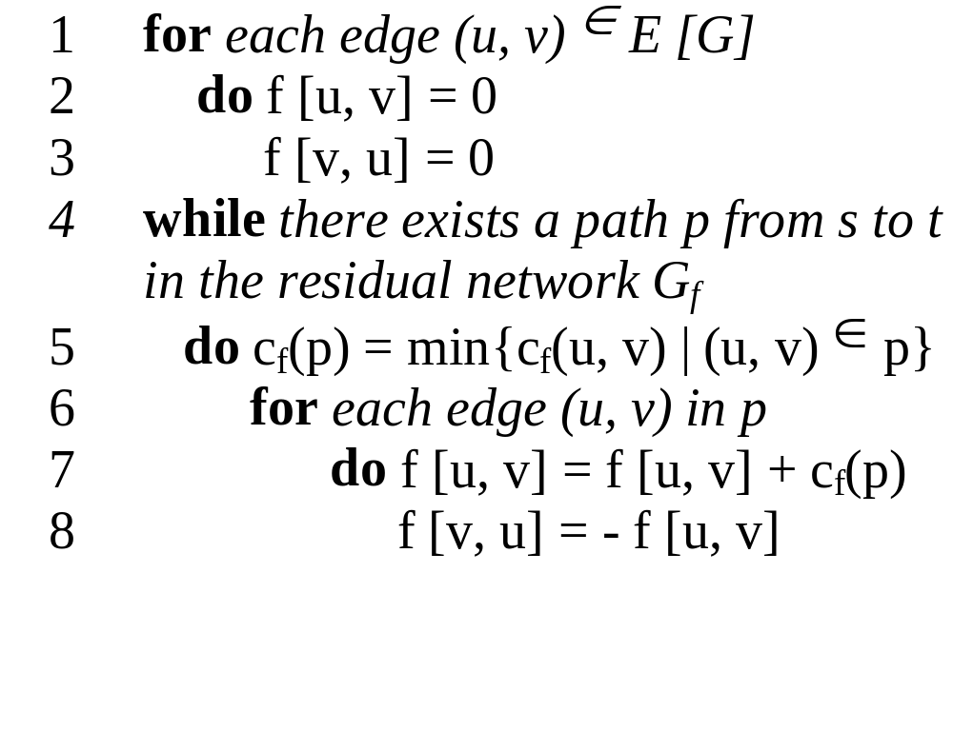
The basic Ford Fulkerson algorithm example of an execution
(residual) network G_{f}
v1
12
v3
16
20
10
4
7
S
9
t
4
13
v2
v4
14
Lecture No 32: Example on Ford Fulkerson

Slide 16
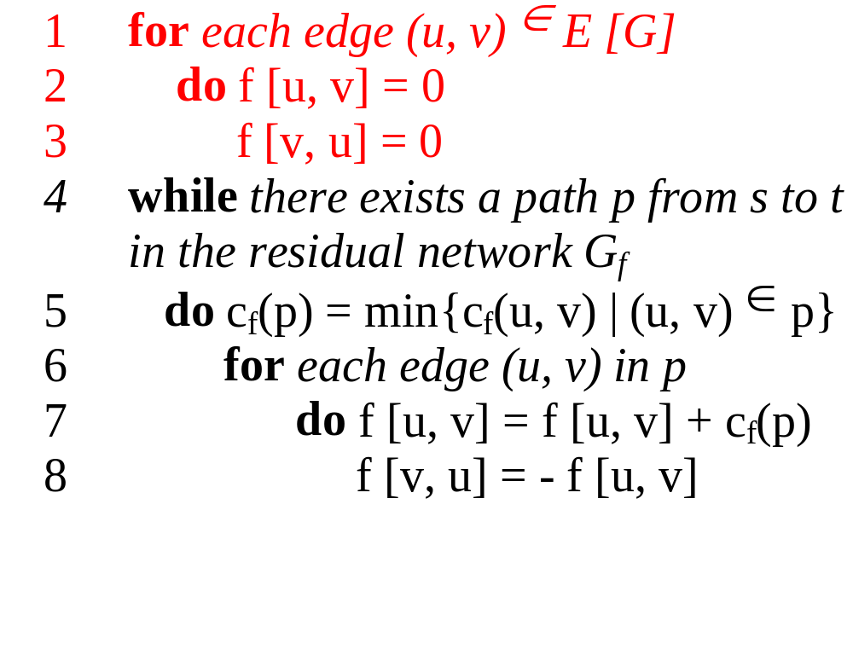
The basic Ford Fulkerson algorithm example of an execution
(residual) network G_{f}
v1
0/12
v3
0/16
0/20
0/10
0/4
7
S
0/9
t
0/4
0/13
v2
v4
0/14
Lecture No 32: Example on Ford Fulkerson

Slide 17
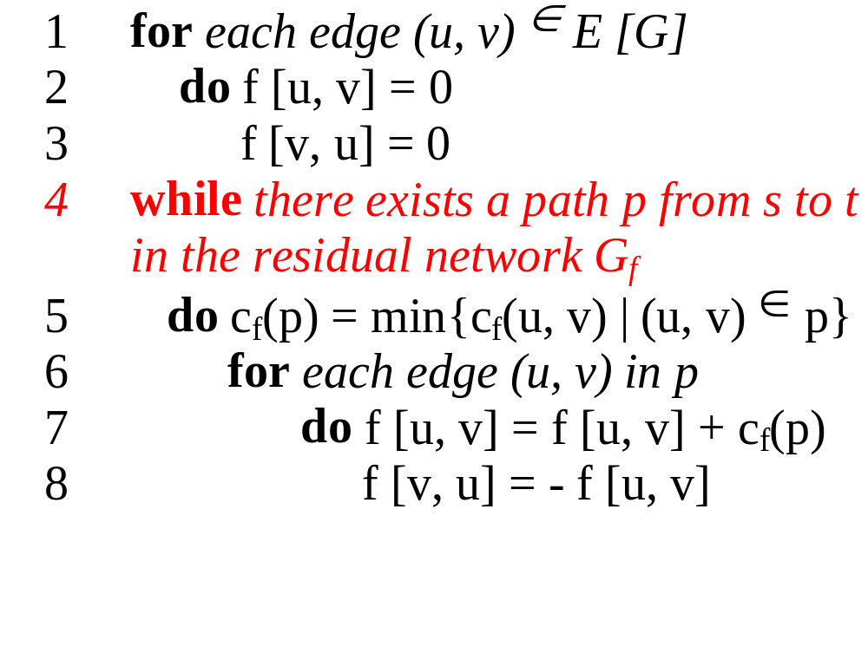
The basic Ford Fulkerson algorithm example of an execution
(residual) network G_{f}
v1
12
v3
16
20
10
4
7
S
9
t
4
13
v2
v4
14
Lecture No 32: Example on Ford Fulkerson

Slide 18
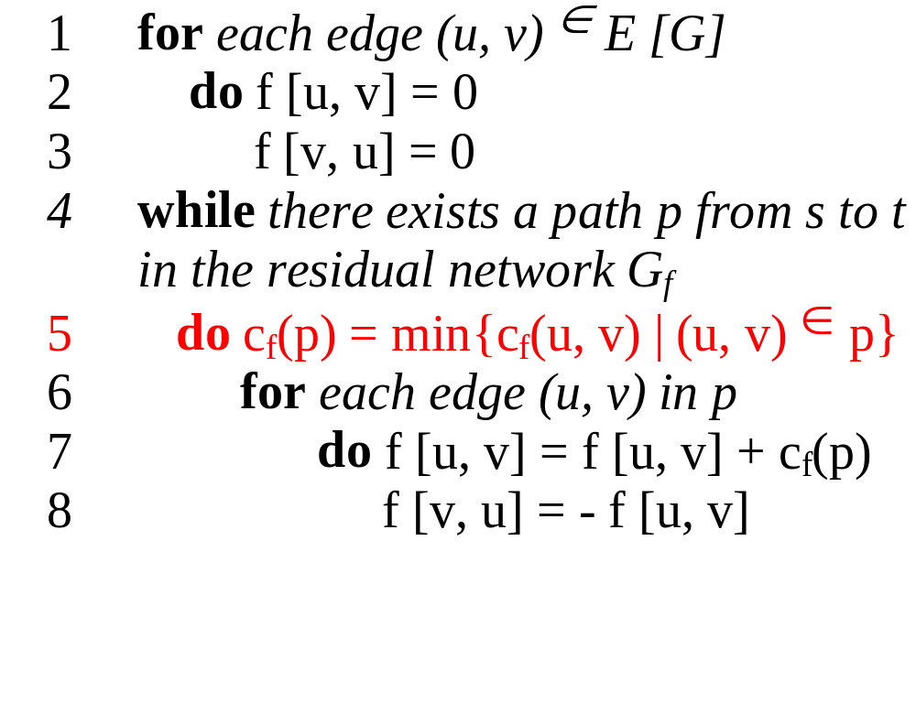
The basic Ford Fulkerson algorithm example of an execution
(residual) network G_{f}
v1
12
v3
16
20
10
4
7
S
9
t
4
13
v2
v4
14
temporary variable:
c_{f} (p) = 12
Lecture No 32: Example on Ford Fulkerson

Slide 19
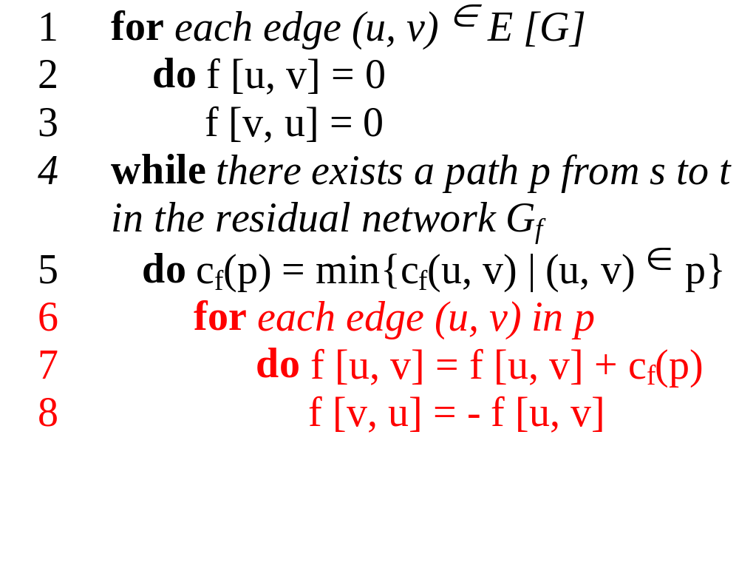
The basic Ford Fulkerson algorithm example of an execution
(residual) network G_{f}
v1
12
v3
16
20
10
4
7
S
9
t
4
13
v2
v4
14
new flow network G
v1
12/12
v3
12/16
12/20
temporary variable:
c_{f} (p) = 12
10
4
7
S
9
t
4
13
v2
v4
14
Lecture No 32: Example on Ford Fulkerson

Slide 20
The basic Ford Fulkerson algorithm example of an execution
(residual) network G_{f}
v1
12
v3
4
8
12
12
10
4
7
S
9
t
4
13
v2
v4
14
new flow network G
v1
12/12
v3
12/16
12/20
10
4
7
S
9
t
4
13
v2
v4
14

Slide 21
The basic Ford Fulkerson algorithm example of an execution
(residual) network G_{f}
v1
12
v3
4
8
12
12
10
4
7
S
9
t
4
13
v2
v4
14
new flow network G
v1
12/12
v3
12/16
12/20
10
4
7
S
9
t
4
13
v2
v4
14
Lecture No 32: Example on Ford Fulkerson

Slide 22
The basic Ford Fulkerson algorithm example of an execution
(residual) network G_{f}
v1
12
v3
4
8
12
12
10
4
7
S
9
t
4
13
v2
v4
14
new flow network G
v1
12/12
v3
12/16
12/20
10
4
7
S
9
t
4
13
v2
v4
14
Lecture No 32: Example on Ford Fulkerson

Slide 23
The basic Ford Fulkerson algorithm example of an execution
(residual) network G_{f}
v1
12
v3
4
8
12
12
10
4
7
S
9
t
4
13
v2
v4
14
new flow network G
v1
12/12
v3
12/16
12/20
10
4
7
S
9
t
temporary variable:
c_{f} (p) = 4
4
13
v2
v4
14
Lecture No 32: Example on Ford Fulkerson

Slide 24
The basic Ford Fulkerson algorithm example of an execution
(residual) network G_{f}
v1
12
v3
4
8
12
12
10
4
7
S
9
t
4
13
v2
v4
14
new flow network G
v1
12/12
v3
12/16
12/20
temporary variable:
c_{f} (p) = 4
10
4
7
S
9
t
4/4
4/13
v2
v4
4/14

Slide 25
The basic Ford Fulkerson algorithm example of an execution
(residual) network G_{f}
v1
12
v3
4
8
12
12
10
4
7
S
9
t
4
4
4
9
v2
v4
10
new flow network G
v1
12/12
v3
12/16
12/20
10
4
7
S
9
t
4/4
4/13
v2
v4
4/14
Lecture No 32: Example on Ford Fulkerson

Slide 26
The basic Ford Fulkerson algorithm example of an execution
(residual) network G_{f}
v1
12
v3
4
8
12
12
10
4
7
S
9
t
4
4
4
9
v2
v4
10
new flow network G
v1
12/12
v3
12/16
12/20
10
4
7
S
9
t
4/4
4/13
v2
v4
4/14
Lecture No 32: Example on Ford Fulkerson

Slide 27
The basic Ford Fulkerson algorithm example of an execution
(residual) network G_{f}
v1
12
v3
4
8
12
12
10
4
7
S
9
t
4
4
4
9
v2
v4
10
new flow network G
v1
12/12
v3
12/16
12/20
10
4
7
S
9
t
4/4
4/13
v2
v4
4/14
Lecture No 32: Example on Ford Fulkerson

Slide 28
The basic Ford Fulkerson algorithm example of an execution
(residual) network G_{f}
v1
12
v3
4
8
12
12
10
4
7
S
9
t
4
4
4
9
v2
v4
10
new flow network G
v1
12/12
v3
12/16
12/20
temporary variable:
c_{f} (p) = 7
10
4
7
S
9
t
4/4
4/13
v2
v4
4/14
Lecture No 32: Example on Ford Fulkerson

Slide 29
The basic Ford Fulkerson algorithm example of an execution
(residual) network G_{f}
v1
12
v3
4
8
12
12
10
4
7
S
9
t
4
4
4
9
v2
v4
10
new flow network G
v1
12/12
v3
12/16
19/20
temporary variable:
c_{f} (p) = 7
10
4
7/7
S
9
t
4/4
11/13
v2
v4
11/14
Lecture No 32: Example on Ford Fulkerson

Slide 30
The basic Ford Fulkerson algorithm example of an execution
(residual) network G_{f}
v1
12
v3
4
1
12
19
10
4
7
S
9
t
11
11
4
2
v2
v4
3
new flow network G
v1
12/12
v3
12/16
19/20
10
4
7/7
S
9
t
4/4
11/13
v2
v4
11/14
Lecture No 32: Example on Ford Fulkerson

Slide 31

The basic Ford Fulkerson algorithm
Analysis
O(|E|)
O(|E|)
O(|E| |f_{max}|)
O(|E|)
running time: O ( |E| |f_{max}| )
with f_{max} as maximum flow
(1) The augmenting path is chosen arbitrarily and all capacities are integers
Lecture No 32: Example on Ford Fulkerson

Slide 32
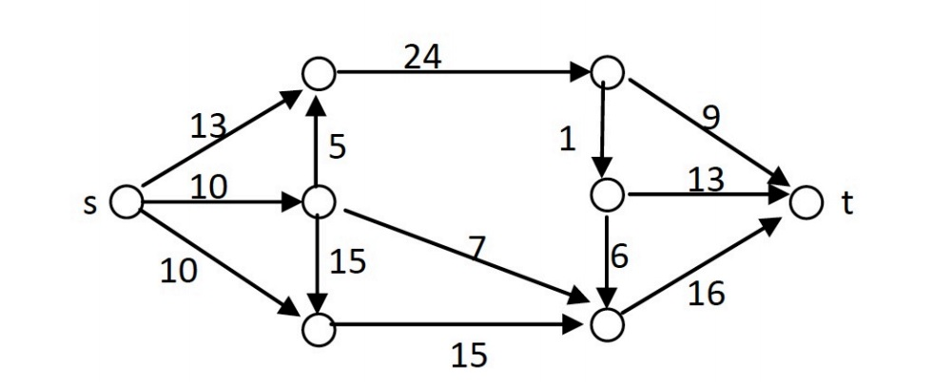

Slide 33
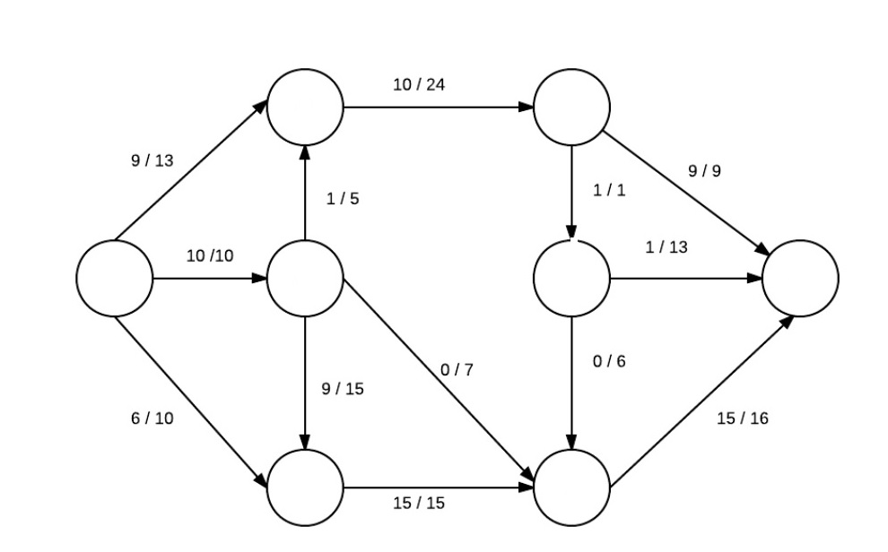

Slide 34
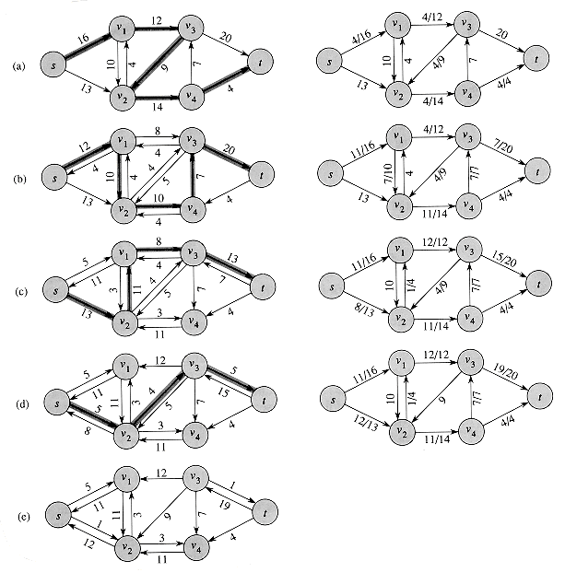

Slide 35
Thank You

