Slide 1


Is flying safe?
Let’s look at the data…
Notes:
With all the headlines recently about windows popping off, tires bursting and planes operating at dangerously low altitudes, you might think that flying is becoming increasingly unsafe. But is it really? Let's look at what the data tells us.

Slide 2
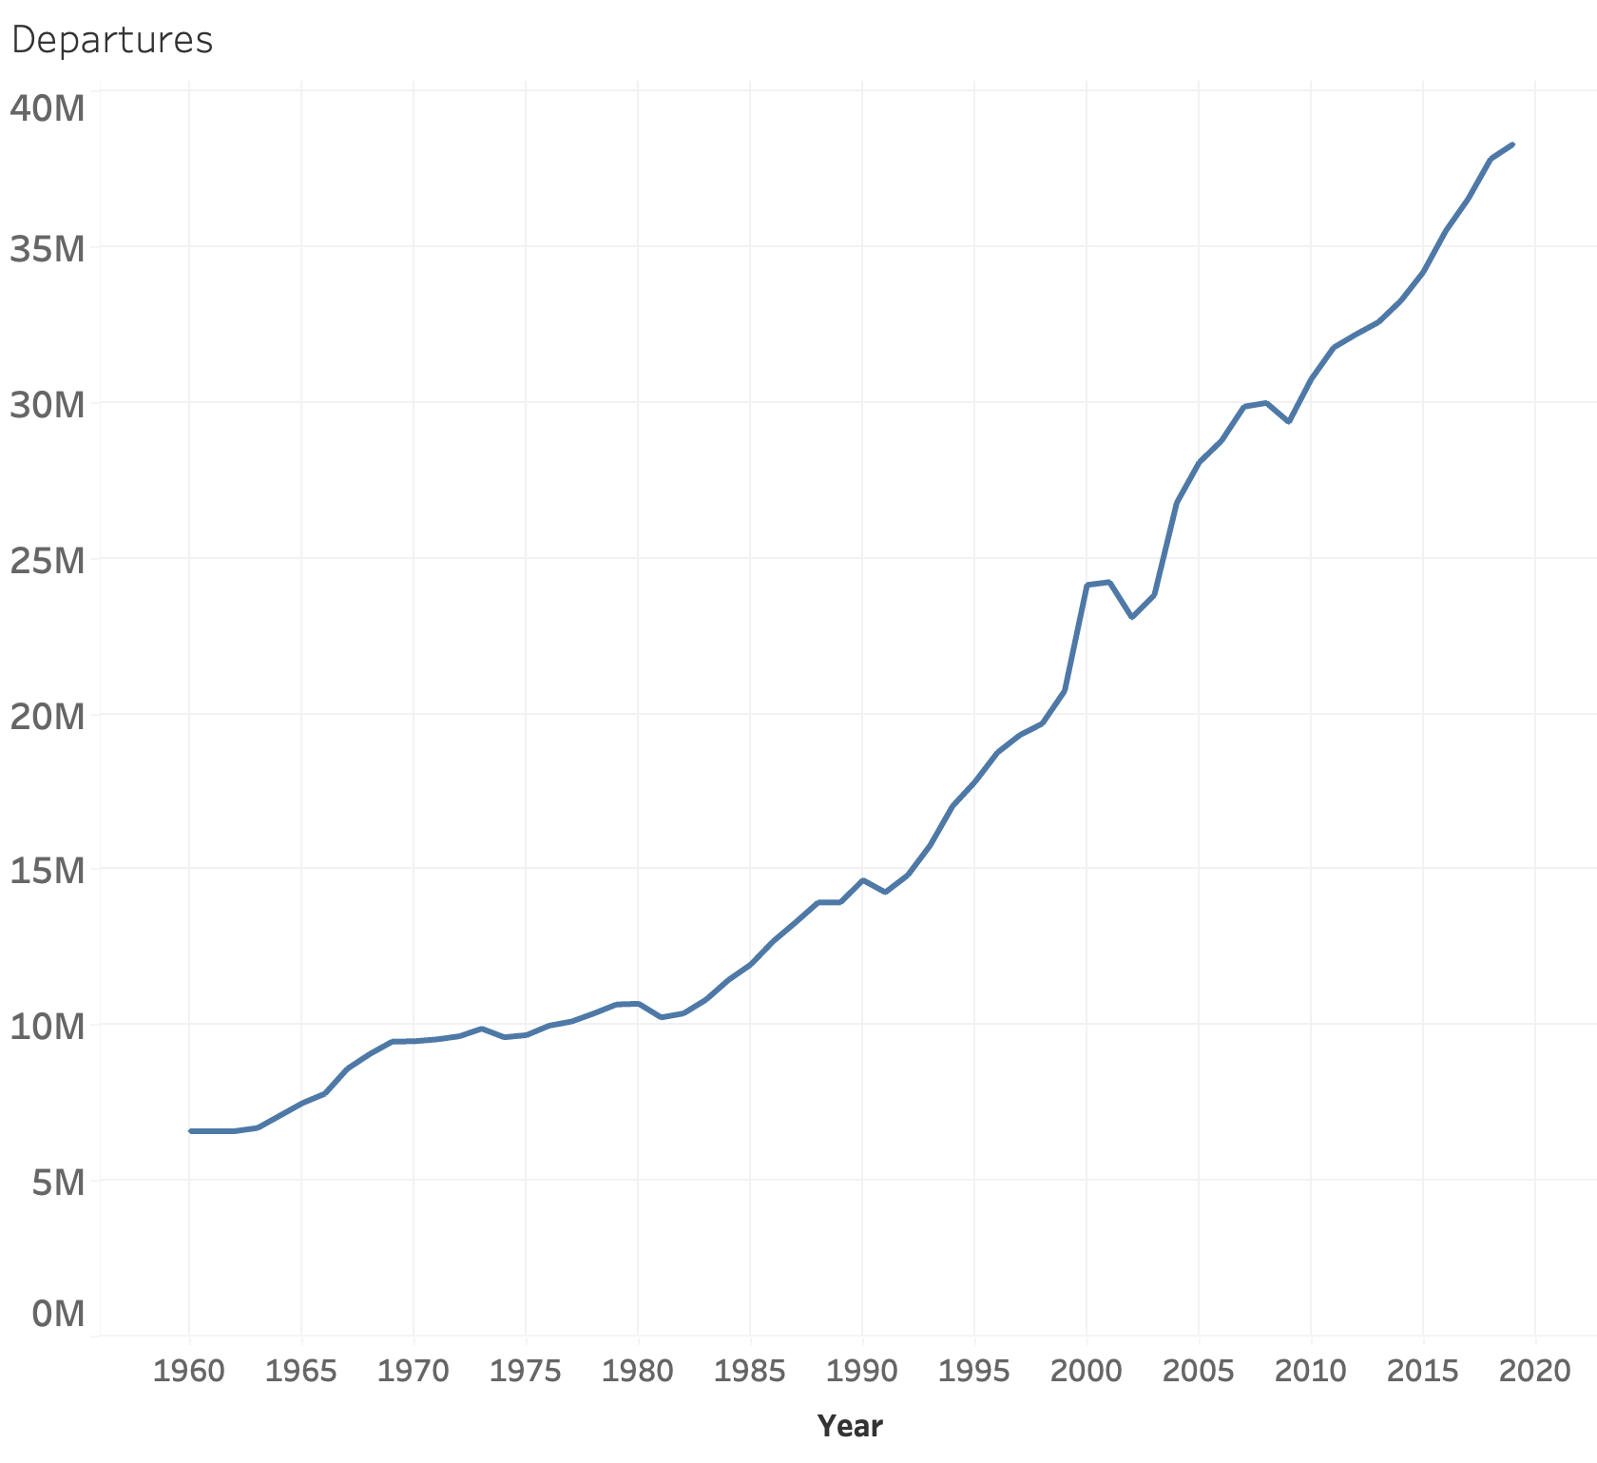
In 2019, there were 38 million flights worldwide
Notes:
In 2019, there were over 38 million flights worldwide. Although the number of flights declined significantly during the COVID-19 pandemic, flights have steadily been increasing every year since restrictions were lifted.

Slide 3

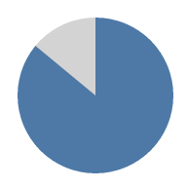
Percentage of Americans who have ever flown on an airplane
1973
2023
54%
86%
Notes:
With the rise in global air traffic, the overall percentage of Americans flying has also grown significantly. According to the Air Travelers in America annual survey, 50 years ago, only 54% of respondents had ever flown. That number has now grown to over 86% percent, or 5 out of every 6 people.

Slide 4




It has been 15 years since the last fatal US airliner accident
Notes:
It has now been over 15 years since the last fatal crash of a US airliner, when Colgan Air flight 3407 crashed in Western New York. That was so long ago that the iPad, TikTok or Uber had not yet been invented.

Slide 5
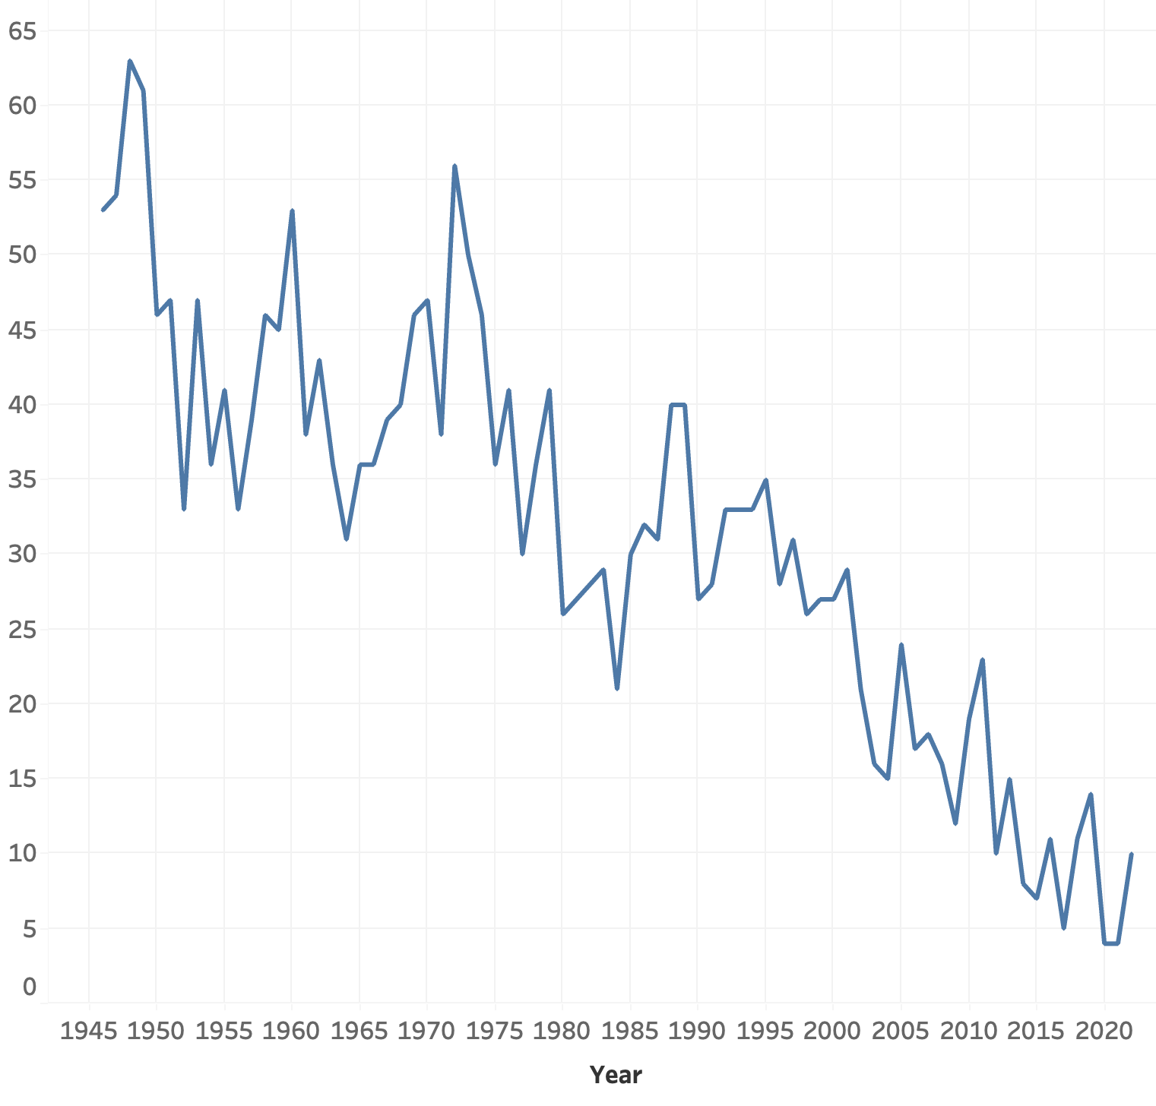
Airline accidents over time
Notes:
Despite the increase in air traffic over the years, the total number of accidents has been on the decline.

Slide 6
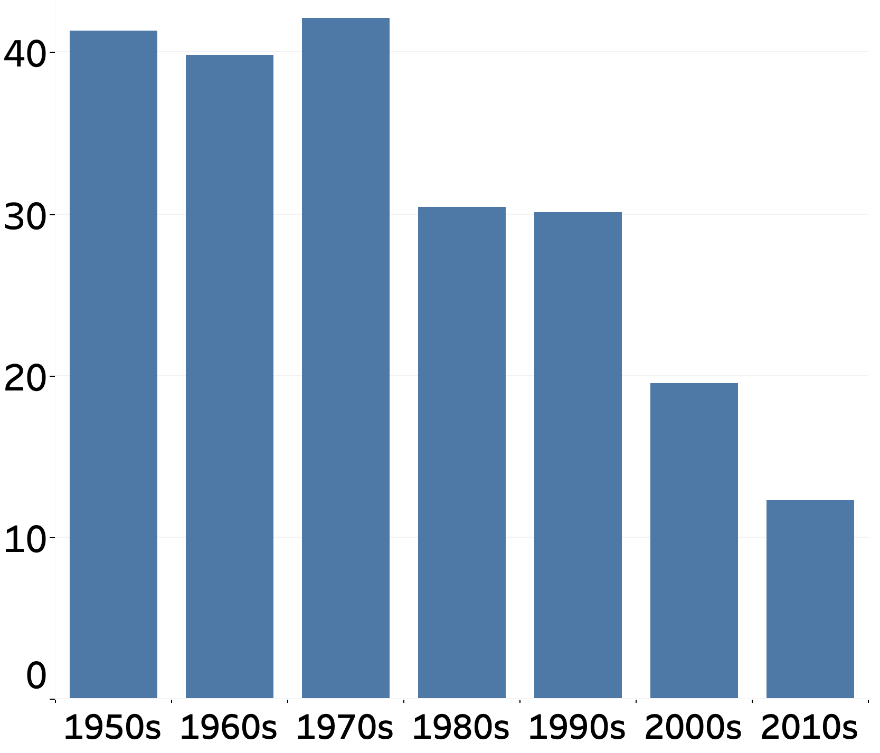
Airline accidents over time
Notes:
If we take a look at the average number of accident per year during each decade, the number has declined from over 40 per year in the 1970s to only about 10 in the 2010s.

Slide 7
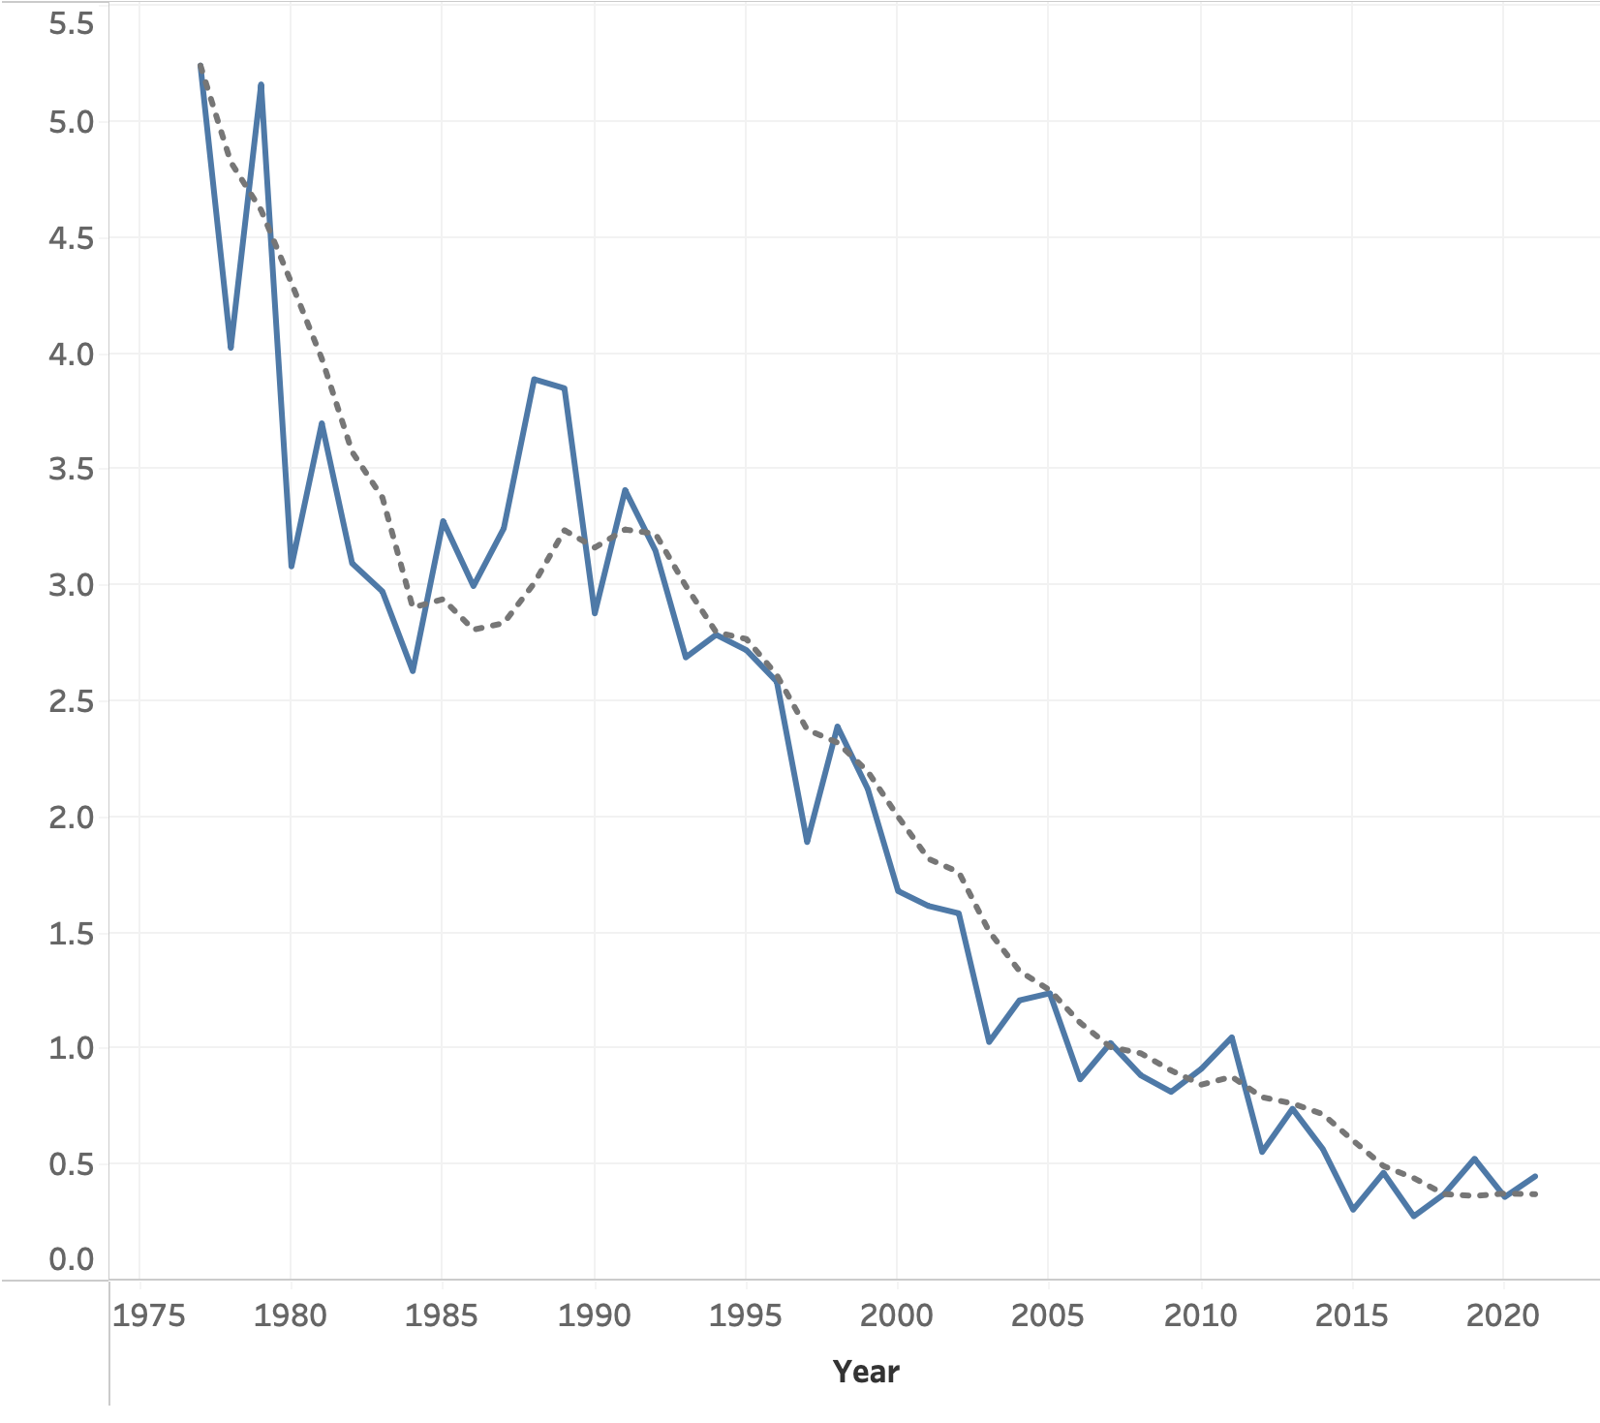

Airline accidents over time
Notes:
Even if we look at the number of fatal accidents across the globe per million flights, the numbers still show a sharp decline from the 1990s to the present day.

Slide 8

Your chance of losing your life in a plane crash is…
1 in 2,000,000 flights
Notes:
So then, you might be wondering. What actually is your chance of losing your life in a plane crash? According to global flight data gathered from the Aviation Safety Network, that number is only 1 in 2,000,000. You would have about the same odds of flipping 21 coins in the air and having all of them come up heads.

Slide 9
US Traffic Accidents vs. Airline Accidents (2022)
Traffic Fatalities
Airline Fatalities
42,514
0
Notes:
You might be thinking, that's low, but I'm still not sure it's worth the risk. Well, you probably drive in a car every week. So how does US vehicle traffic compare to airline traffic? In 2022, there were over 42,500 deaths due to car accidents. As for commercial airlines, there were 0. That's right, 0.

Slide 10
Flying is safer than you think
airlinesafety640.blogspot.com for more info
Presented by Brian Mann
Sponsored by ©SafeAirlines
Notes:
Just remember, don't believe the hype. Flying is safer than you think. Visit airlinesafety640.blogspot.com for more info. This video is sponsored by SafeAirlines.

