Slide 1
Gender Wage Gap Over Time
By Brian Mann

Slide 2
The Question
Is there a wage gap between men and women?
How has it changed over time?
Are there any differences by education level?
What are the trends for the wages of men, women and overall?

Slide 3
The Hypothesis
Our hypothesis is that there has been a statistically significant decline in the gap between the wages of men and women over time
The null hypothesis is that there is no such significant difference in the wage gap between men and women over time

Slide 4
The Data
The data set used to conduct this research project comes from the Economic Policy Institute’s State of Working America Data Library from 2022
This data was taken from the average hourly wage of workers separated by five different education levels, gender and race for the US population
The hourly wages have already been converted to 2022 USD values using the CPI-U-RS index
In this project, we will only be focusing on the data for men, women and the overall population
Data will be analyzed using a Python Jupyter Notebook

Slide 5
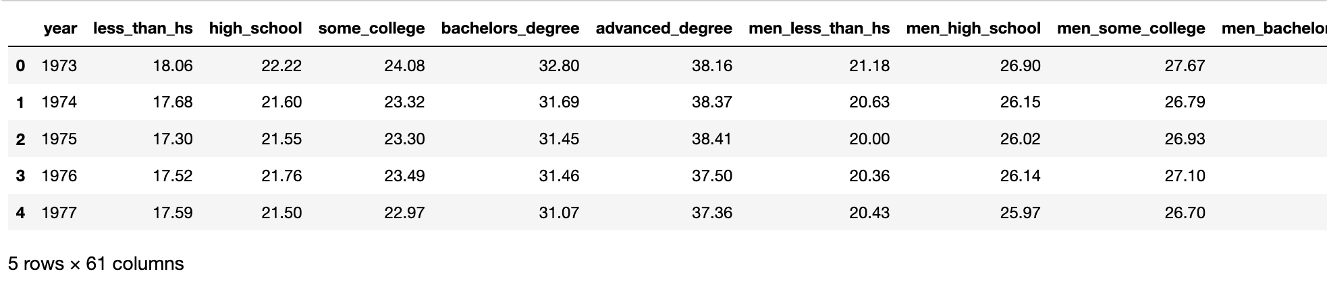
Snapshot of the Data Set

Slide 6
The Variables
In this analysis, we will be focusing on five variables, each representing a different level of education attained:
Less_then_hs: no high school diploma
High_school: a high school diploma
Some_college: at least some college education
Bachelors_degree: a bachelor’s degree
Advanced_degree: a master’s degree or other advanced degree
For each of these variables, we will look at three different groupings: men, women and the overall population
Each entry in the data set represents the average value in 2022 USD for the hourly wage of workers with the given level of education

Slide 7
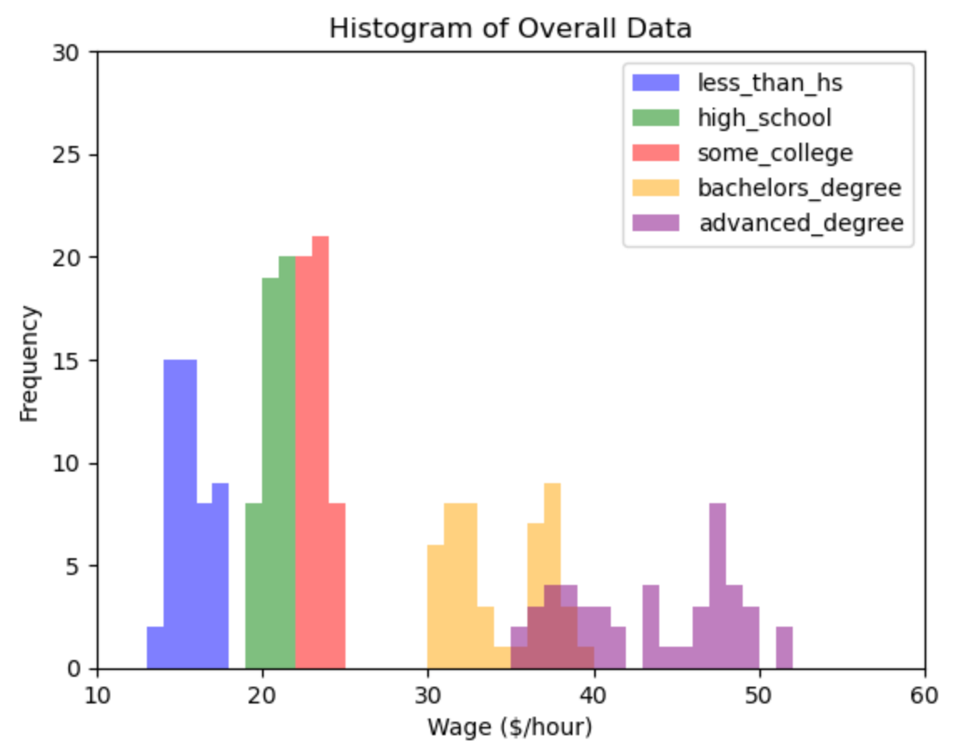
Histograms

Slide 8
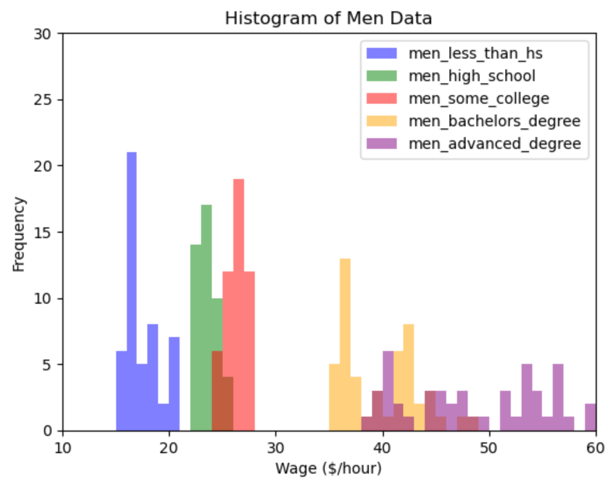
Histograms

Slide 9
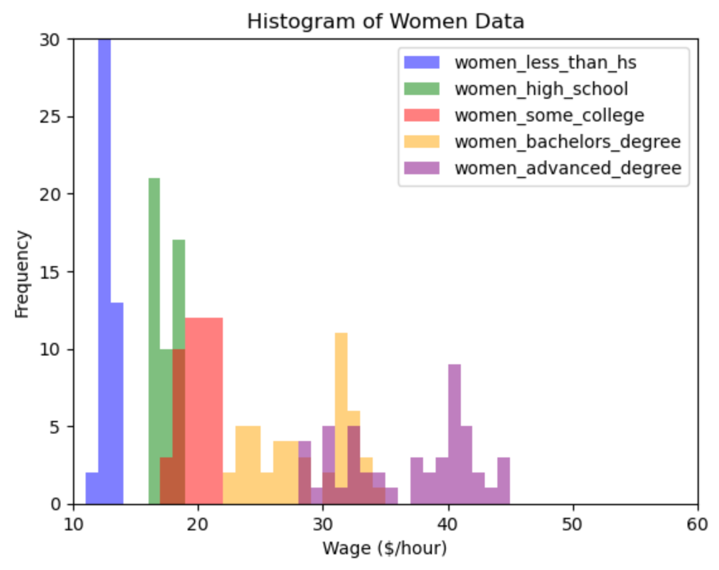
Histograms

Slide 10
Histogram Analysis
Generally, we can see that as education increases, wages tend to increase.
This is the same across genders, as well as overall
We can also see that for each level of education, the values for the male wages histogram tend to be higher than the values for the female wages histogram.
There are essentially no outliers, as the data comes from averages over time.
Average wages tend to be very stable over time, especially with larger sample sizes

Slide 11
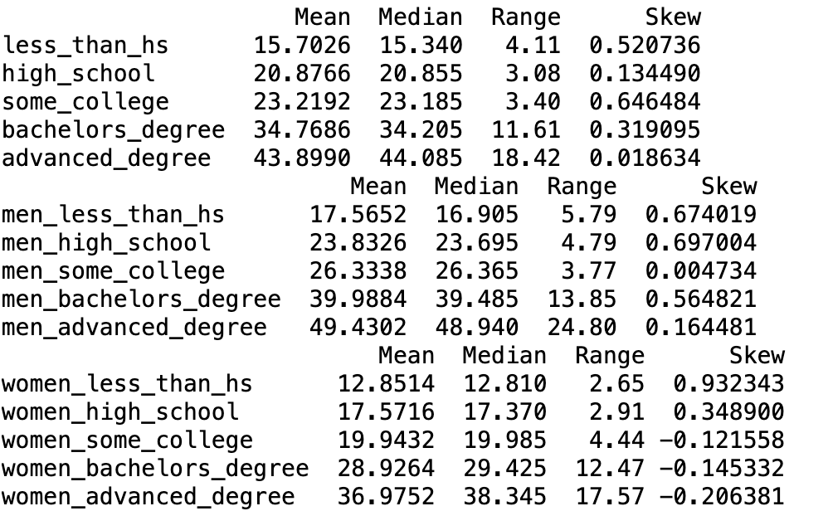
Descriptive Characteristics

Slide 12
Descriptive Characteristics Analysis
We first note that just as we suspected, for every level of education, the mean and median values are higher for men than women, indicating a clear wage gap
Interestingly, as the level of education increases, the range of values between the highest and lowest average wage also seems to increase
Much of the data is somewhat positively skewed, indicating that there is a higher proportion of lower average wages. This makes the mean somewhat higher than the median
Strangely, only in the female data do we see a negative skew. Each of these occurs in higher levels of education

Slide 13
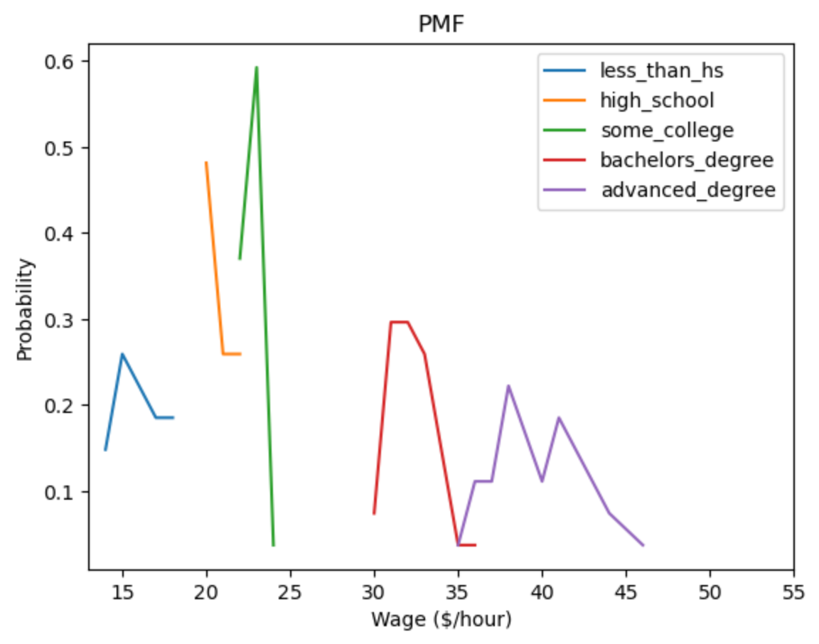
Scenario 1: PMF of Wages Before Pre-2000

Slide 14
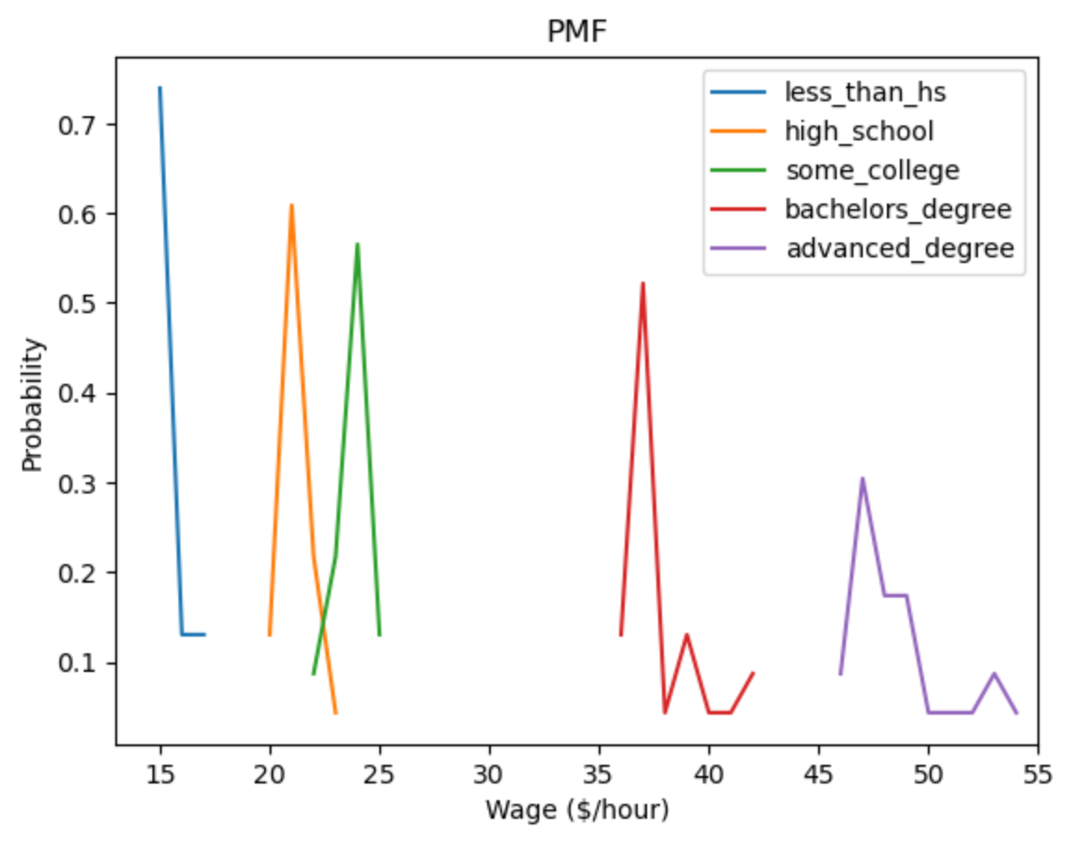
Scenario 2: PMF of Wages Before Post-2000

Slide 15
PMF Scenario Analysis
In both the pre-2000 and post-2000 scenario, we can see that for lower education levels, there does not seem to be a significant difference
The chances of getting an hourly wage between $15-25 do not seem to fluctuate much
However, for bachelor’s and advanced degree holders, there does seem to be a significant increase in hourly wage from pre-2000 to post-2000

Slide 16
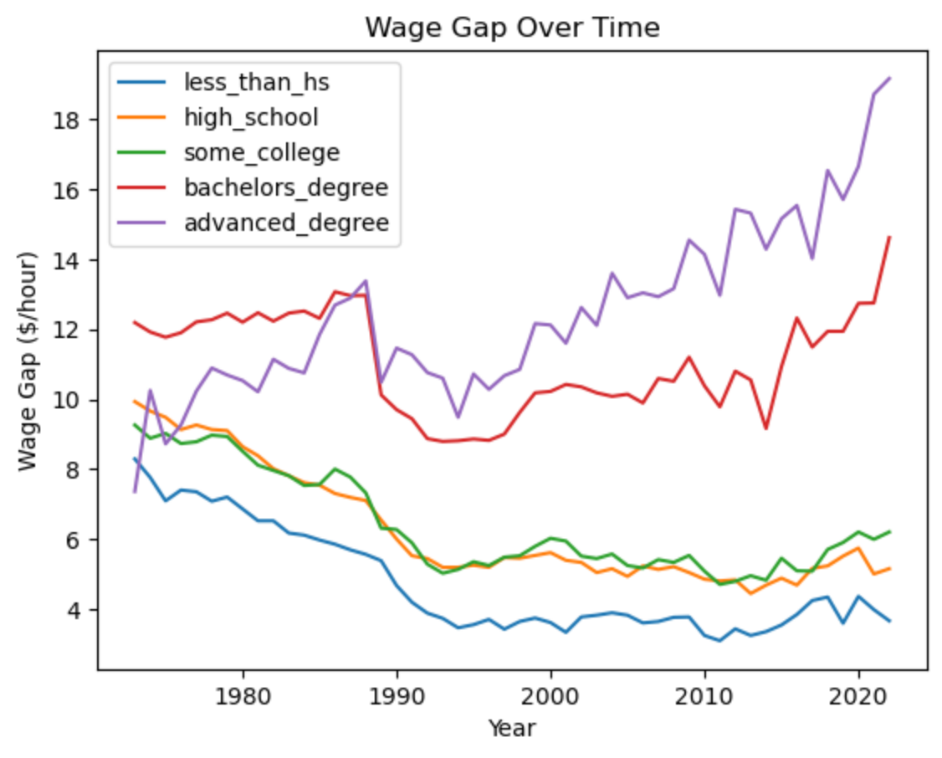
The Wage Gap Over Time

Slide 17
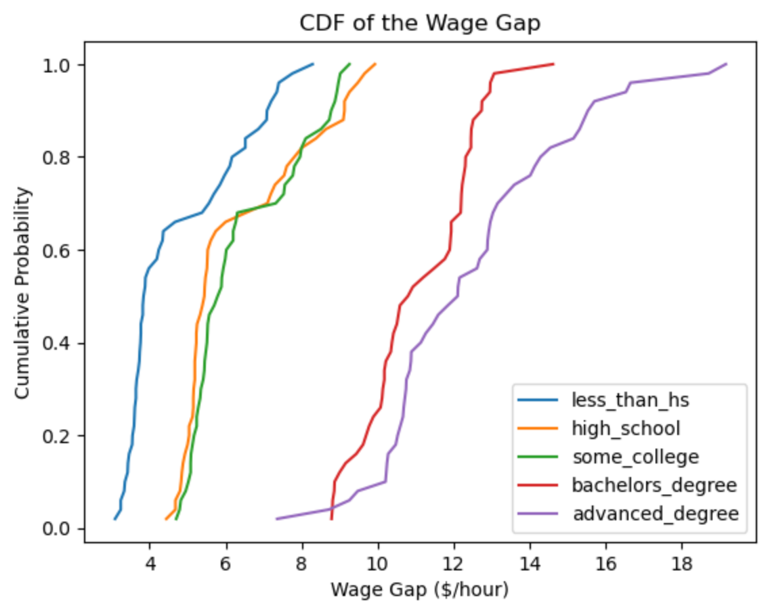
CDF of the Wage Gap

Slide 18
CDF Analysis
Here, we created a new set of data that represents the difference between the average hourly wages of men and women for each level of education
As is seen, the gap is positive (men making more than women) for every single data point
Generally, we can see that the average wage gap between men and women tends to increase with higher levels of education
For lower levels of education the gap is typically only $4 - $6
The gap increases to around $10 for bachelor’s and above

Slide 19
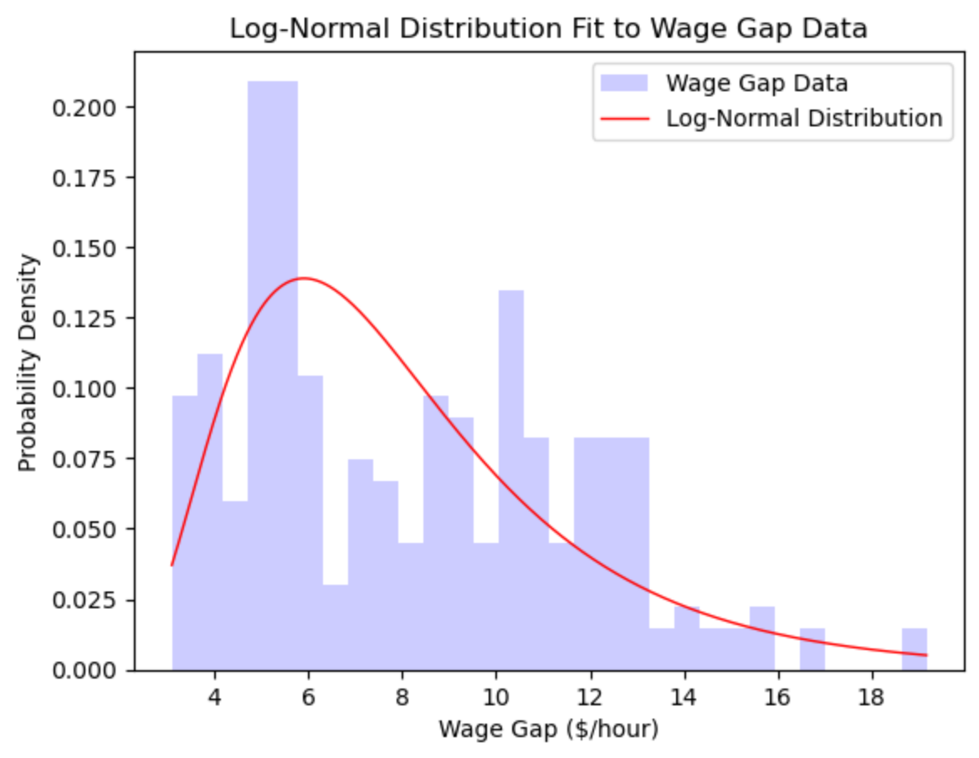
Analytical Distribution

Slide 20
Analytical Distribution Analysis
Here, we have aggregated all the wage gap data into a single array, regardless of education level
A log-normal distribution was chosen to model the given data, as it is usually a better choice when modeling positively skewed data
Income and wages are often positively skewed, as we have already seen in the descriptive statistics analysis
Unfortunately, after testing the distribution and the sample using the Kolmogorov-Smirnov test, we arrive at the conclusion that there is a significant difference between the two
The test statistic is quite low (only 0.1 out of 1)
The p-value is also below 0.05, indicating that there is a significant difference between the distribution and the sample data
Visually, the two look mostly different

Slide 21
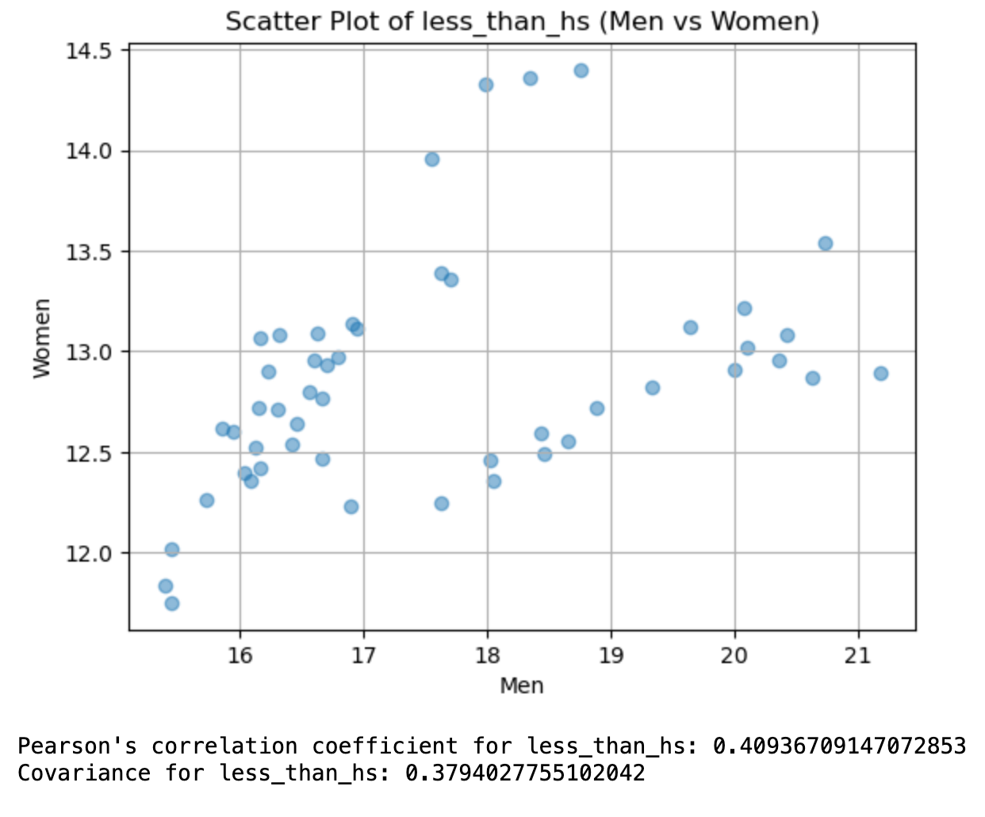
Scatter Plots

Slide 22
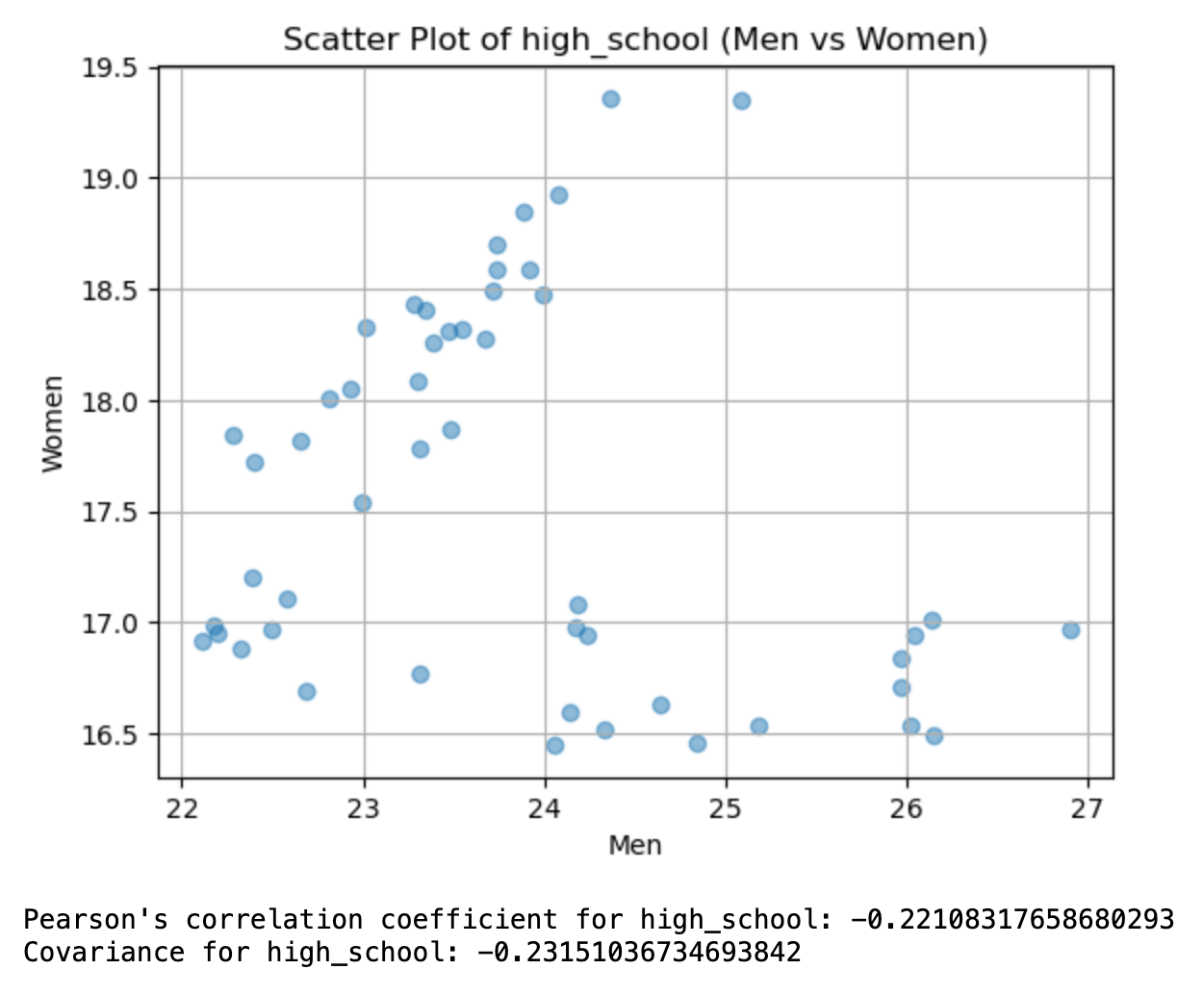
Scatter Plots

Slide 23
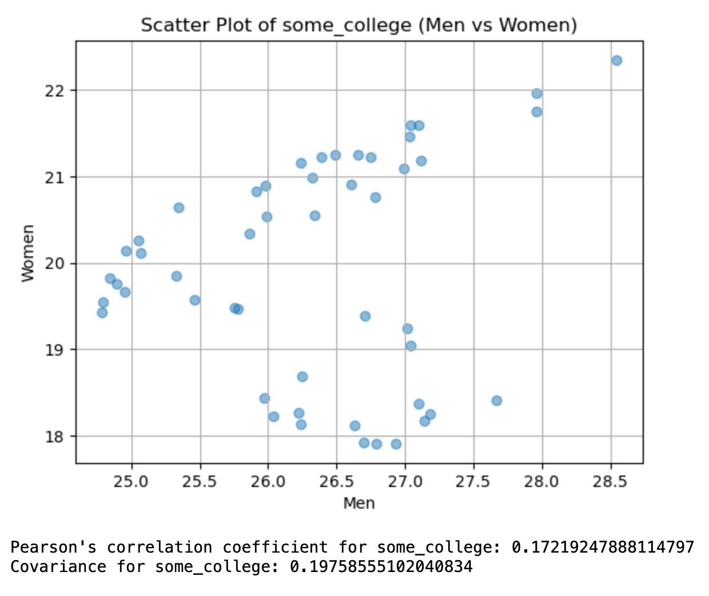
Scatter Plots

Slide 24
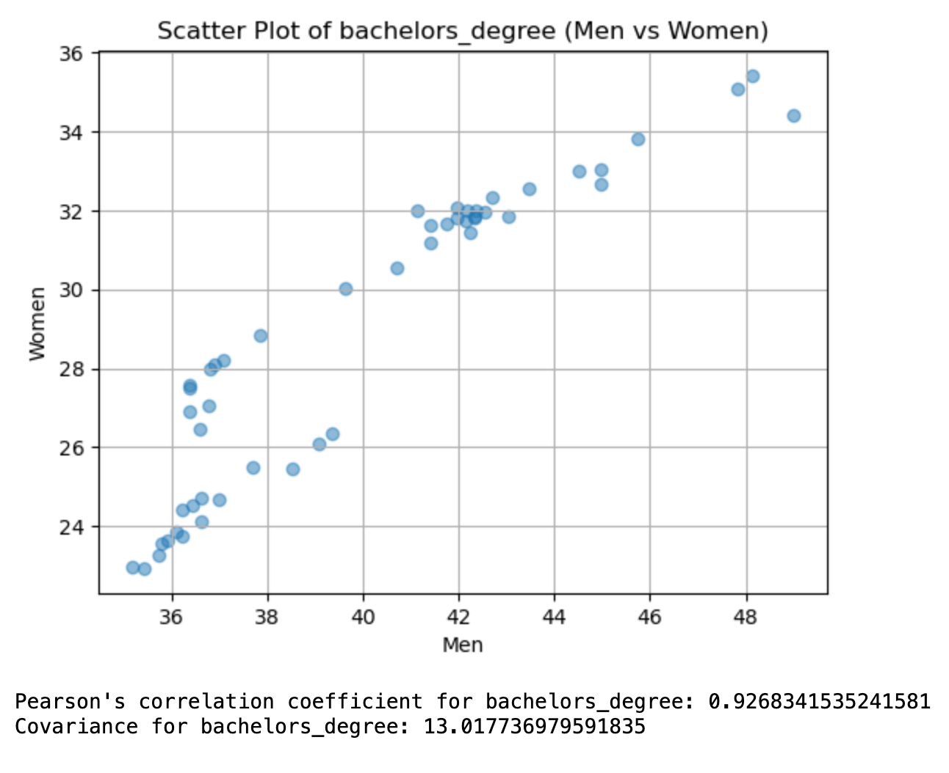
Scatter Plots

Slide 25
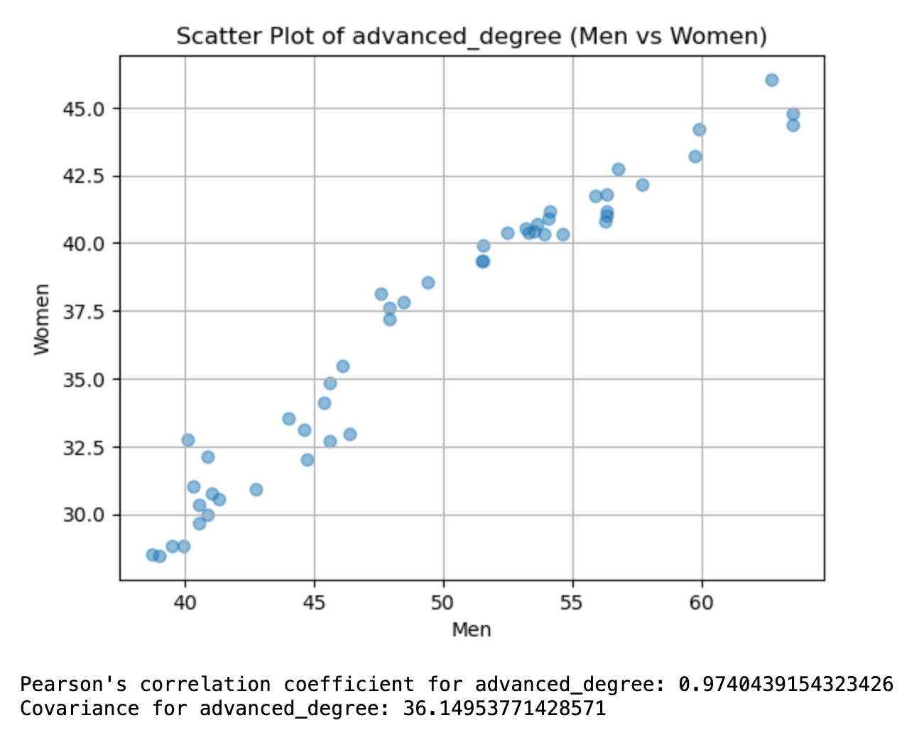
Scatter Plots

Slide 26
Scatter Plot Analysis
Different scatter plots were generated based off of the hourly wages of men and women for each level of education
The x-axis represents the male wage, while the y-axis represents the female wage, with each point being the given values for one particular year
Generally, there was not much correlation or covariance between the values of male and female wages for lower education levels
Those with less than a HS education or some college had a slightly positive correlation, while those with a HS diploma even had a slightly negative correlation
However, for bachelor’s and higher, the correlation and covariance were considerably high (corr > 0.9)
When higher-educated men had higher salaries, so did women

Slide 27
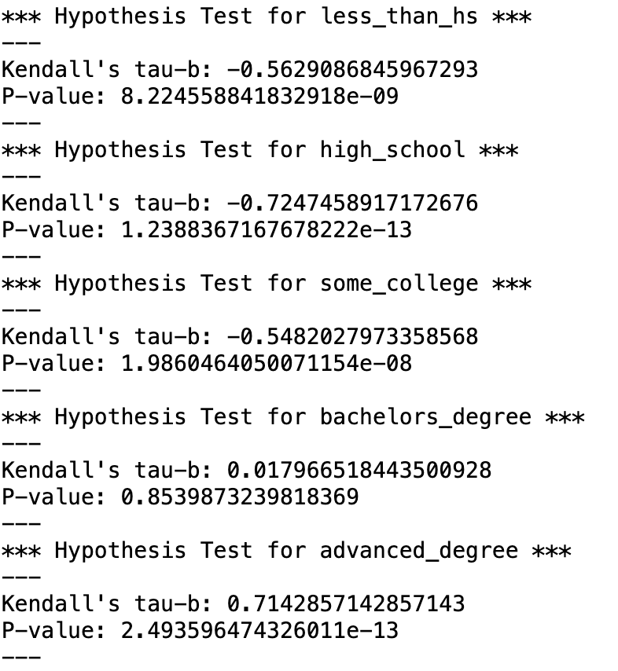
Hypothesis Testing Using Kendall’s Tau-B

Slide 28
Hypothesis Testing Analysis
Here we tested the original hypothesis: There has been a significant decline in the wage gap over time
We used Kendall’s Tau-B to assess significance
Kendall’s Tau-B is non-parametric (doesn’t have to follow a normal distribution)
We compare Time with the Wage Gap to assess if there has been a significant decline
For the three lowest education levels, we can infer that there has been a significant decline in the wage gap
For each, we have Tau-B < -0.5 and p < 0.001
For bachelor’s degree holders, there seems to be no significant change
Tau-B ~0, p > 0.05
For advanced degree holders, there is actually a significant increase in the wage gap over time
Tau-B > 0.7, p < 0.001

Slide 29
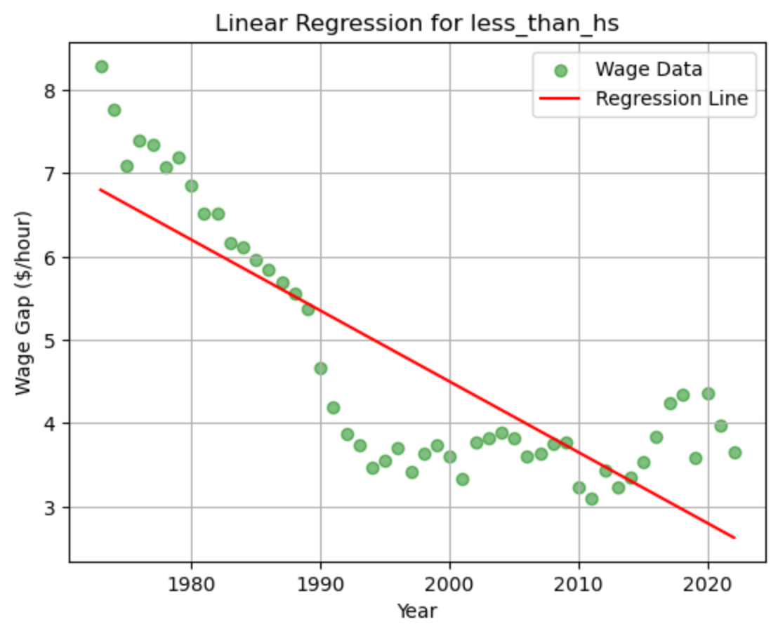
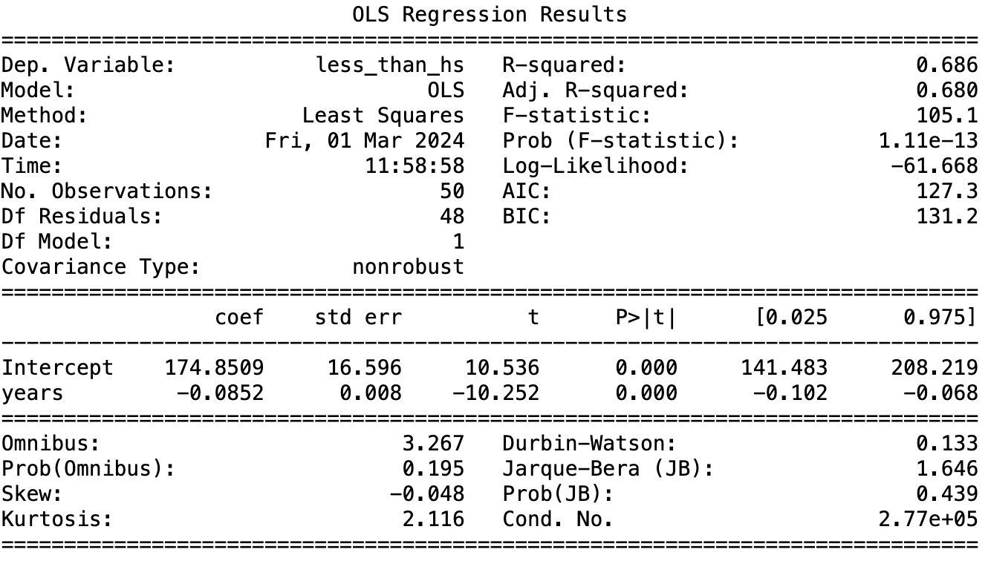
Linear Regression

Slide 30
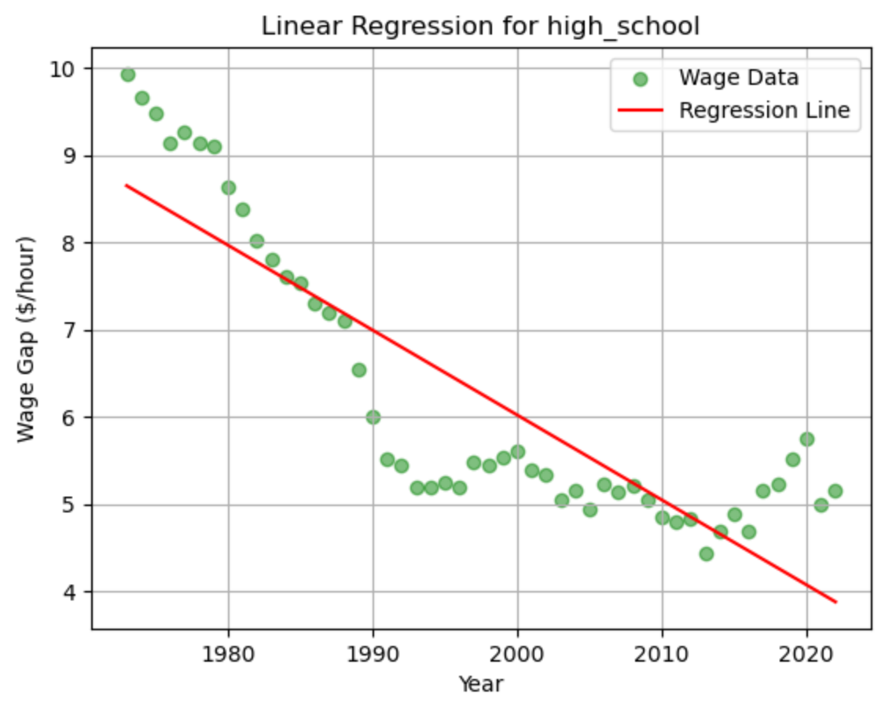
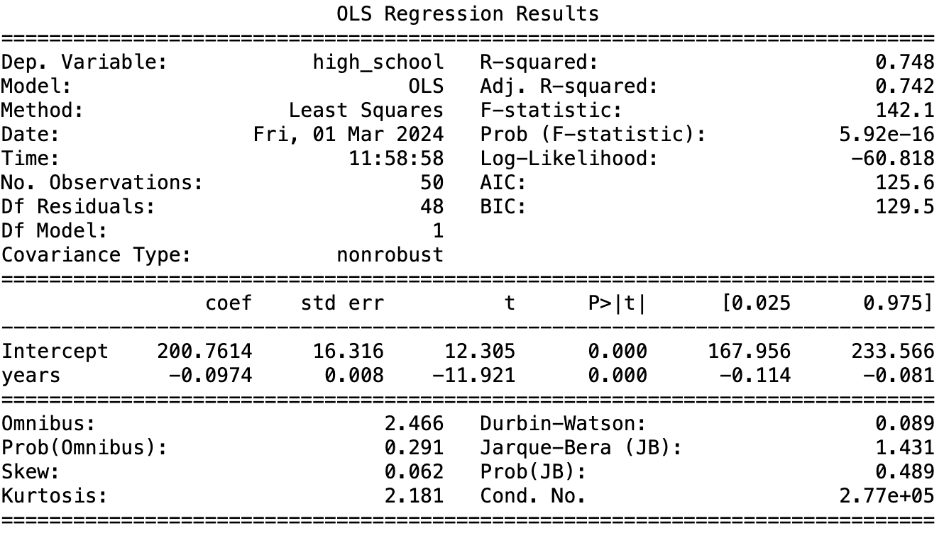
Linear Regression

Slide 31
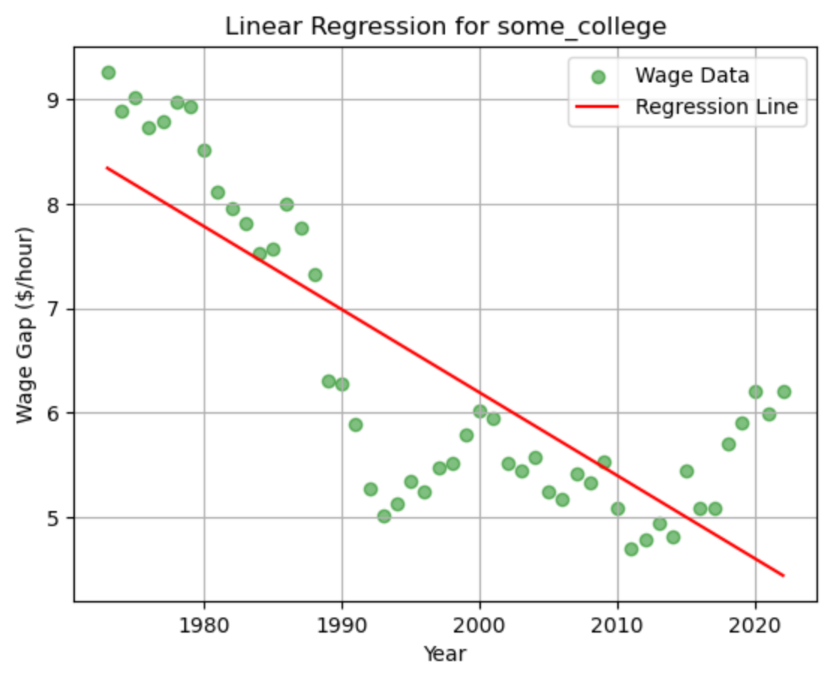

Linear Regression

Slide 32
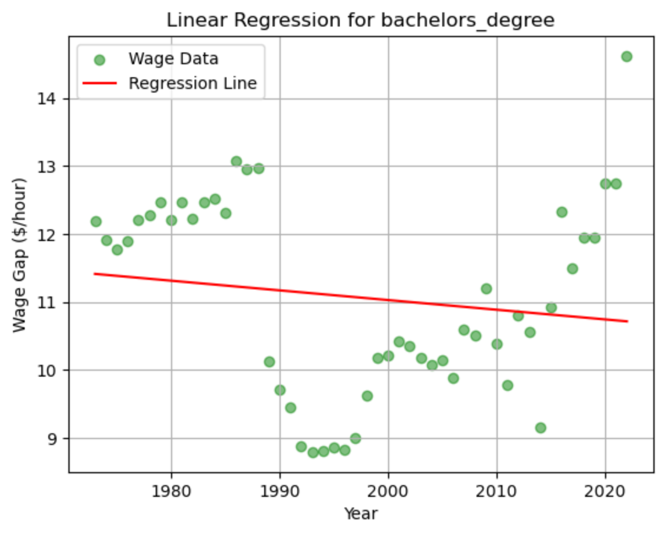
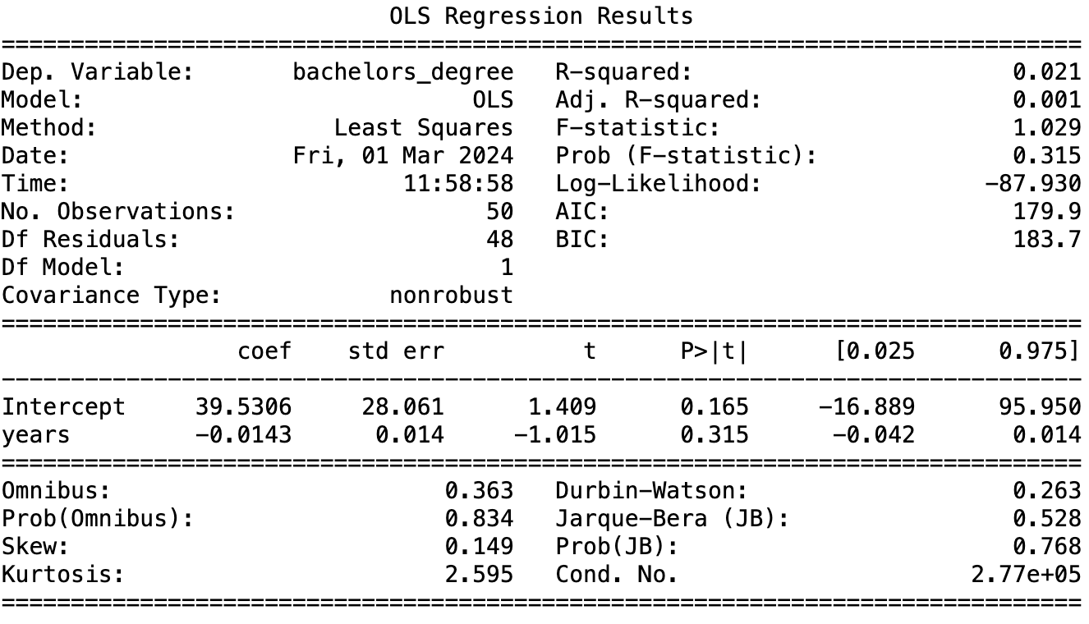
Linear Regression

Slide 33
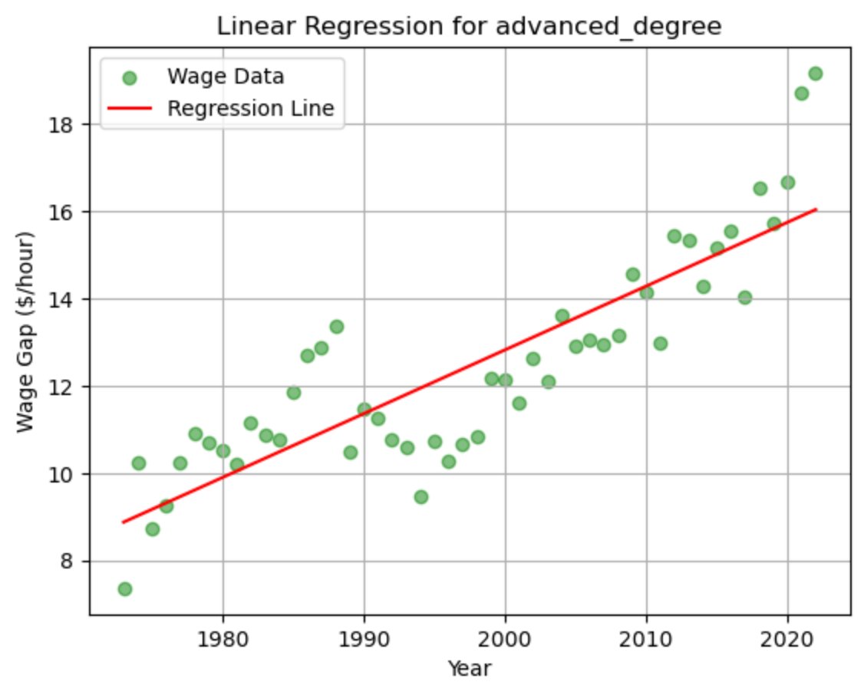
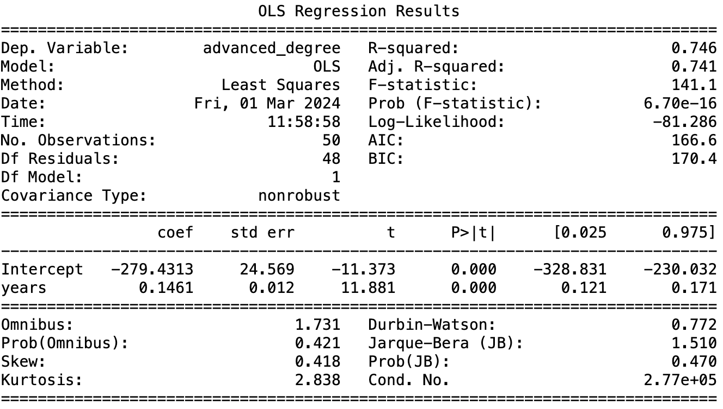
Linear Regression

Slide 34
Linear Regression Analysis
Here we conducted a linear regression for each education level
Each predictor variable was the time in years
Each outcome variable was the hourly wage for that respective education level
This shows us yet another way of viewing how the wage gap has changed over time, delineated by education level
For the three lowest education levels, the plots are all very similar, with the regression lines also sharing similar slopes
Interestingly, each plot seemed to show that there was a significant decline in the wage gap during the 1980’s, with the gap mostly leveling off since the 1990’s
For those with bachelor’s degrees, the data is quite scattered, and the slope of the regression line is mostly horizontal
Again, we see a large decline in the 1980’s. This time, however, the gap seems to have started increasing ever since the 1990’s
For those with advanced degrees, the wage gap follows a very clear upward linear trend throughout the entire 50-year period
The R-squared values for each model (apart from the bachelor’s degree model) were all fairly high - between 0.65 - 0.75.

Slide 35
Overall Conclusions
Original Hypothesis: There has been a statistically significant decline in the gap between the wages of men and women over time
Conclusion: It depends on education level.
For lower lower values of education (less than high school up to some college), we concluded that there has been a statistically significant decline in the wage gap over time. However, much of this is due to a large decline during the 1980’s
For bachelor’s degree holders, no statistically significant difference was found and the null hypothesis was accepted
For advanced degree holders, we arrived at the opposite conclusion: there has been a significantly significant increase in the wage gap over time
Overall, we can see that there still exists a significant gap in the wages of men and women, despite some progress being made for jobs that require less education
For those with advanced degrees, the wage gap has consistently grown higher, making it an interesting trend to assess

Slide 36
Limitations and Future Steps
In this research project, we looked at the average wages for a 50-year period differentiated by education level and gender
We did not take into account differences in job, location, race/ethnicity, and experience level
Each of these could be an important factor to consider when looking at differences in wage
The data has already been adjusted for inflation using the CPI-U-RS index
This index is not perfect, and other factors could have been left out of the calculations that affected wages at the time such as the general buying power of the dollar
The increase in the wage gap for advanced degrees might be heavily skewed by women in education
Many teaching jobs require an advanced degree despite lower wages
Most teachers are female
In the future, more data should be assessed that takes into consideration differences in demographics, job and experience level

Slide 37
Thank You for Viewing this Presentation!

