Slide 1
SUMO Simulation (SimpleT Sensitivity Analysis)
Byron Mason

Slide 2
Note
The analysis shown in this presentation is based on model that hasn’t been validated in any way.
Its purpose is to prototype an approach to analysis that can be used, in time, on a validated model.

Slide 3
What is Sobol sensitivity analysis
Quantifies how much each input variable contributes to the variance in the output both on its own and through interactions with other variables.
Helps in deciding which ‘inputs’ are important in determining an output, in this case, total vehicle emissions.
Separates effects into first-order (individual) and higher-order (interaction) contributions.
Provides total-order indices, showing the full influence of each input including all interactions, which helps identify dominant drivers of system behaviour.
Works globally across the entire input space, not just around a single operating point, making it ideal for nonlinear and complex models.
Uses a variance-based approach, meaning it directly measures how uncertainty in the inputs translates to uncertainty in the outputs.

Slide 4
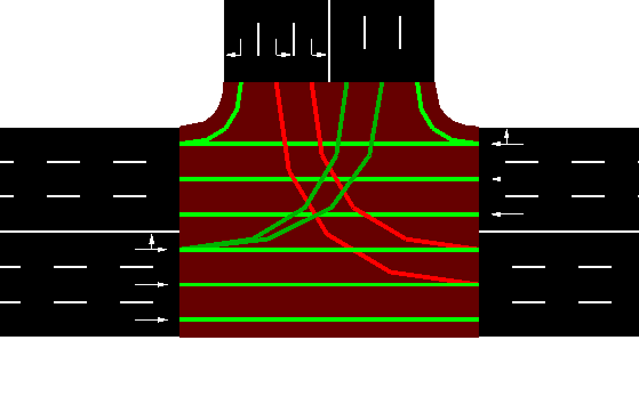
Analysis Setup
L15
L16
Simple T junction
Four vehicle types
pkw
bus
bike
scooter
Traffic flows
L15 to L13 and L18
L14 to L16 and L18
L17 to L13 and L16
L13
L17
L14
L18

Slide 5
Analysis Setup
Total number of vehicles is 1000
Simulation time is 60 minutes
Trips (simpleT.rou.xml) are generated using a defined vehicle distribution which changes in each simulation.
The route file (simpleT.rou.xml) is generated using random_route.py
A trip is assigned to a vehicle that is sampled from the defined vehicle distribution. As a consequence the trips that particular vehicles take between simulations will be different.
The start time of the vehicle is randomly sampled. Vehicle departures over the period of the simulation are approximately uniform (see plot on next page).

Slide 6
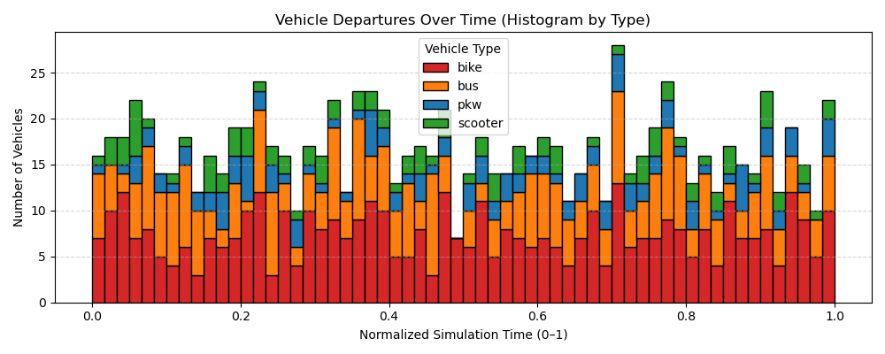
Setup – an example of vehicle start times

Slide 7
Sobol Sensitivity
Sobol sensitivity analysis is undertaken to determine the contribution of each vehicle class [pkw, bus, bike, scooter] on total variance in PM2.5 only
Second order effects (interactions) are also evaluated.
Sobol design was generated using experimental_design.py
Sobol design was created with N * (2D+2) samples using quasi-random saltelli sampling
N = 512 (base sample size set for moderate accuracy)
D = 4 (number of inputs i.e. vehicle types)
Samples = 512 * (2*4+2) = 5120 (total simulations required)

Slide 8
Sobol Sensitivity
5120 simulations are run using vehicle distributions from sobol design taking around 7 hrs
Total PM2.5 emissions are added, for each simulation separately, after all simulations have completed using functions defined in sumo_interface.py
Results analysis and plotting is undertaken using script sensitivity_study_analysis.py

Slide 9
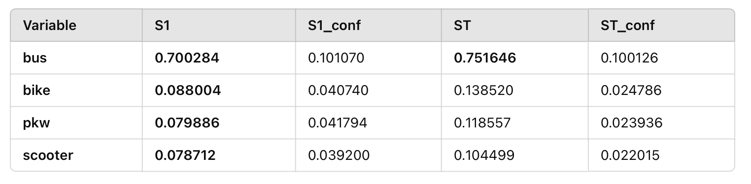
Sobol Sensitivity - Results
main effect contribution to variance
total variance including higher order effects
First order terms (main effects)
Results show
‘bus’ influences PM2.5 variance the most
There is some interaction but most of its influence is first order
‘bike’ influences PM2.5 second variance the most (note that this influence is –ve)
In total 94.7% variance is ‘explained’ by first order terms
confidence interval

Slide 10
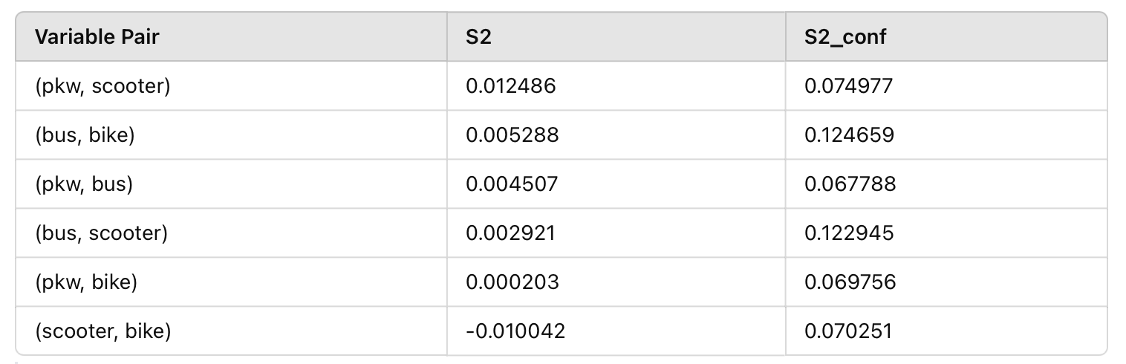
Sobol Sensitivity - Results
Second order terms (interaction effects)
Second order terms contribute significantly less to variance and confidence levels suggest that it may be possible to ignore them (further evaluation is required).
Only 1.5% of variance is ‘explained’ by second order interactions
..and 3.7% of variance is ‘explained’ by higher order interactions and the randomness (trip assignment) in the model

Slide 11
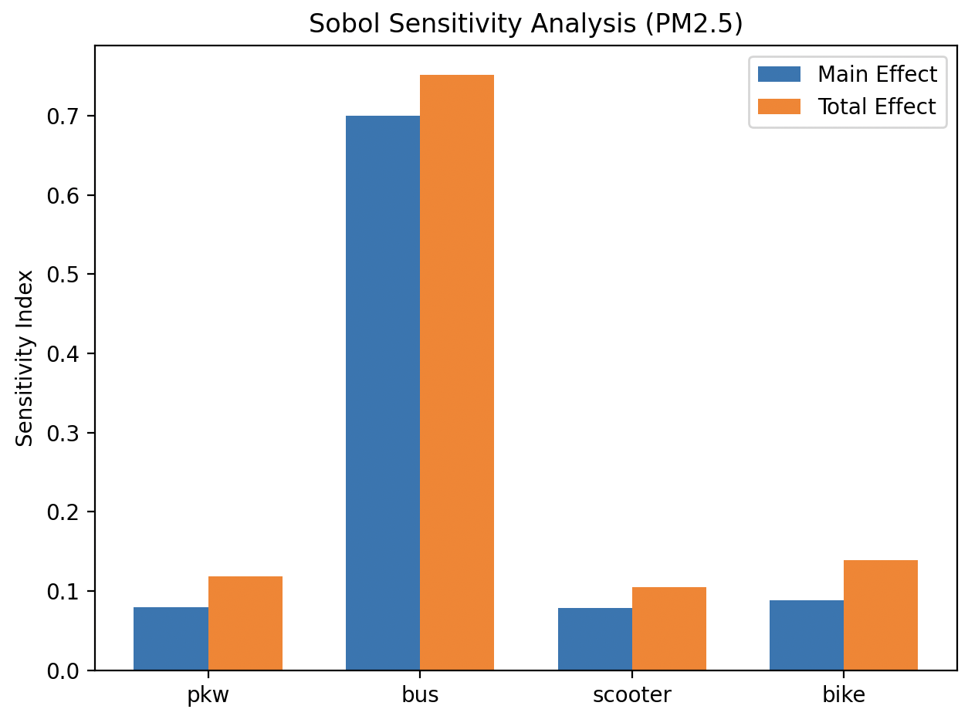
Sobol Sensitivity - Results
As can be seen from the summary above ‘main effects’ are of greatest influence to variance.

Slide 12
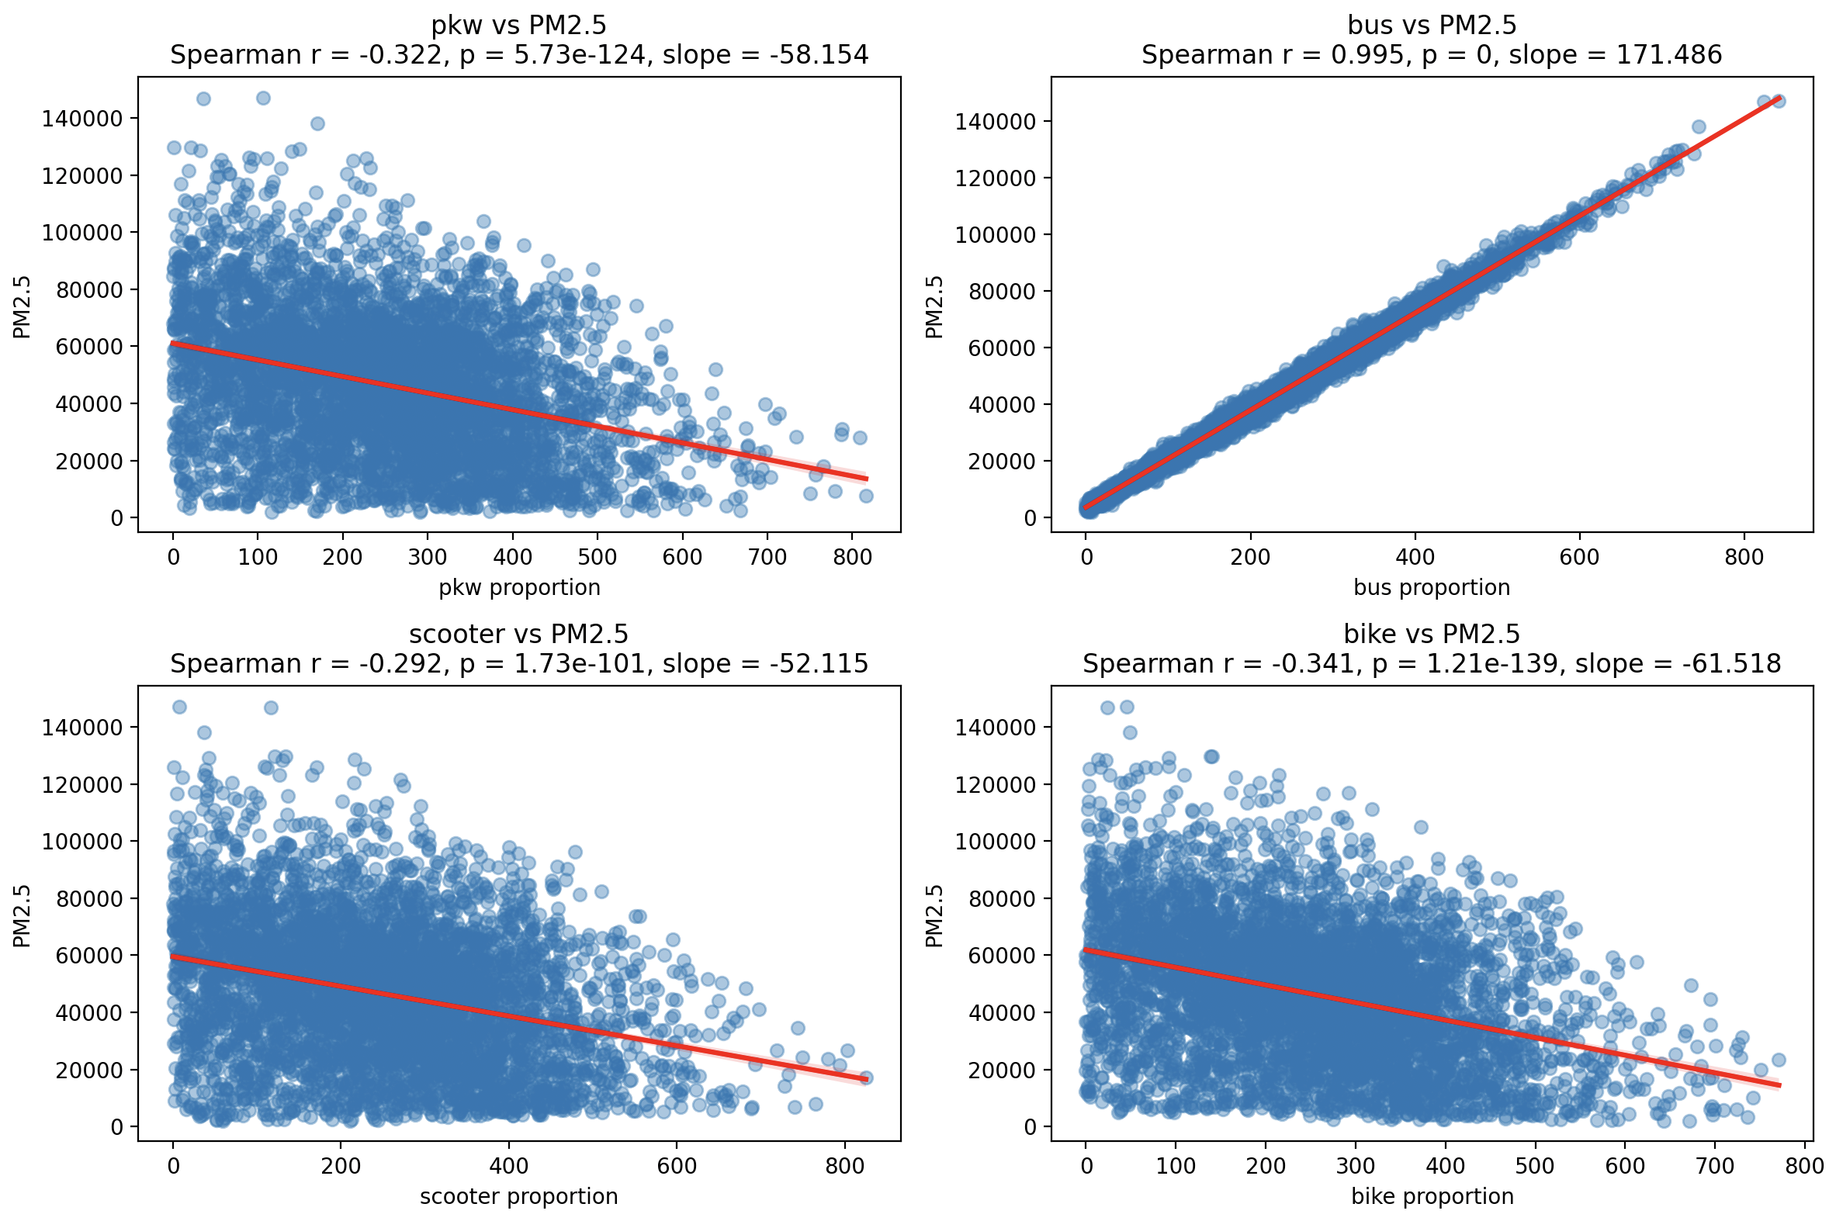
Sobol Sensitivity - Results

Slide 13
Sobol Sensitivity - Results
Interesting results, that at first glance contradict (naive) intuition.
More pkw, bike and scooter decreases PM2.5
More bus increases PM2.5
The above is a limitation of the approach i.e. having fixed vehicle numbers
Need to think about how to deal with the above
Suggest a ‘replacement factor’ for different vehicle types i.e. 1 bus = 1/16 pkw
The above needs to be considered carefully since total vehicle numbers will change (reducing overall) emissions so a direct comparison between absolute emissions results based on different vehicle proportions cannot then be made.

Slide 14
Sobol Sensitivity - Conclusion
At first glance interaction effects are not significant – this is unexpected since it was thought that more buses would change other vehicle behaviour significantly
Maybe this will be the case at a more complex junction?
If there are no second order effects then the model required will be less complex and this will ’cost’ only 1.5% accuracy
A study based on fixed vehicle numbers is flawed since buses dominate PM2.5 and a ‘replacement factor’ should be considered
Need to explicitly quantify repeatability and associated variance as a result of randomisation i.e. departure time in the simulation
5120 simulations takes around 7 hours

Slide 15
Sensitivity Study – Further Work
Need to rerun the analysis on a more complex junction that has preferably been validated.
It may be interesting to see if driving behaviour (however this is characterised) influences contributions from second order effects.
Should consider simulation period i.e. 24 hrs may be a better measure based on fluctuations in traffic volumes.
This does however raise the question of vehicle distribution over the period
Need to tidy up code and release on github

