Slide 1
Predicting plasticity outcomes based on LFP magnitude
Sebastiano Bariselli &
Bridget Matikainen-Ankney
BIOF309, Spring 2018

Slide 2
Background
Neural plasticity
The ability of connections between neurons to change
Test in mice
Baseline period of connectivity
Plasticity induction protocol
Post-induction connectivity

Slide 3
Question
Can we predict plasticity outcomes based on local field potential magnitude during baseline period?

Slide 4
Project goals
Import data from excel (LFP magnitudes and plasticity outcomes)
Clean data (outliers)
Use supervised machine learning to build model

Slide 5
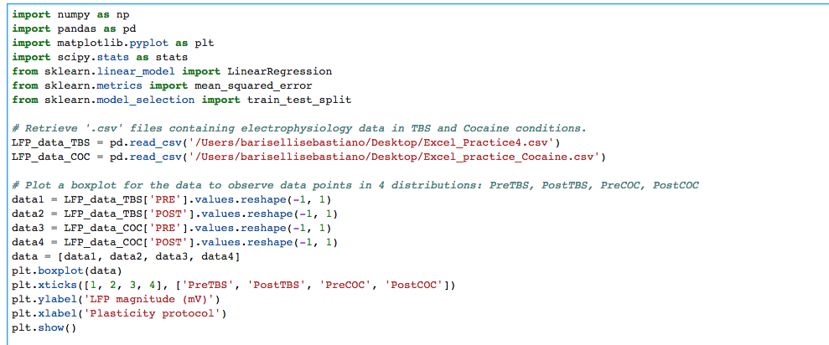
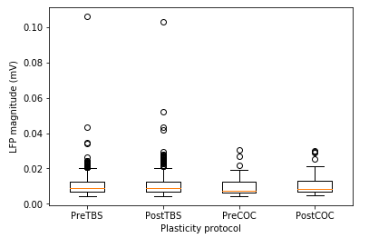
IMPORT THE DATA Import .csv files as dataframe and plot to visualize data
Outliers?

Slide 6
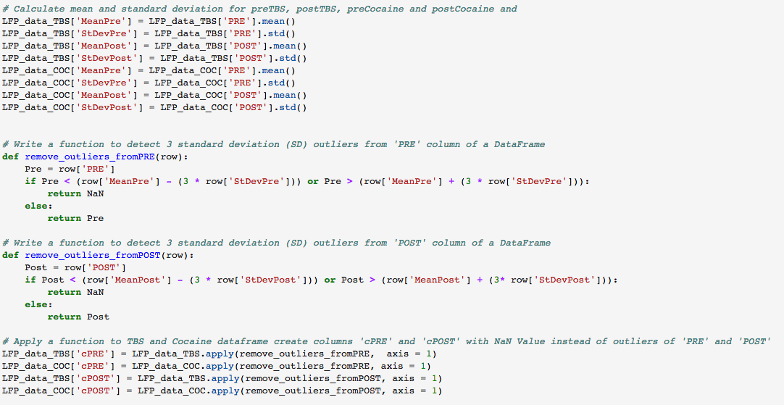
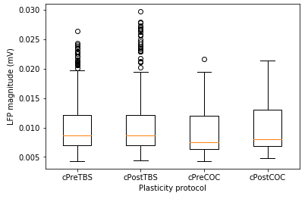
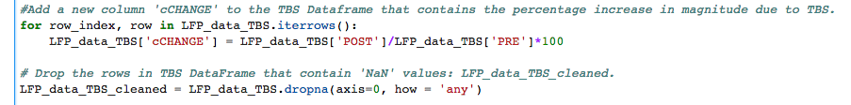
CLEANING THE DATAFRAME
Function to assign NaN to outliers followed by .dropna

Slide 7
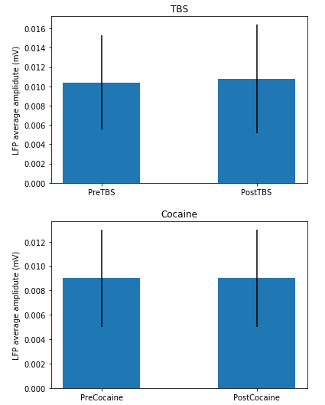
Is there a plasticity?
Paired t-test between Pre and Post

Slide 8
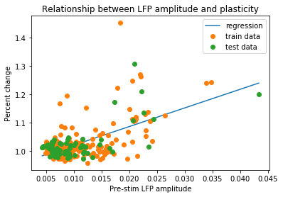
Regression analysis
Regression: % Change = [ 6.55694474] *Pre-stim response amplitude + 0.954975708918
R squared = 0.471091816409

