Slide 1
PRODUCT DEMAND PREDICTION WITH MACHINE LEARNING

Slide 2
INTRODUCTION:
Definition and Design Thinking
Data Collection
Data Preprocessing
Feature Engineering
Model Selection
Model Training
Evaluation

Slide 3
Product Demand Prediction With
MACHINE LEARNING
Phase 1:Problem Definition and Design Thinking
You must have studied that the demand for a product varies with the change in its price. If you take real-world examples, you will see if the product is not a necessity, then its demand decreases with the increase in its price and the demand increases with the decrease in its price. If you want to know how we can predict demand for a product with machine learning, this article is for you. In this article, I will walk you through the task of product demand prediction with machine learning using Python.
Product Demand Prediction (Case Study)
A product company plans to offer discounts on its product during the upcoming holiday season. The company wants to find the price at which its product can be a better deal compared to its competitors. For this task, the company provided a dataset of past changes in sales based on price changes. You need to train a model that can predict the demand for the product in the market with different price segments.

Slide 4
Product Demand Forecasting:
The process of using predictive analysis of historical data to estimate and predict future demand for a product or service . It helps the business make better decisions that estimate the total sales and revenue for future.
Data Collection:
Data collection is the process of gathering and measuring information from countless different sources. In order to use the data we collect to develop practical artificial intelligence (AI) and machine learning solutions, it must be collected and stored in a way that makes sense for the business problem at hand.
Collect and prepare historical data:
The next step is to collect and prepare historical data for your forecasting method. Historical data refers to any data that reflects past demand and supply patterns, such as sales records, customer orders, inventory levels, market share, prices, promotions, seasonality, and external factors. You need to gather enough data to cover a relevant time period and frequency for your forecast. For example, if you want to forecast monthly demand for a year, you need at least 12 months of historical data. You also need to clean and organize your data, removing any outliers, errors, or missing values that could distort your forecast.

Slide 5
Apply and evaluate your forecasting method:
The third step is to apply and evaluate your forecasting method using your historical data. Depending on your method, you may need to use software tools, formulas, or algorithms to generate your forecast. For example, if you use time series analysis, you may need to apply smoothing techniques, trend and seasonality adjustments, and error corrections to your data. You also need to evaluate your forecast accuracy and reliability, using measures such as mean absolute error, mean absolute percentage error, or mean squared error. These measures compare your forecast values with your actual values and indicate how much your forecast deviates from reality.
Adjust and update your forecast:
The final step is to adjust and update your forecast based on new information, feedback, or changes in the market. Your forecast is not a static prediction, but a dynamic estimate that needs to be revised and refined over time. You may need to adjust your forecast if you encounter new demand drivers, such as product launches, competitor actions, customer preferences, or economic shocks. You may also need to update your forecast if you receive new or updated historical data, such as sales reports, customer feedback, or market research. By adjusting and updating your forecast, you can improve its accuracy and relevance for your business decisions.

Slide 6
Data Preprocessing:
The technique of preparing (cleaning and organizing) the raw data to make it suitable for a building and training Machine Learning models.
It involves below steps:
Getting the dataset
Importing libraries
Importing datasets
Finding Missing Data
Encoding Categorical Data
Splitting dataset into training and test set
Feature scaling
How To Transform Categorical Variables To Numeric Python?
Creates dictionary and converts it into a data frame.
Uses "get _ dummies" function for the encoding.
Concates the final encoded dataset into the final data frame.
Drops categorical variable column.

Slide 7
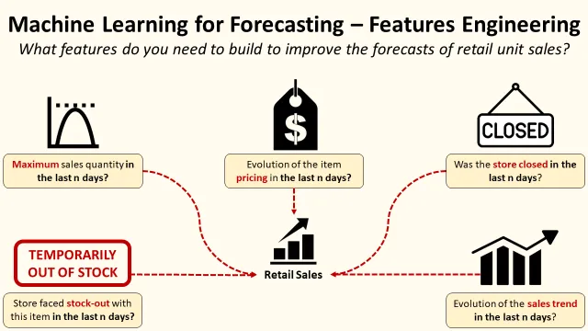
Feature Engineering:
Feature engineering is the process of transforming raw data into features that are suitable for machine learning models. In other words, it is the process of selecting, extracting, and transforming the most relevant features from the available data to build more accurate and efficient machine learning models.

Slide 8
Model Selection:
The process of selecting the best algorithm and model architecture for a specific job or dataset. It entails assessing and contrasting various models to identify the one that best fits the data & produces the best results.
Random Forest:
Random forest regression is a supervised learning algorithm that uses an ensemble learning method for regression. Random forest is a bagging technique and not a boosting technique. The trees in random forests run in parallel, meaning there is no interaction between these trees while building the trees.

Slide 9
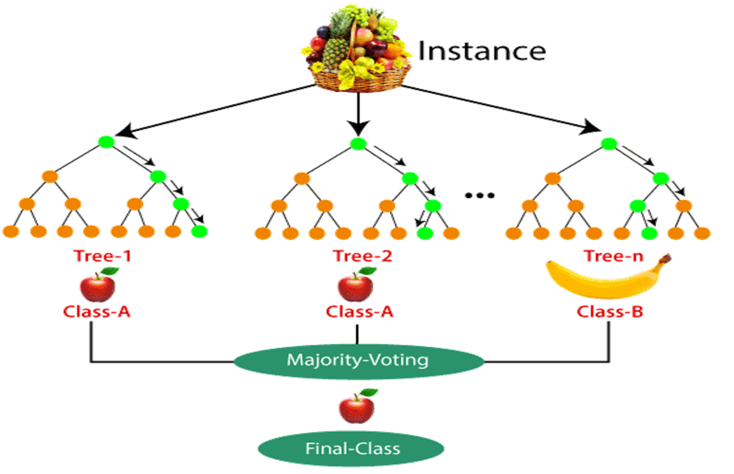
Example for Random Forest

Slide 10
Model Training:
Model training is the phase in the data science development lifecycle where practitioners try to fit the best combination of weights and bias to a machine learning algorithm to minimize a loss function over the prediction range.
Program:
from s k learn import datasets from s k learn . model _ selection import train _ test _ split from s k learn. metrics import accuracy _ score from s k learn .tree import Decision Tree Classifier
data = datasets .load _ wine(as _ frame = True) X = data . data y = data . target
X _ train, X _ test, y _ train, y _ test = train _ test _ split(X, y, test _ size = 0.25, random _ state = 22)
D tree = Decision Tree Classifier(random _ state= 22) d tree . fit(X _ train , y _ train)
OUTPUT:
Decision Tree Classifier(random _ state=22)

Slide 11
Evaluation:
In general, demand forecasting is formulated as a regression problem. Evaluation metrics in regression problems can be split into bias and variation (accuracy) classes, where bias indicates signed deviation from actual values (location), and accuracy evaluates unsigned average deviation (variance of data).
Demand forecast :
forecast demand (prev. period) + Smoothing Factor for Demand Forecast (curr . period) * actual usage (prev. period) - forecast demand (prev.

