Slide 1
Detection of Fraudulence in Credit Card Transactions using Machine Learning

Slide 2
Introduction:-
In recent times the use of credit cards for making transactions have increased a lot due to the rise of e-commerce industries.
On one hand they have made purchasing things a lot more convenient but on the other it has led to an increase in online credit card fraud.
Online credit card fraud amounted to $28 billion in 2018 and it is expected to amount as much as $36 billion by 2022.
This is a huge problem for customers as well as financial institutions which can be solved using ML.

Slide 3
Different model types:-
Fraud detection models can be either supervised or unsupervised or a combination of both.
In this scenario we have used supervised models.
The fraud detection models are made to solve one of the 2 main problems:-
Detection of fraudulent transactions
Detection of non fraudulent transactions
Both types of models have different use cases and they should be evaluated before choosing the relevant model.

Slide 4
The models used to detect fraudulent transactions are used when false negatives are much more harmful than false positives.
Imagine a bank using this model to detect fraud and notify the customer. In this case a false notification when nothing has happened is a lot better than not sending a notification in case something has happened.
Thus in this case reducing the false negatives and increasing recall takes priority even if one has to trade precision.
In the case when detecting just fraudulent transactions is not that big of a concern a general model that increases accuracy is preferred.
But this may let some fraudulent transactions go undetected.

Slide 5
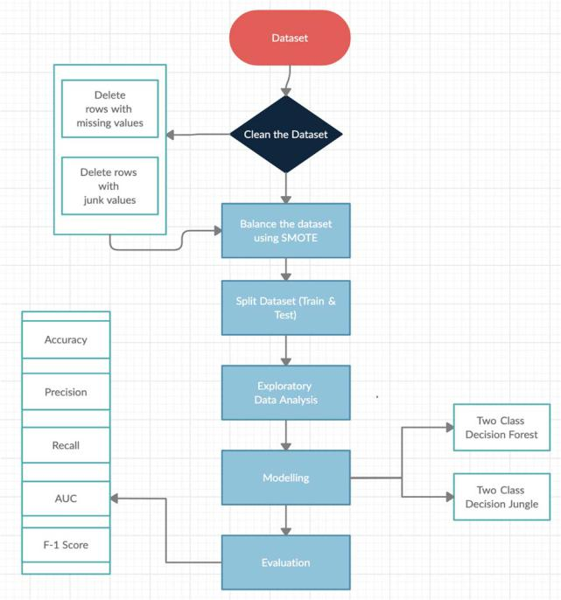
Methodology
Cleaning the dataset
Balancing the dataset using SMOTE or undersampling.
Exploratory data analysis
Modelling
Evaluation

Slide 6
Dataset cleaning and balancing
We have used the credit card transaction dataset.
This dataset has 30 features which have been transformed using PCA to protect customer data.
PCA is an acronym for Principal Component Analysis. It is a dimensionality reduction technique which basically computes the eigen vector of the covariance matrix of the data.
Less than 0.2% of the transactions are fraudulent in this dataset. Thus if used without balancing it will just detect all transactions as non fraudulent which will give us a pretty high accuracy but the recall will be very low.

Slide 7
Thus the dataset needs to be balanced.
There are 2 main balancing techniques:-
Undersampling
Oversampling
In undersampling we reduce the number of instances of the larger class to match that of the smaller class. This results in the loss of a lot of data even if we stratify it. This increases the recall for the smaller class but might reduce overall accuracy.
In oversampling we do the opposite, we increase the instances of the smaller class to match that of the larger class.
There are a few oversampling techniques like:-
SMOTE
ADASYN
Augmentation

Slide 8
SMOTE
This time we have used SMOTE for oversampling the data.
SMOTE is an acronym for Synthetic Minority Oversampling Technique.
It works by taking a data point from the minority class and considers its K-nearest neighbours.
To create a synthetic data point it chooses a vector between one of the neighbour and the chosen data point then multiplies it with a random number between 0 and 1.
It then adds this synthetic point in the dataset.

Slide 9
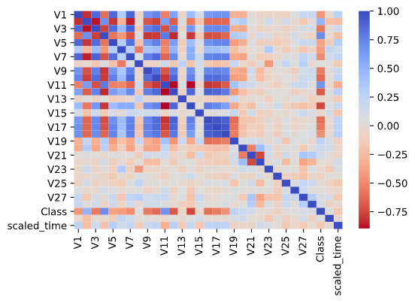
Exploratory data analysis and feature selection
For data analysis we have used a number of open-source libraries like numpy, pandas, matplotlib, seaborn
We start by creating a correlation matrix and creating its heatmap to select the features that have the highest positive and negative relation with our target feature (class).
We use Pearsons correlation for this.

Slide 10
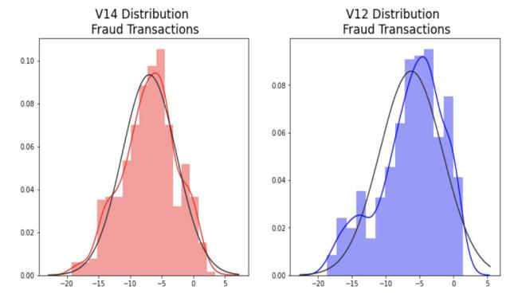
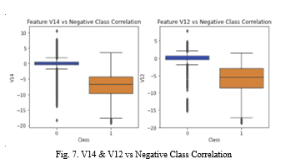
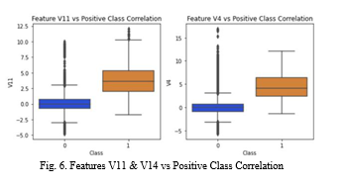
The features with high positive correlation are V2, V4, V11, V19
The features with high negative correlation are V10, V12, V14, V16
For the purpose of model training we are only using these features.
We then remove the outliers and normalize the data to improve efficiency.

Slide 11
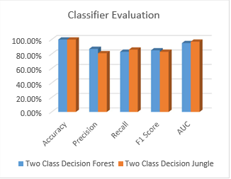
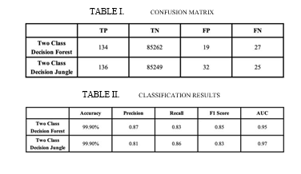
Training and Results
We use the decision forest and decision jungle algorithms which are ensemble learning methods to train the model on our data.
We then use this model to make the predictions and get the result.
We can see that both models have similar accuracy but the decision jungle model has better recall and AUC score.

Slide 12
References
“Annual Fraud Statistics Released by The Nilson Report”, Nov 2019,[online] Available: https://www.prnewswire.com/news-releases/payment-card-fraud-losses-reach-27-85-billion-300963232.html
“Credit Card Fraud Detection Dataset”, Mar 2018, [online] Available: https://www.kaggle.com/mlg-ulb/creditcardfraud
3- Y. Sahin and E. Duman, “Detecting Credit Card Fraud by Decision Trees and Support Vector Machines,” Int. Multiconference Eng. Comput. Sci., vol. I, pp. 442–447, 2011.
V. Van Vlasselaer et al., “APATE: A novel approach for automated credit card transaction fraud detection using networkbased extensions,” Decis. Support Syst., vol. 75, pp. 38–48, 2015.
A. Shen, R. Tong, Y. Deng, "Application of classification models on credit card fraud detection", Service Systems and Service Management 2007 International Conference, pp. 1-4, 2007.

Slide 13
Thank You

