Slide 1
Predicting the best Neighborhood and Perfect location for a Restaurant
Akande Adebambo
December 18, 2020

Slide 2
Introduction
To choose the restaurant, we will need to access data of Neighborhoods in New York (Brooklyn) And Toronto to build our analysis. We will also access coordinates latitude and longitude of the Localities of these two cities from Foursquare APIs and also identify our venues locations with maps. From Foursquare we will need different restaurant information. We will then leverage the data in order to determine which neighborhood is the most appropriate for the restaurant
Data Source
Demographics of New York City from U.S. Census of 2000. Demographics of New York City from Wikipedia
Demographics of Toronto Neighborhoods from Wikipedia 2006
Foursquare API Geolocation data Foursquare-Developer-API

Slide 3
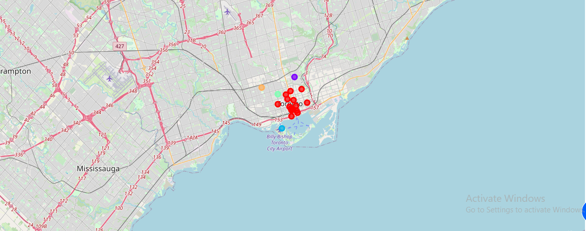
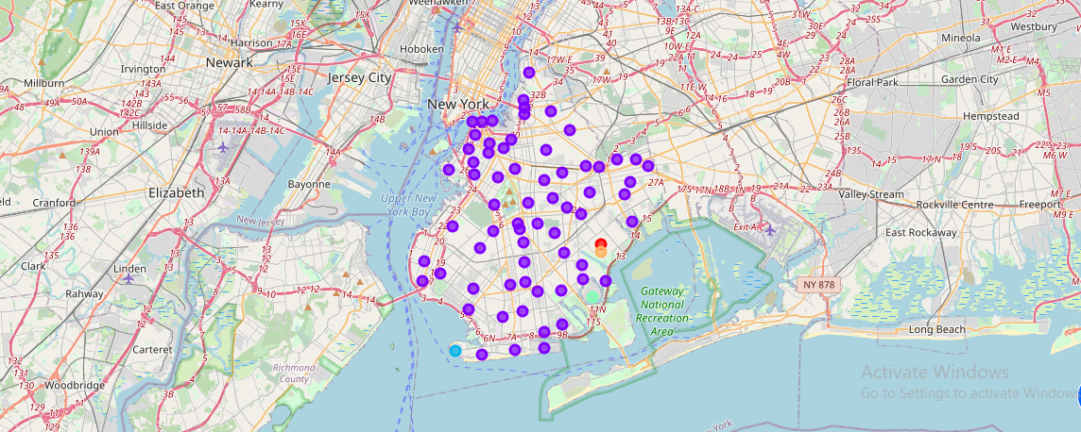
Discussion
The two neighborhoods in the Brooklyn of the New York City and the Downtown Toronto of the Toronto City are similar in having banks, grocery, market, farmers market, waterfall, college, transport station and buildings but dissimilar in other venues
Map of Brooklyn using latitude and longitudm values
Brooklyn map cluster

Slide 4
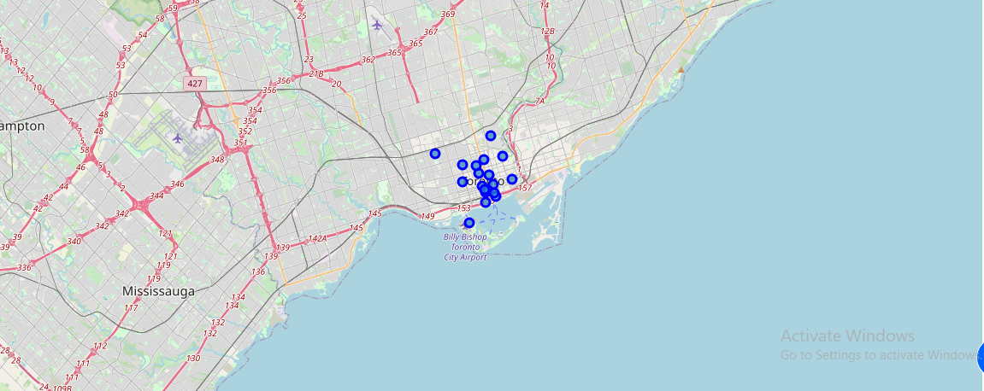
Map of Downtown Toronto using latitude and longitude values
Downtown map cluster

Slide 5
Conclusion
The Brooklyn neighborhoods are better than the Downtown neighborhoods in siting a restaurant business based on the available data. The two neighborhoods are similar in factor that influences the location of restaurant business yet they are glaringly dissimilar in the population densities and hence the market shares of a potential restaurant business.
Any potential restaurant businesses sited in the Brooklyn will have large market share because of the population or population density of the area than if it is to be sited in the Downtown.

