Slide 1
Computer Organization and Assembly Language
Lecture 06:
Data Transfer, Add & SUB (Flags)

Slide 2
Lecture Outline
Data Transfer Instructions
Operand Types
Instruction Operand Notation
Direct Memory Operands
MOV Instruction
Zero & Sign Extension
XCHG Instruction
Direct-Offset Instructions
Addition and Subtraction
Which Flags are affected?

Slide 3
Data Transfer Instructions
Operand Types
Instruction Operand Notation
Direct Memory Operands
MOV Instruction
Zero & Sign Extension
XCHG Instruction
Direct-Offset Instructions

Slide 4
Operand Types
Three basic types of operands:
Immediate – a constant integer (8, 16, or 32 bits)
value is encoded within the instruction
Register – the name of a register
register name is converted to a number and encoded within the instruction
Memory – reference to a location in memory
memory address is encoded within the instruction, or a register holds the address of a memory location

Slide 5
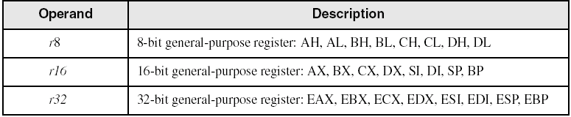
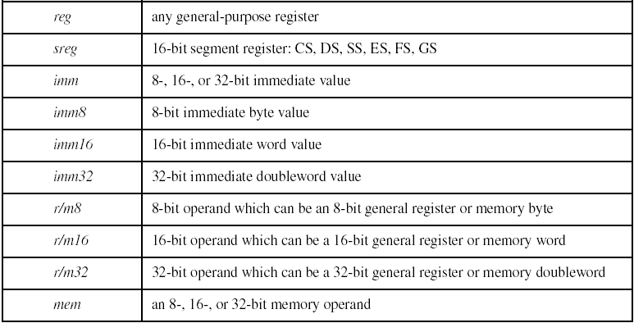
Instruction Operand Notation

Slide 6
Direct Memory Operands
A direct memory operand is a named reference to storage in memory
The named reference (label) is automatically dereferenced by the assembler
.data
var1 BYTE 10h
.code
mov al,var1 ; AL = 10h
mov al,[var1] ; AL = 10h
alternate format

Slide 7
MOV Instruction
Move from source to destination. Syntax:
MOV destination,source
No more than one memory operand permitted
CS, EIP, and IP cannot be the destination
No immediate to segment moves
.data
count BYTE 100
wVal WORD 2
.code
mov bl,count
mov ax,wVal
mov count,al
mov al,wVal ; error
mov ax,count ; error
mov eax,count ; error

Slide 8
Drill . . .
Explain why each of the following MOV statements are invalid:
.data
bVal BYTE 100
bVal2 BYTE ?
wVal WORD 2
dVal DWORD 5
.code
mov ds,45
mov esi,wVal
mov eip,dVal
mov 25,bVal
mov bVal2,bVal
immediate move to DS not permitted
size mismatch
EIP cannot be the destination
immediate value cannot be destination
memory-to-memory move not permitted

Slide 9
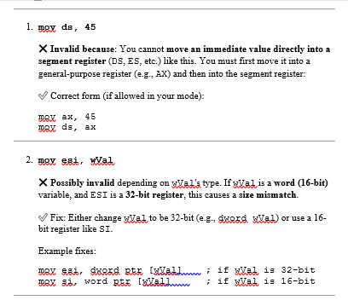

Slide 10
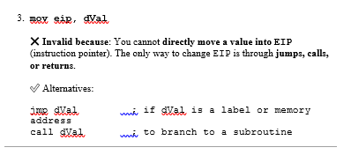
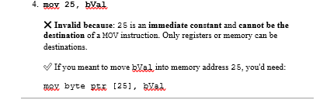

Slide 11
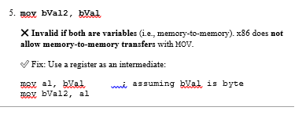

Slide 12
Zero Extension
When you copy a smaller value into a larger destination, the MOVZX instruction fills (extends) the upper half of the destination with zeros.
mov bl,10001111b
movzx ax,bl ; zero-extension
The destination must be a register.

Slide 13
Sign Extension
The MOVSX instruction fills the upper half of the destination with a copy of the source operand's sign bit.
mov bl,10001111b
movsx ax,bl ; sign extension
The destination must be a register.

Slide 14
XCHG Instruction
XCHG exchanges the values of two operands. At least one operand must be a register. No immediate operands are permitted.
.data
var1 WORD 1000h
var2 WORD 2000h
.code
xchg ax,bx ; exchange 16-bit regs
xchg ah,al ; exchange 8-bit regs
xchg var1,bx ; exchange mem, reg
xchg eax,ebx ; exchange 32-bit regs
xchg var1,var2 ; error: two memory operands

Slide 15
Direct-Offset Operands
A constant offset is added to a data label to produce an effective address (EA). The address is dereferenced to get the value inside its memory location.
.data
arrayB BYTE 10h,20h,30h,40h
.code
mov al,arrayB+1 ; AL = 20h
mov al,[arrayB+1] ; alternative notation
Q: Why doesn't arrayB+1 produce 11h?

Slide 16
Direct-Offset Operands (cont)
A constant offset is added to a data label to produce an effective address (EA). The address is dereferenced to get the value inside its memory location.
.data
arrayW WORD 1000h,2000h,3000h
arrayD DWORD 1,2,3,4
.code
mov ax,[arrayW+2] ; AX = 2000h
mov ax,[arrayW+4] ; AX = 3000h
mov eax,[arrayD+4] ; EAX = 00000002h
; Will the following statements assemble?
mov ax,[arrayW-2] ; ??
mov eax,[arrayD+16] ; ??
What will happen when they run?

Slide 17
Drill . . .
Write a program that rearranges the values of three doubleword values in the following array as: 3, 1, 2.
.data
arrayD DWORD 1,2,3
Step1: copy the first value into AX and exchange it with the value in the second position.
mov eax,arrayD
xchg eax,[arrayD+4]
Step 2: Exchange EAX with the third array value and copy the value in EAX to the first array position.
xchg eax,[arrayD+8]
mov arrayD,eax

Slide 18
Evaluate this . . .
We want to write a program that adds the following three bytes:
.data
myBytes BYTE 80h,66h,0A5h
What is your evaluation of the following code?
mov al,myBytes
add al,[myBytes+1]
add al,[myBytes+2]
What is your evaluation of the following code?
mov ax,myBytes
add ax,[myBytes+1]
add ax,[myBytes+2]

Slide 19
Evaluate this . . . (cont)
.data
myBytes BYTE 80h,66h,0A5h
How about the following code. Is anything missing?
movzx ax,myBytes
mov bl,[myBytes+1]
add ax,bx
mov bl,[myBytes+2]
add ax,bx ; AX = sum
Yes: Move zero to BX before the MOVZX instruction.

Slide 20
Addition and Subtraction
INC and DEC Instructions
ADD and SUB Instructions
NEG Instruction
Implementing Arithmetic Expressions
Flags Affected by Arithmetic
Zero
Sign
Carry
Overflow

Slide 21
INC and DEC Instructions
Add 1, subtract 1 from destination operand
operand may be register or memory
INC destination
Logic: destination ← destination + 1
DEC destination
Logic: destination ← destination – 1
Flag Register | Full Name | Applies To | Set When... | Example | Decimal | Binary
CF | Carry Flag | Unsigned Ops | Carry out or borrow occurs | 0xFF + 1 = 0x00, CF = 1 | 255 | 11111111
OF | Overflow Flag | Signed Ops | Signed result is too big or small | 127 + 1 = -128, OF = 1
11111111 (0xFF)
+ 00000001 (0x01)
-----------
1 00000000 → 9 bits!

Slide 22
INC and DEC Examples
.data
myWord WORD 1000h
myDword DWORD 10000000h
.code
inc myWord ; 1001h
dec myWord ; 1000h
inc myDword ; 10000001h
mov ax,00FFh
inc ax ; AX = 0100h
mov ax,00FFh
inc al ; AX = 0000h
AX: [AH][AL]
↑ ↑
8 8 bits
mov ax, 00FFh ; AX = 00FFh → AH = 00h, AL = FFh
inc al ; AL = FFh → 00h (overflow)

Slide 23
Drill ...
Show the value of the destination operand after each of the following instructions executes:
.data
myByte BYTE 0FFh, 0
.code
mov al,myByte ; AL =
mov ah,[myByte+1] ; AH =
dec ah ; AH =
inc al ; AL =
dec ax ; AX =
FFh
00h
FFh
00h
FEFF

Slide 24
ADD and SUB Instructions
ADD destination, source
Logic: destination ← destination + source
SUB destination, source
Logic: destination ← destination – source
Same operand rules as for the MOV instruction

Slide 25
ADD and SUB Examples
.data
var1 DWORD 10000h
var2 DWORD 20000h
.code ; ---EAX---
mov eax,var1 ; 00010000h
add eax,var2 ; 00030000h
add ax,0FFFFh ; 0003FFFFh
add eax,1 ; 00040000h
sub ax,1 ; 0004FFFFh

Slide 26
NEG (negate) Instruction
Reverses the sign of an operand. Operand can be a register or memory operand.
.data
valB BYTE -1
valW WORD +32767
.code
mov al,valB ; AL = -1
neg al ; AL = +1
neg valW ; valW = -32767
Suppose AX contains –32,768 and we apply NEG to it. Will the result be valid?

Slide 27
NEG Instruction and the Flags
The processor implements NEG using the following internal operation:
SUB 0,operand
Any nonzero operand causes the Carry flag to be set.
.data
valB BYTE 1,0
valC SBYTE -128
.code
neg valB ; CF = 1, OF = 0
neg [valB + 1] ; CF = 0, OF = 0
neg valC ; CF = 1, OF = 1

Slide 28
Implementing Arithmetic Expressions
HLL compilers translate mathematical expressions into assembly language. You can do it also. For example:
Rval = -Xval + (Yval – Zval)
Rval DWORD ?
Xval DWORD 26
Yval DWORD 30
Zval DWORD 40
.code
mov eax,Xval
neg eax ; EAX = -26
mov ebx,Yval
sub ebx,Zval ; EBX = -10
add eax,ebx
mov Rval,eax ; -36

Slide 29
Drill ...
Translate the following expression into assembly language. Do not permit Xval, Yval, or Zval to be modified:
Rval = Xval - (-Yval + Zval)
Assume that all values are signed doublewords.
mov ebx,Yval
neg ebx
add ebx,Zval
mov eax,Xval
sub eax,ebx
mov Rval,eax

Slide 30
Flags Affected by Arithmetic
The ALU has a number of status flags that reflect the outcome of arithmetic (and bitwise) operations
based on the contents of the destination operand
Essential flags:
Zero flag – set when destination equals zero
Sign flag – set when destination is negative
Carry flag – set when unsigned value is out of range
Overflow flag – set when signed value is out of range
The MOV instruction never affects the flags.

Slide 31
Concept Map
CPU
part of
executes
executes
ALU
conditional jumps
arithmetic & bitwise operations
attached to
used by
provide
affect
status flags
branching logic
You can use diagrams such as these to express the relationships between assembly language concepts.

Slide 32
This diagram illustrates the relationship between key components within a Central Processing Unit (CPU) and how they work together to execute instructions, particularly focusing on arithmetic and bitwise operations and conditional jumps.
Here's a breakdown of the diagram:
1. CPU (Central Processing Unit):
This is the brain of the computer, responsible for executing instructions. It's at the top of the diagram, indicating its central role.
2. ALU (Arithmetic Logic Unit):
Connected to the CPU with the label "part of," the ALU is a fundamental component of the CPU.
Its primary function is to execute "arithmetic & bitwise operations."
3. Arithmetic & Bitwise Operations:
This box represents the set of operations that the ALU can perform.
Arithmetic operations include addition, subtraction, multiplication, division, etc.
Bitwise operations include logical operations like AND, OR, NOT, XOR, and shift/rotate operations (like the ones we discussed earlier).
4. Status Flags:
The ALU is "attached to" the status flags.
"arithmetic & bitwise operations" "affect" the status flags.

Slide 33
Status flags are special bits within the CPU that store information about the result of the last ALU operation. Common flags include:
Zero Flag (Z): Set if the result of the operation is zero.
Carry Flag (C): Set if there was a carry-out from the most significant bit (in addition) or a borrow (in subtraction).
Sign Flag (S): Set if the result is negative (the most significant bit is 1 in signed arithmetic).
Overflow Flag (V or OF): Set if a signed arithmetic operation resulted in an overflow.
5. Conditional Jumps:
The CPU "executes" "conditional jumps."
"conditional jumps" "used by" the "ALU." This is slightly inaccurate phrasing; rather, the results of ALU operations (reflected in the status flags) determine whether a conditional jump is taken.
Conditional jumps are instructions that allow the program's execution flow to change based on certain conditions. These conditions are often the state of the status flags. For example, "jump if zero" will cause the program to jump to a different instruction if the Zero Flag is set.
6. Branching Logic:
"conditional jumps" "provide" "branching logic."
Branching logic refers to the ability of a program to execute different sequences of instructions based on conditions. Conditional jumps are the fundamental mechanism for implementing branching logic (e.g., if-else statements, loops) in assembly language.

Slide 34
In Simple Terms:
Imagine the ALU as a calculator inside the CPU. When you perform a calculation (arithmetic or bitwise operation), the calculator not only gives you the result but also sets some little indicators (status flags) based on that result (e.g., was the result zero? was there a carry?).
The CPU can then look at these indicators when it encounters a "conditional jump" instruction. Based on what the indicators say, the CPU might decide to jump to a different part of the program instead of just executing the next instruction in sequence. This is how programs can make decisions and follow different paths, creating more complex and intelligent behavior.

Slide 35
Zero Flag (ZF)
The Zero flag is set when the result of an operation produces zero in the destination operand.
mov cx,1
sub cx,1 ; CX = 0, ZF = 1
mov ax,0FFFFh
inc ax ; AX = 0, ZF = 1
inc ax ; AX = 1, ZF = 0
Remember...
A flag is set when it equals 1.
A flag is clear when it equals 0.

Slide 36
Sign Flag (SF)
The Sign flag is set when the destination operand is negative. The flag is clear when the destination is positive.
mov cx,0
sub cx,1 ; CX = -1, SF = 1
add cx,2 ; CX = 1, SF = 0
The sign flag is a copy of the destination's highest bit:
mov al,0
sub al,1 ; AL = 11111111b, SF = 1
add al,2 ; AL = 00000001b, SF = 0

Slide 37
Signed and Unsigned Integers A Hardware Viewpoint
All CPU instructions operate exactly the same on signed and unsigned integers
The CPU cannot distinguish between signed and unsigned integers
YOU, the programmer, are solely responsible for using the correct data type with each instruction

Slide 38
Overflow and Carry Flags A Hardware Viewpoint
How the ADD instruction modifies OF and CF:
OF = (carry out of the MSB) XOR (carry into the MSB)
CF = (carry out of the MSB)
How the SUB instruction modifies OF and CF:
NEG the source and ADD it to the destination
OF = (carry out of the MSB) XOR (carry into the MSB)
CF = INVERT (carry out of the MSB)
MSB = Most Significant Bit (high-order bit)
XOR = eXclusive-OR operation
NEG = Negate (same as SUB 0,operand )

Slide 39
Carry Flag (CF)
The Carry flag is set when the result of an operation generates an unsigned value that is out of range (too big or too small for the destination operand).
mov al,0FFh
add al,1 ; CF = 1, AL = 00
; Try to go below zero:
mov al,0
sub al,1 ; CF = 1, AL = FF

Slide 40
Drill . . .
For each of the following marked entries, show the values of the destination operand and the Sign, Zero, and Carry flags:
mov ax,00FFh
add ax,1 ; AX= SF= ZF= CF=
sub ax,1 ; AX= SF= ZF= CF=
add al,1 ; AL= SF= ZF= CF=
mov bh,6Ch
add bh,95h ; BH= SF= ZF= CF=
mov al,2
sub al,3 ; AL= SF= ZF= CF=
0100h 0 0 0
00FFh 0 0 0
00h 0 1 1
01h 0 0 1
FFh 1 0 1

Slide 41
Overflow Flag (OF)
The Overflow flag is set when the signed result of an operation is invalid or out of range.
; Example 1
mov al,+127
add al,1 ; OF = 1, AL = ??
; Example 2
mov al,7Fh ; OF = 1, AL = 80h
add al,1
The two examples are identical at the binary level because 7Fh equals +127. To determine the value of the destination operand, it is often easier to calculate in hexadecimal.

Slide 42
A Rule of Thumb
When adding two integers, remember that the Overflow flag is only set when . . .
Two positive operands are added and their sum is negative
Two negative operands are added and their sum is positive
What will be the values of the Overflow flag?
mov al,80h
add al,92h ; OF =
mov al,-2
add al,+127 ; OF =
1
0

Slide 43
Drill . . .
What will be the values of the given flags after each operation?
mov al,-128
neg al ; CF = OF =
mov ax,8000h
add ax,2 ; CF = OF =
mov ax,0
sub ax,2 ; CF = OF =
mov al,-5
sub al,+125 ; OF =
1 1
0 0
1 0
1

Slide 44
Summary
Data Transfer Instructions
Operand Types
Instruction Operand Notation
Direct Memory Operands
MOV Instruction
Zero & Sign Extension
XCHG Instruction
Direct-Offset Instructions

Slide 45
Summary
(cont.)
Add and Subtract
Flags affected by the above operations
mov ax,00FFh
add ax,1 ; AX= SF= ZF= CF=
sub ax,1 ; AX= SF= ZF= CF=
add al,1 ; AL= SF= ZF= CF=
mov bh,6Ch
add bh,95h ; BH= SF= ZF= CF=
mov al,2
sub al,3 ; AL= SF= ZF= CF=
0100h 0 0 0
00FFh 0 0 0
00h 0 1 1
01h 0 0 1
FFh 1 0 1

Slide 46
Reference
Most of the Slides are taken from Presentation:
Chapter 4
Assembly Language for Intel-Based Computers, 4th Edition
Kip R. Irvine
(c) Pearson Education, 2002. All rights reserved. You may modify and copy this slide show for your personal use, or for use in the classroom, as long as this copyright statement, the author's name, and the title are not changed.

