Slide 1
Computer Organization and Assembly Language
Lecture 04:
Machine Instruction Characteristics

Slide 2
Lecture Outline
Instruction Set
Instruction Format
Instruction Cycle State Diagram
Operation Types
Operands
Data Types
Little and Big-Endian

Slide 3
What is an Instruction Set?
The complete collection of instructions that are understood by a CPU
Machine Code
Binary
Usually represented by assembly codes
Notes:
2

Slide 4
Simple Instruction Format
The instruction is divided into fields, corresponding to the basic elements of the instruction.
Instruction is read into an Instruction Register (IR)
The CPU must be able to extract the data from the various instruction fields to perform the required operation.
Opcode
Operand(s) and/or Address(es)

Slide 5
Elements of an Instruction
Operation code (Op code) → Do this…
Specifies the operation to be performed (e.g.. ADD, SUB, I/O).
Source Operand reference → To this…
The operation may involve one or more source operands, that is, operands that are inputs for the operation.
Result Operand reference → Put the answer here…
The operation may produce a result.
Next Instruction Reference → When done that, do this...
It tells the CPU where to fetch the next instruc­tion after the execution of this instruction is complete.
Notes:
3

Slide 6
Location of all the Operands
Including source and result operands can be found:
Main or virtual memory.
Processor register- contains registers that can be used by machine instructions.
Immediate- the operand value is being contained when the instruction is being executed.
I/O devices- instruction specifies I/O module and device but if memory mapped then just another main or virtual memory address.
Notes:
4

Slide 7
Instruction Length
This is how long (in bits or bytes) each instruction is in a computer's instruction set.
Affected by and affects:
Memory size
Memory organization - addressing
Bus structure, e.g. width
CPU complexity
CPU speed
Trade off between powerful instruction set and saving space.

Slide 8
Instruction Length
Memory size: Larger memory may need longer instructions to reference all possible memory addresses.
Memory organization - addressing: The way memory is structured and how addresses are assigned (e.g., direct, indirect, indexed) influences how long an instruction needs to be to fully specify an address.
Bus structure, e.g., width: The bus is how data travels between components. A wider bus (e.g., 32-bit vs 16-bit) can carry more data at once, which might affect instruction length.
CPU complexity: A complex instruction set may require longer instructions to support various addressing modes and operations.
CPU speed: Longer instructions may take longer to fetch and decode, potentially slowing down the CPU. Shorter instructions can be processed faster but might be less powerful.

Slide 9
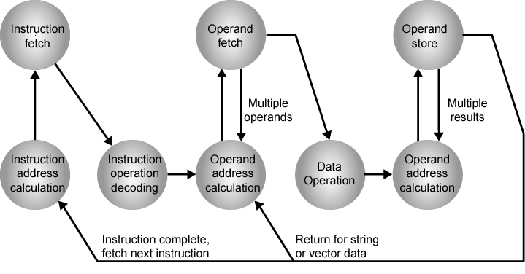
Instruction Cycle State Diagram
Transitions and Loops:
After some steps, the CPU may go back (e.g., to fetch more operands or store multiple results).
Once everything is complete, it returns to fetch the next instruction.
2
5
5
8
1
4
6
7
3
The CPU calculates the address of the next instruction to be fetched (usually from the Program Counter)
The instruction is fetched from memory using the calculated address.
The fetched instruction is decoded to understand what operation needs to be performed (e.g., ADD, LOAD, STORE).
The required operand(s) are fetched from memory.
If the instruction uses operands (data), the CPU calculates where in memory the operand(s) are located.
The required operand(s) are fetched from memory.
If the result of the operation needs to be stored, the CPU calculates the destination address.
The actual operation (like addition, subtraction, comparison) is performed on the fetched operands.
The result of the operation is stored in the calculated memory address

Slide 10
Instruction Representation
Within a Computer or in machine code each instruction is represented by the sequence of bits and has a unique bit pattern.
For human consumption (well, programmers anyway) a symbolic representation is used.
Opcodes are represented by abbreviations, called mnemonics, that indicate the operation.
Common examples:
ADD Add
SUB Subtract
MUL Multiply
DIV Divide
LOAD Load data from memory
STOR Store data to memory etc.
Operands can also be represented in this way
ADD A,B
Notes:
5

Slide 11
Example
X = X+Y
Assume that the variable X and Y correspond to locations 513 and 514
Operation: (by assuming a simple set of machine instructions)
Load a register with the contents of memory location 513.
Add the contents of memory location 514 to the register.
Store the contents of the register in memory location 513.
Single High-Level Expression ←→Multiple Machine Level Instructions
Notes:
6

Slide 12
Instruction Types
Data processing
Arithmetic and logic instructions
Data storage (main memory)
Moving data into or out of register or memory locations
Data movement (I/O)
I/O instructions
Program flow control
Test and branch instructions
Notes:
6

Slide 13
Number of Addresses
A traditional way of describing processor architecture
What is the maximum number of addresses one might need in an instruction?
An instruction could be required to contain four addresses.

Slide 14
Number of Addresses
"A traditional way of describing processor architecture"
In early CPU design, one key way to describe the processor was by how many addresses each instruction could hold.
This helps determine how complex or powerful the instructions can be.
"What is the maximum number of addresses one might need in an instruction?"
This is a theoretical question. Some operations might need to work with multiple values—so the CPU needs to know where to get them from (input operands) and where to put the result (output).
"An instruction could be required to contain four addresses."
Example: In a complex instruction, you might have:
One address for source operand 1
One for source operand 2
One for destination (where result is stored)
One for the next instruction or some extra info (like a condition or modifier)

Slide 15
Number of Addresses
Instruction Formats by Address Count:
0-address (stack-based): Operands are implicit, usually on top of the stack.
1-address: One explicit operand; other(s) are implicit (like accumulator).
2-address: One source and one destination.
3-address: Two sources and one destination (e.g., ADD R1, R2, R3 → R1 = R2 + R3)
4-address: Rare, but possible in special architectures for complex operations.

Slide 16
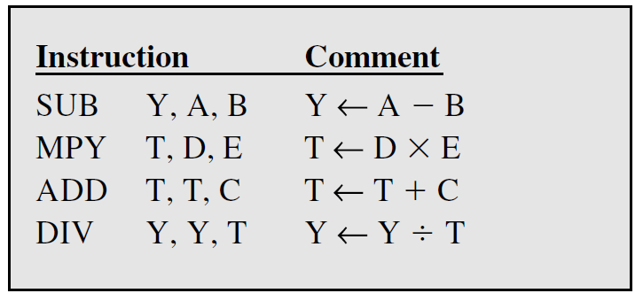
Number of Addresses (a)
3 addresses
Operand 1, Operand 2, Result
a = b + c;
May be a forth - next instruction (usually implicit)
Not common
Needs very long words to hold everything
3-address: Two sources and one destination (e.g., ADD R1, R2, R3 → R1 = R2 + R3)
Notes:
7

Slide 17
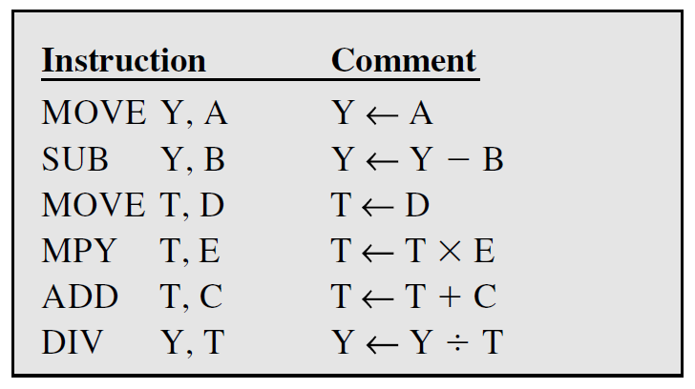
Number of Addresses (b)
2 addresses
One address doubles as operand and result
a = a + b
Reduces length of instruction
Requires some extra work
Temporary storage to hold some results
2-address: One source and one destination.
Notes:
8

Slide 18
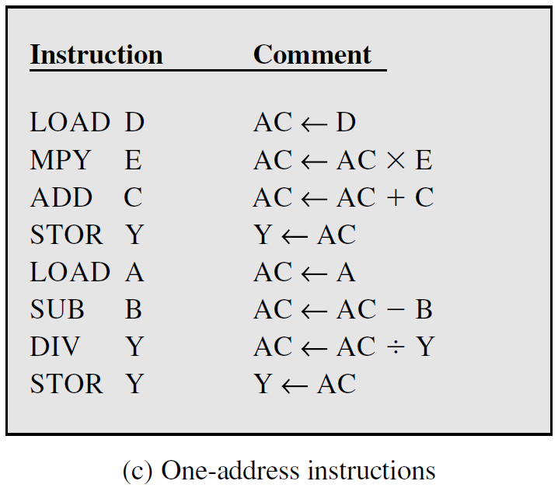
Number of Addresses (c)
1 address
Implicit second address
Usually a register (accumulator)
Common on early machines
1-address: One explicit operand; other(s) are implicit (like accumulator).
Notes:
9

Slide 19
Number of Addresses (d)
0 (zero) addresses
All addresses implicit
Uses a stack
e.g. push a
push b
add
pop c
c = a + b
0-address (stack-based): Operands are implicit, usually on top of the stack.
Notes:
10

Slide 20
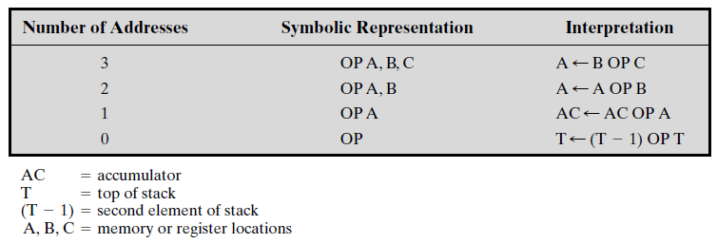
Number of Addresses (Summarized)
Utilization of Instruction Addresses (Nonbranching Instructions)

Slide 21
How Many Addresses?
More addresses
More complex instructions
More registers →Inter-register operations are quicker
Fewer instructions per program
Fewer addresses
Less complex instructions
More instructions per program
Faster fetch/execution of instructions
Example: Y=(A-B):[(C+(DxE)]
Notes:
11

Slide 22
Design Decisions
Operation range
How many operations?
What can they do?
How complex are they?
Data types
The various types of data upon which operations are performed.
Instruction formats
Length/Size of fields (in bits)
Number of addresses
Notes:
12

Slide 23
Design Decisions
(cont.)
Registers
Number of processor registers available and can be referenced by the instructions.
Which operations can be performed on which registers?
Addressing modes (later…)
The mode or modes by which the address of an operand is specified.
RISC v CISC
Notes:
13

Slide 24
Types of Operand
Addresses: immediate, direct, indirect, stack …
Numbers:
Integer or fixed point (binary, twos complement),
Floating point (sign, significand, exponent),
(packed) decimal (246 = 0000 0010 0100 0110)
Characters:
ASCII (128 printable and control characters + bit for error detection)
Logical Data
bits or flags, e.g. Boolean 0 and 1
Data Structures
Notes:
14

Slide 25
Numbers
A limit to the magnitude of numbers representable on a machine
Types of operands
A limit to their precision in the case of floating-point numbers
Rounding, overflow and underflow
Three types of numerical data
Integer of fixed point
Floating point
Decimal
Notes:
14

Slide 26
Characters
ASCII code (unique 7-bit pattern,128 characters)
The eighth bit may be set to 0 or used as a parity bit for error detection
Bit pattern 011XXXX, the digits 0 through 9 are represented by their binary equivalents, 0000 through 1001, in the right-most 4 digits
Notes:
14

Slide 27
Characters
ASCII Code Overview
Bit Size: ASCII is a 7-bit encoding scheme.
This gives a total of 2⁷ = 128 unique characters.
These characters include:
Control characters (0–31 and 127)
Printable characters (32–126), including:
Digits: '0' to '9' (ASCII 48 to 57)
Uppercase letters: 'A' to 'Z' (ASCII 65 to 90)
Lowercase letters: 'a' to 'z' (ASCII 97 to 122)
Punctuation and symbols
8th Bit:
ASCII is technically 7 bits.
However, in modern systems, an 8th bit may be added:
Set to 0 (making it compatible with ASCII)
Or used as a parity bit for error detection
Notes:
14

Slide 28
Characters
Digits and the Bit Pattern 011XXXX
All digit characters '0' to '9' follow the pattern: 011XXXX, where XXXX is the 4-bit binary of the digit.
So essentially:
The prefix 011 helps identify that it's a digit.
The suffix is the actual binary representation of the number.
Character | ASCII Binary | Explanation
'0' | 0110000 | XXXX = 0000
'1' | 0110001 | XXXX = 0001
'2' | 0110010 | XXXX = 0010
'3' | 0110011 | XXXX = 0011
'4' | 0110100 | XXXX = 0100
'5' | 0110101 | XXXX = 0101
'6' | 0110110 | XXXX = 0110
'7' | 0110111 | XXXX = 0111
'8' | 0111000 | XXXX = 1000
'9' | 0111001 | XXXX = 1001
Notes:
14

Slide 29
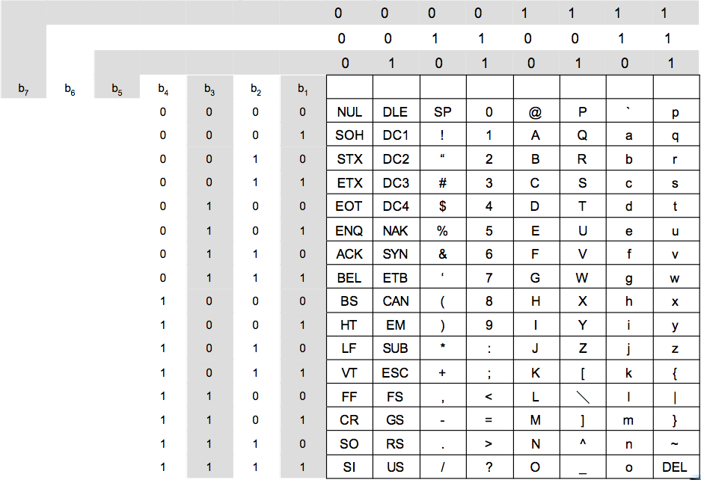
Characters
Notes:
14

Slide 30
x86 Data Types
8 bit Byte
16 bit word
32 bit double word
64 bit quad word
128 bit double quadword
Addressing is by 8 bit unit
Words do not need to align at even-numbered address
Data accessed across 32 bit bus in units of double word read at addresses divisible by 4
Notes:
15

Slide 31
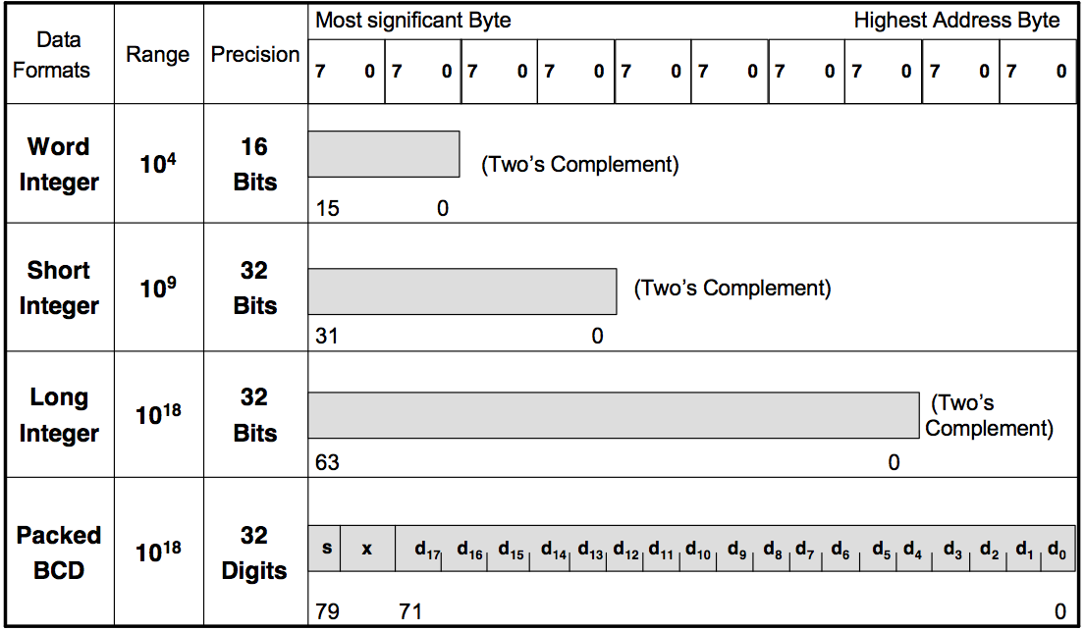
Pentium II Numerical Data Formats
Notes:
15

Slide 32
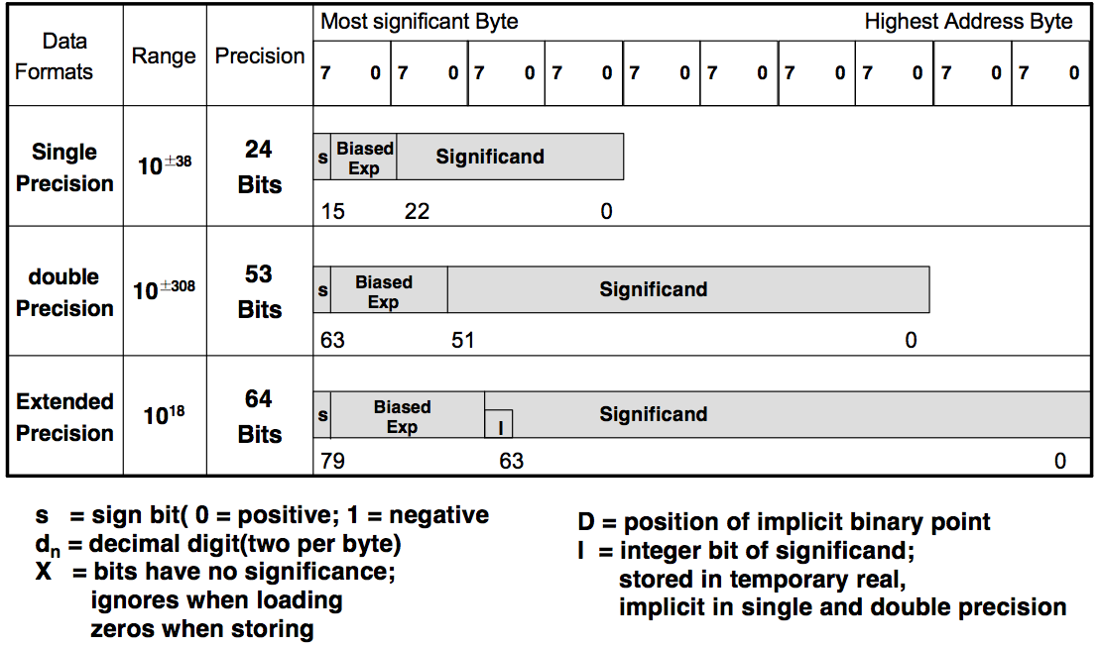
Pentium II Numerical Data Formats
Notes:
15

Slide 33
Types of Operations
Data Transfer
Arithmetic
Logical
Conversion
I/O
System Control
Transfer of Control
Notes:
18

Slide 34
Data Transfer
Specify
Source
Destination
Amount of data
May be different instructions for different movements
e.g. IBM 370
Or one instruction and different addresses
e.g. VAX (Virtual Address eXtension – ISA)
Notes:
19

Slide 35
Arithmetic
Add, Subtract, Multiply, Divide ….
Signed Integer
Floating point
May include
Increment (a++)
Decrement (a--)
Negate (-a)
Notes:
20

Slide 36
Shift and Rotate Operations
Logical Shifts:
Logical Shift Left (LSL):
Think of pushing all the light bulbs to the left.
The light bulb at the very left end falls off and disappears.
A new, off light bulb (representing a '0') is added at the very right end.
Before: 0 0 1 1 1 0 ... 0 1 1
After: 1 1 1 0 ... 0 1 1 0 0
Notice how the '0' at the beginning and the next '0' have fallen off (the last one might go into a special 'carry' indicator). Two new '0's are added at the end.
C
R3
0
before:
0
0
1
1
1
0
.
.
.
0
1
1
after:
1
1
1
0
.
.
.
0
1
1
0
0
(a) Logical shift left
LSL R3, #2
Logical Shift Right (LSR):
Think of pushing all the light bulbs to the right.
The light bulb at the very right end falls off and disappears.
A new, off light bulb (representing a '0') is added at the very left end.
Before: 0 1 1 1 0 ... 0 1 1 0
After: 0 0 0 1 1 1 0 ... 0 1
Notice how the '1' at the end and the '0' before it have fallen off (the last one might go into the 'carry' indicator). Two new '0's are added at the beginning.
0
R3
C
before:
0
1
1
1
0
.
.
.
0
1
1
0
after:
0
0
0
1
1
1
0
.
.
.
0
1
(b) Logical shift right
LSR R3,#2

Slide 37
Shift and Rotate Operations
Arithmetic Shifts:
Arithmetic Shift Right (ASR)
R3
C
before:
1
0
0
1
1
.
.
.
0
1
0
0
after:
1
1
1
0
0
1
1
.
.
.
0
1
(a) Arithmetic shift right
ASR R3,#2

Slide 38
Shift and Rotate Operations
Rotate:
C
R3
C
R3
before:
0
0
1
1
1
0
.
.
.
0
1
1
before:
0
0
1
1
1
0
.
.
.
0
1
1
after:
1
1
1
0
.
.
.
0
1
1
0
1
after:
1
1
1
0
.
.
.
0
1
1
0
0
(a) Rotate left without carry
ROR R3, #2
(b) Rotate left with carry
RCL R3, #2
Rotate Right without carry
Rotate Right with carry

Slide 39
Logical
Bitwise operations:
AND,
OR,
NOT,
XOR,
TEST,
CMP,
SET …
Notes:
21

Slide 40
Conversion
Change the format or operate on the format of data
e.g. Binary to Decimal
Notes:
22

Slide 41
Input/Output
May be specific instructions
May be done using data movement instructions (memory mapped)
May be done by a separate controller (DMA)
Notes:
23

Slide 42
Systems Control
Executed only while
The processor is in a certain privileged state
The processor is executing a program in a special privileged area of memory
CPU needs to be in specific state
Ring 0 on 80386+
Kernel mode
For the use of operating systems
Examples
Read or alter a control register
Read or modify a storage protection key
Access to process control blocks in a multiprogramming system
Privileged instructions
Notes:
24

Slide 43
Transfer of Control
Branch
e.g. branch to x if result is zero
Conditional branch instruction
Two ways of generating the condition
Most machines provide a 1-bit or multiple- bit condition code that is set as the result of some operations
To perform a comparison and specify a branch in the same instruction
Subroutine call
c.f. interrupt call
Notes:
25

Slide 44
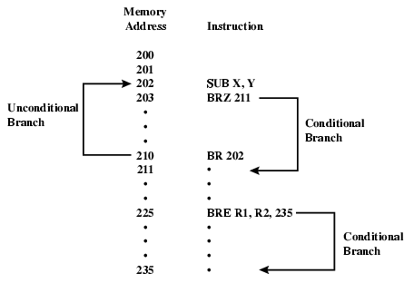
Branch Instruction

Slide 45
Procedure Calls
Procedure Call Instructions
Self-contained computer program incorporated into a larger program
Two principal reasons for the use of procedures
Economy and modularity
Two basic instructions
A call instruction branching from the present location to the procedure
A Return instruction returning from the procedure to the place from which it was called

Slide 46
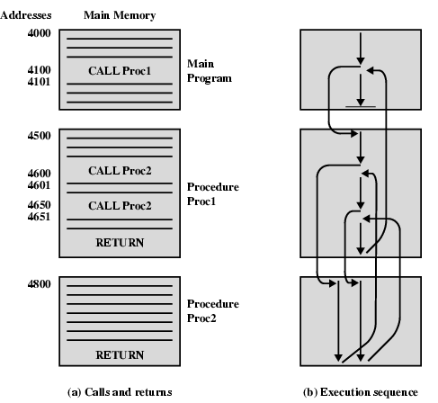
Nested Procedure Calls

Slide 47
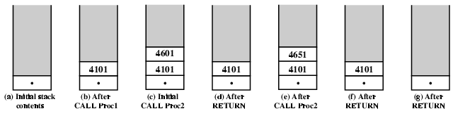
Use of Stack

Slide 48
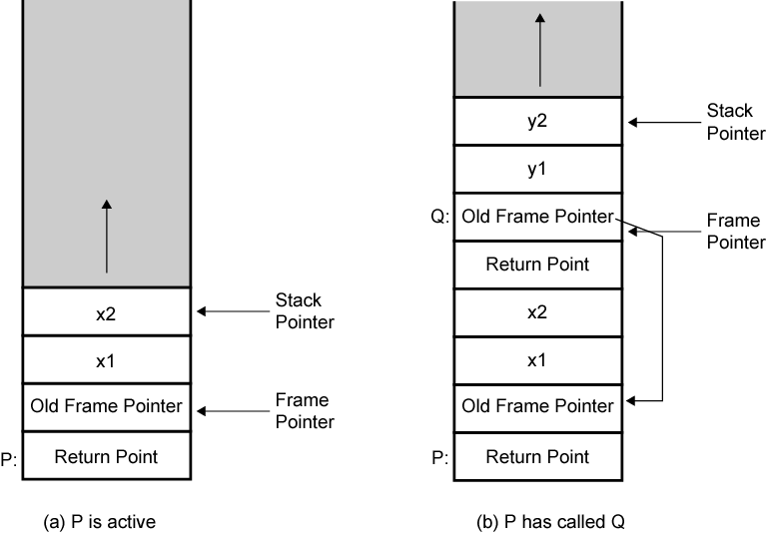
Stack Frame Growth Using Sample Procedures P and Q

Slide 49
Byte Order
In what order do we read numbers that occupy more than one byte?
e.g. (numbers in hex to make it easy to read)
12345678 can be stored in 4x8bit locations as follows:
Address | Data | Address | Data
00F00 | 12 | 00F00 | 78
00F01 | 34 | 00F01 | 56
00F02 | 56 | 00F02 | 34
00F03 | 78 | 00F03 | 12
How to read? top down or bottom up?
Notes:
27

Slide 50
Byte Order Names
The problem is called Endian
The system on the left has the Most significant byte first or in the lowest address
This is called Big-endian
The system on the right has the least significant byte first or in the Lowest address
This is called little-endian
Address | Data | Address | Data
00F00 | 12 | 00F00 | 78
00F01 | 34 | 00F01 | 56
00F02 | 56 | 00F02 | 34
00F03 | 78 | 00F03 | 12
Notes:
29

Slide 51
Standard…What Standard?
Pentium (x86), VAX (Virtual Address eXtension - ISA) are little-endian
IBM 370, Motorola 680x0 (Mac), and most RISC are big-endian
Internet is big-endian
Makes writing Internet programs on PC more awkward!
WinSock provides htoi and itoh (Host to Internet & Internet to Host) functions to convert.
Notes:
30

Slide 52
SUMMARY
Instruction Set
Instruction Format
Instruction Cycle State Diagram
Operation Types
Operands
Data Types
Little and Big-Endian

