Slide 1
Algorithms
Lecture # 02
Mustafa Ali Bamboat

Slide 2
Example – 2 dimension maxima

Slide 3
Random Access Machine
(RAM)

Slide 4
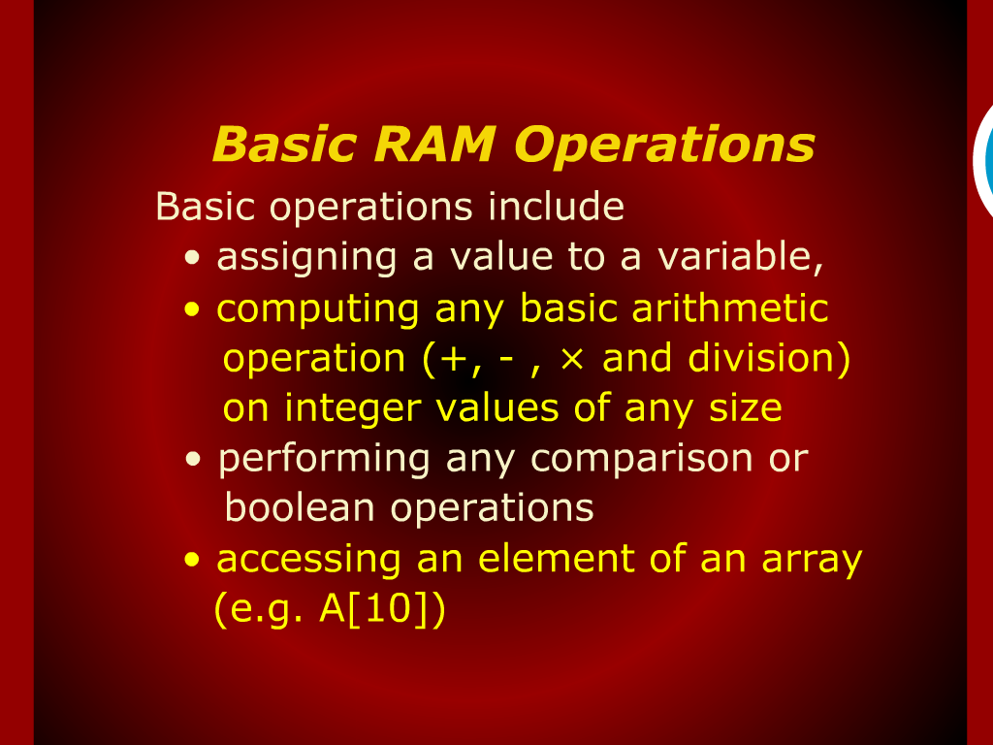
Basic RAM Operations

Slide 5
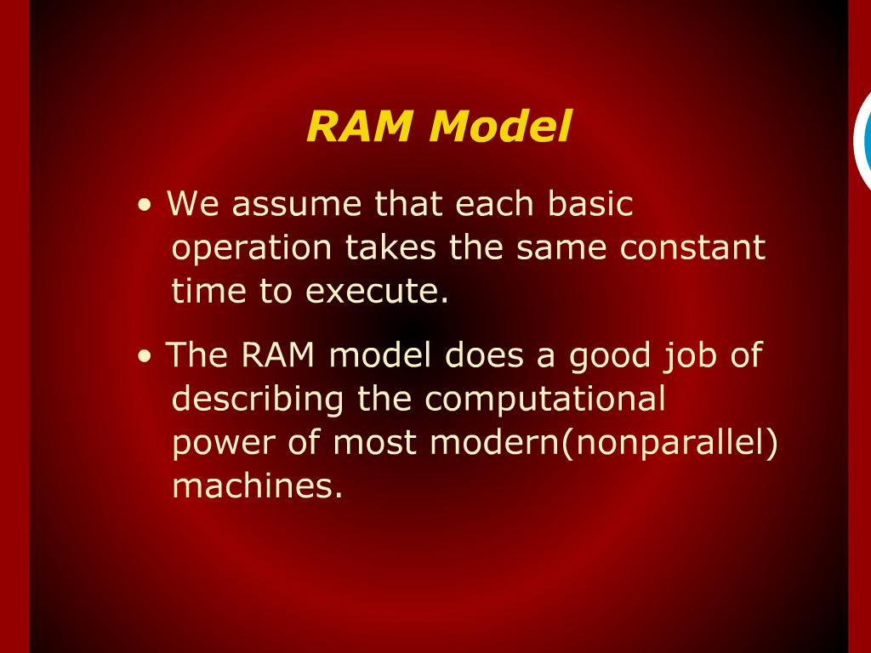
RAM Model

Slide 6
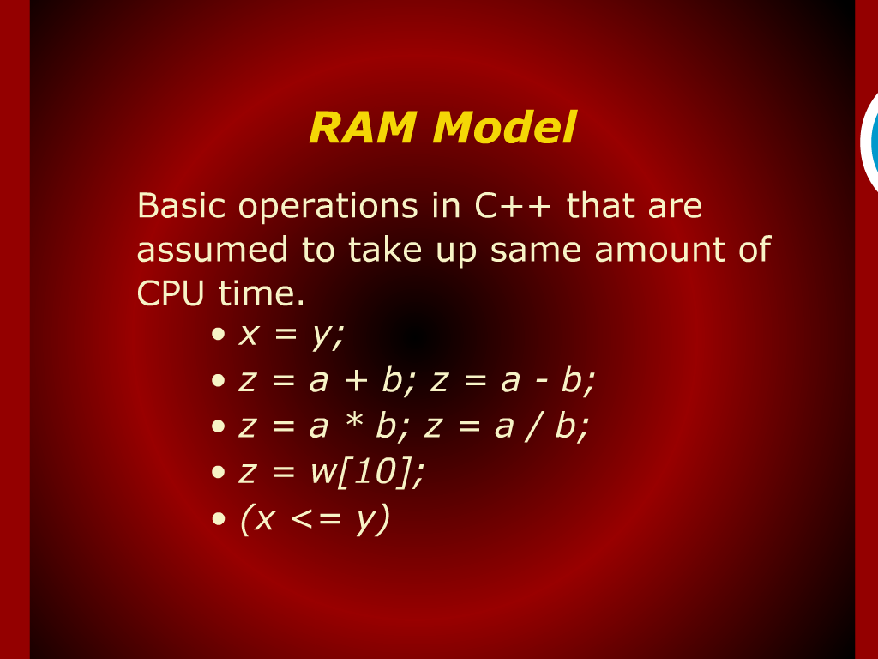
RAM Model

Slide 7
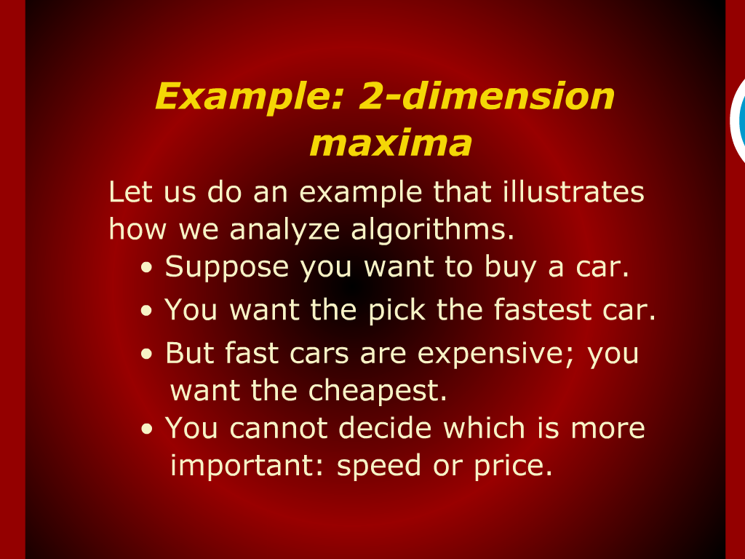
Example: 2-dimension maxima

Slide 8
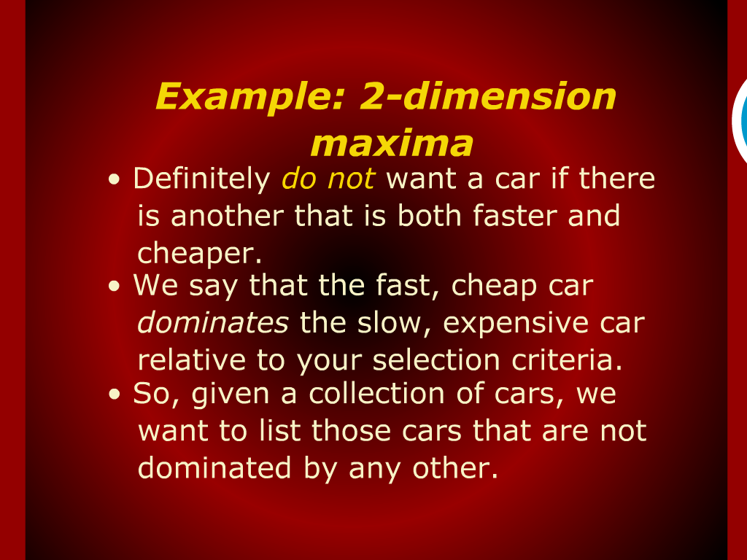
Example: 2-dimension maxima

Slide 9
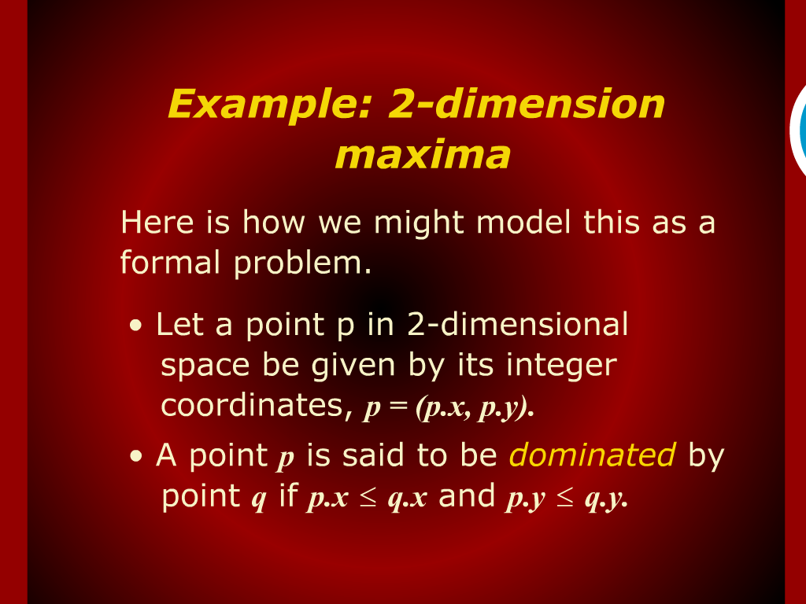
Example: 2-dimension maxima

Slide 10
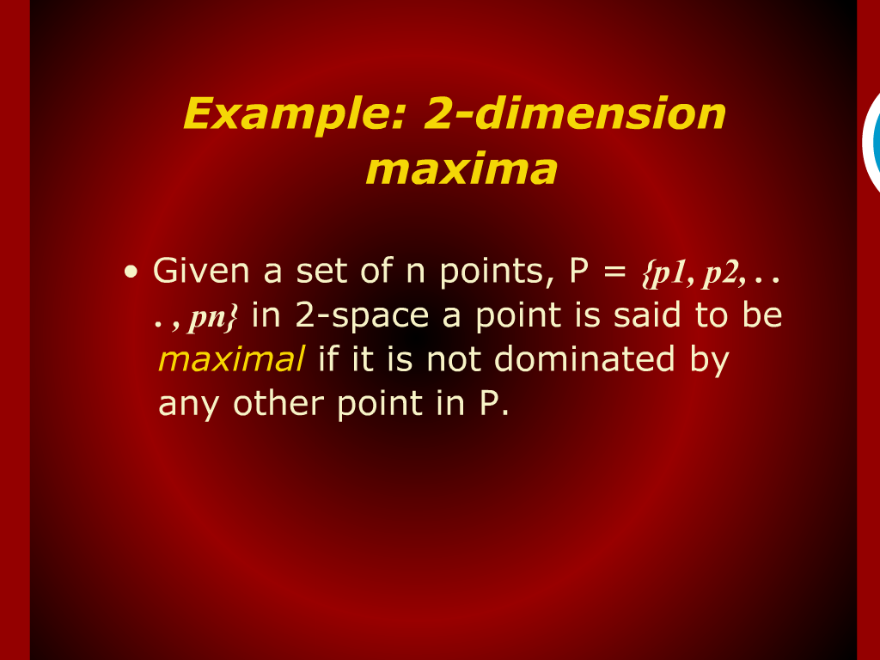
Example: 2-dimension maxima

Slide 11
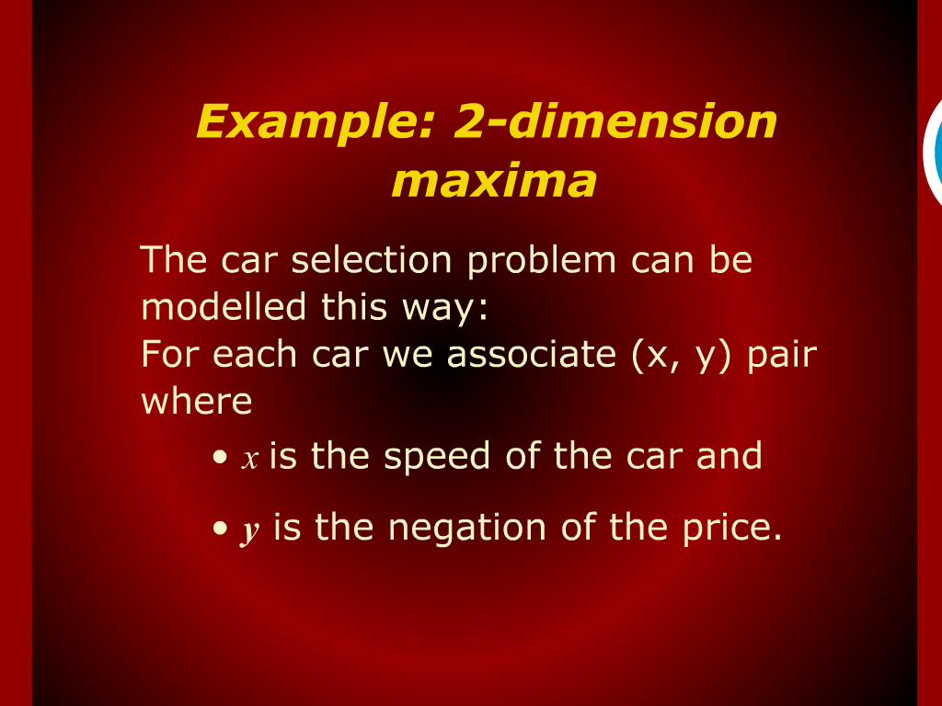
Example: 2-dimension maxima

Slide 12
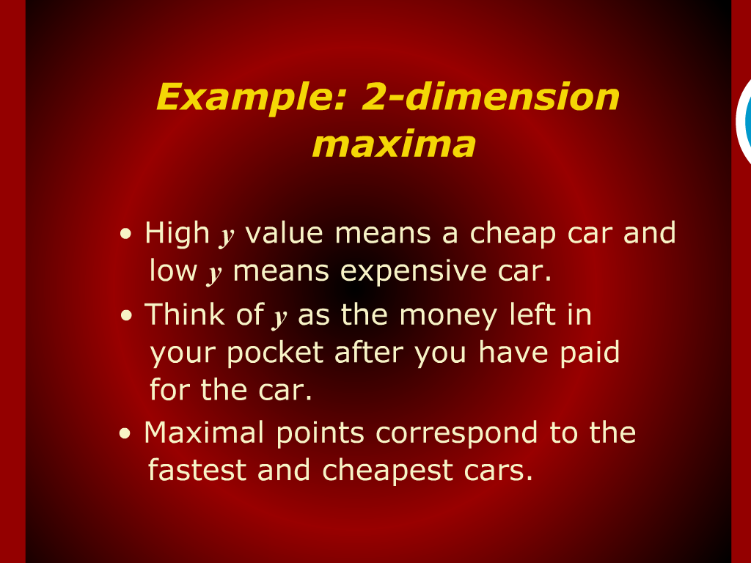
Example: 2-dimension maxima

Slide 13
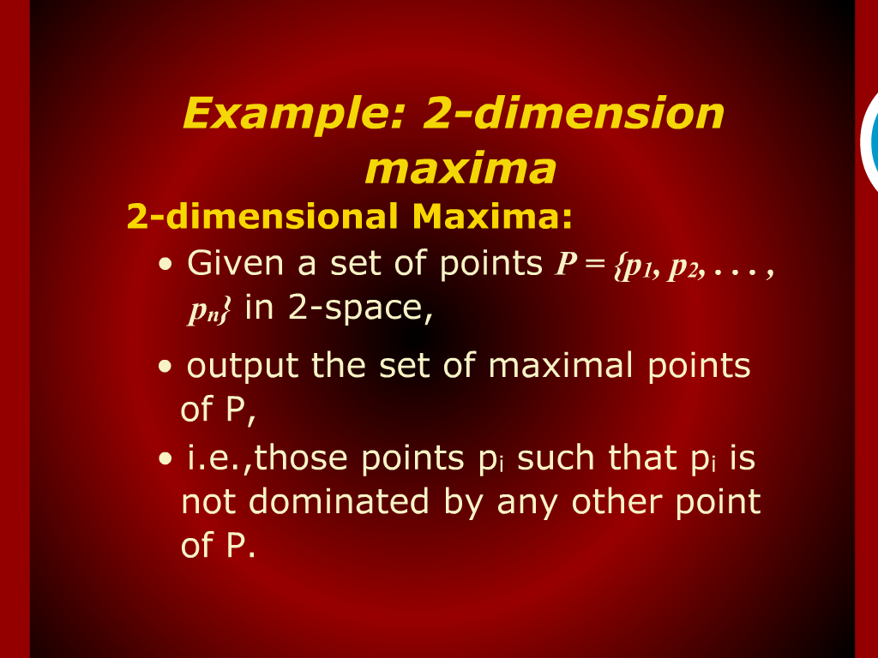
Example: 2-dimension maxima

Slide 14
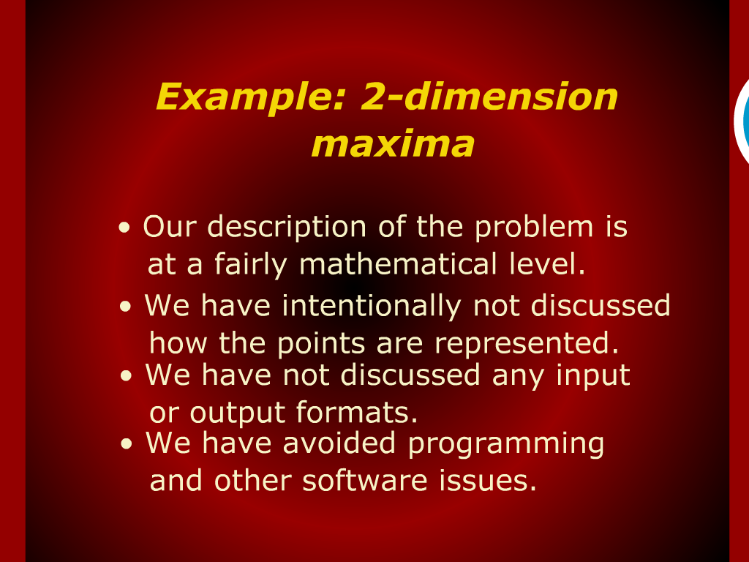
Example: 2-dimension maxima

Slide 15
Example: 2-dimension maxima

Slide 16
Example: 2-dimension maxima

Slide 17
Example: 2-dimension maxima

Slide 18

Example: 2-dimension maxima

Slide 19
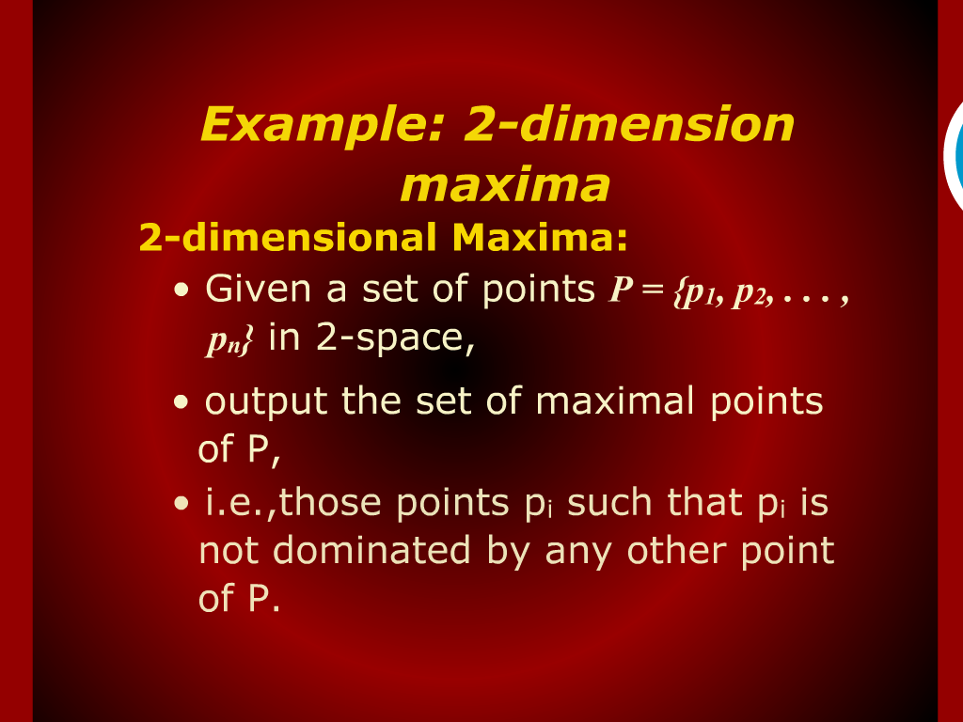
Example: 2-dimension maxima

Slide 20

Example: 2-dimension maxima

Slide 21
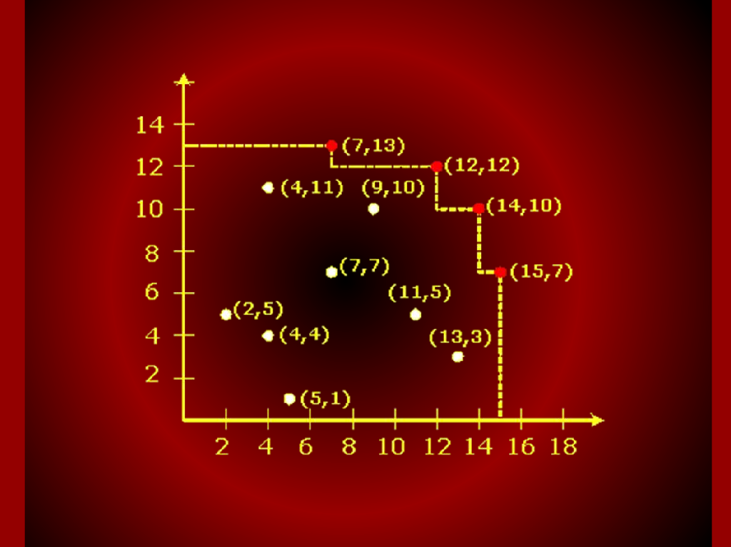
Graph
2,5
4,4
4,11
5,1
7,7
7,13
9,10
11,5
12,12
13,3
14,10
15,7

