Slide 1
Algorithms
Lecture #08
Mustafa Ali Bamboat

Slide 2
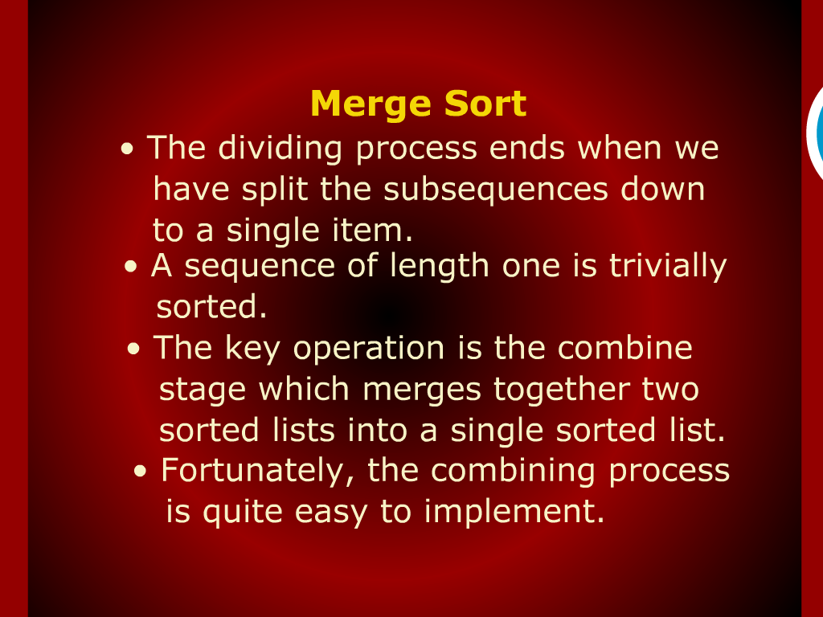
Merge Sort

Slide 3
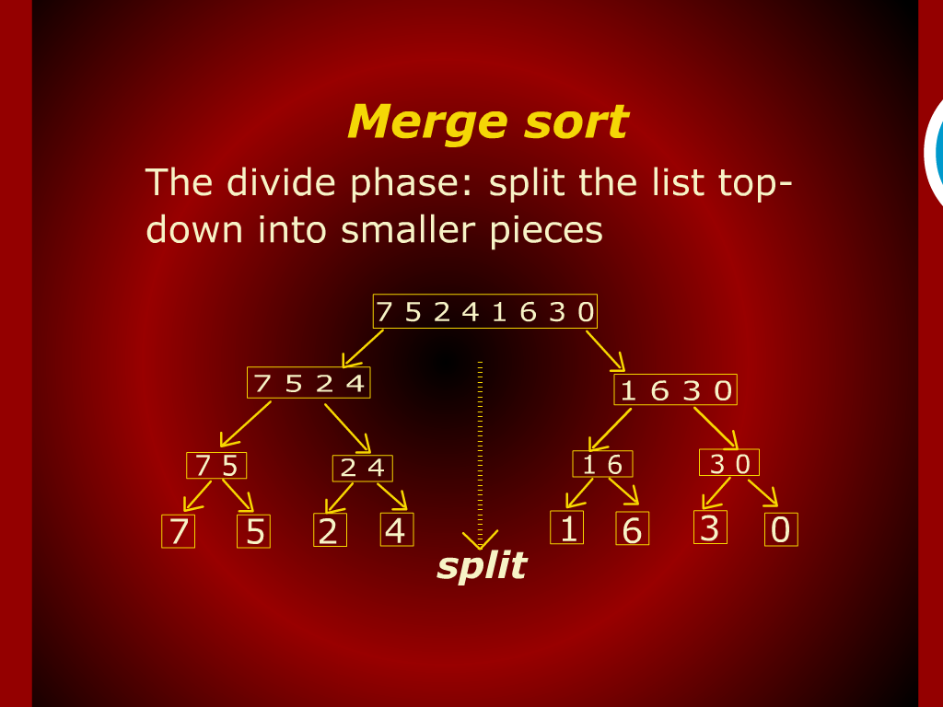
Merge Sort

Slide 4
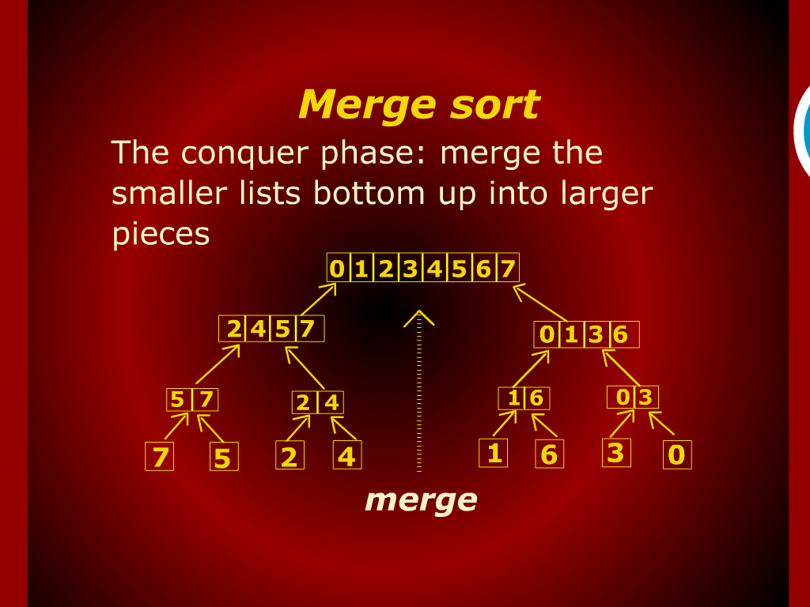
Merge Sort

Slide 5
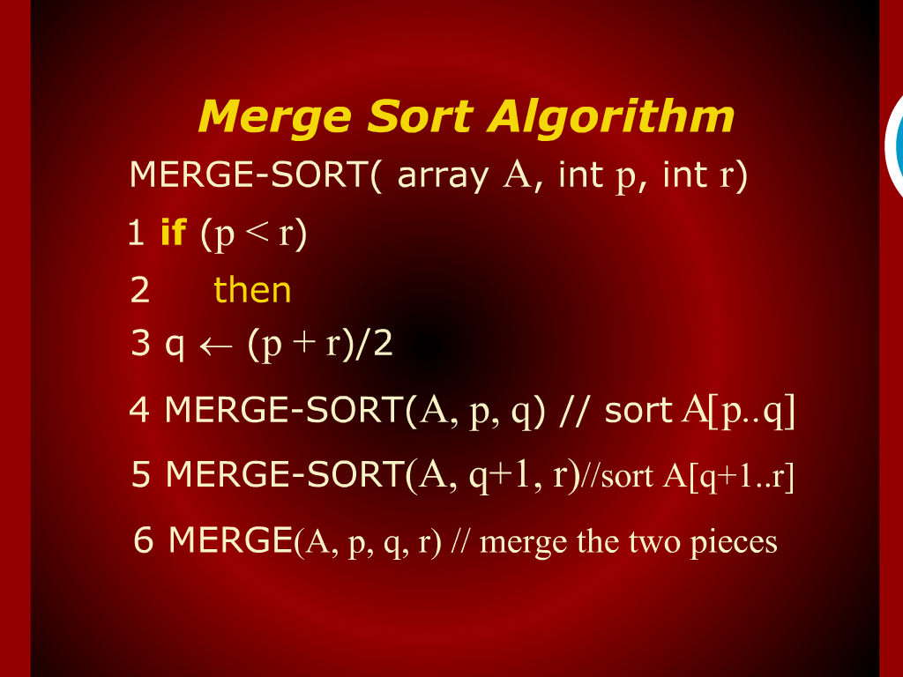
Merge Sort Algorithm

Slide 6
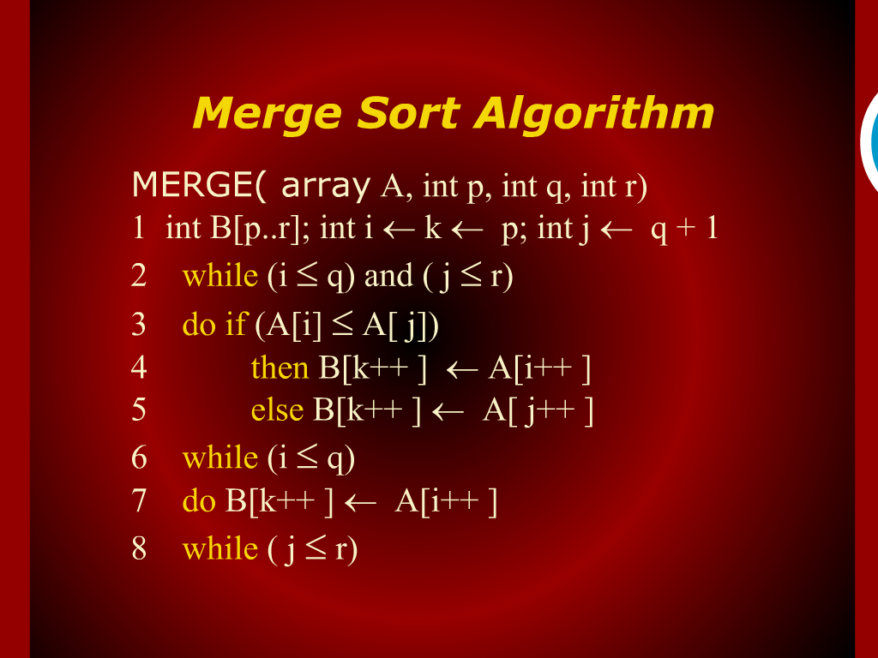
Merge Sort Algorithm

Slide 7
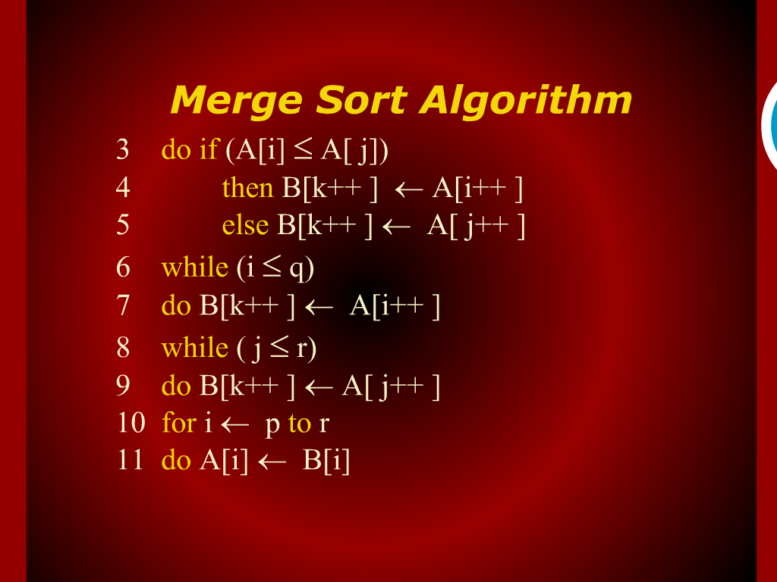
Merge Sort Algorithm

Slide 8
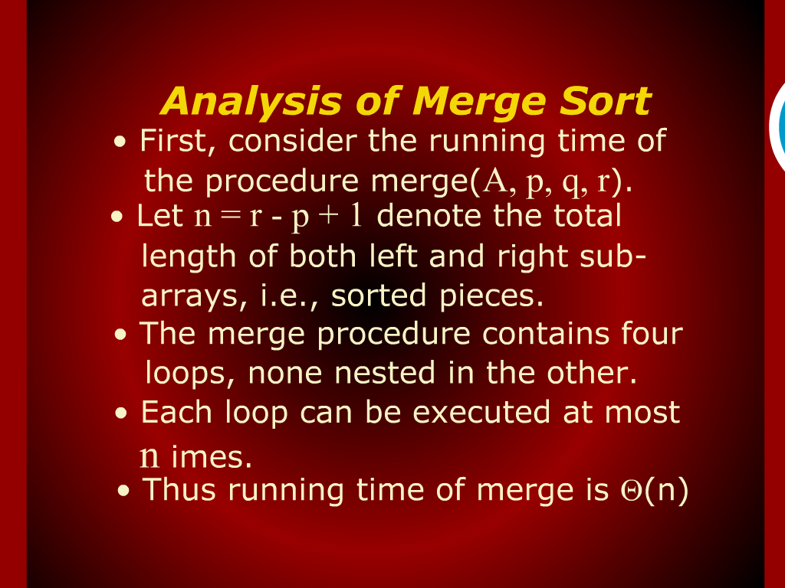
Analysis of Merge Sort

Slide 9
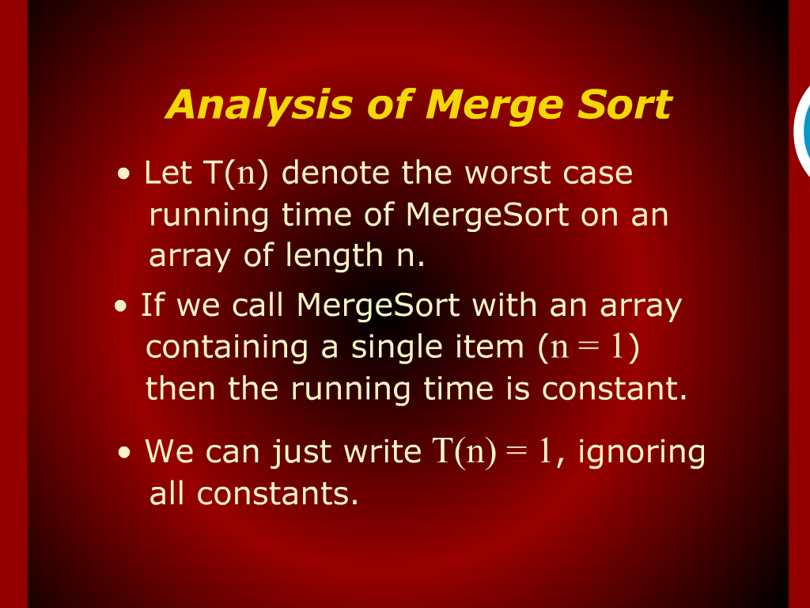
Analysis of Merge Sort

Slide 10
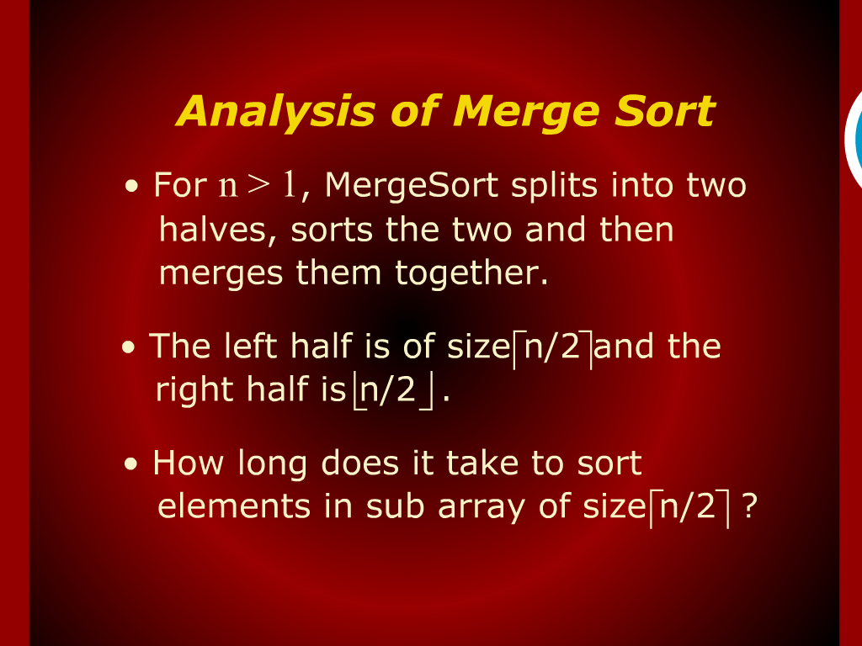
Analysis of Merge Sort

Slide 11
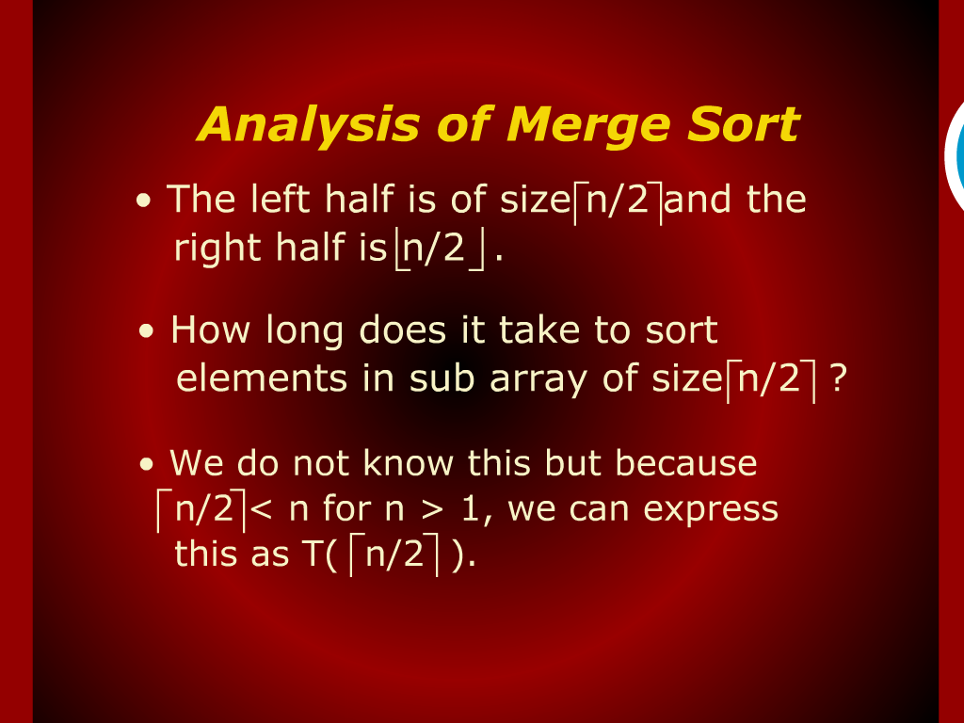
Analysis of Merge Sort

Slide 12
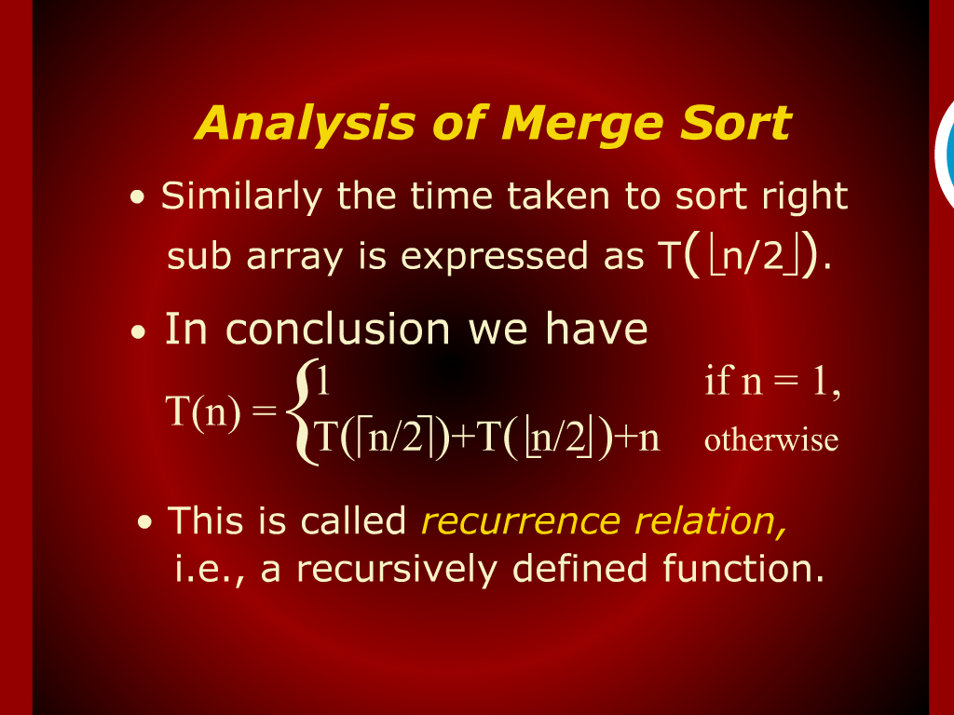
Analysis of Merge Sort

Slide 13
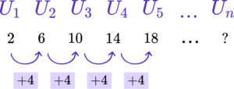
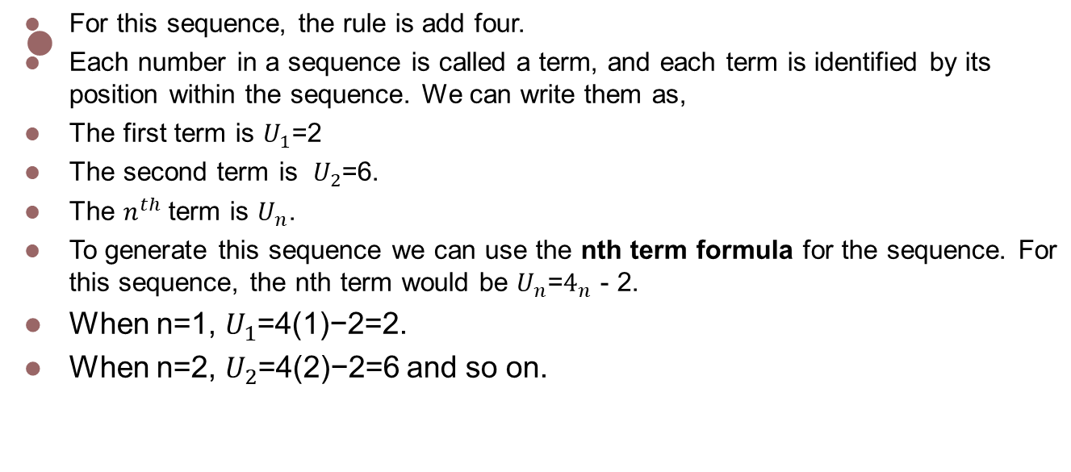

Slide 14
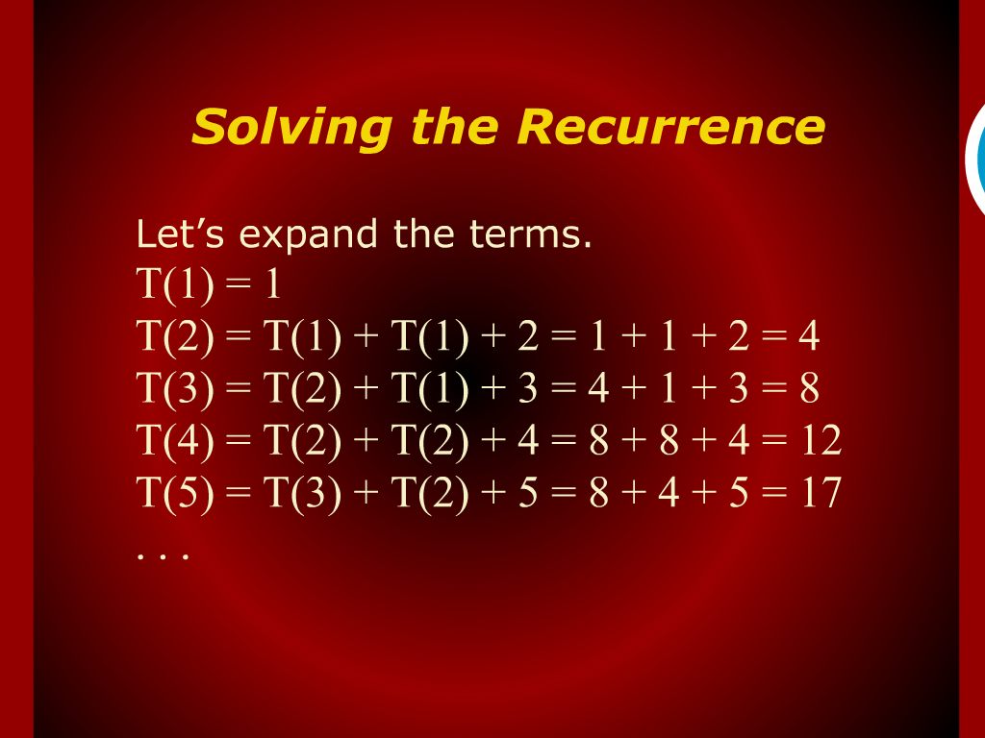
Solving the Recurrence

Slide 15
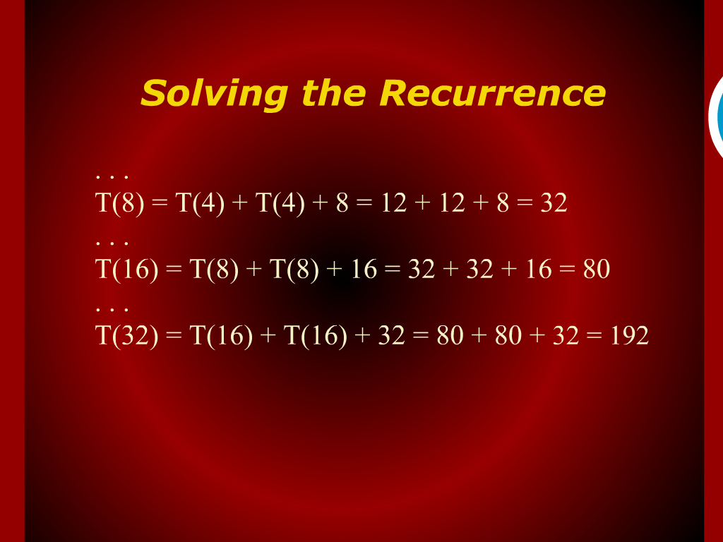
Solving the Recurrence

Slide 16
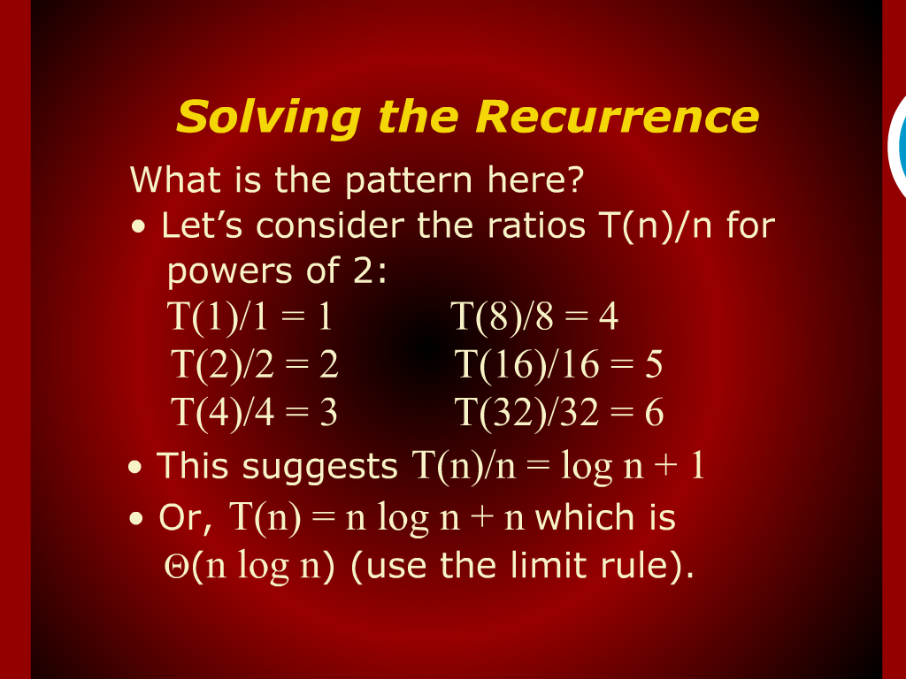
Solving the Recurrence

