Slide 1
Lecture No.11
Data Structures

Slide 2
Tree Data Structures
There are a number of applications where linear data structures are not appropriate.
Consider a genealogy tree of a family.

Slide 3
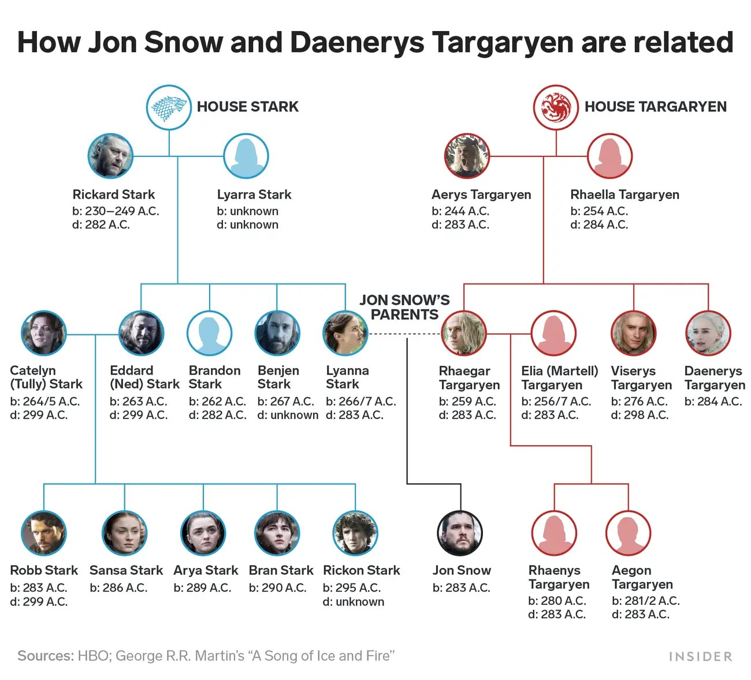

Slide 4
Tree Data Structure
A linear linked list will not be able to capture the tree-like relationship with ease.
Shortly, we will see that for applications that require searching, linear data structures are not suitable.
We will focus our attention on binary trees.

Slide 5
Binary Tree
A binary tree is a finite set of elements that is either empty or is partitioned into three disjoint subsets.
The first subset contains a single element called the root of the tree.
The other two subsets are themselves binary trees called the left and right subtrees.
Each element of a binary tree is called a node of the tree.

Slide 6
Binary Tree
Binary tree with 9 nodes.
A
B
C
D
E
F
G
H
I

Slide 7
Binary Tree
root
A
B
C
D
E
F
G
H
I
Left subtree
Right subtree

Slide 8
Binary Tree
Recursive definition
A
root
B
C
D
E
F
Left subtree
G
H
I
Right subtree

Slide 9
Binary Tree
Recursive definition
A
B
C
root
D
E
F
G
H
I
Left subtree

Slide 10
Binary Tree
Recursive definition
A
B
C
D
E
F
root
G
H
I

Slide 11
Binary Tree
Recursive definition
A
root
B
C
D
E
F
G
H
I
Right subtree

Slide 12
Binary Tree
Recursive definition
A
B
C
root
D
E
F
G
H
I
Left subtree
Right subtree

Slide 13
Not a Tree
Structures that are not trees.
A
B
C
D
E
F
G
H
I

Slide 14
Not a Tree
Structures that are not trees.
A
B
C
D
E
F
G
H
I

Slide 15
Not a Tree
Structures that are not trees.
A
B
C
D
E
F
G
H
I

Slide 16
Binary Tree: Terminology
parent
A
Left descendant
B
C
Right descendant
D
E
F
G
H
I
Leaf nodes
Leaf nodes

Slide 17
Binary Tree
If every non-leaf node in a binary tree has non-empty left and right subtrees, the tree is termed a strictly binary tree.
A
B
C
D
E
J
F
G
K
H
I

Slide 18
Level of a Binary Tree Node
The level of a node in a binary tree is defined as follows:
  Root has level 0,
  Level of any other node is one more than the level its parent (father).
The depth of a binary tree is the maximum level of any leaf in the tree.

Slide 19
Level of a Binary Tree Node
A
0
Level 0
B
1
C
1
Level 1
D
E
F
2
Level 2
2
2
G
H
3
I
3
Level 3
3

Slide 20
Complete Binary Tree
A complete binary tree of depth d is the strictly binary all of whose leaves are at level d.
A
0
B
1
C
1
D
2
E
2
F
2
G
2
H
3
I
J
3
K
L
3
M
3
N
3
O
3

Slide 21
Complete Binary Tree
A
Level 0: 2⁰ nodes
B
C
Level 1: 2¹ nodes
D
E
F
G
Level 2: 2² nodes
H
I
J
K
L
M
N
O
Level 3: 2³ nodes

Slide 22
Complete Binary Tree
At level k, there are 2^{k} nodes.
Total number of nodes in the tree of depth d:
2⁰+ 2¹+ 2² + ………. + 2^{d} =  2^{j} = 2^{d+1} – 1
In a complete binary tree, there are 2^{d} leaf nodes and (2^{d} - 1) non-leaf (inner) nodes.
d
j=0

Slide 23
Complete Binary Tree
If the tree is built out of ‘n’ nodes then
n = 2^{d+1} – 1
or log₂(n+1) = d+1
or d = log₂(n+1) – 1
I.e., the depth of the complete binary tree built using ‘n’ nodes will be log₂(n+1) – 1.
For example, for n=1,000,000, log₂(1000001) is less than 20; the tree would be 20 levels deep.
The significance of this shallowness will become evident later.

Slide 24
Operations on Binary Tree
There are a number of operations that can be defined for a binary tree.
If p is pointing to a node in an existing tree then
  left(p) returns pointer to the left subtree
  right(p) returns pointer to right subtree
  parent(p) returns the father of p
  brother(p) returns brother of p.
  info(p) returns content of the node.
Notes:
End of lecture 11

