Slide 1
Lecture No.08
Data Structures

Slide 2
Converting Infix to Postfix
Example: (A + B) * C
symb postfix stack
( (
A A (
+ A ( +
B AB ( +
) AB +
* AB + *
C AB + C *
AB + C *
Notes:
A primary concern for this course is efficiency.
You might believe that faster computers make it unnecessary to be concerned with efficiency. However…
So we need special training.

Slide 3
C++ Templates / Java Generics
We need a stack of operands and a stack of operators.
Operands can be integers and floating point numbers, even variables.
Operators are single characters.
We would have to create classes FloatStack and CharStack.
Yet the internal workings of both classes is the same.
Notes:
A primary concern for this course is efficiency.
You might believe that faster computers make it unnecessary to be concerned with efficiency. However…
So we need special training.

Slide 4
C++ Templates / Java Generics
We can use C++ Templates to create a “template” of a stack class.
OR we can use Java Generics to create a “template” of a stack class
Instantiate float stack, char stack, or stack for any type of element we want.
Notes:
A primary concern for this course is efficiency.
You might believe that faster computers make it unnecessary to be concerned with efficiency. However…
So we need special training.

Slide 5
Stack using templates
Stack.h:
template <class T>
class Stack {
public:
Stack();
int empty(void); // 1=true, 0=false
int push(T &); // 1=successful,0=stack overflow
T pop(void);
T peek(void);
~Stack();
private:
int top;
T* nodes;
};
Notes:
A primary concern for this course is efficiency.
You might believe that faster computers make it unnecessary to be concerned with efficiency. However…
So we need special training.

Slide 6
Stack using templates
Stack.cpp
  #include <iostream.h>
  #include <stdlib.h>
  #include "Stack.cpp"
  #define MAXSTACKSIZE 50
  template <class T>
  Stack<T>::Stack()
  {
  top = -1;
  nodes = new T[MAXSTACKSIZE];
  }
Notes:
A primary concern for this course is efficiency.
You might believe that faster computers make it unnecessary to be concerned with efficiency. However…
So we need special training.

Slide 7
Stack using templates
Stack.cpp
  template <class T>
  Stack<T>::~Stack()
  {
  delete nodes;
  }
  template <class T>
  int Stack<T>::empty(void)
  {
  if( top < 0 ) return 1;
  return 0;
  }
Notes:
A primary concern for this course is efficiency.
You might believe that faster computers make it unnecessary to be concerned with efficiency. However…
So we need special training.

Slide 8
Stack using templates
Stack.cpp
  template <class T>
  int Stack<T>::push(T& x)
  {
  if( top < MAXSTACKSIZE ) {
  nodes[++top] = x;
  return 1;
  }
  cout << "stack overflow in push.\n";
  return 0;
  }
Notes:
A primary concern for this course is efficiency.
You might believe that faster computers make it unnecessary to be concerned with efficiency. However…
So we need special training.

Slide 9
Stack using templates
Stack.cpp
  template <class T>
  T Stack<T>::pop(void)
  {
  T x;
  if( !empty() ) {
  x = nodes[top--];
  return x;
  }
  cout << "stack underflow in pop.\n";
  return x;
  }
Notes:
A primary concern for this course is efficiency.
You might believe that faster computers make it unnecessary to be concerned with efficiency. However…
So we need special training.

Slide 10
Stack using templates
main.cpp
  #include "Stack.cpp"
  int main(int argc, char *argv[]) {
  Stack<int> intstack;
  Stack<char> charstack;
  int x=10, y=20;
  char c='C', d='D';
  intstack.push(x); intstack.push(y);
  cout << "intstack: " << intstack.pop() << ", "
  << intstack.pop() << "\n";
  charstack.push(c); charstack.push(d);
  cout << "charstack: " << charstack.pop() << ", "
  << charstack.pop() << "\n";
  }
Notes:
A primary concern for this course is efficiency.
You might believe that faster computers make it unnecessary to be concerned with efficiency. However…
So we need special training.

Slide 11
In Java
import java.util.Arrays;
public class Stack<T> {
private int top;
private T[] nodes;
private static final int MAXSTACKSIZE = 50; public Stack() {
top = -1;
nodes = (T[]) new Object[MAXSTACKSIZE];
}

Slide 12
In Java
public boolean empty() {
return top < 0; }
public boolean push(T x) {
if (top < MAXSTACKSIZE) {
nodes[++top] = x; return true;
}
System.out.println("stack overflow in push.");
return false;
}

Slide 13
In Java
public T pop() {
T x = null;
if (!empty())
{
x = nodes[top--]; return x;
}
System.out.println("stack underflow in pop.");
return x;
}//end pop()
}//end class

Slide 14
Function Call Stack
Stacks play a key role in implementation of function calls in programming languages.
for example, the “call stack” is used to pass function arguments and receive return values.
The call stack is also used for “local variables”

Slide 15
Call Stack
In GCC, a popular C/C++ compiler on Intel platform, stack entries are:
n*4(%esp)
last argument
……….
8(%esp)
second argument
4(%esp)
first argument
(%esp)
return address
top

Slide 16
Call Stack
Example: consider the function:
  int i_avg (int a, int b)
  {
  return (a + b) / 2;
  }
    # Stack layout on entry:
    #
    # 8(%esp) b
    # 4(%esp) a
    # (%esp) return address

Slide 17
Call Stack
Example: consider the function:
  int i_avg (int a, int b)
  {
  return (a + b) / 2;
  }
.globl _i_avg
_i_avg:
movl 4(%esp), %eax
addl 8(%esp), %eax # Add the args
sarl $1, %eax # Divide by 2
ret # Return value is in %eax

Slide 18
Memory Organization
When a program (.exe) is run, it is loaded in memory. It becomes a process.
The process is given a block of memory.
[Control-Alt-DEL]
Process 1
(browser)
Process 3
(word)
Process 4
(excel)
Process 2
(dev-c++)
Windows OS

Slide 19
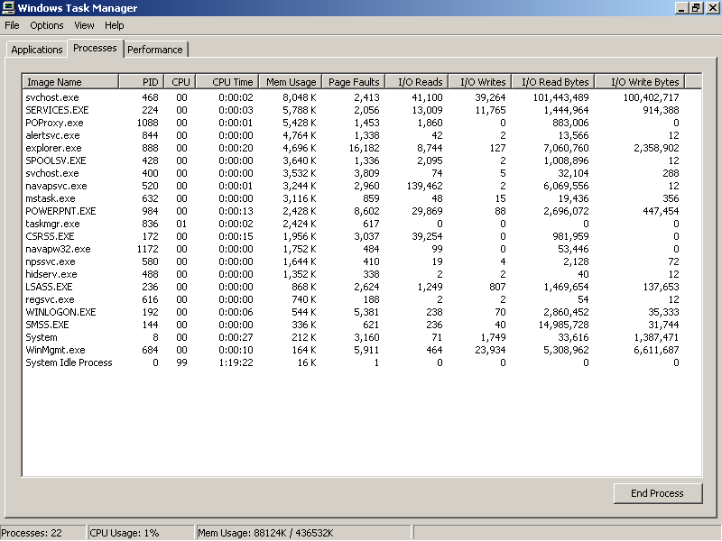
Task Manager

Slide 20
Memory Organization
Process 1
(browser)
Code
Process 3
(word)
Static data
Process 4
(excel)
Stack
Process 2
(dev-c++)
Windows OS
Heap
Notes:
End of lecture 8

