Slide 1
Dicee
Building Apps with State

Slide 2
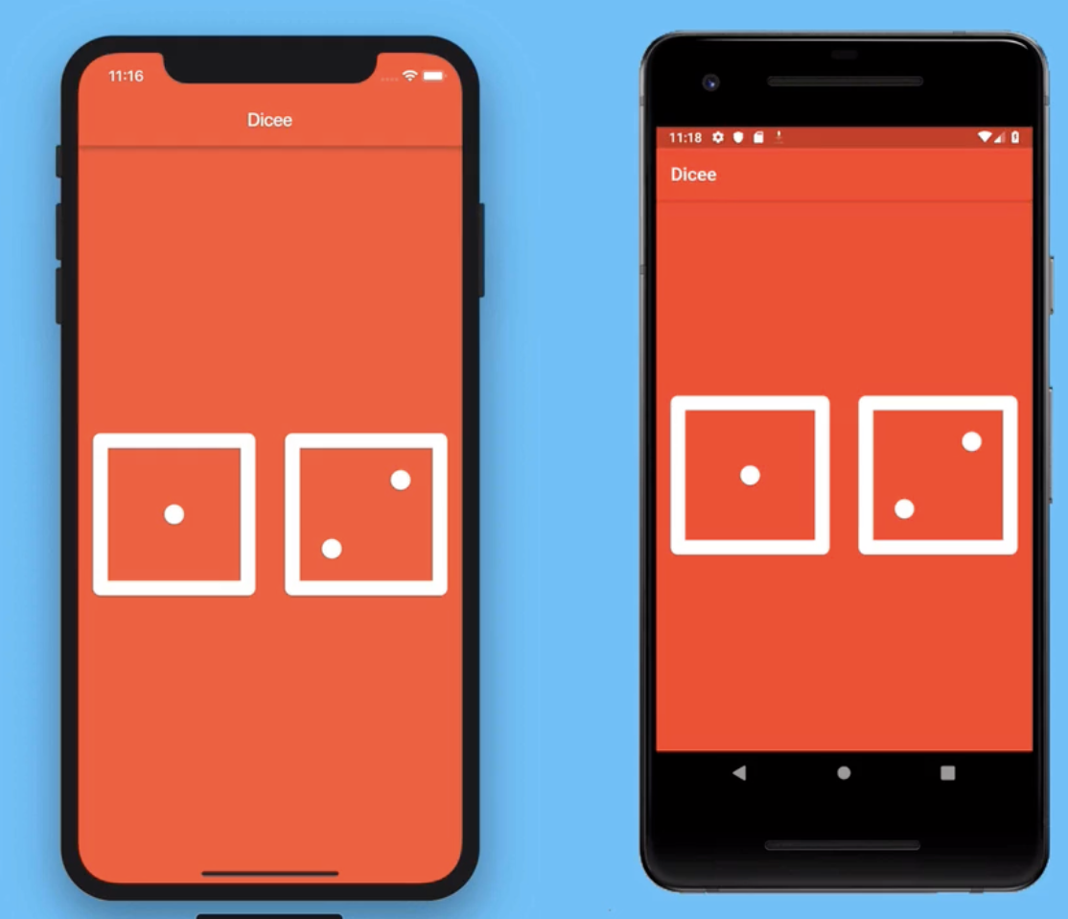
Creating Flutter Apps with Functionality
We will build a Dice rolling app. We learn here how to create apps that only look good but actually also have functionality.
Already I uploaded the assets on the github; you may download it from there. https://github.com/bamboat3/mobileappdev/tree/main/code_3/assets

Slide 3
Topics in this Lecture
A Stateful Dice App
Using the Expanded Widgets for Flexible Layouts
How to Use Intention Actions
Detecting User Interaction with Flutter Buttons
Dart Functions – Part – 1
Making the Dice Image Change Reactively
Dart Variables
Dart Data Types
Stateful vs Stateless Widgets
Randomizing the Dice
Class Task 2, Class Task 3, Class Task 4

Slide 4
A Stateful Dice App
Create new Flutter Project in Android Studio named as dice_app
Create StateLess class as we did in the previous lecture using shortcut stless + hit enter
Name that class as DicePage, as well as call it in the above runApp -> MaterialApp -> Scaffold ->appBar: AppBar(title: Text(‘Dicee’),backgroundColor: Colors.red , body: DicePage()
Add Images and update pubspec.yaml as we did in the previous lecture
After all this hit pub update
Extra-Hint: if on ctrl+save the code is not formatting then open analysis_options.yaml -> formatter:
                trailing_commas: preserve
                TRY TO RUN ON EMULATOR

Slide 5

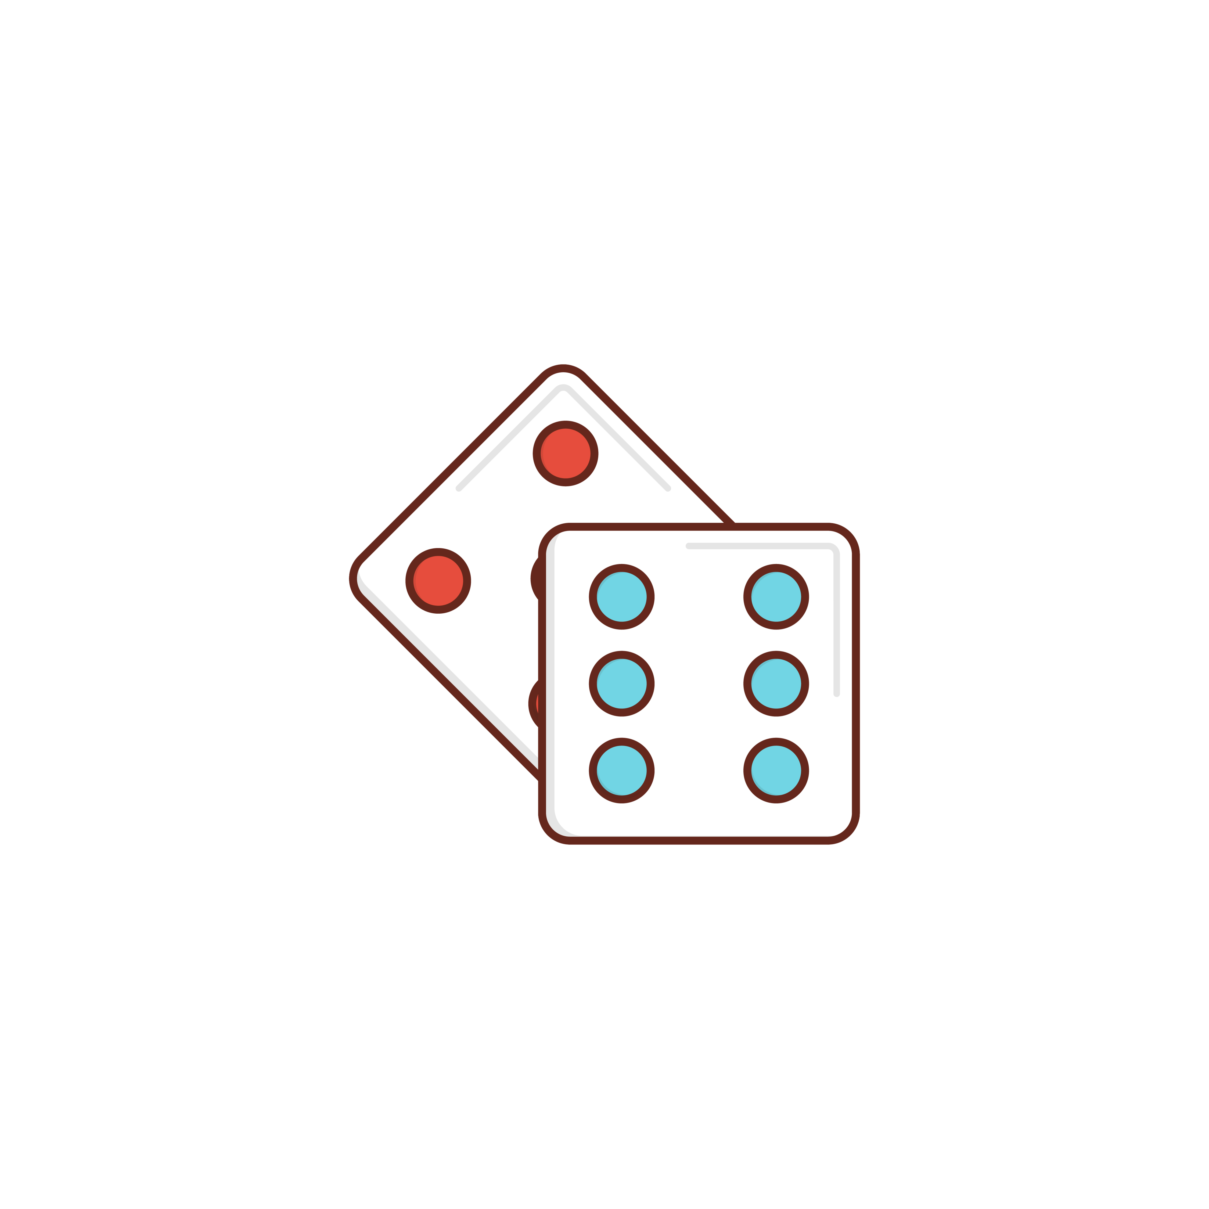
A Stateful Dice App – Change App Icon
By default you may see app icon as
Change it to
For that first download the png approx. 1024 x 1024 size, and visit at https://www.appicon.co/
Now drag & drop the image on it; it will generate zip file containing icons for are android and iOs (iPhone).
Get back to Android-Studio, navigate to the Android folder ->app->src->main->res (reveal it in the file explore by right click)
Similarly, open ios -> runner -> Assets.xcassets

Slide 6
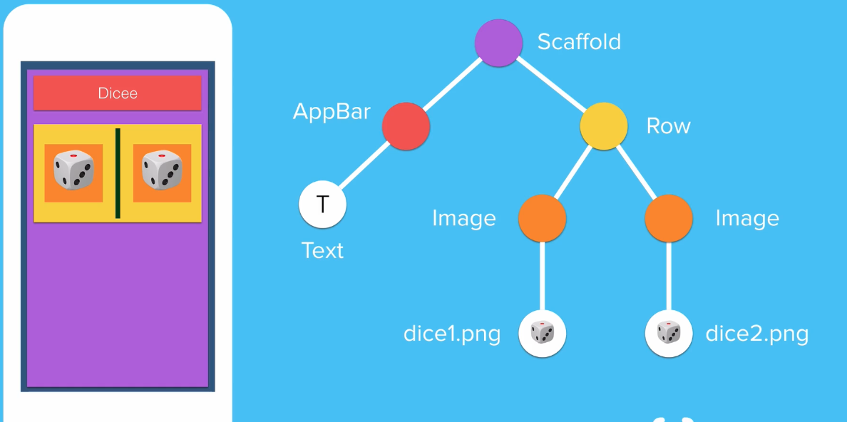
2. Using the Expanded Widget for Flexible Layouts
App Anatomy
We need to build according to this widgets tree
Remove container from the scaffold; as we need multiple children we use row.
If you notice Row have two children Image & Image,by default image is too large – overflow
To fit the widget into the screen we use Expanded class, wrap your Image into Expanded
Expanded widget take whole space of screen if in the Row then horizontal else in Column -> vertical

Slide 7
2. Using the Expanded Widget for Flexible Layouts
As we add one more widget the Expanded class manage itself to take available space but remain in the same horizontal axis
There is an attribute ‘flex’ in the Expanded class which tell the widget to cover the space extra if required.
E.g. first image takes twice space of the second image.
In our case we don’t need flex, because we need both dice of same size.
Short way to add Image widget, we can add it as child of Expanaded widget.

Slide 8
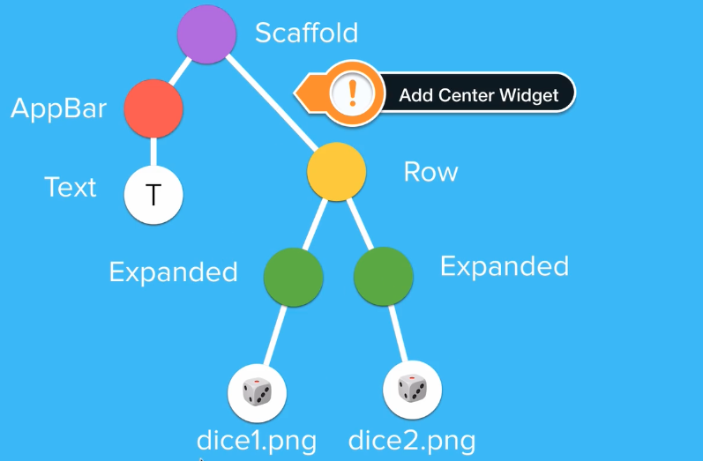
3. How to Use Intention Actions
If you notice dice images are in center and there are space in-between them.
Insert Center Widget before Row, one way is to use shortcut key Alt+enter it shows the wrap widget option.
Now for the space wrap Widget around padding: 16px

Slide 9
4. Detecting User Interaction with Flutter Buttons
Now add functionality
Need to detect the user click on the image; for that we use button
Visit doc (https://docs.flutter.dev/ui/widgets) -> Material Design -> Common Buttons and choose anyone suitable in this case
I choose ElevatedButton, use intention action and wrap widget around image
As you do it shows error the onPressed function is required

Slide 10
4. Detecting User Interaction with Flutter Buttons
As you insert the ElevatedButton, by default white background and shadow appears
We need to either transparent it or red it
For that use attribute style: ElevatedButton.styleFrom class
If you notice the ElevatedButton dice is much smaller then the other dice because of extra padding, by default ElevatedButton has 8px padding
So remove Padding widget instead that use padding attribute within the style as 16px

Slide 11
4. Detecting User Interaction with Flutter Buttons
If you notice for the action detection ElevatedButton has onPressed attribute, which calling voidFunction CallBack method, declared as ( ){ }
For a demo how onPressed works we write print statement which give the output on the console.
But we need image to be change on the click
So get clear idea how Dart Function is helpful in this lets dive into Dart Programming

Slide 12

5. Dart Functions – Part – 1
We try to package bits of code together into a block and to call that block of code repeatedly, saving us typing the same code again n again
E.g. I have a Robot who’s task is to bring Milk from the milk store daily, as its machine we need to give it set of instruction such as
        {
        move-right,
        move-left,
        move-forward
        backward,
        pick the milk,
        get back to the home
        }
As a programmer we create a program to repeat such instruction on daily basis rather to enter commands on daily basis.

Slide 13
5. Dart Functions – Part – 1
In Dart we create Function as
void getMilk() { //do something}
Calling Function as
getMilk();
Above we created named function because getMilk referring function name
Now if we drop all parts except (){} is called Anonymous function

Slide 14
6. Making the Dice Image Change Reactively
Now on click button dice image suppose to be change
If you observe the all images have same name in common with the numeric such as dice1, dice2 and so on
So somehow we need to change the suffix part rest of the remain same
Create a variable inside the stateless class e.g. var leftDiceNumber = 5;
Include the variable into the filename by using $ symbol
If you notice not updated because only code under the build method gets reload only. So declare the variable under the build method

Slide 15
7. Dart Variables
We use variable within the string value by placing $ sign, this is called String Interpolation
Open dart editor online https://dartpad.dev/
Create var myName and print the value

Slide 16
8. Dart Types
Dart statically Type Language
Var data type variable declare the type according to the value used at the time declaration/initialization
If you given first value string then var type would remain string and viceversa.

Slide 17
9. Stateful vs Stateless Widgets
So far we click on the dice the onPressed event trigger which has print statement
But we need to roll the dices, mean on click the dice image change. For that previously we created a variable and call that variable as the file name. But still its not changing!
For that we need stateful class;
Think state that refers to the way that things are e.g. Row also be Row, Column also be Column; in other words those widgets are not changing the positions are called stateless widgets and should be declared within stateless class
Whereas, stateful class where we can change the widgets as per requirement, e.g. in our app when user click the dice it suppose to change the dice image and to do that we need to update the state

Slide 18
9. Stateful vs Stateless Widgets
if you are creating a UI where the state of the widget isn’t going to change, then you would use a stateless widget.
If you’re creating something which is going to change especially when its dependent on user interaction, click/tap on button or user pulls in some data from the internet something on the screen updates, then we need stateful widget.
Shortcut to create stateful class (stful)

Slide 19
9. Stateful vs Stateless Widgets
I would cutout the whole code in the stateless class and past it in the stateful class
Remove the empty stateless class structure; we don’t need any more.
Now in the onPressed: change the dice number instead of just print number
Restart the App; at this stage reload don’t work so we need to Restart the App
If you notice still on click its not changing. In addition to updating the left dice number, we need to tell the complier that we need to update this state by calling the method setState((){}); and inside it we update the variable value.

Slide 20
9. Stateful vs Stateless Widgets
setState() function recall the build function again so it repaint the updated widget again on the screen. Without that the value changes but screen not updated.
When we use setState() it maked the changes and when click event trigger the build method recall which repaint the screen and do the changes where it is marked
Now move forward rather to set the dice number manually we try to assign the numbers randomly

Slide 21
10. Randomizing the Dice
For randomize the leftDiceNumber, we use Dart Math library https://api.flutter.dev/flutter/dart-math/
To use the library we need to import it and call method named as Random().nextInt(max)
E.g. if max=6 that means random numbers generated from 0 to 5

Slide 22
Class Task -2
Class Task -3
If you notice still the right dice doing nothing; try to implement the same functionality as we did for the left dice.
We wanted both dice to change when one of the buttons is pressed e.g. if I click left dice then first it change itself and also change the right dice too; or if I click right dice then first it change itself then it change left dice too
Class Task -4
There are lots of repeated codes; we know that for the repeated codes we declare function and call that function everywhere in place of repeated codes; your task is to declare the function which can be used in the onPressed action of both dices

Slide 23
RESOURCES – Build Apps with State
Expanded class
Flexible class
Actions class
ElevatedButton class
StatefulWidget class
StatelessWidget class

