Slide 1
MiCard
How to Build Beautiful UIs with Flutter Widgets

Slide 2
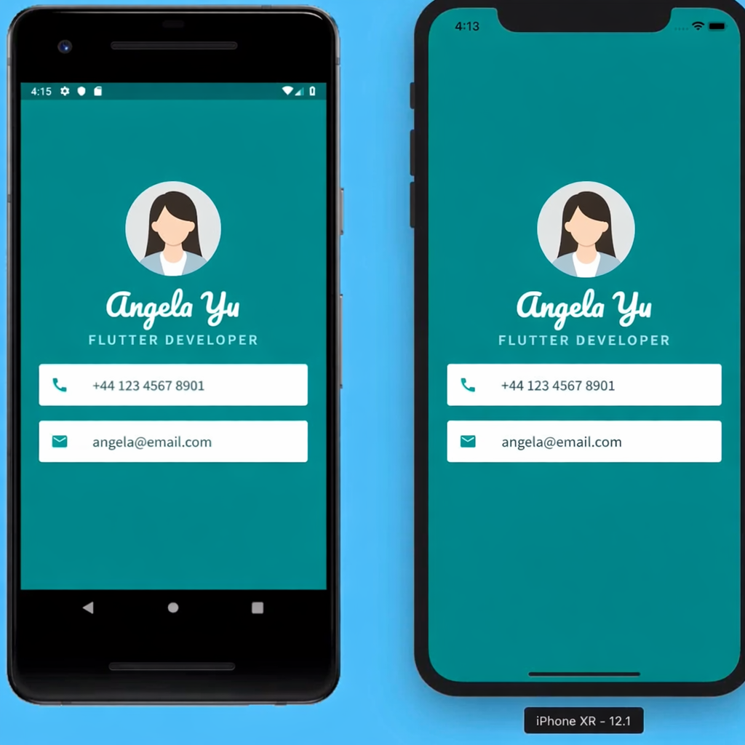
DESIGN YOUR APP WITH FLUTTER LAYOUT WIDGETS
We build business card app, that has all of your contact details
Very simple app but we will learn more about the layout, such as User Interface Elements, onscreen, using various Flutter Layouts widgets and so on.

Slide 3
Topics in this Lecture
Hot Reload & Hot Restart - Flutter Power Tools
How to Use Container Widgets
How to Use Column and Row Widgets for Layout
Flutter Layouts Challenge – Class Task/Activity
Tapping into Widget Properties
Incorporating Custom Fonts in Your Flutter App
Adding Material Icons with the Icon Widget
Flutter Card & ListTile Widget

Slide 4
Hot Reload & Hot Restart - Flutter Power Tools
Allow you almost instantaneously see your changes in the simulator or your device that you’re testing it on.
E.g. if you change the color of the Scaffold -> backgroundColor: Colors.white into Colors.red, it should change instantly.
For hot-reload to work we have to changed inside a Flutter stateless or stateful widgets.
To create stateless widget use shortcut : stless + enter, flutter will create boilerplate code for building a statless widget.
Hot reload meant to happen so fast and it really is like a reload

Slide 5
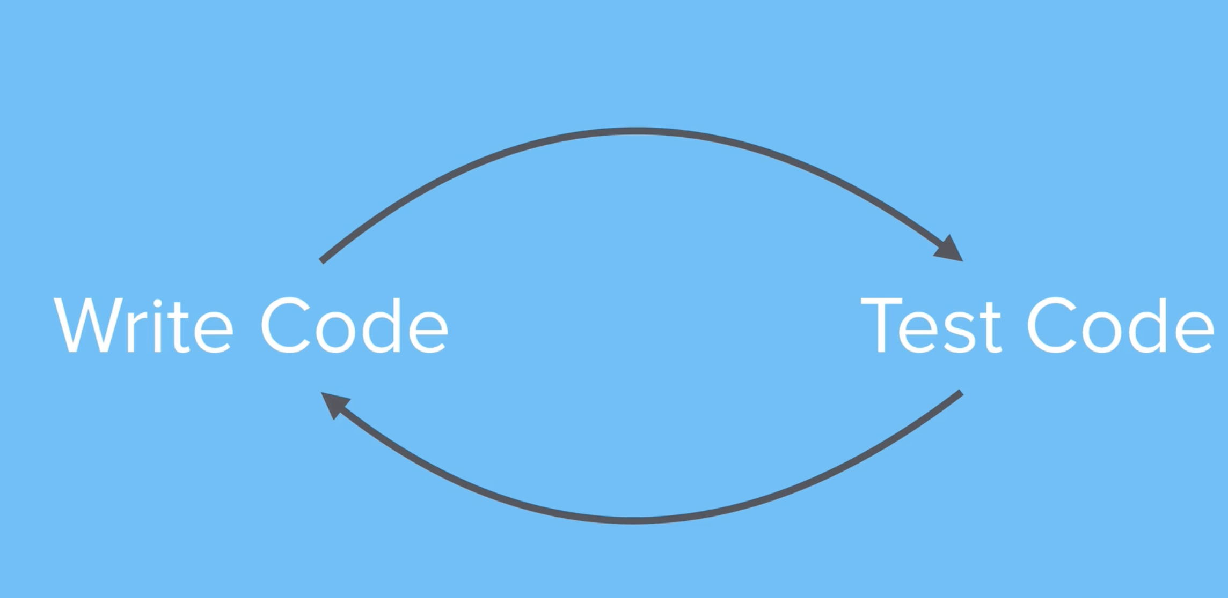
Hot Reload & Hot Restart - Flutter Power Tools
Hot reload massively shorten the time that’s taken to create that cycle, for each of those cycles.
Hot reload not lose data if you make changes in the UI
On the other hand Hot-Restart, restart the app where it lose data/reset data too along the changes done in the code.
Hot-Restart, still helpful instead stop the app and then re-run which takes Gradle setting and many more settings, the Hot-Restart instantly re-start the app, skipping the Gradle setting and many more settings part.
Very helpful in the large scale of projects, and for that screen size doesn’t matter, it works same as its working on mobile screen size.

Slide 6
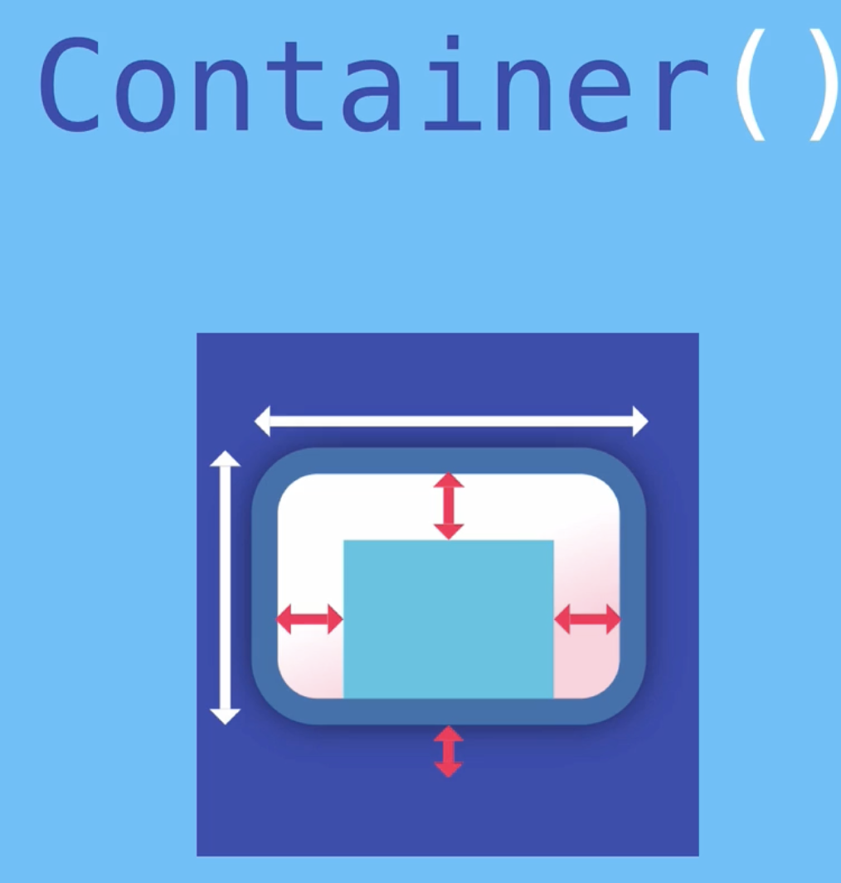
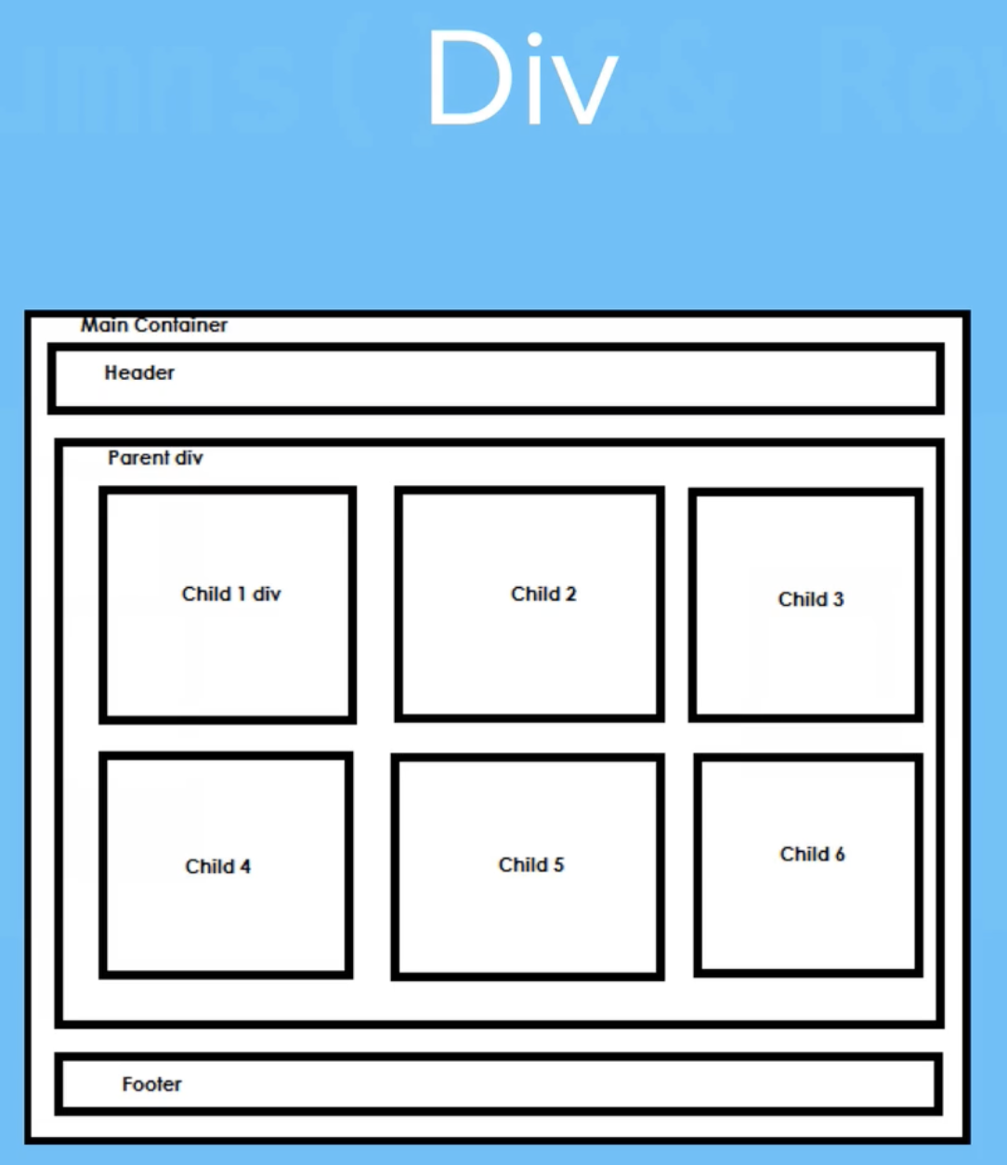
How to Use Container Widgets
One of the fundamental widgets to be used all the time, to lay out our apps, that a container widget.
Container widget inspired by the web designing; in which we use DIV, its essentially just layout box, we can position it and move it around the screen, can give child to display such as image, or text.
Pro-Tip: always consider the Flutter Documentation: Widgets Catalogue

Slide 7
How to Use Container Widgets
Container with no children try to be as big as possible
If child exists container shrinks to the size of the child widget
If you notice text widget hidden away a bit by bezel of iphone or android phone screen, to save the content from all of the borders such as top bar, signal bar, notch?
For that Flutter comes with another widget i.e. SafeArea.
Anything in the inside the SafeArea will be inside the parts which don’t have notch or top-bar, for that use shortcurt Option / ALT and hit Enter
We can also change height/width of the container
We can also offset the container from the edges of screen for that we use margin attribute with EdgeInsets.all for all sides and EdgeInsets.symmetric such as vertical or horizontal or both.
We can define values for specific sides with the option EdgeInsets.fromLTRB

Slide 8
How to Use Container Widgets
Now we want child of the container away from the container; for that we use padding attribute ( similar as we do in web-designing) and for the value we use EdgeInsets
We can’t add multiple children in the Container

Slide 9
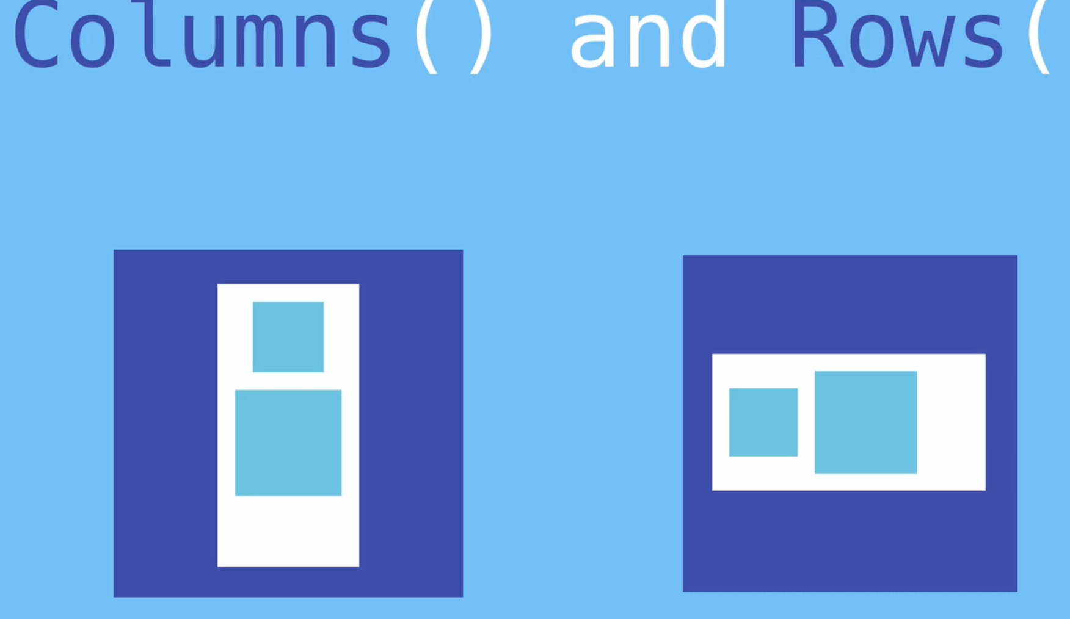
How to Use Column and Row Widgets for Layout
If you design requires lots of children; not like a container with one child, then we need Column and Row Widgets
Columns for vertical & Rows for horizontal
Column/Row has attribute children:[ ], whereas square brackets means list of widgets just think like an array

Slide 10
How to Use Column and Row Widgets for Layout
Column automatically try and take up as much of the vertical space as possible hint check flutter inspector
We can restrict the space by using mainAxisSize attribute
We can change direction up and down
We can change the Alignment; by default its start alignment, we can do end, center, spaceEvenly, spaceBetwen
We align the widegts horizontally in the column using crossAxisAlignment, we can do start,end,stretch
We can give gap between the widgets, if you know the specific gap for that we use SizedBox widget in the column

Slide 11
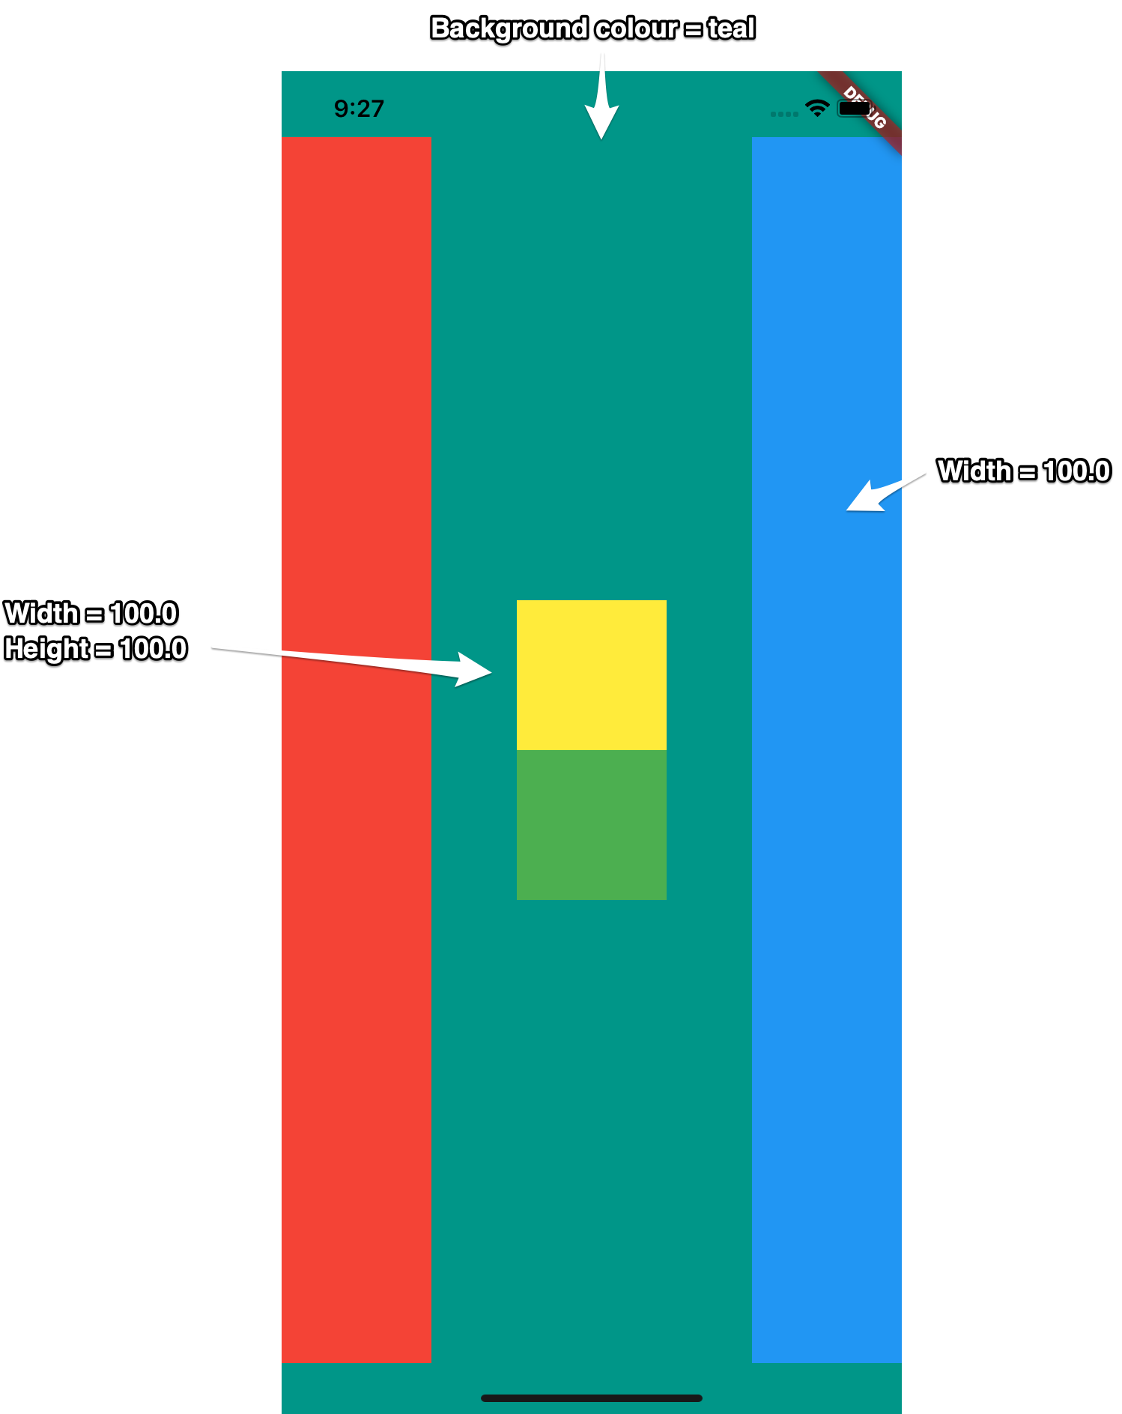
Flutter Layouts Challenge
Now that you have learnt about Column and Row Widgets and how to use them to layout your app, it's time to test your understanding.
Head over to the given picture and take a look of a layout that I would like you to try and replicate with code.
I recommend using the existing Mi Card app to create this layout and once you've achieved the desired look and you're satisfied with the solution then you can delete the challenge code from the project.

Slide 12
5. Tapping into Widget Properties
Lets start building final product, if you notice layout is top to bottom, and for that we have widget Column.
Inside column we need widgets which can display image, text , and material card which shows phone # and email address,
SO LETS START

Slide 13
5. Tapping into Widget Properties anatomy
Add Column Widget
Add CircularAvatar Widget, radius:50
Add Image widget inside CiruclarAvatar, for that create folder as image, save the photo in it and update the pubspec.yaml file to declare your assets then hit Pub get option
Declare attribute backgroundImage: AssetImage()
Now add Text widget in Column for name and designation
Change the default text style: TextStyle such as fontSize,color,fontWeight

Slide 14
6. Incorporating Custom Fonts in Your Flutter App
Download font from https://fonts.google.com
As shown in the picture its font: Pacifico
For the designation download another font i.e. source sans Pro
Add Text for designation, change style, fontFamily, fontSize, color, fontWeight, letterSpacing
Now create two container for phone # and email, with the icons and text
Each container have Row and inside Row have Icon + Text widgets as children
Each container margin: EdgeInsets.symmertric (vertical:10, horizontal:25), and Padding all sides 10

Slide 15
8. Flutter Card & ListTile Widget
If notice the containers are in rounded corners, so we need that, there are two options for that either modify the container or simply replace the container with Card widget
For container use decoration: BoxDecoration(borderRadius,color), if using this then you don’t need color attribute of container
If use Card widget, replace container with the Card, rest style will be manage by Card itself automatically, such as border corners
In Card there is no padding attribute like container, for that we use wrapping child widget with Padding
Even we replace the row child of card with the ListTile Widget, usually with card ListTile being used because it gives you icon + text widget
Card by default comes with white color, so we can remove the color attribute using in the container previously

Slide 16
Final Touch Up
We build the app almost except center the whole column, for that we use mainAxisAlignment to center
Secondly I would like to give line between text and card for that use SizeBox with the child: Divider
The Divider is similar as we use in web designing tag i.e. hr to create horizontal row bar

Slide 17
RESOURCES - How to Build Beautiful UIs with Flutter Widgets
Widgets Catalogue
Container Documentation
Column Documentation
Row Documentation
Tomek's Flutter Layout Cheat Sheet
Download fancy fonts from fonts.google.com
How to add fonts to the pubspec.yaml file
The Icons Class
Material Design Icons
Icons on materialpalette.com
Card Class Documentation
The Padding Class
The ListTile Class
Flutter's Horizontal Rule - The Divider
MiCard Completed Project
Material Color Palette

