Slide 1
Xylophone Using Flutter & Dart Packages to Speed up Development

Slide 2
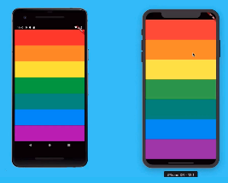
Diving Deeper into Dart Programming
We will build an app with far more functionality.
We will learn “How to use open source Flutter Packages”.
We build a music app which play a real song
https://github.com/bamboat3/mobileappdev/tree/main/code_lecture_4

Slide 3
Topics in this Lecture
Xylophone – Get the ingredient for that
What are Flutter & Dart Packages?
How to Play Sound Across Platforms
How to Play Multiple Sounds
Updating the UI of Our App
Refactor and Clean Up our Code
Class Task – 5

Slide 4
Xylophone – Get the ingredient for that
Download the assets.zip from the GitHub
Create Flutter Project named it as xylophone_project
Create Directory named it as “assets”
Update the pubspec.yaml; our project required local assets, so declare
assets:
- assets/
Copy the downloaded .wav files in it
Change the App Icon as we did in the previous lecture – 3, app icon available in the assets.zip
Clear the Flutter Template and create MaterialApp->Scaffold->SafeArea->Container only.
Run the Project

Slide 5
What are Flutter & Dart Packages?
In order to play sound in our app both iOS and Android, we use flutter package.
Flutter Packages are open source libraries of code that other people have created which you can incorporate into your project with minimal efforts.
Visit https://pub.dev/ , search for suitable package for our project
Search package e.g. english words, you might get multiple results choose the one with the highest scores. The highest score package means package is most robust and best suited

Slide 6
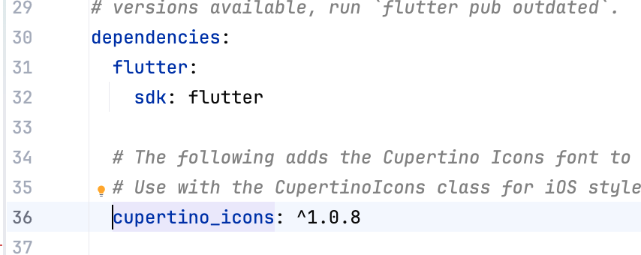
What are Flutter & Dart Packages?
In our case we search a package which plays sound
These packages are called dependencies in the Flutter Project; and we declare the packages under the pubspec.ymal under the heading dependencies
By default flutter have these dependencies as shown in the picture

Slide 7
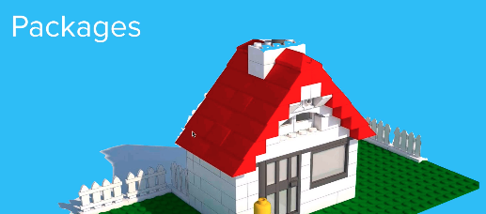
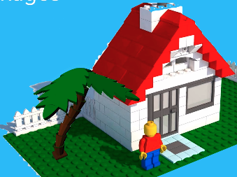
What are Flutter & Dart Packages?
Think like a Lego blocks, you created a house, now you need tree in your garden
Now you could use the already build components such tree, doors, widows etc., which helps you to build house easier
Conclusion: Packages are essentially a bunch of code that somebody else wrote to achieve a specific goal.

Slide 8
How to Play Sound Across Platforms
Search package “play audio file”, choose the higher score
E.g. just_audio: ^0.10.5 has highest score
Include the package in the pubspec.yaml under dependencies
Import the library in the main.dart
import 'package:just_audio/just_audio.dart’;
Get help from the ReadMe available on the package doc.
After including the package stop the running App and re-start it. Hot-Reload or Hot-Restart not include the package

Slide 9
How to Play Sound Across Platforms
Create Elevated button and call the player.setAsset on the onPressed function
Center it and do styling as you like
first declare AudioPlay instance, in the class.
final player = AudioPlayer();
onPressed: () { await player.setAsset('assets/note1.wav’);
await player.play();
}

Slide 10
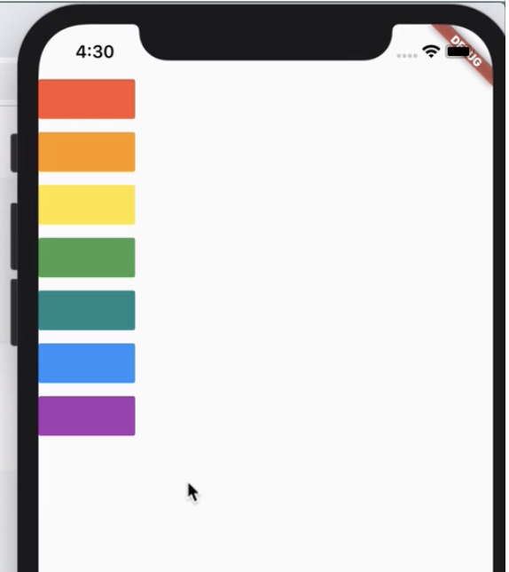
How to Play Multiple Sounds
Now create 7 buttons which plays the each sound
Remove the Center widget, and add Column in which declare 7 buttons with different colors
Make the ElevatedButton corners flat as shown in the figure; for that use side attribute
style: ElevatedButton.styleFrom( backgroundColor: Colors.red, shape: RoundedRectangleBorder( borderRadius: BorderRadius.zero, ),

Slide 11
How to Play Multiple Sounds
Copy – past the ElevateButton 6 times and change the color and sound filename
After doing that you may observe that lots of repeated code; for that we build a function
First I would like to use a function which take care of my sound files;
void playsound(int fileno){}
We reduce no. of lines dramatically, by using function

Slide 12
Updating the UI of Our App
The layout still taking small proportion of the screen, instead this we need similar layout as shown in the image
First make a black background and each key full width take up all the available space in horizontal axis and vertical space evenly divided among all buttons
Scaffold->backgroundColor: black
Expanded Widget to each button, as our widgets in Column they expand vertically

Slide 13
Updating the UI of Our App
We need to each button take up the width space available horizontally, in order to do that we use crossAxisAlignment: CrossAxisAlignment. stretch
Now the app is completed but if you look the code its incredibly repetitive, the Expanded Widget code are the same for all the buttons except the button colors and playsound number

Slide 14
Updating the UI of Our App
Extract the one of the Expanded Widget and try to make the function for that.
Then call that function seven time in the Column Widgets.
NOTE:
The column widget only takes widgets as children; so your function should return as Widget

Slide 15
Refactor and Clean Up our Code
Expanded buildKey(int soundFileNo, Color keyColor) { return Expanded( child: ElevatedButton( onPressed: () async { playSound(soundFileNo); }, child: Text(''), style: ElevatedButton.styleFrom( backgroundColor: keyColor, shape: RoundedRectangleBorder( borderRadius: BorderRadius.zero, ), ), ), ); }

Slide 16
Extra
There's a large collection of free sounds at https://freesound.org/
You can download collections of various sounds, e.g. birds/fart sounds/atmospheric sounds.

Slide 17
Class Task-5
Create a new Flutter project named: soundboard_app
Download 5 sound files (for example: dog, cat, bell, clap, whistle) and place them inside the assets folder.
Use package just_audio
Create 5 buttons where each button plays a different sound.
Modify the UI with the following requirements:
Background color dark grey
Buttons take full width
Buttons take equal vertical space
Instead of repeating code, create a function for the playSound
Create a function that returns a Widget.
Each button must display an animal icon that represents the sound being played. When the user clicks the button, the animal sound should play.
Button | Icon | Sound File
Dog | 🐶 | dog.wav
Cat | 🐱 | cat.wav
Cow | 🐮 | cow.wav
Lion | 🦁 | lion.wav
Bird | 🐦 | bird.wav

