Slide 1
Operating Systems Lecture - 14

Slide 2
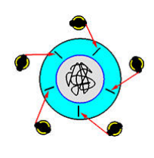
Dining Philosophers Problem (continue…)
Several possibilities that remedy the deadlock situation discussed in the last lecture are listed.
Each results in a good solution for the problem.
Allow at most four philosophers to be sitting simultaneously at the table.
Allow a philosopher to pick up her chopsticks only if both chopsticks are available (to do this she must pick them up in a critical section)
Use an asymmetric solution; that is, an odd philosopher picks up first her left chopstick, whereas an even philosopher picks up her right chopstick and then her left chopstick.

Slide 3
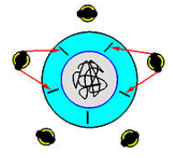
Dining Philosophers Problem (continue…)
Removing the possibility of deadlock does not ensure that starvation does not occur.
Imagine that two philosophers are fast thinkers and fast eaters.
They think fast and get hungry fast. Then, they sit down in opposite chairs as shown in the figure.
Because they are so fast, it is possible that they can lock their chopsticks and eat.
After finish eating and before their neighbors can lock the chopsticks and eat, they come back again and lock the chopsticks and eat.
In this case, the other three philosophers, even though they have been sitting for a long time, they have no chance to eat.
This is a starvation. Note that it is not a deadlock because there is no circular waiting, and everyone has a chance to eat!

Slide 4
The Deadlock Problem
A set of blocked processes each holding a resource and waiting to acquire a resource held by another process in the set. Here’s an example:
System has 2 tape drives.
P1 and P2 each hold one tape drive and each needs another one.
Another deadlock situation can occur when the poor use of semaphores, as discussed in the previous lecture.
We reproduce that situation here. Assume that two processes, P0 and P1, need to access two semaphores, A and B, before executing their critical sections.

Slide 5
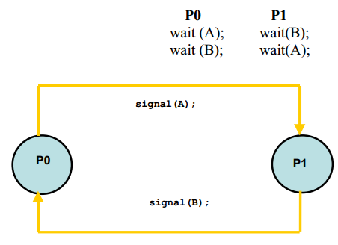
The Deadlock Problem (continue…)
Semaphores are initialized to 1 each. The following code snippets show how a situation can arise where P0 holds semaphore A, P1 holds semaphore B, and both wait for the other semaphore—a typical deadlock situation as shown in the figure that follows the code.

Slide 6
The Deadlock Problem (continue…)
In the first solution for the dining philosophers problem, if all philosophers become hungry at the same time, they will pick up the chopsticks on their right and wait to get the chopsticks on their left. This causes a deadlock.
Yet another example of a deadlock situation can occur on a one-way bridge, as shown the figure. Traffic flows only in one direction, and each section of a bridge can be viewed as a resource.
If a deadlock occurs, it can be resolved if one car backs up (preempt resources and rollback). Several cars may have to be backed up if a deadlock occurs. Starvation is possible.

Slide 7
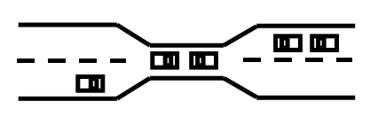
The Deadlock Problem (continue…)
we will discuss the issue of deadlocks in computer systems in detail.

Slide 8
System Model (part of Deadlock topic)
A system consists of a finite number of resources to be distributed among a finite number of cooperating processes.
The resources are partitioned into several types, each of which consists of some number of identical instances. Memory space, CPU cycles, disk drive, file are examples of resource types.
A system with two identical tape drives is said to have two instances of the resource type disk drive.
If a process requests an instance of a resource type, the allocation of any instance of that type will satisfy the request.
If it will not, then the instances are not identical and the resource type classes have not been defined properly

Slide 9
System Model (Continue)
A process must request a resource before using it, and must release the resource after using it.
A process may request as many resources as it requires in order to carryout its designated task. Obviously, the number of resources requested may not exceed the total number of resources available in the system.
Under the normal mode of operation, a process may utilize a resource in only the following sequence:
Request: The process requests a needed resource. If the request cannot be granted immediately, then the requesting process must wait until it can acquire the resource.
Use: The process can use the resource.
Release: The process releases the resource

Slide 10
Deadlock Characterization
The following four conditions must hold simultaneously for a deadlock to occur:
Mutual exclusion: At least one resource must be held in a non-sharable mode; that is only one process at a time can use the resource. If another process requests that resource, the requesting process must be delayed until the resource has been released
Hold and wait: A process must be holding at least one resource and waiting to acquire additional resources that are currently being held by other processes
No preemption: Resources cannot be preempted. That is, after using it a process releases a resource only voluntarily
Circular wait: A set {P0, P1… Pn} of waiting processes must exist such that P0 is waiting for a resource that is held by P1, P1 is waiting for a resource that is held by P2, and so on, Pn-1 is waiting for a resource held by Pn, and Pn is waiting for a resource held by P0.

Slide 11
Resource Allocation Graphs
Deadlocks can be described more precisely in terms of a directed graph called a system resource allocation graph.
This graph consists of a set of vertices V and a set of edges E.
The set of vertices is portioned into two different types of nodes P={P0, P1… Pn}, the set of the active processes in the system, and R={R0, R1… Rn}, the set consisting of all resource types in the system.
A directed edge from a process Pi to resource type Rj signifies that process Pi requested an instance of Rj and is waiting for that resource.
A directed edge from Rj to Pi signifies that an instance of Rj has been allocated to Pi.
We will use the following symbols in a resource allocation graph.

Slide 12
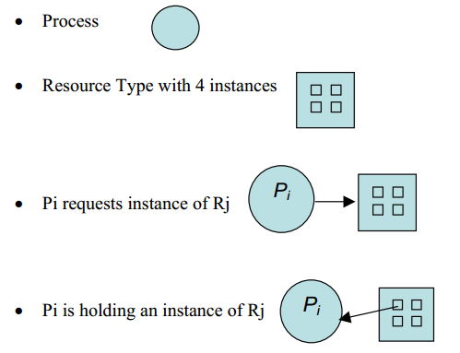
Resource Allocation Graphs (Continue..)

Slide 13
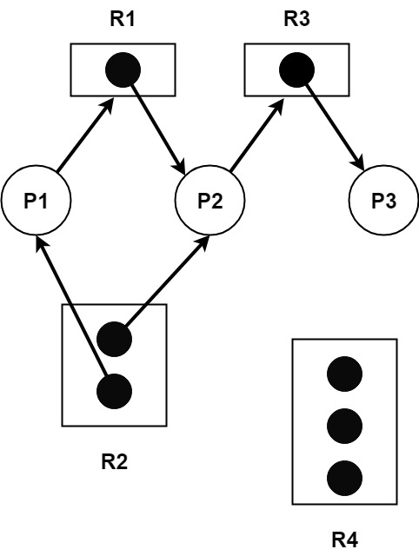
Resource Allocation Graphs (Continue..)
The resource allocation graph shown depicts the following situation:
P={P1, P2, P3 }
R={R1, R2, R3}
E={P1 → R1, P2 → R3, R1 → P2, R2 → P2, R2 → P1, P3 → R3}
Resource Instances
One instance of resource type R1
Two instances of resource type R2
One instance of resource type R3
Three instances of resource type R4

Slide 14
Resource Allocation Graphs (Continue..)
Process States
Process P1 is holding an instance of resource R2, and is waiting for an instance of resource R1.
Process P2 is holding an instance of resource R1 and R2, and is waiting for an instance of resource R3.
Process P3 is holding an instance of resource R3.

Slide 15
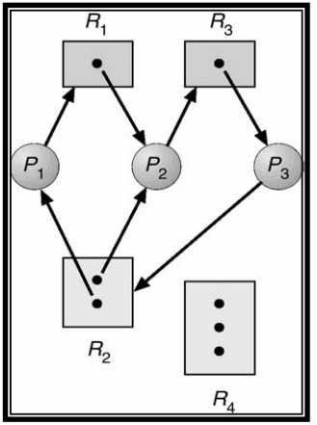
Resource Allocation Graphs (Continue..)
Given the definition of a resource allocation graph, it can be shown that if the graph contains no cycles, then no process is deadlocked. If the graph contains cycles then:
If only one instance per resource type, then a deadlock exists.
If several instances per resource type, possibility of deadlock exists.
Here is a resource allocation graph with a deadlock. There are two cycles in this graph:

Slide 16
Resource Allocation Graphs (Continue..)
{P1 → R1, R1 → P2, P2 → R3, R3 → P3, P3 → R2, R2 → P1} and
{P2 → R3, R3 → P3, P3 → R2, R2 → P2}
No process will release an already acquired resource and the three processes will remain in the deadlock state.

Slide 17
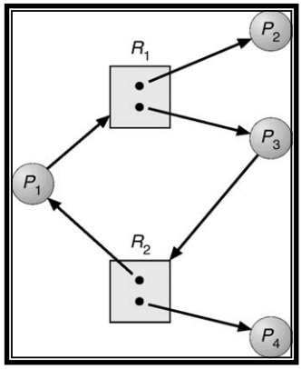
Resource Allocation Graphs (Continue..)
The graph shown below has a cycle but there is no deadlock because processes P2 and P4 do not require further resources to complete their execution and will release the resources they are currently hold in finite time.
These resources can then be allocated to P1 and P3 for them to resume their execution.

