Slide 1
Operating Systems Lecture - 13

Slide 2
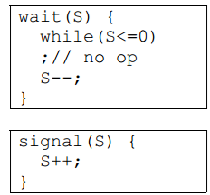
Semaphores
Hardware solutions to synchronization problems are not easy to generalize to more complex problems.
To overcome this difficulty we can use a synchronization tool called a semaphore.
A semaphore S is an integer variable that, apart from initialization is accessible only through two standard atomic operations: wait and signal.
These operations were originally termed P (for wait) and V (for signal).
The classical definitions of wait and signal are:

Slide 3
Semaphores (continue…)
Modifications to the integer value of the semaphore in the wait and signal operations must be executed indivisibly.
That is, when one process is updating the value of a semaphore, other processes cannot simultaneously modify that same semaphore value.
In addition, in the case of the wait(S), the testing of the integer value of S (S<=0) and its possible modification (S--) must also be executed without interruption.

Slide 4
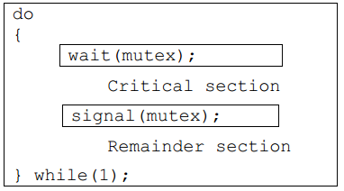
Semaphores (continue…)
We can use semaphores to deal with the n-process critical section problem.
The n processes share a semaphore, mutex (standing for mutual exclusion) initialized to 1.
Each process Pi is organized as follows:

Slide 5
Semaphores (continue…)
As was the case with the hardware-based solutions, this is not a good solution because even though it satisfies mutual exclusion and progress, it does not satisfy bounded wait
In a uni-processor environment, to ensure atomic execution, while executing wait and signal, interrupts can be disabled. In case of a multi-processor environment, to ensure atomic execution is one can lock the data bus, or use a soft solution such as the Bakery algorithm
The main disadvantage of the semaphore discussed in the previous section is that it requires busy waiting.
While a process is in its critical section, any other process that tries to enter its critical section must loop continuously in the entry code.

Slide 6
Semaphores (continue…)
This continual looping is clearly a problem in a real multiprogramming system, where a single CPU is shared among many processes.
Busy waiting wastes CPU cycles that some other process may be able to use productively.
This type of semaphore is also called a spinlock (because the process spins while waiting for the lock).
Spinlocks are useful in multiprocessor systems.
The advantage of a spinlock is that no context switch is required when a process must wait on a lock, and a context switch may take considerable time.
This is, spinlocks are useful when they are expected to be held for short times.
The definition of semaphore should be modified to eliminate busy waiting. We will discuss the modified definition of semaphore on the next slide.

Slide 7
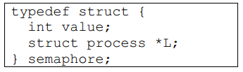
Semaphores (continue…)
A process that is blocked, waiting on a semaphore S, should be restarted when some other process executes a signal operation.
The process is restarted by a wakeup operation, which changes the process from the waiting state to the ready state.
The process is then placed in the ready queue.
The CPU may or may not be switched from the running process to the newly ready process, depending on the CPU scheduling algorithm.
Such an implementation of a semaphore is as follows:

Slide 8
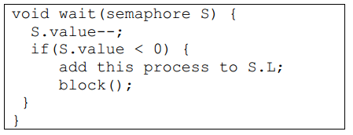
Semaphores (continue…)
Each semaphore has an integer value and a list of processes.
When a process must wait on a semaphore; it is added to the list of processes.
A signal operation removes one process from the list of the waiting processes and awakens that process.
The wait operation can be defined as:

Slide 9
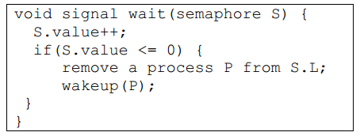
Semaphores (continue…)
The signal semaphore operation can be defined as
The block operation suspends the process that invokes it.
The wakeup(P) operation resumes the execution of a blocked process P.
These two operations are provided by the operating system as basic system calls.

Slide 10
Semaphores (continue…)
The signal semaphore operation can be defined as
The negative value of S.value indicates the number of processes waiting for the semaphore.
A pointer in the PCB needed to maintain a queue of processes waiting for a semaphore.
As mentioned before, the busy-waiting version is better when critical sections are small and queue-waiting version is better for long critical sections (when waiting is for longer periods of time).

Slide 11
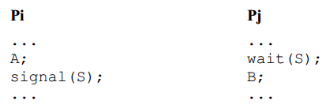
Process Synchronization
You can use semaphores to synchronize cooperating processes.
Consider, for example, that you want to execute statement B in Pj only after statement A has been executed in Pi.
You can solve this problem by using a semaphore S initialized to 0 and structuring the codes for Pi and Pj as follows:

Slide 12
Process Synchronization (continue…)
Pj will not be able to execute statement B until Pi has executed its statements A and signal(S).
Here is another synchronization problem that can be solved easily using semaphores.
We want to ensure that statement S1 in P1 executes only after statement S2 in P2 has been executed, and statement S2 in P2 should execute only after statement S3 in P3 has been executed.
One possible semaphore-based solution uses two semaphores, A and B. Here is the solution.

Slide 13
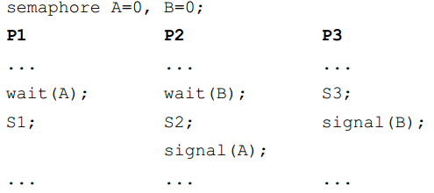
Process Synchronization (continue…)

Slide 14
Problems with Semaphores
Here are some key points about the use of semaphores:
Semaphores provide a powerful tool for enforcing mutual exclusion and coordinating processes.
The wait(S) and signal(S) operations are scattered among several processes. Hence, it is difficult to understand their effects.
Usage of semaphores must be correct in all the processes.
One bad (or malicious) process can fail the entire system of cooperating processes.
Incorrect use of semaphores can cause serious problems.
We now discuss a few of these problems.

Slide 15
Deadlocks and Starvation
A set of processes are said to be in a deadlock state if every process is waiting for an event that can be caused only by another process in the set.
Here are a couple of examples of deadlocks in our daily lives.
Traffic deadlocks
One-way bridge-crossing
Starvation is infinite blocking caused by to unavailability of resources. Here is an example of a deadlock.

Slide 16
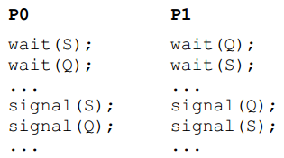
Deadlocks and Starvation (continue…)
P0 and P1 need to get two semaphores, S and Q, before executing their critical sections.
The following code structures can cause a deadlock involving P0 and P1.
In this example, P0 grabs semaphore S and P1 obtains semaphore Q.
Then, P0 waits for Q and P1 waits for S.
P0 waits for P1 to execute signal(Q) and P1 waits for P0 to execute signal(S).

Slide 17
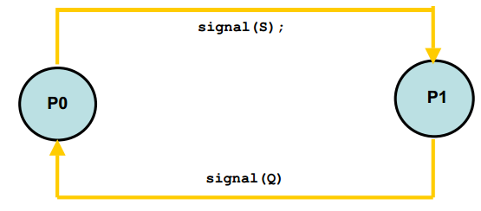
Deadlocks and Starvation (continue…)
Neither process will execute the respective instruction—a typical deadlock situation. The following diagram shows the situation pictorially.

Slide 18
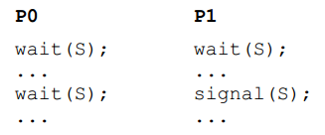
Deadlocks and Starvation (continue…)
Here is an example of starvation. The code structures are self-explanatory.

Slide 19
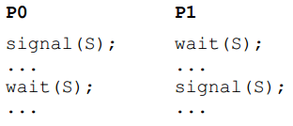
Deadlocks and Starvation (continue…)
Violation of Mutual Exclusion
In the following example, the principle of mutual exclusion is violated.
Again, the code structures are self-explanatory.
These problems are due to programming errors because of the tandem use of the wait and signal operations.
The solution to these problems is higher-level language constructs such as critical region (region statement) and monitor.
We discuss one of these constructs and their use to solve the critical section and synchronization problems in the next slides

Slide 20

Readers Writers Problem
A data object (such as a file or a record) is to be shared among several concurrent processes.
Some of these processes, called readers, may want only to read the content of the shared object whereas others, called writers, may want to update (that is to read and write) the shared object.

Slide 21
Readers Writers Problem (continue…)
Obviously, if two readers access the data simultaneously, no adverse effects will result.
However, if a writer and some other process (whether a writer or some readers) access the shared object simultaneously, chaos may ensue.
To ensure these difficulties do not arise, we require that the writers have exclusive access to the shared object.
This synchronization problem is referred to the readers-writers problem.
Since it was originally stated, it has been used to test nearly every new synchronization primitive.

Slide 22
Readers Writers Problem (continue…)
The readers-writers problem has several variations, all involving priorities.
The simplest one, referred to as the first readers-writers problem, requires that no reader will be kept waiting unless a writer has already obtained permission to use the shared object.
In other words, no reader should wait for other readers to finish simply because a writer is waiting.
The second readers-writers problem requires that once a writer is ready, that writer performs its write as soon as possible.
In other words, if a writer is waiting to access the object, no new readers may start reading.

Slide 23

Readers Writers Problem (continue…)
A solution to either problem may result in starvation.
In the first case, writers may starve; in the second case, readers may starve.
For this reason, other variants of the problem have been proposed.
In this section, we discuss a solution to the first readers-writers problem.
In the solution to the first readers-writers problem, processes share the following data structures.

Slide 24
Readers Writers Problem (continue…)
The semaphores mutex and wrt are initialized to 1; readcount is initialized to 0.
The semaphore wrt is common to both the reader and writer processes.
The mutex semaphore is used to ensure mutual exclusion when the reader processes update the readcount variable.
The readcount variable keeps track of how many processes are currently reading the object.
The wrt semaphore is used to ensure mutual exclusion for writers or a writer and readers.

Slide 25
Readers Writers Problem (continue…)
This semaphore is also used by the first and last readers to block entry of a writer into its critical section and to allow open access to the wrt semaphore, respectively.
It is not used by readers who enter or exit, while at least one reader is in its critical sections.
The codes for reader and writer processes are shown below:

Slide 26
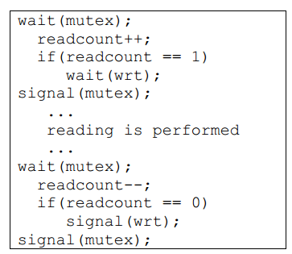
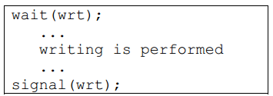
Readers Writers Problem (continue…)

Slide 27
Readers Writers Problem (continue…)
Note that, if a writer is in the critical section and n readers are waiting, then one reader is queued on wrt, and n-1 readers are queued on mutex.
Also observe that when a writer executes signal(wrt) we may resume the execution of either the waiting readers or a single waiting writer; the selection is made by the CPU scheduler.

Slide 28
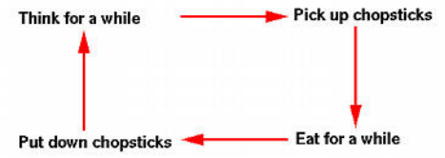
Dining Philosophers Problem
Consider five philosophers who spend their lives thinking and eating, as shown in the following diagram.

Slide 29

Dining Philosophers Problem (continue…)
The philosophers share a common circular table surrounded by five chairs, each belonging to one philosopher.
In the center of the table is a bowl of rice, and the table is laid with five single chopsticks.

Slide 30
Dining Philosophers Problem (continue…)
When a philosopher thinks, she does not interact with her colleagues. From time to time, a philosopher gets hungry and tries to pick up the two chopsticks that are closest to her (the chopsticks that are between her and her left and right neighbors).
A philosopher may pick up only one chopstick at a time. Obviously, she cannot pick up a chopstick that is already in the hand of her neighbor.
When a hungry philosopher has both her chopsticks at the same time, she eats without releasing her chopsticks.
When she is finished eating, she puts down both of her chopsticks and starts thinking again.

Slide 31
Dining Philosophers Problem (continue…)
The dining philosophers problem is considered to be a classic synchronization problem because it is an example of a large class of concurrency control problems.
It is a simple representation of the need to allocate several resources among several processes in a deadlock and starvation free manner.
One simple solution is to represent each chopstick by a semaphore. A philosopher tires to grab the chopstick by executing a wait operation on that semaphore;
she releases her chopsticks by executing the signal operation on the appropriate semaphores. Thus the shared data are:

Slide 32
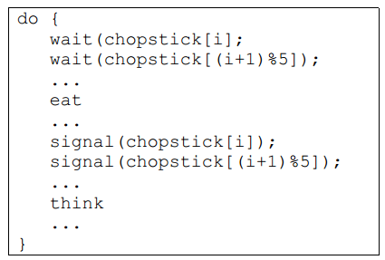
Dining Philosophers Problem (continue…)
All the chopsticks are initialized to 1. The structure of philosopher i is as follows:

Slide 33
Dining Philosophers Problem (continue…)
Although this solution guarantees that no two neighbors are eating simultaneously, it nevertheless must be rejected because it has the possibility of creating a deadlock.
Suppose that all five gets hungry at the same time and pick up their left chopsticks as shown in the following figure.
In this case, all chopsticks are locked and none of the philosophers can successfully lock her right chopstick.
As a result, we have a circular waiting (i.e., every philosopher waits for his right chopstick that is currently being locked by his right neighbor), and hence a deadlock occurs.

Slide 34
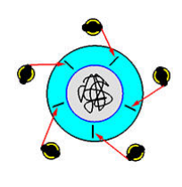
Dining Philosophers Problem (continue…)
There are several possible good solutions of the problem. We will discuss these in the next lecture.

