Slide 1
Operating Systems Lecture No. 1
Instructor:
M.A.Bamboat

Slide 2
Summary
Introduction and purpose of the course
Organization of a computer system
Purpose of a computer system
Requirements for achieving the purpose – Setting the stage for OS concepts and principles
Outline of topics to be discussed
What is an Operating System?

Slide 3
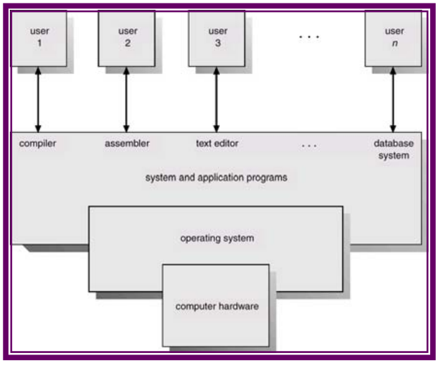
Organization of a Computer System
As shown in Figure, the major high-level components of a computer system are:
Hardware, which provides basic computing resources (CPU, memory, I/O devices).
Operating system, which manages the use of the hardware among the various application programs for the various users and provides the user a relatively simple machine to use.
Applications programs that define the ways in which system resources are used to solve the computing problems of the users (compilers, database systems, video games, business programs).
Users, which include people, machines, other computers.

Slide 4
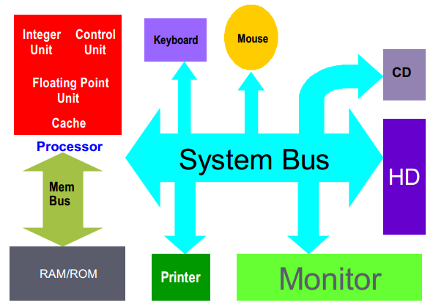
Purpose of a computer system
Computer systems consist of software and hardware that are combined to provide a tool to implement solutions for specific problems in an efficient manner and to execute programs. Figure shows the general organization of a contemporary computer system and how various system components are interconnected.

Slide 5
Purpose of a computer system (Continue..)
Viewing things closely will reveal that the primary purpose of a computer system is to generate executable programs and execute them. The following are some of the main issues involved in performing these tasks.
Storing an executable on a secondary storage device such as hard disk
Loading executable from disk into the main memory
Setting the CPU state appropriately so that program execution could begin
Creating multiple cooperating processes, synchronizing their access to shared data, and allowing them to communicate with each other

Slide 6
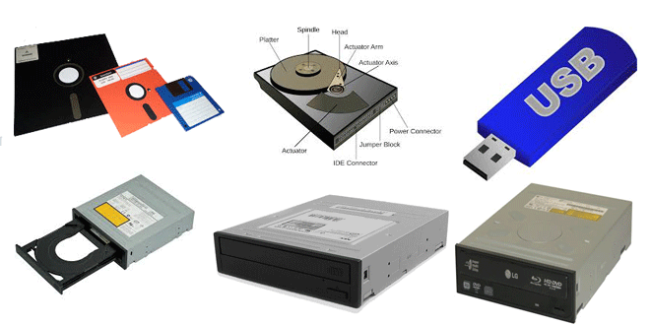
Purpose of a computer system (Continue..)
The above issues require the operating system to provide the following services and much more
Manage secondary storage devices
Allocate appropriate amount of disk space when files are created
Deallocate space when files are removing
Insure that a new file does not overwrite an existing file
Schedule disk requests

Slide 7
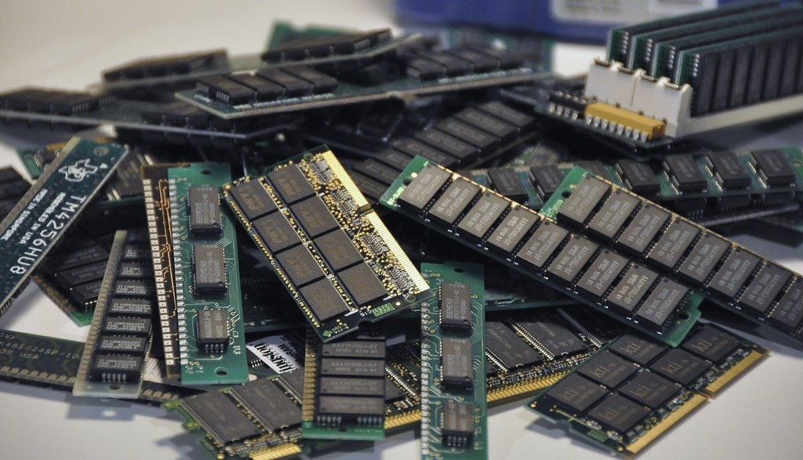
Purpose of a computer system (Continue..)
Manage primary storage
Allocate appropriate amount of memory space when programs are to be loaded into the memory for executing
Deallocate space when processes terminate
Insure that a new process is not loaded on top of an existing process
Insure that a process does not access memory space that does not belong to it
Minimize the amount of unused memory space
Allow execution of programs larger in size than the available main memory

Slide 8
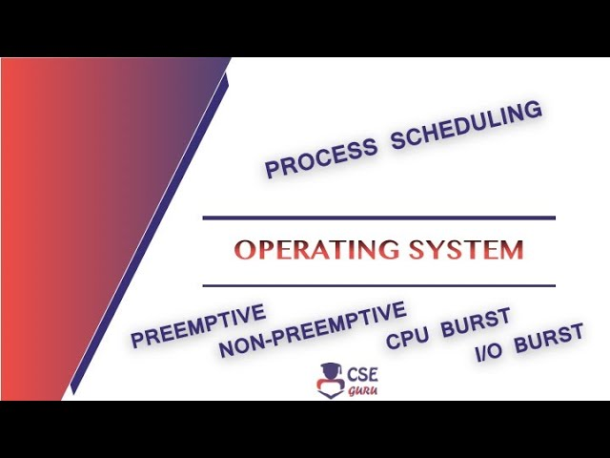
Purpose of a computer system (Continue..)
Manage processes
Allow simultaneous execution of processes by scheduling the CPU(s)
Prevent deadlocks between processes
Insure integrity of shared data
Synchronize executions of cooperating processes
Allow a user to manage his/her files and directories properly
User view of directory structure
Provide a mechanism that allows users to protect their files and directories
In this course, we will discuss in detail these operating system services (and more), with a particular emphasis on the UNIX and Linux operating systems.

Slide 9
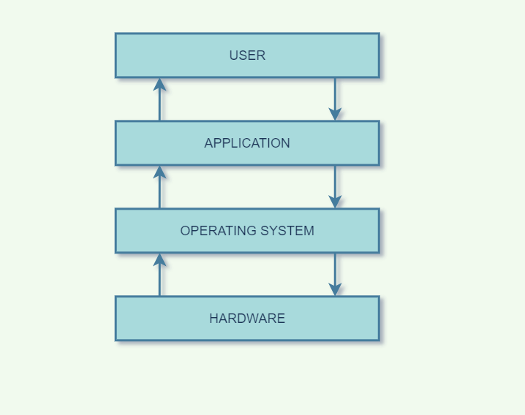
What is an Operating System?
There are two views about this.
The top-down view
is that it is a program that acts as an intermediary between a user of a computer and the computer hardware, and makes the computer system convenient to use.
It is because of the operating system that users of a computer system don’t have to deal with computer’s hardware to get their work done.
Users can use simple commands to perform various tasks and let the operating system do the difficult work of interacting with computer hardware.
Thus, you can use a command like copy file1 file2 to copy ‘file1’ to ‘file2’ and let the operating system communicate with the controller(s) of the disk that contain(s) the two files.

Slide 10
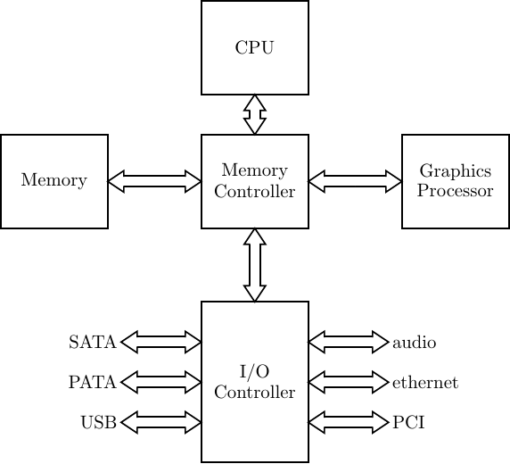
What is an Operating System? (Continue..)
The bottom-up view
A computer system has many hardware and software resources that may be required to solve a problem: CPU time, memory space, file storage space, I/O devices etc.
The operating system acts as the manager of these resources, facing numerous and possibly conflicting requests for resources, the operating system must decide how (and when) to allocate (and deallocate) them to specific programs and users so that it can operate the computer system efficiently, fairly, and securely.
So, the bottom-up view is that operating system is a resource manager who manages the hardware and software resources in the computer system.

Slide 11
What is an Operating System? (Continue..)
Concluding:
A slightly different view of an operating system emphasizes the need to control the various I/O devices and programs. An operating system is a control program that manages the execution of user programs to prevent errors and improper use of a computer.

