Slide 1
Operating Systems Lecture No. 2
Instructor: M.A.Bamboat

Slide 2
Summary
Single-user systems
Batch systems
Multi programmed systems
Time-sharing systems
Real time systems
Interrupts, traps and software interrupts (UNIX signals)
Hardware protection

Slide 3
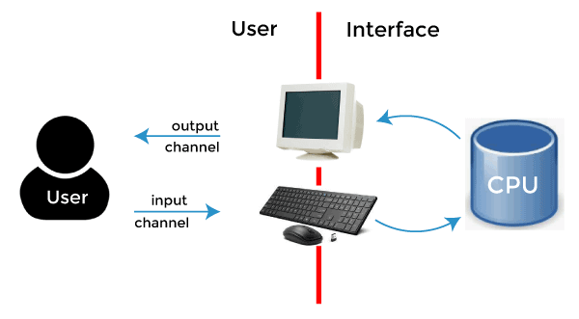
Single-user systems
A computer system that allows only one user to use the computer at a given time is known as a single-user system.
The goals of such systems are maximizing user convenience and responsiveness, instead of maximizing the utilization of the CPU and peripheral devices. Single-user systems use I/O devices such as keyboards, mice, display screens, scanners, and small printers.
They can adopt technology developed for larger operating systems. Often individuals have sole use of computers and do not need advanced CPU utilization and hardware protection features.
They may run different types of operating systems, including DOS, Windows, and MacOS. Linux and UNIX operating systems can also be run in single-user mode

Slide 4
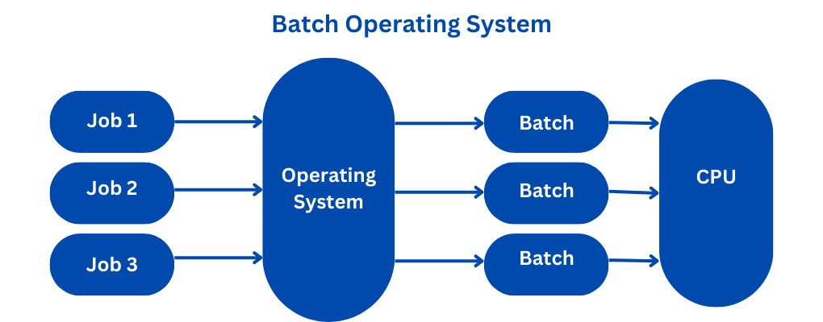
Batch Systems
Early computers were large machines run from a console with card readers and tape drives as input devices and line printers, tape drives, and card punches as output devices.
The user did not interact directly with the system; instead the user prepared a job, (which consisted of the program, data, and some control information about the nature of the job in the form of control cards) and submitted this to the computer operator.
The job was in the form of punch cards, and at some later time the output was generated by the system— user didn’t get to interact with his/her job.
The output consisted of the result of the program, as well as a dump of the final memory and register contents for debugging

Slide 5
Batch Systems (Continue…)
To speed up processing, operators batched together jobs with similar needs and ran them through the computer as a group. For example, all FORTRAN programs were compiled one after the other.
The major task of such an operating system was to transfer control automatically from one job to the next. In this execution environment, the CPU is often idle because the speeds of the mechanical I/O devices such as a tape drive are slower than that of electronic devices.
Such systems in which the user does not get to interact with his/her jobs and jobs with similar needs are executed in a “batch”, one after the other, are known as batch systems.
Digital Equipment Corporation’s VMS is an example of a batch operating system

Slide 6
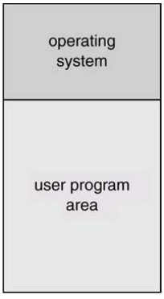
Batch Systems (Continue…)
Figure shows the memory layout of a typical computer system, with the system space containing operating system code and data currently in use and the user space containing user programs (processes). In case of a batch system, the user space contains one process at a time because only one process is executing at a given time.

Slide 7
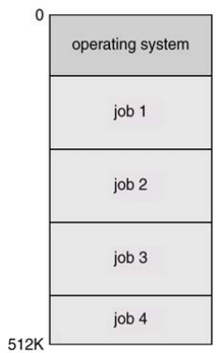
Multi-programmed Systems
Multi-programming increases CPU utilization by organizing jobs so that the CPU always has one to execute.
The operating system keeps several jobs in memory simultaneously, as shown in Figure. This set of jobs is a subset of the jobs on the disk which are ready to run but cannot be loaded into memory due to lack of space.
Since the number of jobs that can be kept simultaneously in memory is usually much smaller than the number of jobs that can be in the job pool; the operating system picks and executes one of the jobs in the memory.
Eventually, the job has to wait for some task such as an I/O operation to complete.
In a non-multi-programmed system, the CPU would sit idle. In a multiprogrammed system, the operating system simply switches to, and executes another job. When that job needs to wait, the CPU simply switches to another job and so on.

Slide 8
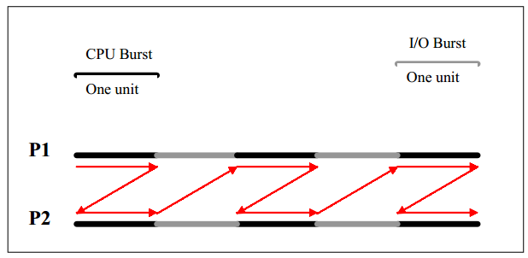
Multi-programmed Systems (Continue..)
Figure illustrates the concept of multiprogramming by using an example system with two processes, P1 and P2.
The CPU is switched from P1 to P2 when P1 finishes its CPU burst and needs to wait for an event, and vice versa when P2 finishes it CPU burst and has to wait for an event.
This means that when one process is using the CPU, the other is waiting for an event (such as I/O to complete).
This increases the utilization of the CPU and I/O devices as well as throughput of the system.
In our example below, P1 and P2 would finish their execution in 10 time units if no multiprogramming is used and in six time units if multiprogramming is used.

Slide 9
Multi-programmed Systems (Continue..)
All jobs that enter the system are kept in the job pool.
This pool consists of all processes residing on disk awaiting allocation of main memory.
If several jobs are ready to be brought into memory, and there is not enough room for all of them, then the system must choose among them.
This decision is called job scheduling. In addition, if several jobs are ready to run at the same time, the system must choose among them.
We will discuss CPU scheduling later

Slide 10

Time-sharing systems
A time-sharing system is multi-user, multi-process, and interactive system.
This means that it allows multiple users to use the computer simultaneously.
A user can run one or more processes at the same time and interact with his/her processes.
A time-shared system uses multiprogramming and CPU scheduling to provide each user with a small portion of a time-shared computer.
Each user has at least one separate program in memory. To obtain a reasonable response time, jobs may have to be swapped in and out of main memory.
UNIX, Linux, Widows NT server, and Windows 2000 server are timesharing systems.
We will discuss various elements of time-sharing systems throughout the course.

Slide 11

Real time systems
Real time systems are used when rigid time requirements are placed on the operation of a processor or the flow of data;
thus it is often used as a control device in a dedicated application. Examples are systems that control scientific experiments, medical imaging systems, industrial control systems and certain display systems
A real time system has well defined, fixed time constraints, and if the system does not produce output for an input within the time constraints, the system will fail.
For instance, it would not do for a robot arm to be instructed to halt after it had smashed into the car it was building.

Slide 12
Real time systems (Continue..)
Real time systems come in two flavors/types:
Hard real-time system
Guarantees that critical tasks be completed on time.
This goal requires that all delays in the system be completed on time.
This goal requires that all delays in the system be bounded, from the retrieval of stored data to the time it takes the operating system to finish any request made of it.
Secondary storage of any sort is usually limited or missing, with data instead being stored in short-term memory or in read only memory.
Most advanced operating system features are absent too, since they tend to separate the user from the hardware, and that separation results in uncertainty about the amount of time an operation will take.

Slide 13
Real time systems (Continue..)
Soft real time system
A less restrictive type of real time system, where a critical real-time task gets priority over other tasks, and retains that priority until it completes.
As in hard real time systems, the operating system kernel delays need to be bounded.
The soft real time is an achievable goal that can be mixed with other types of systems, whereas hard real time systems conflict with the operation of other systems such as time-sharing systems, and the two cannot be mixed.

Slide 14
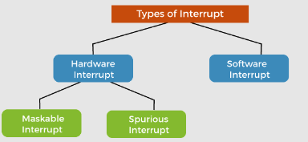
Interrupts, traps and software interrupts
Interrupts:
An interrupt is a signal generated by a hardware device (usually an I/O device) to get the CPU’s attention.
Interrupt transfers control to the interrupt service routine (ISR), generally through the interrupt vector table, which contains the addresses of all the service routines.
The interrupt service routine executes; on completion, the CPU resumes the interrupted computation. Interrupt architecture must save the address of the interrupted instruction.
Incoming interrupts are disabled while another interrupt is being processed to prevent a lost interrupt. An operating system is an interrupt-driven software

Slide 15
Interrupts, traps and software interrupts (Continue..)
Traps:
A trap (or an exception) is a software-generated interrupt caused either by an error (division by zero or invalid memory access) or by a user request for an operating system service
Signal Interrupt (SIGINT): ON THE NEXT SLIDE

Slide 16
Interrupts, traps and software interrupts (Continue..)
Signal Interrupt (SIGINT):
A signal is an event generated to get the attention of a process. An example of a signal is the event that is generated when you run a program and then press <Ctrl-C>.
The signal generated in this case is called SIGINT (Interrupt signal).
Three actions are possible on a signal
Kernel-defined default action—which usually results in process termination and, in some cases, generation of a ‘core’ file that can be used by the programmer/user to know the state of the process at the time of its termination.
The process can intercept the signal and ignore it.
The process can intercept the signal and take a programmer-defined action

Slide 17
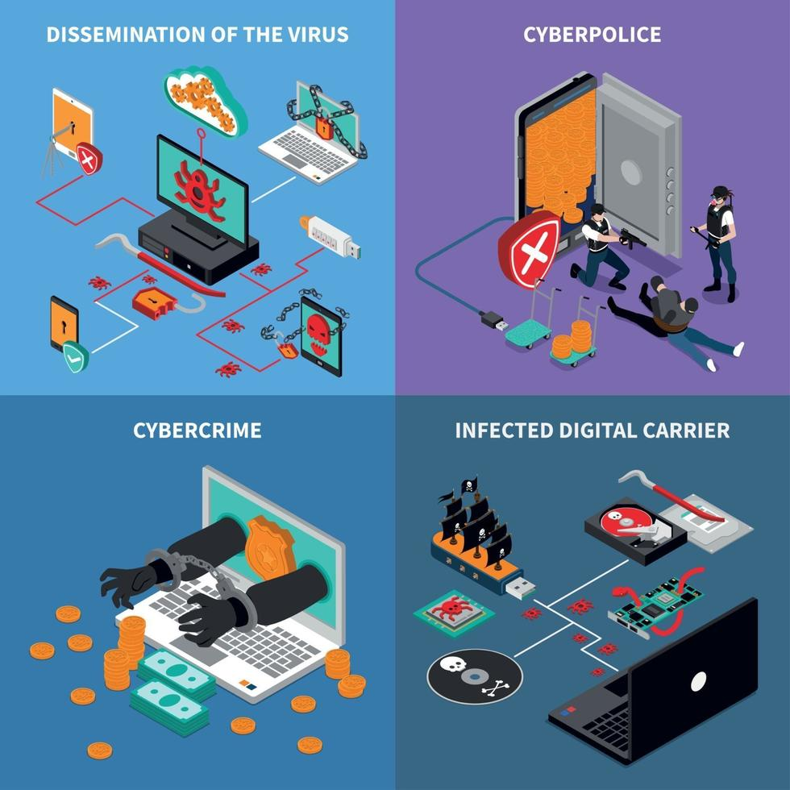
Hardware Protection
Multi-programming puts several programs in memory at the same time;
while this increased system utilization it also increased problems.
With sharing, many processes could be adversely affected by a bug in one program.
One erroneous program could also modify the program or data of another program or even the resident part of the operating system.
A file may overwrite another file or folder on disk.
A process may get the CPU and never relinquish it.
So the issues of hardware protection are: I/O protection, memory protection, and CPU protection. We will discuss them one by one, but first we talk about the dual-mode operation of a CPU.

Slide 18
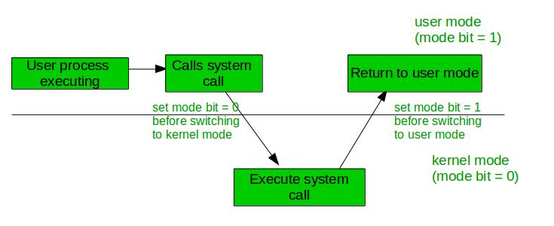
Hardware Protection (Continue..)
Dual Mode Operation
To ensure proper operation, we must protect the operating system and all other programs and their data from any malfunctioning program.
Protection is needed for any shared resources. Instruction set of a modern CPU has two kinds of instructions, privileged instructions and non-privileged instructions.
Privileged instructions can be used to perform hardware operations that a normal user process should not be able to perform, such as communicating with I/O devices.
If a user process tries to execute a privileged instruction, a trap should be generated and the process should be terminated prematurely. At the same time, a piece of operating system code should be allowed to execute privileged instructions.

Slide 19
Hardware Protection (Continue..)
Dual Mode Operation (continue..)
Privileged instructions (continue..)
In order for the CPU to be able to differentiate between a user process and an operating system code, we need two separate modes of operation: user mode and monitor mode (also called supervisor mode, system mode, or privileged mode).
A bit, called the mode bit, is added to the hardware of the computer to indicate the current mode: monitor mode (0) or user mode (1). With the mode bit we are able to distinguish between a task that is executed on behalf of the operating system and one that is executed on behalf of the user
The concept of privileged instructions also provides us with the means for the user to interact with the operating system by asking it to perform some designated tasks that only the operating system should do.

Slide 20
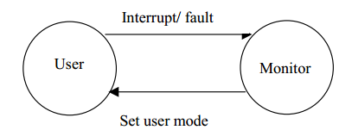
Hardware Protection (Continue..)
Dual Mode Operation (continue..)
Privileged instructions (continue..)
A user process can request the operating system to perform such tasks for it by executing a system call.
Whenever a system call is made or an interrupt, trap, or signal is generated, CPU mode is switched to system mode before the relevant kernel code executes.
The CPU mode is switched back to user mode before the control is transferred back to the user process. This is illustrated by the diagram in Figure

Slide 21
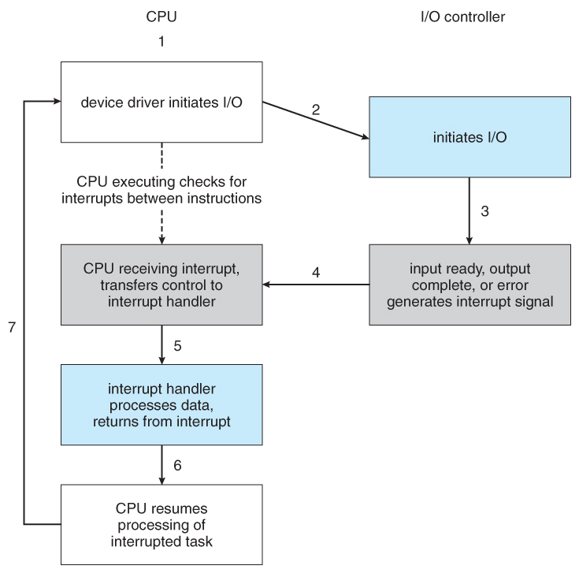
Hardware Protection (Continue..)
I/O Protection
A user process may disrupt the normal operation of the system by issuing illegal I/O instructions, by accessing memory locations within the operating system itself, or by refusing to relinquish the CPU. We can use various mechanisms to ensure that such disruptions cannot take place in the system.
To prevent users from performing illegal I/O, we define all I/O instructions to be privileged instructions.
Thus users cannot issue I/O instructions directly; they must do it through the operating system.
For I/O protection to be complete, we must be sure that a user program can never gain control of the computer in monitor mode. If it could, I/O protection could be compromised.

Slide 22
Hardware Protection (Continue..)
I/O Protection (Continue..)
Consider a computer executing in user mode. It will switch to monitor mode whenever an interrupt or trap occurs, jumping to the address determined from the interrupt from the interrupt vector.
If a user program, as part of its execution, stores a new address in the interrupt vector, this new address could overwrite the previous address with an address in the user program.
Then, when a corresponding trap or interrupt occurred, the hardware would switch to monitor mode and transfer control through the modified interrupt vector table to a user program, causing it to gain control of the computer in monitor mode.
Hence we need all I/O instructions and instructions for changing the contents of the system space in memory to be protected. A user process could request a privileged operation by executing a system call such as read (for reading a file)

