Slide 1
Operating Systems Lecture No. 4
Instructor: M.A.Bamboat

Slide 2
Summary
Operating system structures
Operating system design and implementation
UNIX/Linux directory structure
Browsing UNIX/Linux directory structure

Slide 3
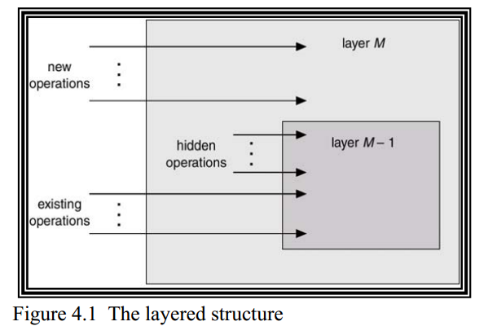
Operating Systems Structures (continued)
Layered Approach
The modularization of a system can be done in many ways.
As shown in Figure 4.1, in the layered approach the OS is broken up into a number of layers or levels each built on top of the lower layer.
The bottom layer is the hardware; the highest layer (layer N) is the user interface.
A typical OS layer (layer-M) consists of data structures and a set of routines that can be invoked by higher-level layers.
Layer M in turn can invoke operations on lower-level layers

Slide 4
Operating Systems Structures (continued)
Layered Approach (continue..)
The main advantage of the layered approach is modularity. The layers are selected such that each uses functions and services of only lower layers. This approach simplifies debugging and system verification.
The major difficulty with layered approach is careful definition of layers, because a layer can only use the layers below it. Also it tends to be less efficient than other approaches. Each layer adds overhead to a system call (which is trapped when the program executes a I/O operation, for instance)
This results in a system call that takes longer than does one on a non-layered system
THE operating system by Dijkstra and IBM’s OS/2 are examples of layered operating systems.

Slide 5
Operating Systems Structures (continued)
Micro kernels
This method structures the operating system by removing all non-essential components from the kernel and implementing system and user level programs.
The result is a smaller kernel. Microkernels typically provide minimum process and memory management in addition to a communication facility
The main function of the micro kernel is microkernel provide a communication facility between the client program and the various services that are also running in the user space
The benefits of the microkernel approach include the ease of extending the OS
All new services are added to user space and consequently do not require modification of the kernel

Slide 6
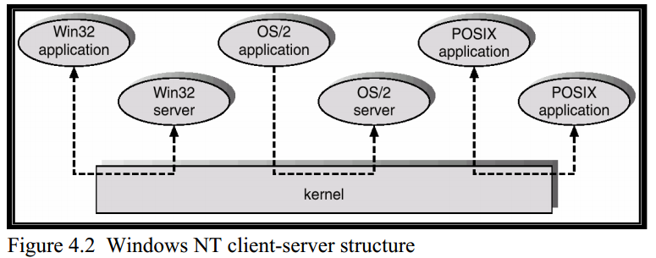
Operating Systems Structures (continued)
Micro kernels (Continue..)
When the kernel does have to be modified, the changes tend to be fewer because the microkernel is a smaller kernel
The resulting OS is easier to port from one hardware ware design to another
It also provides more security and reliability since most services are running as user rather than kernel processes
Mach, MacOS X Server, QNX, OS/2, and Windows NT are examples of microkernel based operating systems.
As shown in Figure 4.2, various types of services can be run on top of the Windows NT microkernel, thereby allowing applications developed for different platforms to run under Windows NT

Slide 7
Operating Systems Structures (continued)
Virtual Machines
Conceptually a computer system is made up of layers. The hardware is the lowest level in all such systems
The kernel running at the next level uses the hardware instructions to create a set of system call for use by outer layers
The system programs above the kernel are therefore able to use either system calls or hardware instructions and in some ways these programs do not differentiate between these two
System programs in turn treat the hardware and the system calls as though they were both at the same level
In some systems the application programs can call the system programs

Slide 8
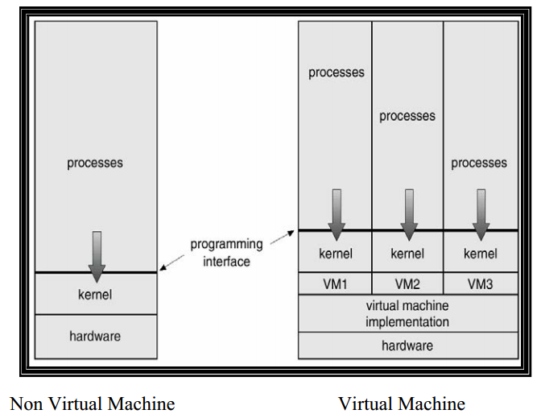
Operating Systems Structures (continued)
Virtual Machines (Continue..)
The application programs view everything under them in the hierarchy as though the latter were part of the machine itself
This layered approach is taken to its logical conclusion in the concept of a virtual machine (VM). The VM operating system for IBM systems is the best example of VM concept
By using CPU scheduling and virtual memory techniques an operating system can create the illusion that a process has its own memory with its own (virtual) memory
The virtual machine approach on the other hand does not provide any additional functionality but rather provides an interface that is identical to the underlying bare hardware. Each process is provided with a virtual copy of the underlying computer
The physical computer shares resources to create the virtual machines
Figure 4.3 illustrates the concepts of virtual machines by a diagram

Slide 9
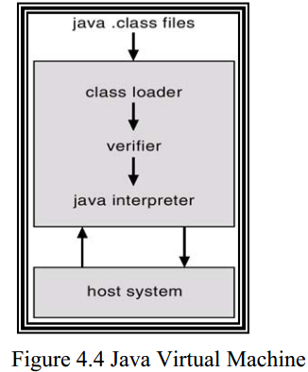
Operating Systems Structures (continued)
Virtual Machines (Continue..)
Java Virtual Machine (JVM) loads, verifies, and executes programs that have been translated into Java Bytecode, as shown in Figure 4.4.
VMWare can be run on a Windows platform to create a virtual machine on which you can install an operating of your choice, such as Linux.
We have shown a couple of snapshots of VMWare on a Windows platform in the lecture slides
Virtual PC software works in a similar fashion.

Slide 10
System Design and Implementation
Design Goals
At the highest level, the deign of the system will be affected by the choice of hardware and type of system: batch , time shared, single user, multi user, distributed , real time or general purpose.
Beyond this highest level, the requirements may be much harder to specify. The requirements can be divided into much two basic groups: user goal and system goals.
Users desire a system that is easy to use, reliable, safe and fast.
People who design, implement and operate the system, require a system that is easy to design, implement and maintain.
An important design goal is separation of mechanisms and policies.
Mechanism: they determine how to do something. A general mechanism is more desirable. Example: CPU protection
Policy: determine what will be done. Example: Initial value in the counter used for CPU protection

Slide 11
System Design and Implementation (Continue..)
Design Goals (continue..)
The separation of policy and mechanism is important for flexibility, as policies are likely to change across places or over time. For example, the system administrator can set the initial value in the counter before booting a system
Implementation
Once an operating system is designed, it must be implemented. Traditionally operating systems have been written in assembly language.
Now however they are written in higher-level languages such as C/ C++ since these allow the code to be written faster, more compact, easier to understand and easier to port.

Slide 12
UNIX/LINUX Directory Structure
Dennis Ritchie and Ken Thomsom wrote UNIX at the Bell Labs in 1969.
It was initially written in assembly language and a high-level language called Bit was later converted from B to C language
Linus Torvalds, an undergraduate student at the University of Helsinki, Finland, wrote Linux in 1991. It is one of the most popular operating systems, certainly for PCs
UNIX has a hierarchical file system structure consisting of a root directory (denoted as /) with other directories and files hanging under it.
Unix uses a directory hierarchy that is commonly represented as folders.
However, instead of using graphical folders typed commands (in a command line user interface) are used to navigate the system.
Particular files are then represented by paths and filenames much like they are in html addresses.
A pathname is the list of directories separated by slashes (/). If a pathname starts with a /, it refers to the root directory. The last component of a path may be a file or a directory.
A pathname may simply be a file or directory name.

